Slide 1
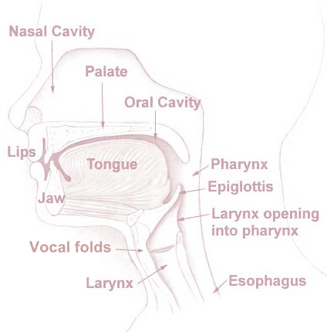
AA
A
L
D
T
Z
R
I
J
zh
S
H
G
N
as above (heaven)
E
so below (earth)
ch
ʔ
K
th
sh
M
U
L
B
Y
V
W
P
F
O
(spiritual) inward
outward (not spiritual - temporal)

