Slide 1
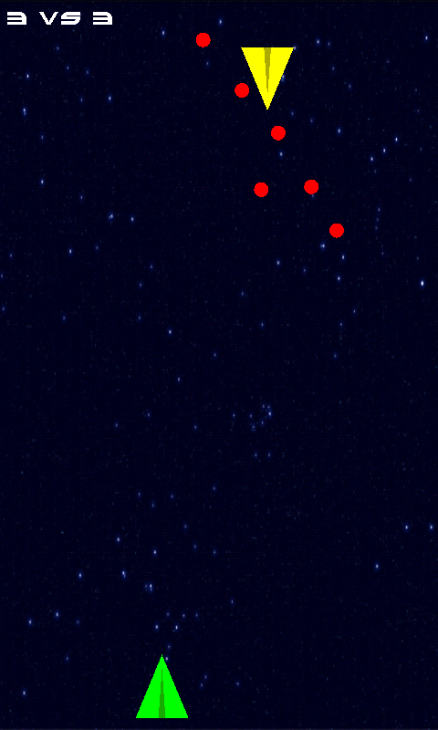
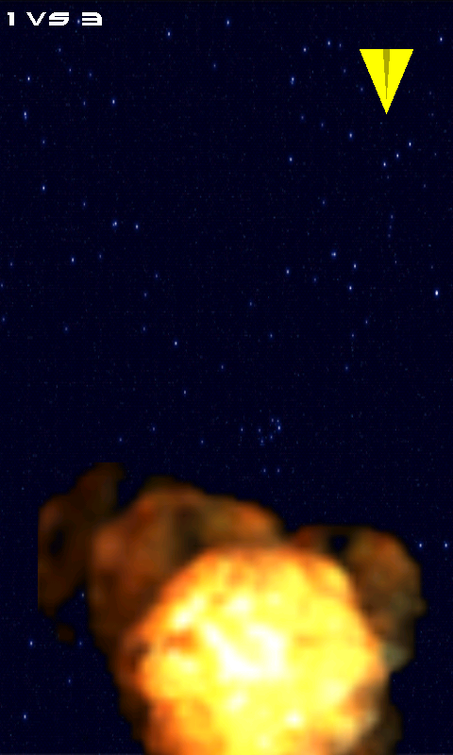


Starshooter
.
Sascha Montellese Daniel Mäder

Slide 2
table of contents
Intro
Background
Design / Architecture
Testing
Discussion

Slide 3
Intro - Motivation
Gain some knowledge in …
… OpenGL
… sensors
… networking
… general gamedesign
… Android

Slide 4
Intro - Goals
Having a game that ‘works‘ ☺
intuitively controllable by sensor
playable over network

Slide 5
Background

Slide 6
Design / Architecture

Slide 7
Testing
??? Evtl. Telnet für Server Part?
??? OpenGL im Emulator?

Slide 8
Discussion – Lessons learnt
scarce OpenGL ES 2.0 documentation
OpenGL ES 2.0 not supported by emulator
different devices need different implementations
acceleration sensor delivers values in different ranges on different devices

Slide 9
Discussion – Future work
in game sound
reconnect after a connection loss
improved graphics (more 3D)
connection over bluetooth
master automatically detectable in LAN
thrilling gameplay (different weapons etc…)
in game ads

Slide 10

Fragen

Slide 11
Quellenverzeichnis

