Slide 1
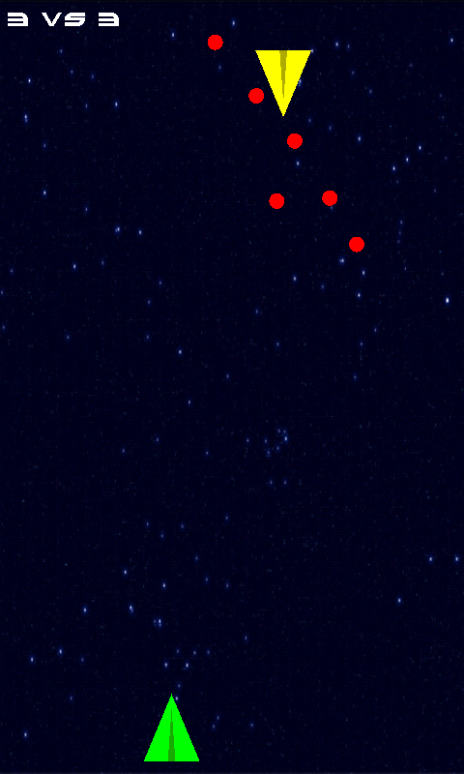
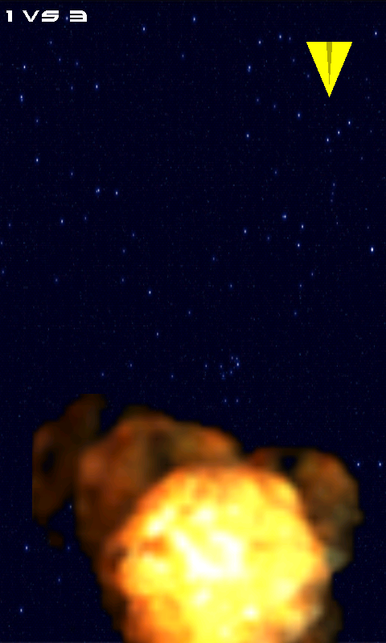


Starshooter
Sascha Montellese Daniel Mäder

Slide 2
Table of Contents
Intro
Background
Design / Architecture
Testing
Demo
Discussion

Slide 3
Intro - Motivation
Gain some knowledge in …
OpenGL
sensors
networking
general game-design
Android

Slide 4
Intro - Goals
Having a game that ‘works‘ ☺
intuitively controllable by sensor
playable over network

Slide 5
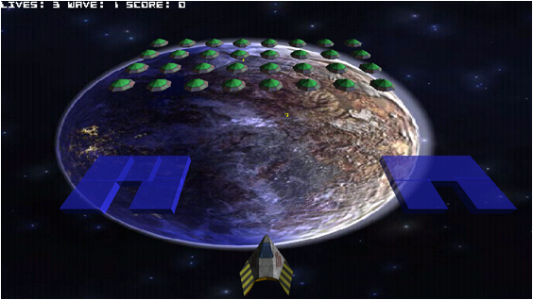
Background
Spieleentwicklung 101
good introduction to OpenGL ES based game design for Android
architectural basis of our implementation
http://www.androidpit.de/de/android/wiki/view/Spieleentwicklung_101

Slide 6
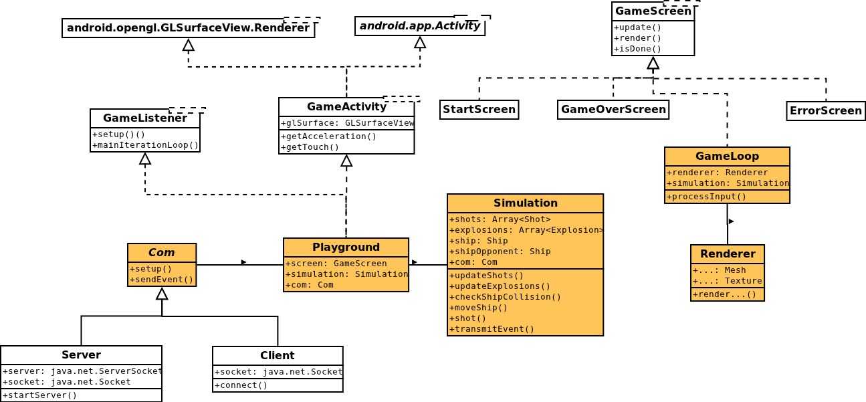
Design / Architecture - Overview

Slide 7
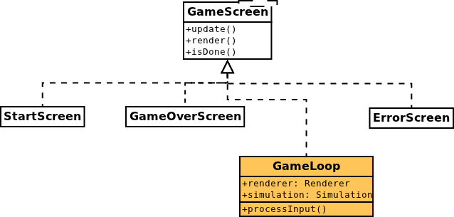
Design / Architecture – Active Screen

Slide 8
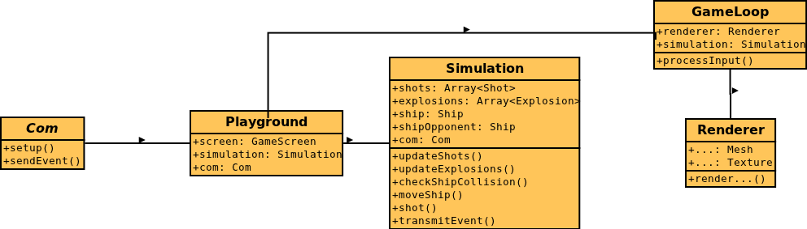
Design / Architecture – Game Loop

Slide 9
Testing
Communication:
protocol behaviour of server with telnet
client not easy
OpenGL
on emulator and on two different devices with different screen dimension
general testing by playing the game

Slide 10
Discussion – Lessons learnt
scarce OpenGL ES 2.0 documentation
OpenGL ES 2.0 not supported by emulator
different devices need different implementations
acceleration sensor delivers values in different ranges on different devices

Slide 11
Discussion – Future work
in game sound
reconnect after a connection loss
improved graphics (more 3D)
connection over Bluetooth
master automatically detectable in LAN
thrilling gameplay (different weapons etc…)

Slide 12

Demo

Slide 13

Fragen

