Slide 1
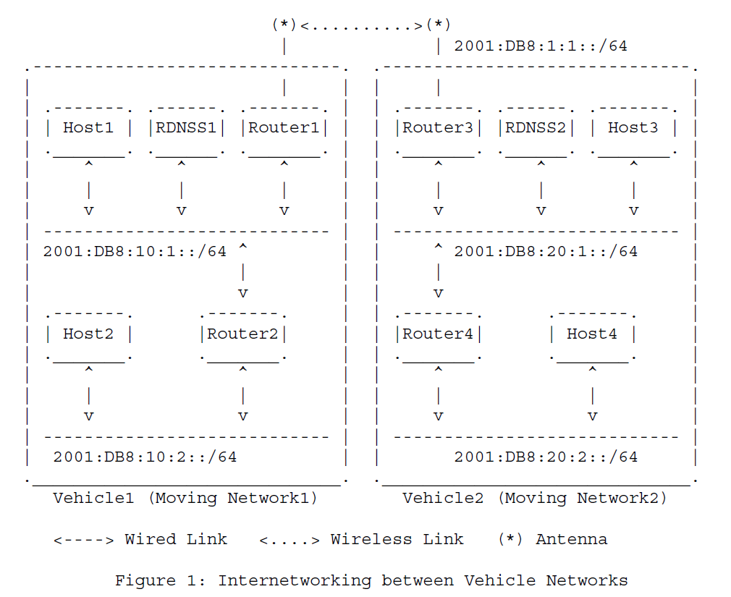
1. V2V
Cooperative Adaptive
Cruise Control (C-ACC) program for physical collision avoidance.
The vehicular
applications, such as C-ACC and C-OCS, can be registered into the DNS
Server (i.e., RDNSS) through DNSNA protocol in [ID-DNSNA] along with
IPv6 ND DNS options in [RFC6106].
by referring to their own RDNSS through the DNSNA protocol [ID-DNSNA].
Cooperative
On-board Camera Sharing (C-OCS) program for sharing road hazards or
obstacles to avoid road accidents.

Slide 2
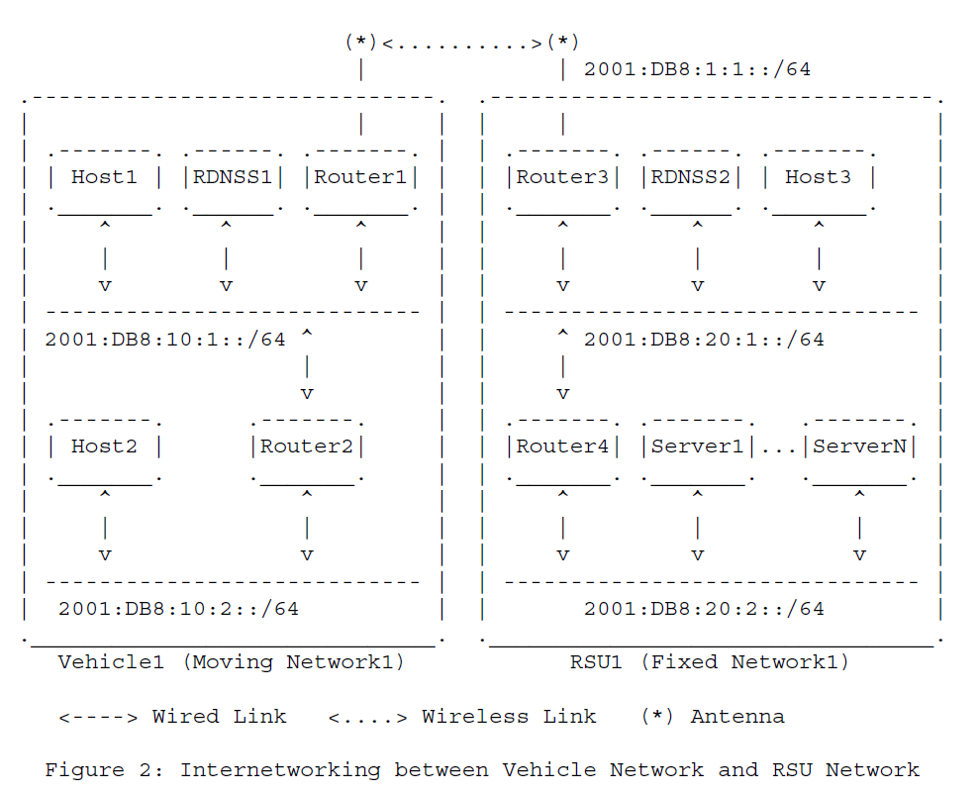
1. V2I
collection of servers (Server1 to
Server N) for various services in the road networks, such as road
emergency notification and navigation services. can be registered into the DNS Server (i.e.,
RDNSS) through DNSNA protocol in [ID-DNSNA] along with IPv6 ND DNS
options in [RFC6106].
internal network by referring to their own RDNSS through the DNSNA protocol [ID-DNSNA].

Slide 3
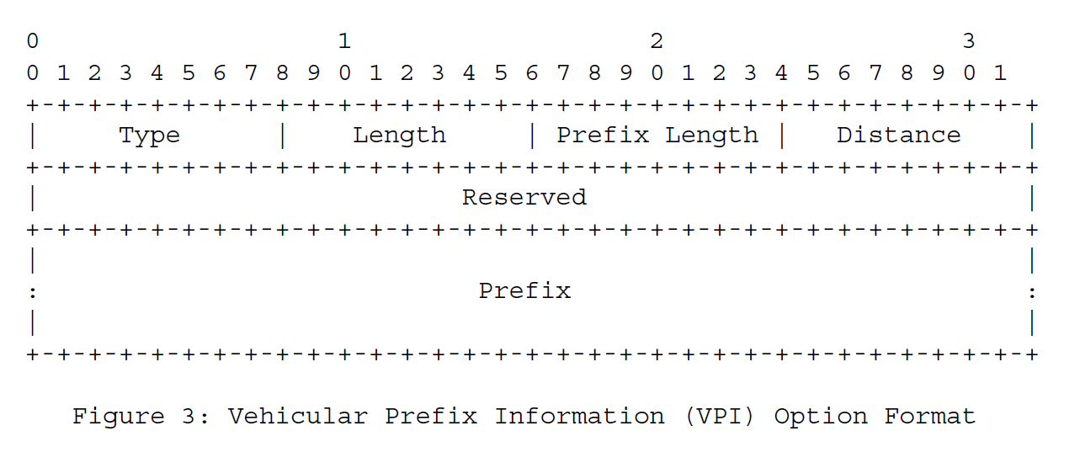

Slide 4
Type:
8-bit identifier of the VPI option type as assigned
by the IANA: TBD
Length:
8-bit unsigned integer. The length of the option
(including the Type and Length fields) is in units of
8 octets. The value is 3.
Prefix:
Length 8-bit unsigned integer. The number of leading bits
in the Prefix that are valid. The value ranges
from 0 to 128.
Distance:
8-bit unsigned integer. The distance between the
subnet announcing this prefix and the subnet
corresponding to this prefix in terms of the number
of hops.
Reserved:
This field is unused. It MUST be initialized to
zero by the sender and MUST be ignored by the
receiver.
Prefix:
An IP address or a prefix of an IP address. The
Prefix Length field contains the number of valid
leading bits in the prefix. The bits in the prefix
after the prefix length are reserved and MUST be
initialized to zero by the sender and ignored by
the receiver.

Slide 5
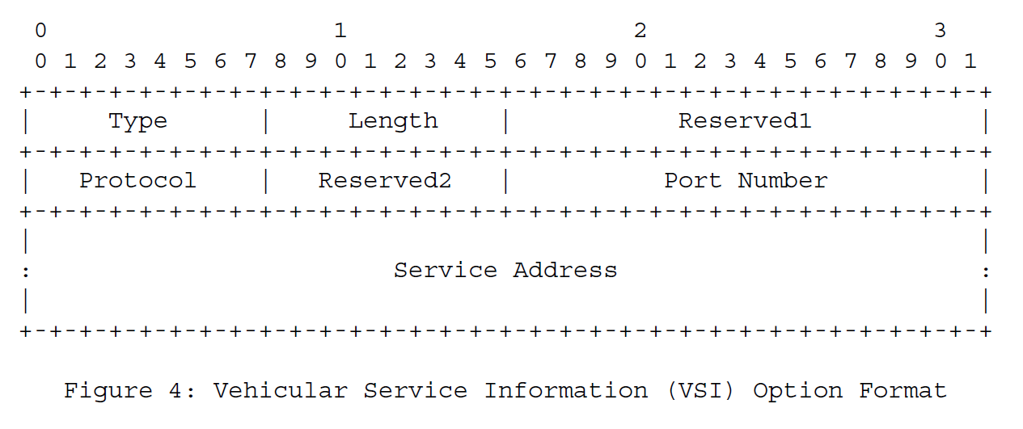

Slide 6
Type:
8-bit identifier of the VSI option type as assigned
by the IANA: TBD
Length:
8-bit unsigned integer. The length of the option
(including the Type and Length fields) is in units of
8 octets. The value is 3.
Reserved1:
This field is unused. It MUST be initialized to
zero by the sender and MUST be ignored by the
receiver.
Protocol:
8-bit unsigned integer to indicate the upper-layer
protocol, such as transport-layer protocol (e.g.,
TCP, UDP, and SCTP).
Reserved2:
This field is unused. It MUST be initialized to
zero by the sender and MUST be ignored by the
receiver.
Port Number:
16-bit unsigned integer to indicate the port number
for the protocol.
Service Address
128-bit IPv6 address of a vehicular service.

