Slide 1
Modelling Super Mario in EmbeddedMontiArc
Presentation
Philipp Haller
Software Engineering
RWTH Aachen
http://www.se-rwth.de/
Notes:
Nicht löschen: Vorlage V32

Slide 2
Structure
1.
Motivation
2.
Game
3.
Simulator
4.
Model
5.
Problems & Conclusion

Slide 3
Motivation
Autonomous Vehicles will play a big role in our future
Robots
Cars
Importance of DSLs
Automization
Control structures
EmbeddedMontiArc DSL for Cyber-Physical Systems
Component and Connectors

Slide 4
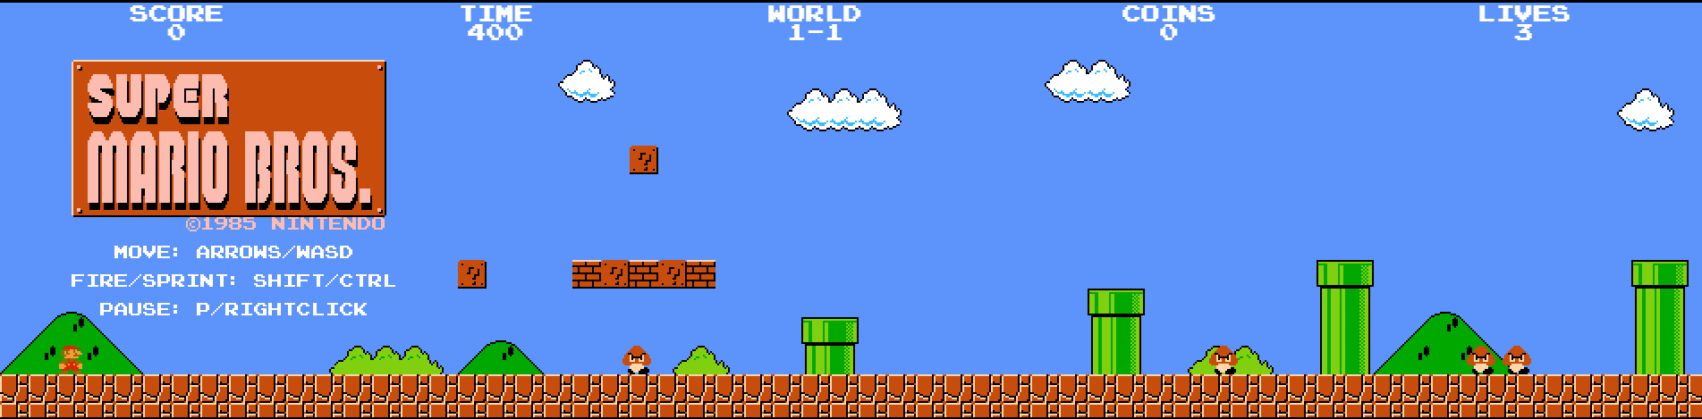
The Game
Super Mario Bros
Developed by Nintendo in 1985
HTML5 / JavaScript rewrite by Josh Goldberg

Slide 5
Simulator
Data Structures
FSM.GroupHolder.groups.
Character
Scenery
Solids
Interaction – Simulating key presses
Direction (left / right)
Jump (up)
Crouch (down)
Cyclic Data Extraction, Execution and Simulation of input
20Hz

Slide 6
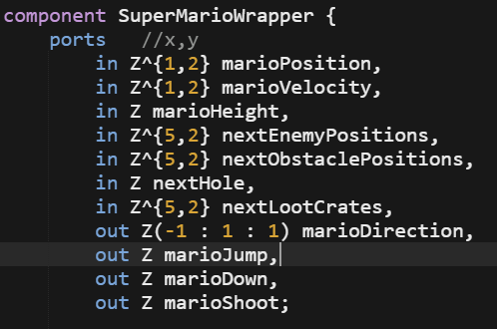
Simulator - Simplification

Slide 7
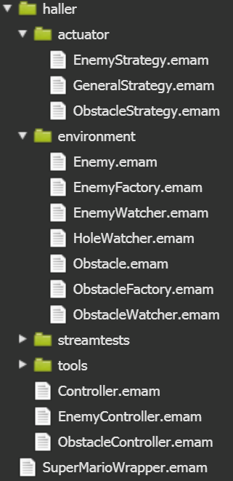
Modelling
Actuator Package
Different Strategies
Environment Package
Enemies
Obstacles
Hole
Tools Package
GetVelocity
Or
Controller
EnemyController
ObstacleController

Slide 8
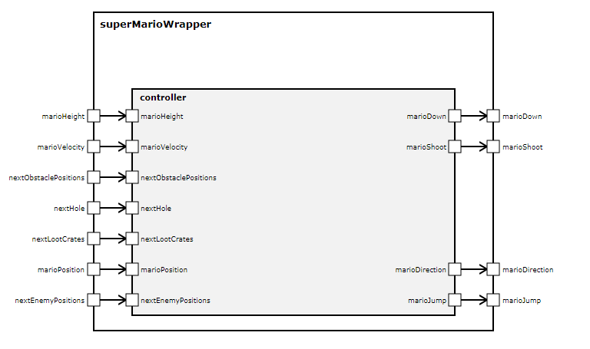
Modelling - Wrapper

Slide 9
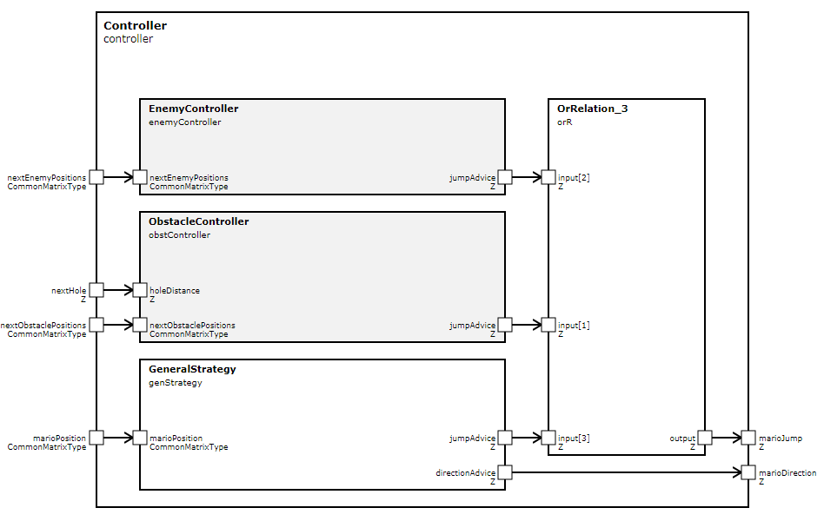
Modelling – Controller

Slide 10
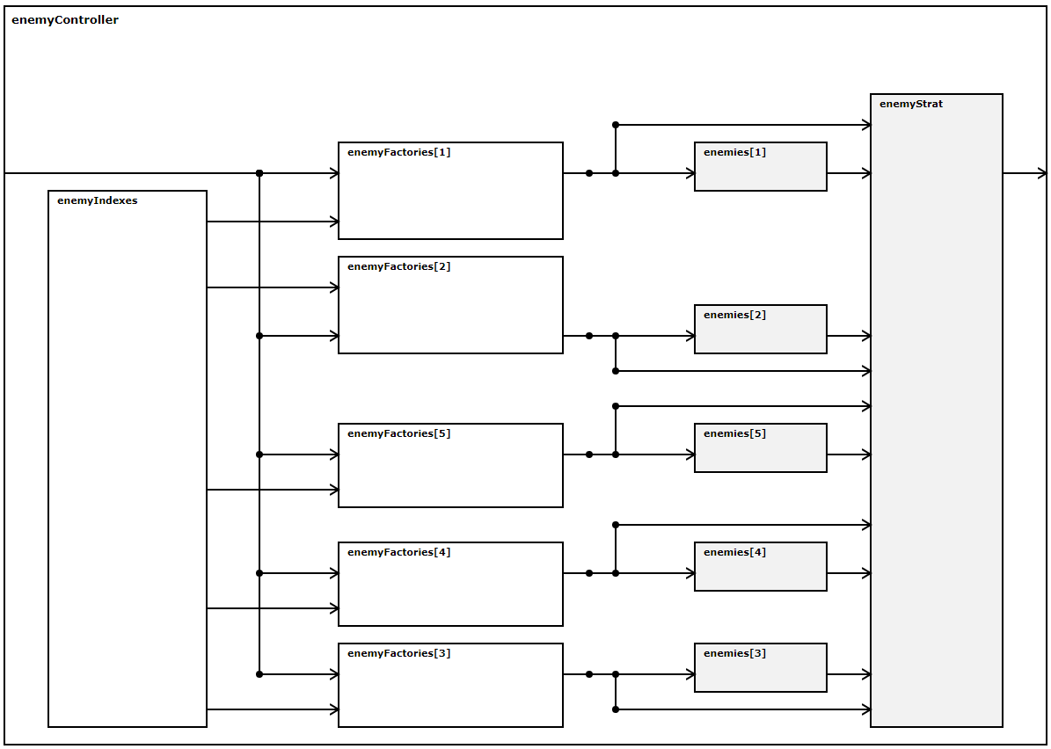
Modelling – EnemyController
Notes:
In den Enemies werden noch zusätzlich Geschwindigkeiten zur Richtungsbestimmung errechnet
Obstacle Controller sehr ähnlich, bis darauf das keine Geschwindigkeiten errechnet werden.

Slide 11
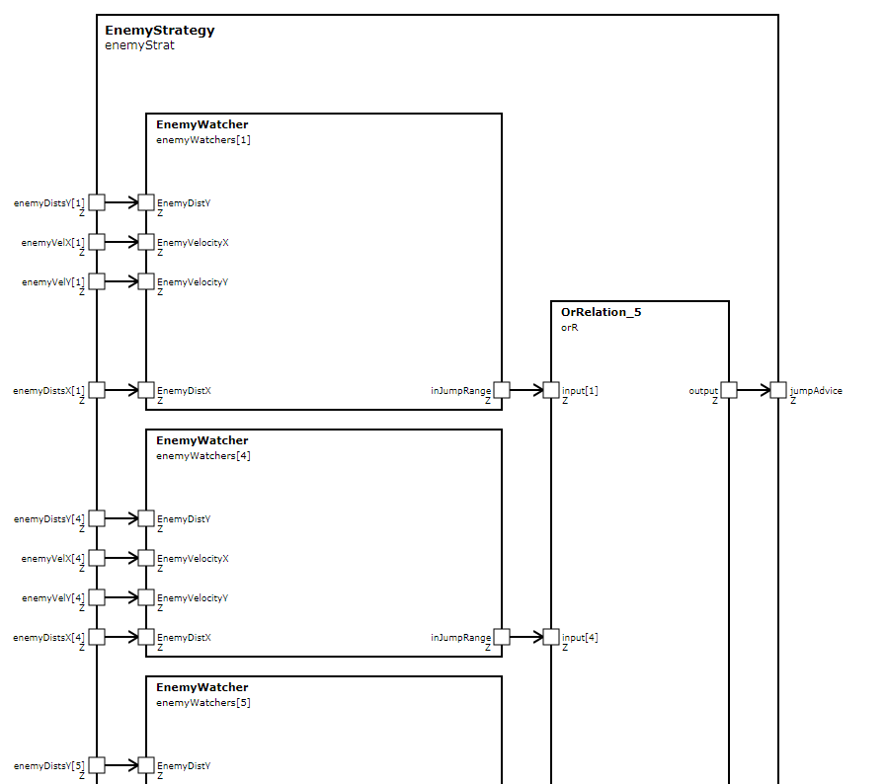
Modelling – EnemyStrategy

Slide 12
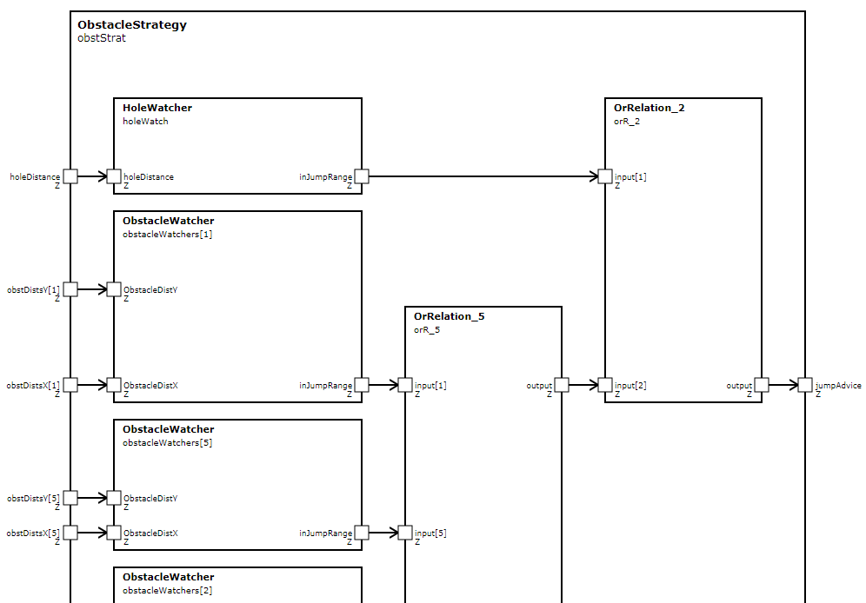
Modelling – ObstacleStrategy

Slide 13
Problems & Conclusion
Data Structures
FSM.GroupHolder.groups.
Character
Scenery
Solids
Interaction – Simulating key presses
Direction (left / right)
Jump (up)
Crouch (down)
Cyclic Data Extraction, Execution and Simulation of input
Notes:
20Hz

Slide 14
Thank you for your attention!

Slide 15
Modelling Super Mario in EmbeddedMontiArc
Live Demo
Philipp Haller
Software Engineering
RWTH Aachen
http://www.se-rwth.de/
Notes:
Nicht löschen: Vorlage V32

Slide 16
Structure
1.
Showcase of current level solving
2.
Taking an alternative route
3.
Problems on the way
4.
Modelling
5.
Problems & Conclusion
Notes:
2. Making a small change in the model to see an alternative level route
3. We will then see, that we need to alter the model
4. Actual modeling
5. ?

Slide 17
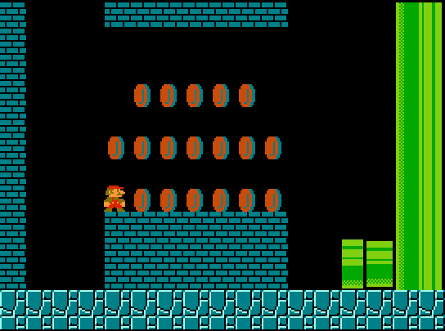
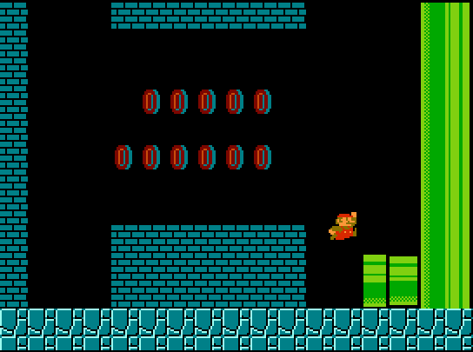
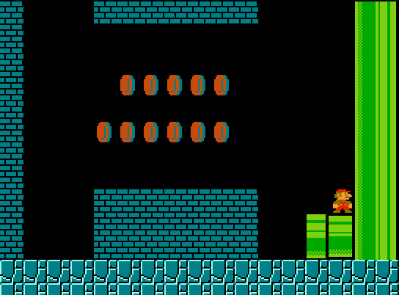
Live Demo

Slide 18
Modelling – Controller

