Slide 1

Multi-Target Code Generation
12.06.2018
Alexander Hellwig
Evgeny Kusmenko
Software Engineering
RWTH Aachen
http://www.se-rwth.de/
Notes:
Nicht löschen: Vorlage V32

Slide 2
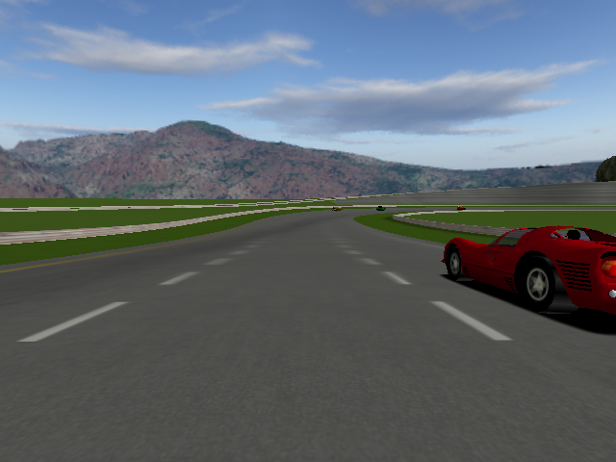
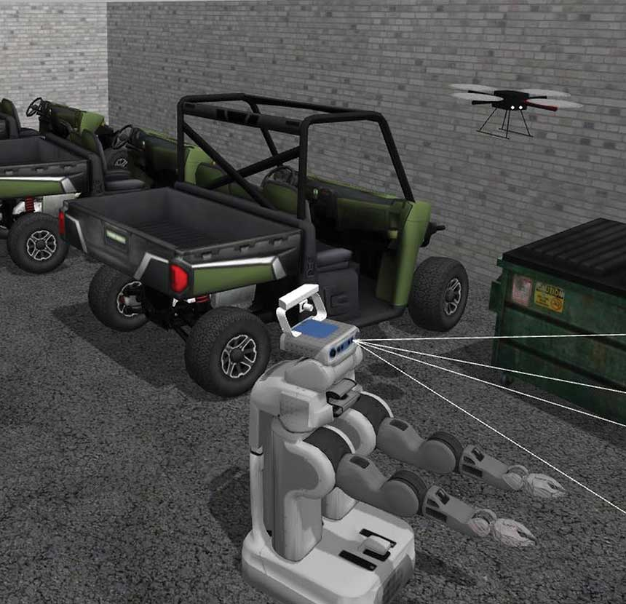
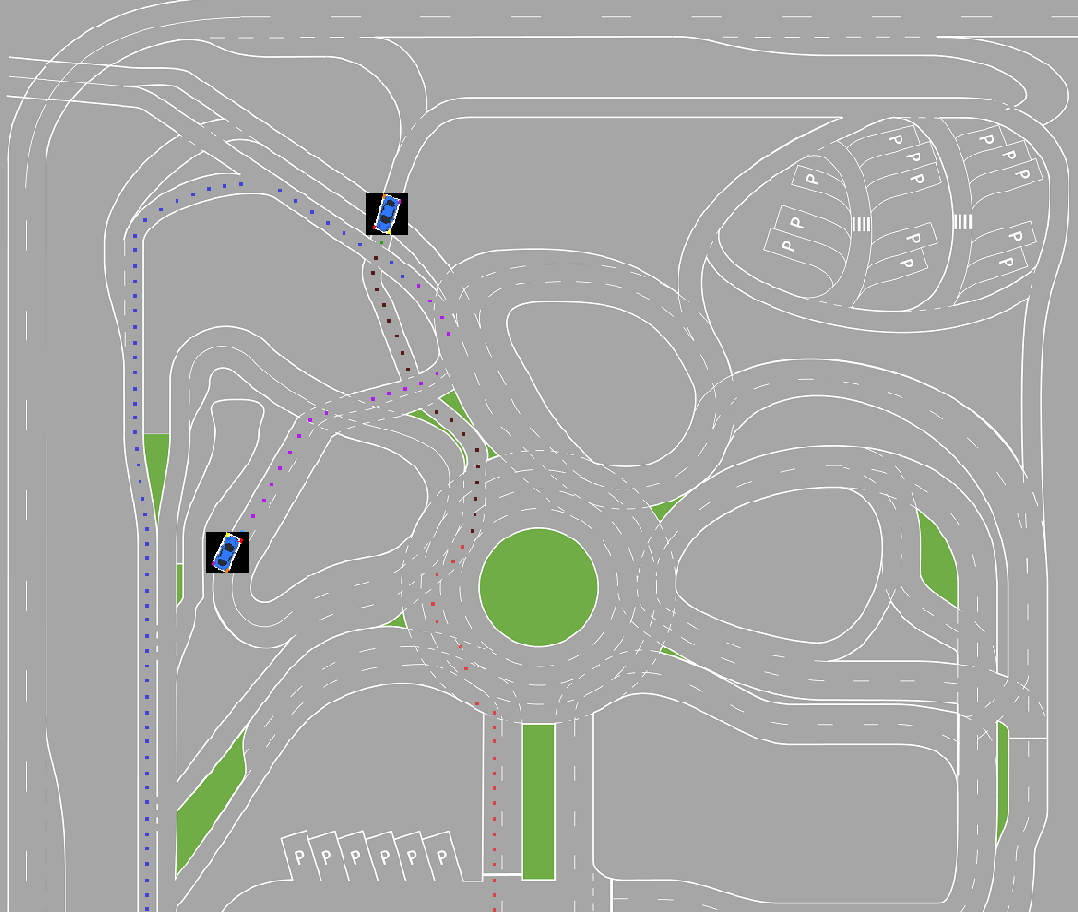

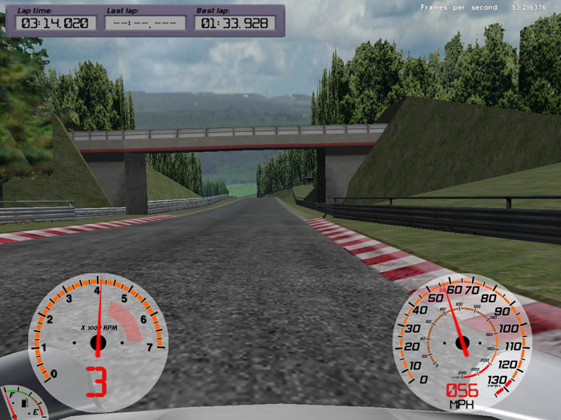
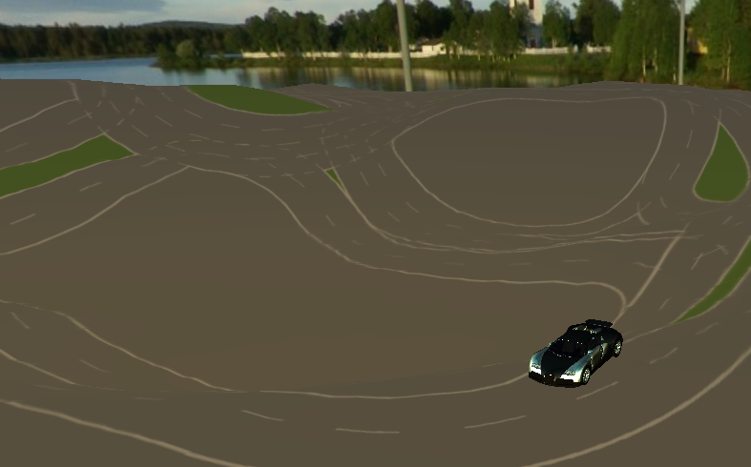
Simulatoren
TORCS / OpenDaVINCI
Gazebo / ROS
Simulink
How to get models into a simulator?
VDrift / OpenDaVINCI
MontiSim
Veins

Slide 3
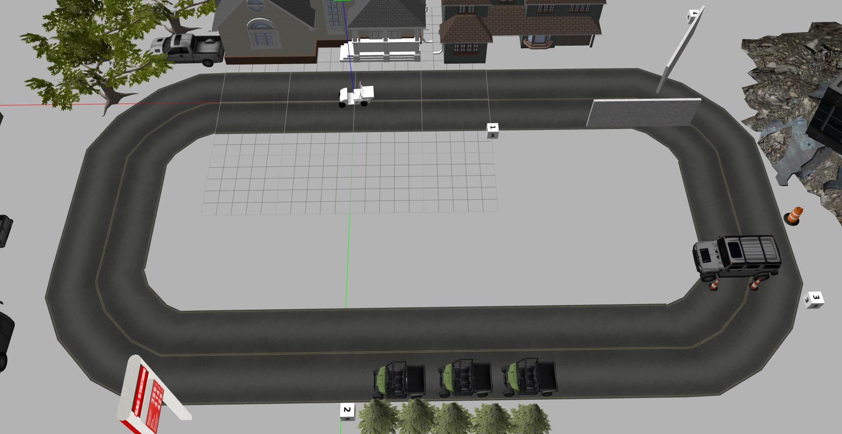
Gazebo Self-Driving Vehicle Example
Vehicle
Wall
Trajectory Plan
Obstacle
Parking Vehicles

Slide 4
EmbeddedMontiArc Model
¹ | component TrajectorySystem{
² | ports in Map map,
³ | in Position pos,
⁴ | in SensorSignal senSig,
⁵ | out Trajectory desiredTraj;
⁶ | instance ObstacleDetection obsDetection;
⁷ | instance Filter filter;
⁸ | instance Planner planner;
⁹ | connect map -> planner.mapIn;
¹⁰ | connect pos -> planner.posIn;
¹¹ | connect planner.trajOut -> desiredTraj;
¹² | connect obsDetection.obstacles -> planner.obsIn;
¹³ | /* other connections */ }
direction
type
name
instances of subcomponents defined in other artifacts
source port
target port

Slide 5
EMAM Diagram
TrajectorySystem
copy ros connection from super component
Planner
map:Map
mapIn:Map
pos:Position
posIn:Position
ObstacleDetection
obstacles:Obstacles
obsIn:Obstacles
senSig:SensorSignal
trajOut:Trajectory
Filter
senSig:SensorSignal
sigOut:SensorSignal
generate ros connection
sigIn:SensorSignal
desiredTraj:Trajectory

Slide 6
EMAM Diagram + Port Tagging
normal EMAM-Port
EMAM-Port with incomplete ros info(no topic name or type)
EMAM-Port with complete ros info
TrajectorySystem
copy ros connection from super component
Planner
map:Map
mapIn:Map
pos:Position
posIn:Position
ObstacleDetection
obstacles:Obstacles
obsIn:Obstacles
senSig:SensorSignal
trajOut:Trajectory
Filter
senSig:SensorSignal
sigOut:SensorSignal
generate ros connection
sigIn:SensorSignal
desiredTraj:Trajectory

Slide 7
Tagging Model
tagged symbol
tag type
¹ | tags RosTags{
² | tag trajectorySystem.map with RosConnection = {topic= (name=/map, type=struct_msgs/Map)};
³ | tag trajectorySystem.desiredTraj with RosConnection = {topic= (name=/desiredMotion, type=struct_msgs/Trajectory)};
⁴ | tag trajectorySystem.planner.mapIn with RosConnection;
⁵ | tag trajectorySystem.planner.obsIn with RosConnection;
⁶ | [...]}
tag value
RosConnection with complete information( )
RosConnection with incomplete information( )
¹ | struct Position{
² | Q ( -90° : 0.000001° : 90° ) longitude;
³ | Q ( -180° : 0.000001° : 180°) latitude;
⁴ | Q ( -10km : 10cm : 10km) altitude;}
type
min value
step size
max value
name

Slide 8
Symbol Table
each ECIS contains Symbols of its sub-elements (like Subcomponents, Ports and Connectors) in its spannedScope
trajectorySystem:ECIS
every element of the EMAM model is represented by a symbol (i.e. each Component instance has an ExpandedComponentInstanceSymbol = ECIS)
spannedScope:Scope
obstacleDetection:ECIS
filter:ECIS
map:PortSymbol
planner:ECIS
incoming = true
type = Map
:Scope
:Scope
:Scope
:RosConnectionSymbol
senSig:PortSymbol
...
sigOut:PortSymbol
topicName = /map
topicType =
struct_msgs/Map
obsIn:PortSymbol
...
incoming = true
type = SensorSignal
incoming = false
type = SensorSignal
incoming = true
type = Obstacles
:RosConnectionSymbol
:RosConnectionSymbol
:RosConnectionSymbol
Symbols of a Port with an incomplete RosConnection( )
Symbols of a Port with a complete RosConnection( )
...

Slide 9
Clustered Symbol Table
each ECIS contains Symbols of its sub-elements (like Subcomponents, Ports and Connectors) in its spannedScope
trajectorySystem:ECIS
every element of the EMAM model is represented by a symbol (i.e. each Component instance has an ExpandedComponentInstanceSymbol = ECIS)
spannedScope:Scope
obstacleDetection:ECIS
filter:ECIS
map:PortSymbol
planner:ECIS
incoming = true
type = Map
:Scope
:Scope
:Scope
:RosConnectionSymbol
senSig:PortSymbol
...
sigOut:PortSymbol
topicName = /map
topicType =
struct_msgs/Map
obsIn:PortSymbol
...
incoming = true
type = SensorSignal
incoming = false
type = SensorSignal
incoming = true
type = Obstacles
:RosConnectionSymbol
:RosConnectionSymbol
:RosConnectionSymbol
Symbols of a Port with an incomplete RosConnection( )
Symbols of a Port with a complete RosConnection( )
...
Machine A
Replaced by middleware
Machine B

Slide 10
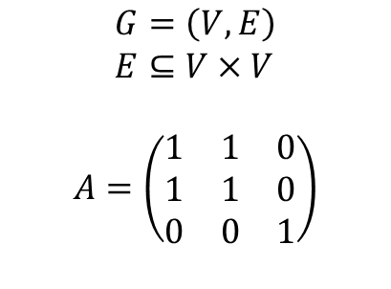
Exkurs Machine Learning in SE
Planner
mapIn:Map
posIn:Position
ObstacleDetection
obstacles:Obstacles
obsIn:Obstacles
senSig:SensorSignal
trajOut:Trajectory
Filter
1
3
sigOut:SensorSignal
sigIn:SensorSignal
$$G=\left(V,E\right) \\ E⊆V×V$$
$$A=\left(\begin{matrix}1 & 1 & 0 \\ 1 & 1 & 0 \\ 0 & 0 & 1\end{matrix}\right)$$
2

Slide 11
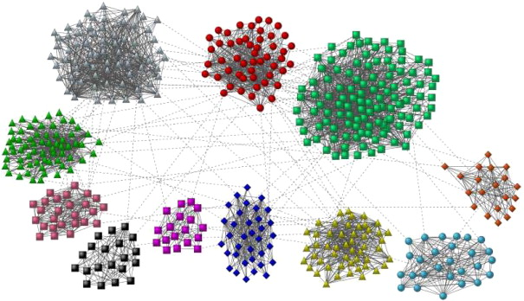
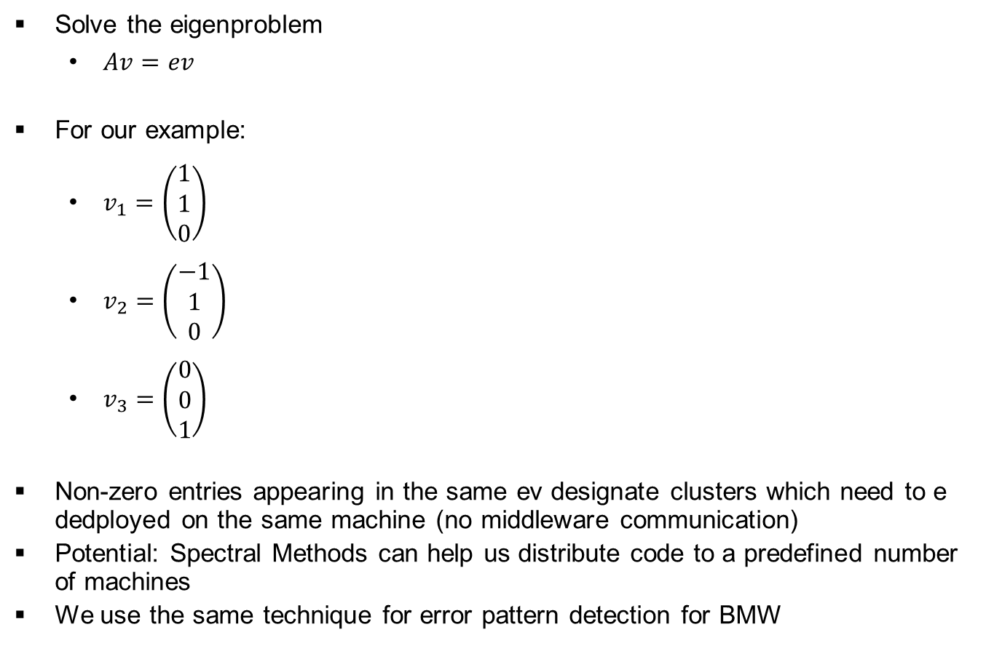
Spectral Analysis
Solve the eigenproblem
$Av=ev$
For our example:
$v_{1}=\left(\begin{matrix}1 \\ 1 \\ 0\end{matrix}\right)$
$v_{2}=\left(\begin{matrix}−1 \\ 1 \\ 0\end{matrix}\right)$
$v_{3}=\left(\begin{matrix}0 \\ 0 \\ 1\end{matrix}\right)$
Non-zero entries appearing in the same ev designate clusters which need to e dedployed on the same machine (no middleware communication)
Potential: Spectral Methods can help us distribute code to a predefined number of machines
We use the same technique for error pattern detection for BMW

Slide 12
*-Bridge Generator Composition
MainGenerator
CoordinatingGenerator
generate(ECIS comp)
add(GeneratorImpl genImpl)
remove(GeneratorImpl genImpl)
generateCoordination()
...
for each g in genImpls:
g.generate(comp);
Abstraction
GeneratorCpp
1
genImpls
*
generate(ECIS comp)
«interface»
GeneratorImpl
GeneratorRosCpp
generate(ECIS comp)
generate(ECIS comp)
Implementation
GeneratorOpenDavinciCpp
generate(ECIS comp)
...

Slide 13
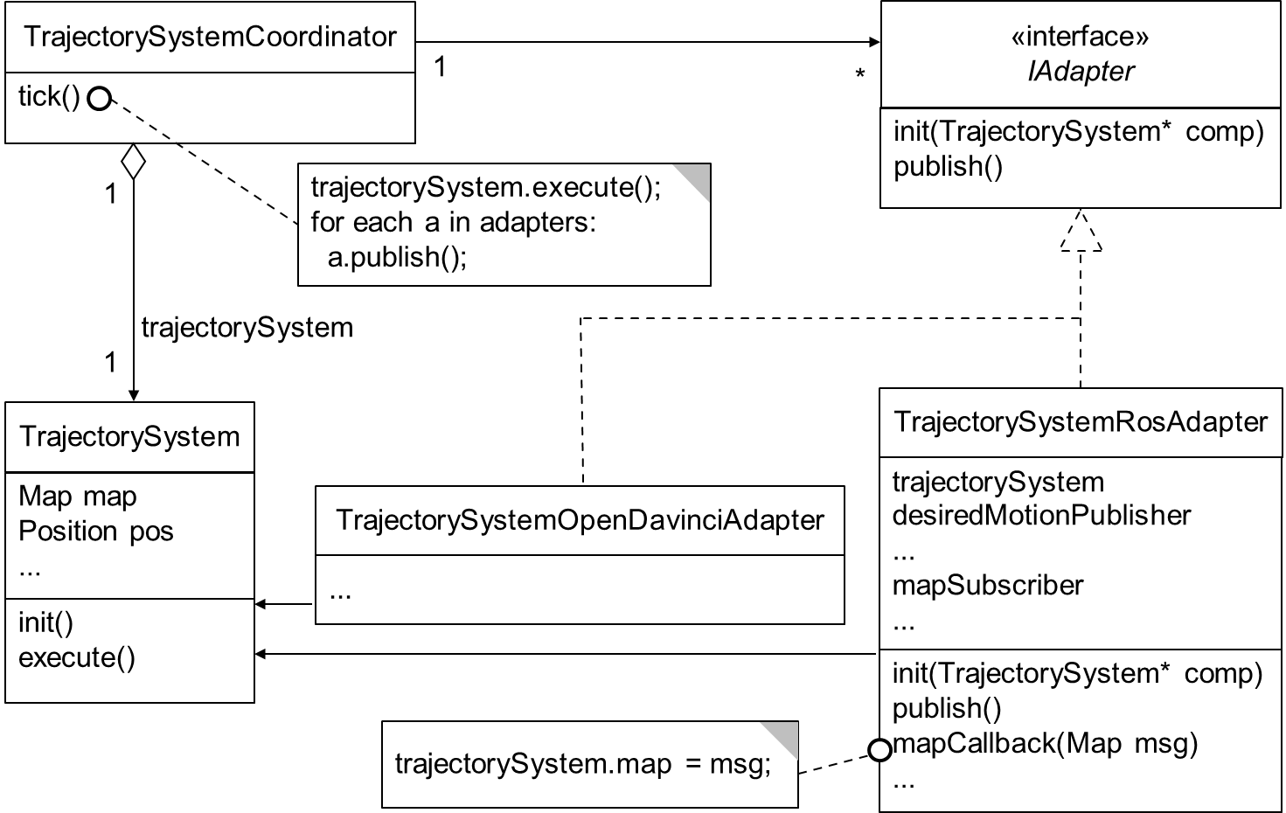
Generated System incl. Adapter
Generated Code Adapter
Middleware
Adapter

Slide 14
Generated Artifacts
Generator | Generated files
CoordinatingGenerator | ├── CMakeLists.txt ├── coordinator │ ├── CMakeLists.txt │ ├── TrajectorySystemCoordinator.cpp │ └── IAdapter.h
GeneratorCpp | ├── cpp │ ├── CMakeLists.txt │ └── TrajectorySystem.h
GeneratorOpenDavinciCpp | ├── opendavinci │ ├── CMakeLists.txt │ └── TrajectorySystem │ OpenDavinciAdapter.h
GeneratorRosCpp | └── roscpp ├── CMakeLists.txt └── TrajectorySystemAdapter.h

Slide 15
Generated Adapter
¹ | #include "TrajectorSystem.h"
² | [...] /* other includes*/
³ | class TrajectorySystemRosAdapter : public IAdapter{
⁴ | TrajectorySystem* trajectorySystem;
⁵ | ros::Subscriber mapSubscriber;
⁶ | ros::Publisher desiredMotionPublisher;
⁷
⁸ | public:
⁹ | void init(TrajectorySystem* comp){
¹⁰ | trajectorySystem = comp;
¹¹ | /*init publishers, subscribers and start ROS thread*/
¹² | [...]
¹³ | }
¹⁴ | void publish(){
¹⁵ | struct_msgs::Map tmpMsg =
 | msgFromStructMap(trajectorySystem->desiredTraj);
¹⁶ | desiredMotionPublisher.publish(tmpMsg);
¹⁷ | }
¹⁸
¹⁹ | void mapCallback(struct_msgs::Map& msg){
²⁰ | trajectorySystem->map = structFromMsgMap(msg);
²¹ | } [...] };
instance shared between the coordinator and other adapters
called once by TrajectorySystemCoordinator
called in a defined interval by TrajectorySystemCoordinator
called by ROS every time a message is published on the topic /map

