Slide 1
EmbeddedMontiArc: An Implementation Case Study
Philipp Haller, Malte Heithoff, Mustafa Sezer
Seminar am Lehrstuhl für Software Engineering
RWTH Aachen

Slide 2
Outline
1.
Introduction
2.
Context
3.
Approach
4.
Modelling
5.
Evaluation
6.
Conclusion
Notes:
Bei kurzen Vorträgen zu vermeiden

Slide 3
Introduction
Modelling languages for cyber-physical systems play an important role in SE (e.g. automotive sector)
Domain Specific Languages (DSLs) are used to cope with specialized tasks and environment
Implementation of modelling languages is still a problem
Component and Connector (C&C) approach to describe the architecture of DSLs
Testing on cyber-physical systems is still necessary
Higher costs in real-life
Simulation must be based on physical laws

Slide 4
Introduction
Our contribution: Case Study
Evaluation of the ease of use and reusability for reactive systems
Exactly: Analysing the components and behaviour of the PacMan and SuperMario game
Our experiences (how long did we need to learn EMA? Which difficulties?)
Basis of the case study: 4 Research questions
RQ1: Is EmbeddedMontiArc suitable for other systems?
RQ2: Is it possible to integrate other simlators in a recent amount of work?
RQ3: What kind of background knowledge is needed to model C&C in EMA
RQ4: What features are good and what are not suited?

Slide 5
Outline
1.
Introduction
2.
Context
3.
Approach
4.
Modelling
5.
Evaluation
6.
Conclusion
Notes:
Bei kurzen Vorträgen zu vermeiden

Slide 6
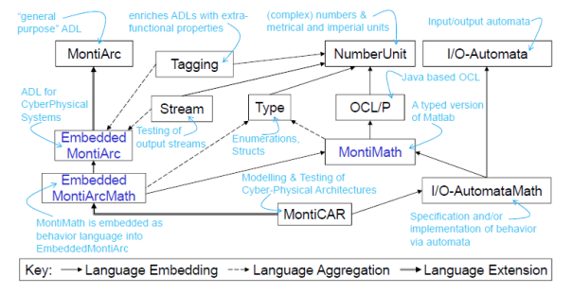
Context
EmbeddedMontiArc language family

Slide 7
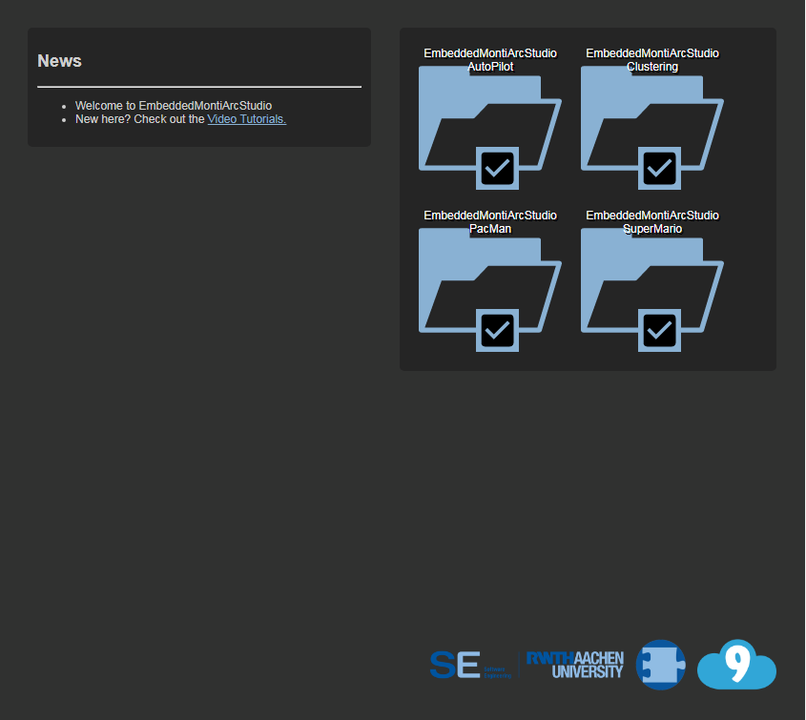
Context
Cloud9 IDE is used to make the development process more comfortable

Slide 8
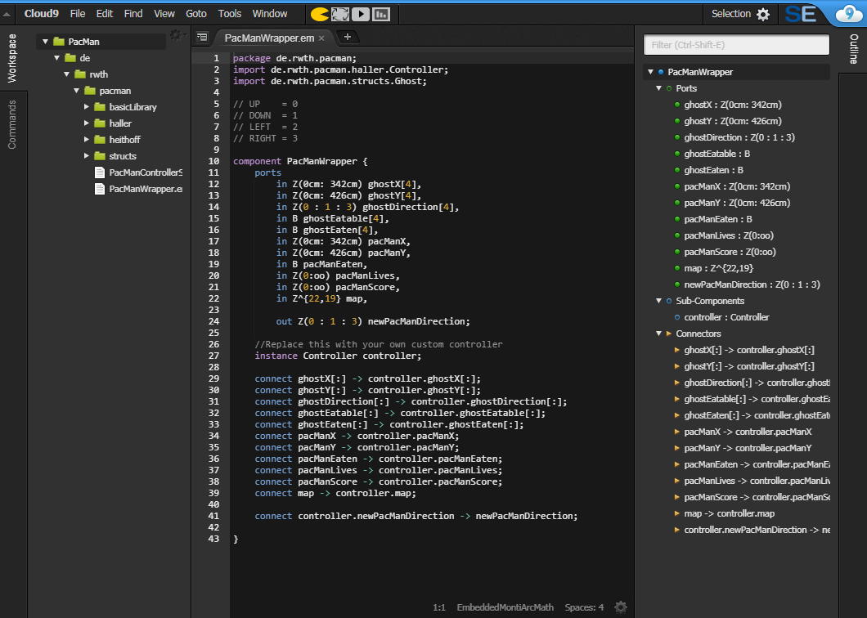
Context

Slide 9
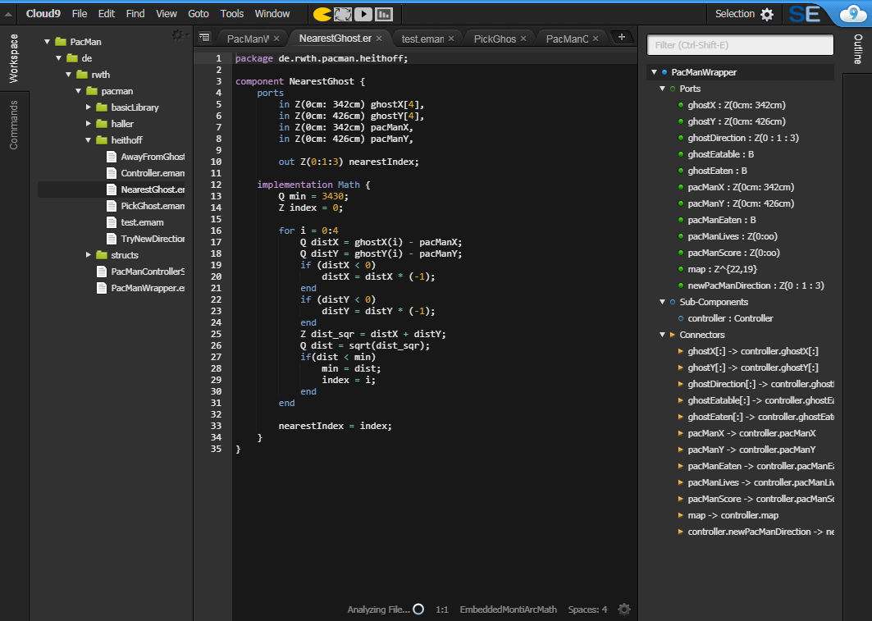
Context

Slide 10
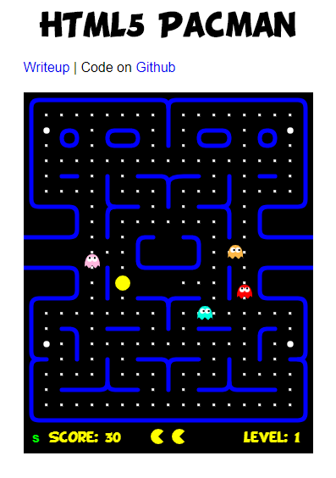
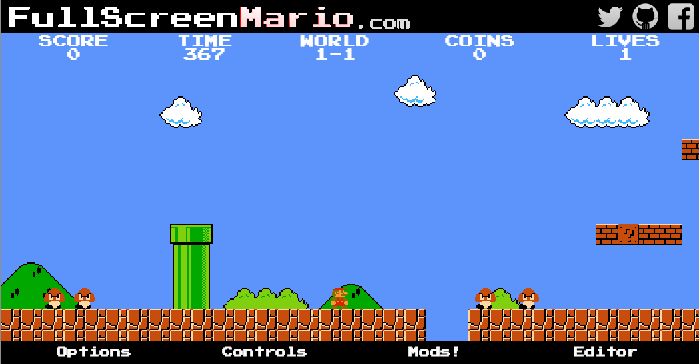
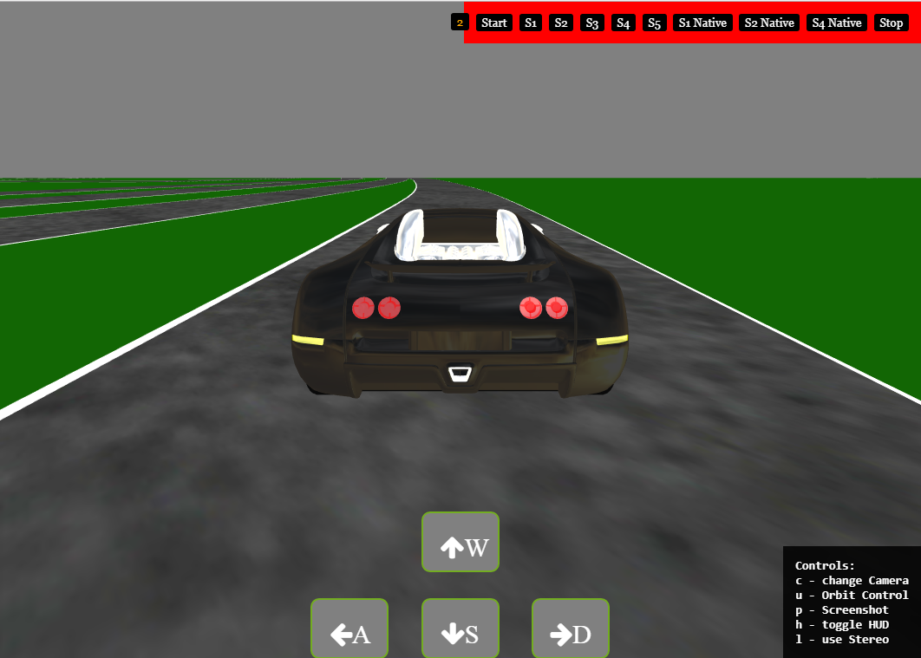
Context
Simulators callable from IDE directly

Slide 11
Outline
1.
Introduction
2.
Context
3.
Approach
4.
Modelling
5.
Evaluation
6.
Conclusion
Notes:
Bei kurzen Vorträgen zu vermeiden

Slide 12
Approach
Two groups
Expert
Beginners
Tasks:
Implement Pacman model
Integrate SuperMario into IDE
Implement SuperMario model
Fill out a questionnaire throughout the development process, reporting problems and impressions

Slide 13
Approach
Questionnaire (to be translated & refactored)
Aufwand der Einrichtung der IDE / des Simulators
Performance (Im Workflow gibt es nicht viele Wartezeiten)
Integration des Simulators in IDE
Intuitivität der Umgebung / der Eingabemöglichkeiten 2x
Angemessene Zeit zur Implementierung
Skala: 10: Viel schneller als erwartet,
Skala: 1: Sehr viel langsamer,
Skala: 5: Keine Abweichung von der Erwartung
Häufigkeit von Bugs
Anteil der Bugs die den Arbeitsablauf sehr stark stören
Error Handling / Intuitivität der Fehlermeldungen
Featurevollständigkeit

Slide 14
Outline
1.
Introduction
2.
Context
3.
Approach
4.
Modelling
5.
Evaluation
6.
Conclusion
Notes:
Bei kurzen Vorträgen zu vermeiden

Slide 15
Modeling
Interfaces:
Pacman
[ADD]
SuperMario
[ADD]
Define test cases
EmbeddedMontiArc Stream component for testing

Slide 16
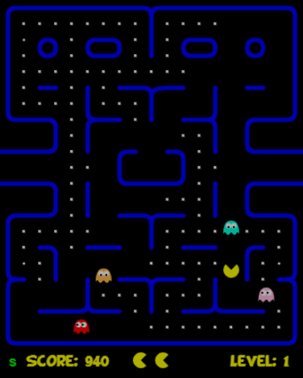
Modeling – Test cases
Pacman should choose a path away from ghosts

Slide 17
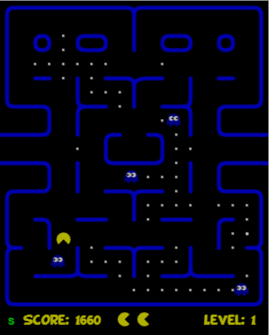
Modeling – Test cases
Pacman should eat the ghost to send it home

Slide 18
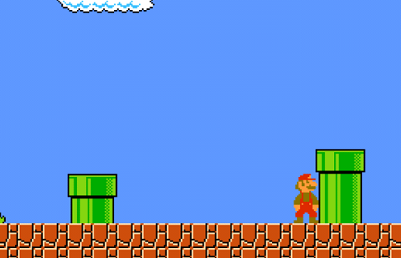
Modeling – Test cases
Mario has to jump over obstacles

Slide 19
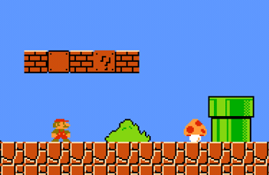
Modeling – Test cases
Mario has to eat mushrooms to enhance his survivability

Slide 20
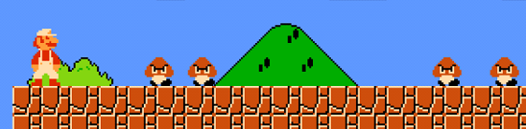
Modeling – Test cases
Mario should not walk into holes and watch out for enemies

Slide 21
Outline
1.
Introduction
2.
Context
3.
Approach
4.
Modelling
5.
Evaluation
6.
Conclusion
Notes:
Bei kurzen Vorträgen zu vermeiden

Slide 22
Evaluation: Subject Write-up by Mustafa
Understanding C&C (connector, component, ports etc.)
Getting accustomed to the syntax of EMA
Easy IDE
Honestly: not easy to get into the project
More intuitive datatypes in EMA: B (Boolean), Z (Integer), Q (Rational number), N (Natural number)
Assigning intervals/domain to the datatypes
Defining units
Creation of matrices in a more intuitive way
Good beginner tutorials which taught the “component principle“
Displaying whether a package is correct or not
No possibility of debugging (there is no variable watcher and breakpoints)
Only start console is available

Slide 23
Outline
1.
Introduction
2.
Context
3.
Approach
4.
Modelling
5.
Evaluation
6.
Conclusion
Notes:
Bei kurzen Vorträgen zu vermeiden

Slide 24
Conclusion
TBD

Slide 25
Thank you for your attention!

