Slide 1
PacMan Scenarios

Slide 2
Test 1
PacMan flees by going downwards

Slide 3
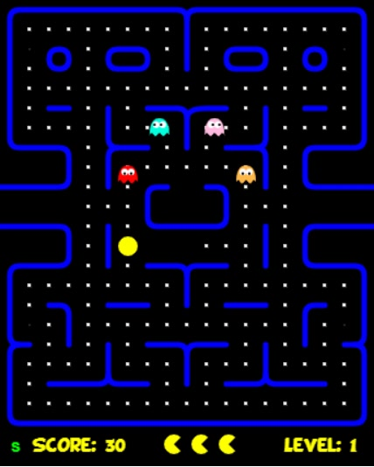
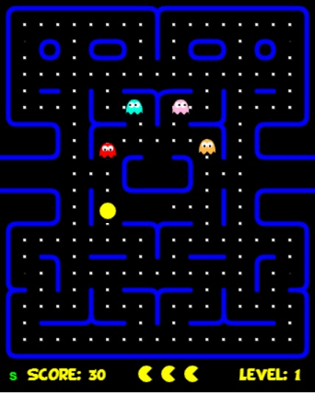
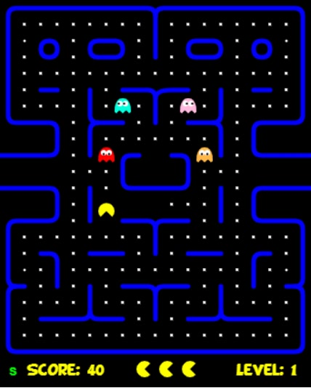
PacMan
(70cm, 130cm)
Red Ghost
(70cm, 92cm)
PacMan
(70cm, 132cm)
Red Ghost
(70cm, 94cm)
PacMan
(70cm, 134cm)
Red Ghost
(70cm, 96cm)
Blue Ghost
(88cm, 70cm)
Pink Ghost
(112cm, 70cm)
Blue Ghost
(86cm, 70cm)
Pink Ghost
(114cm, 70cm)
Blue Ghost
(84cm, 70cm)
Pink Ghost
(116cm, 70cm)
Yellow Ghost
(130cm, 92cm)
NewPacManDir
1
Yellow Ghost
(130cm, 94cm)
NewPacManDir
1
Yellow Ghost
(130cm, 96cm)
NewPacManDir
1

Slide 4
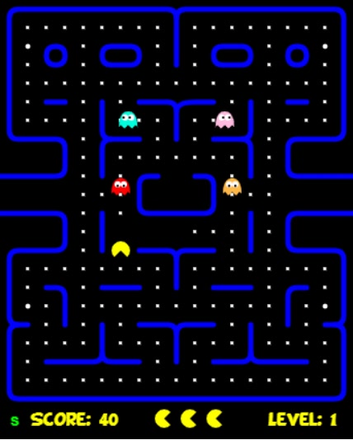
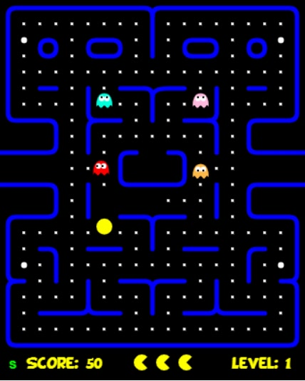
PacMan
(70cm, 136cm)
Red Ghost
(70cm, 98cm)
PacMan
(70cm, 138cm)
Red Ghost
(68cm, 100cm)
Blue Ghost
(70cm, 92cm)
Pink Ghost
(70cm, 118)
Blue Ghost
(70cm, 92cm)
Pink Ghost
(70cm, 120)
Yellow Ghost
(130cm, 98cm)
NewPacManDir
1
Yellow Ghost
(130cm, 100cm)
NewPacManDir
1

Slide 5
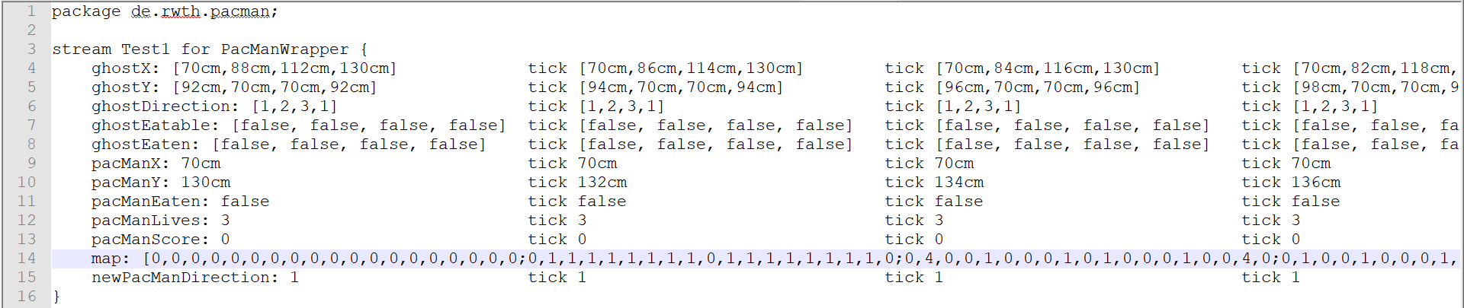
Stream Test

Slide 6
Test 2
PacMan flees by going left (other ways are occupied)

Slide 7
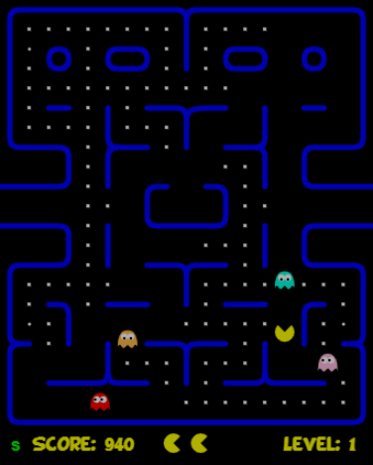
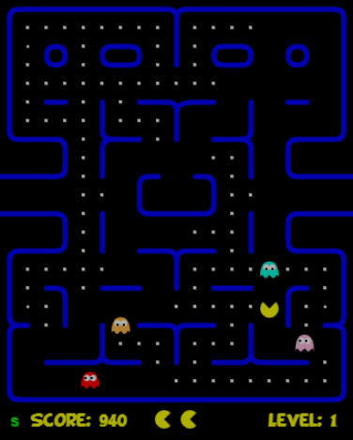
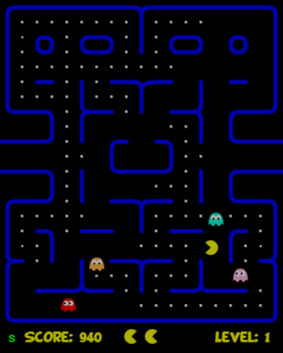
PacMan
(150cm, 172cm)
Red Ghost
(54cm, 210cm)
PacMan
(150cm, 170cm)
Red Ghost
(52cm, 210cm)
PacMan
(148cm, 170cm)
Red Ghost
(50cm, 210cm)
Blue Ghost
(150cm, 148cm)
Pink Ghost
(170cm, 190cm)
Blue Ghost
(150cm, 150cm)
Pink Ghost
(168cm, 190cm)
Blue Ghost
(150cm, 152cm)
Pink Ghost
(166cm, 190cm)
Yellow Ghost
(70cm, 172cm)
NewPacManDir
0
Yellow Ghost
(70cm, 174cm)
NewPacManDir
0
Yellow Ghost
(70cm, 176cm)
NewPacManDir
2

Slide 8
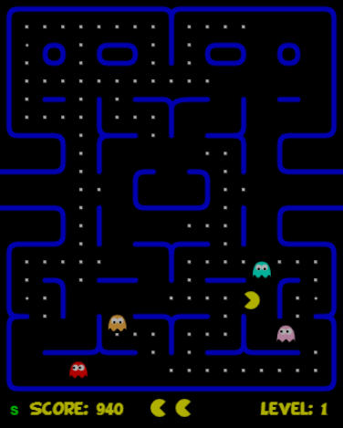
PacMan
(146cm, 170cm)
Red Ghost
(48cm, 210cm)
Blue Ghost
(150cm, 154cm)
Pink Ghost
(164cm, 190cm)
Yellow Ghost
(70cm, 178cm)
NewPacManDir
2

Slide 9
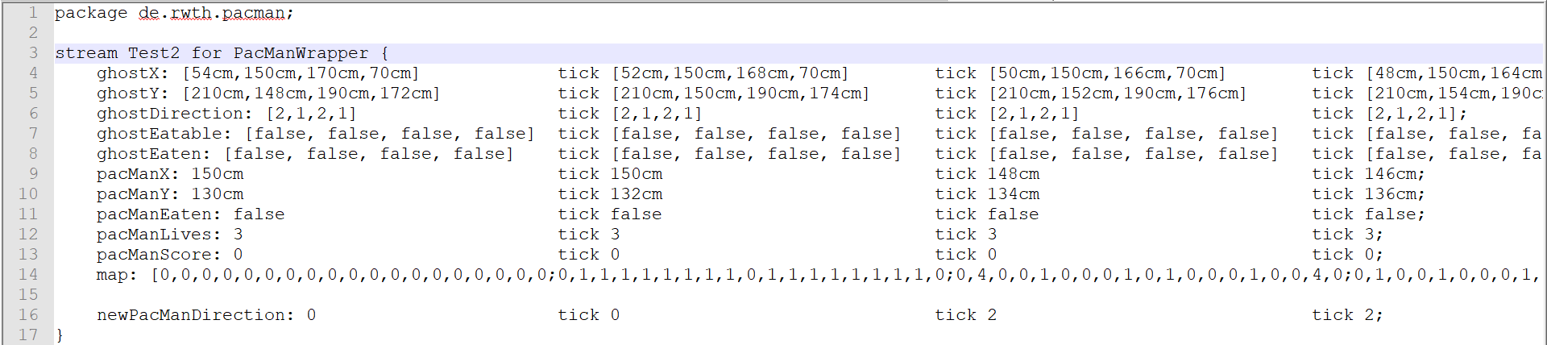
Stream Test

Slide 10
Test 3
PacMan goes toward eatable ghost

Slide 11
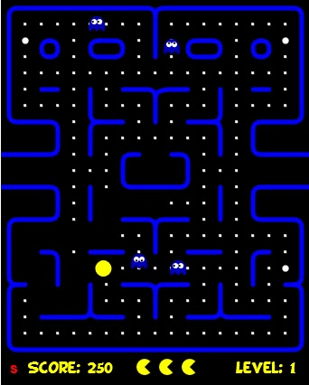
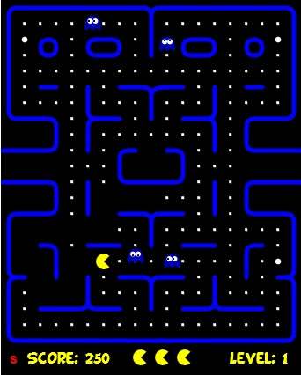
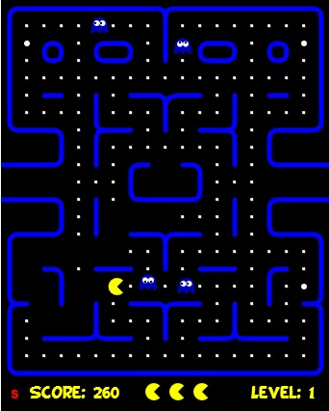
ghostX: [80cm,100cm,54cm,104cm]
[80cm,100cm,53cm,103cm]
[80cm,100cm,52cm,102cm]
ghostY: [156cm,24cm,10cm,160cm]
[157cm,23cm,10cm,160cm]
[158cm,22cm,10cm,160cm]
ghostDirection: [1,0,2,2]
[1,0,2,2]
[1,0,2,2]
ghostEatable: [1,1,1,1]
[1,1,1,1]
[1,1,1,1]
ghostEaten: [0,0,0,0]
[0,0,0,0]
[0,0,0,0]
pacManX: 58cm
60cm
62cm
pacManY: 160cm
160cm
160cm
NewPacManDir: 3
NewPacManDir: 3
NewPacManDir: 3

Slide 12
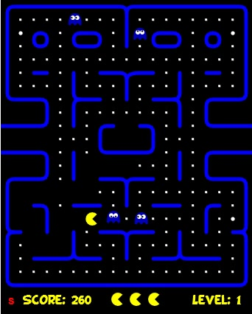
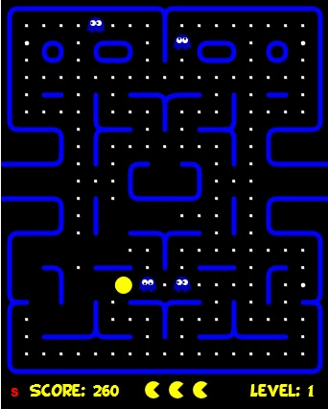
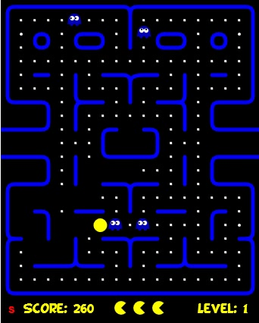
ghostX: [80cm,100cm,51cm,101cm]
[80cm,100cm,50cm,100cm]
[79cm,100cm,49cm,99cm]
ghostY: [159cm,21cm,10cm,160cm]
[160cm,20cm,10cm,160cm]
[160cm,19cm,10cm,160cm]
ghostDirection: [1,0,2,2]
[1,0,2,2]
[2,0,2,2]
ghostEatable: [1,1,1,1]
[1,1,1,1]
[1,1,1,1]
ghostEaten: [0,0,0,0]
[0,0,0,0]
[0,0,0,0]
pacManX: 64cm
66cm
68cm
pacManY: 160cm
160cm
160cm
NewPacManDir: 3
NewPacManDir: 3
NewPacManDir: 3

Slide 13
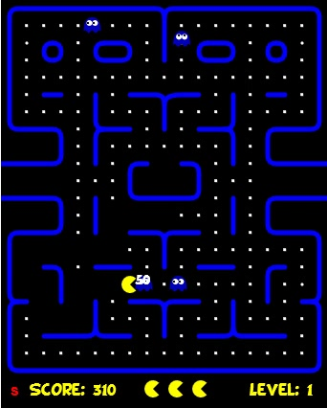
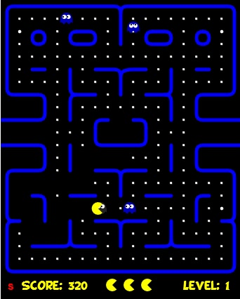

ghostX: [78cm,100cm,48cm,98cm]
[74cm,100cm,47cm,97cm]
[70cm,100cm,46cm,96cm]
ghostY: [160cm,18cm,10cm,160cm]
[160cm,17cm,10cm,160cm]
[160cm,16cm,10cm,160cm]
ghostDirection: [2,0,2,2]
[2,0,2,2]
[2,0,2,2]
ghostEatable: [0,1,1,1]
[0,1,1,1]
[0,1,1,1]
ghostEaten: [1,0,0,0]
[1,0,0,0]
[1,0,0,0]
pacManX: 70cm
72cm
74cm
pacManY: 160cm
160cm
160cm
NewPacManDir: 3
NewPacManDir: 3
NewPacManDir: 3

Slide 14
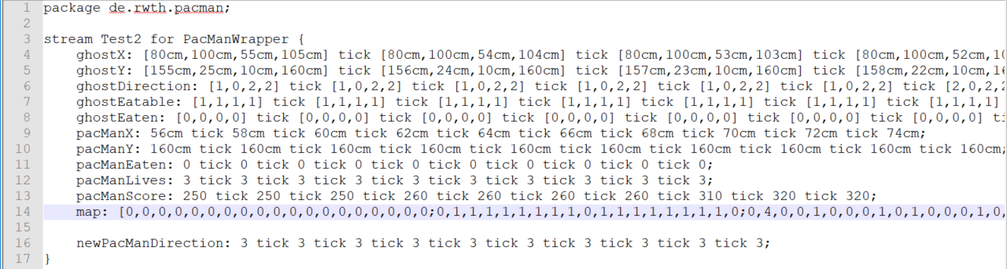

Slide 15
Test 4
PacMan prefers going to biscuit

Slide 16
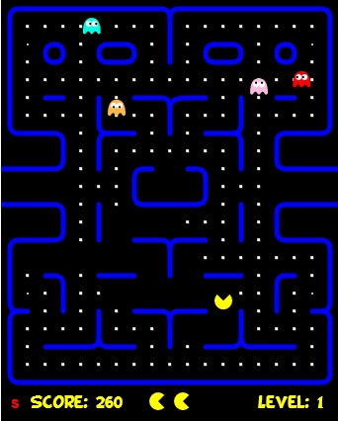
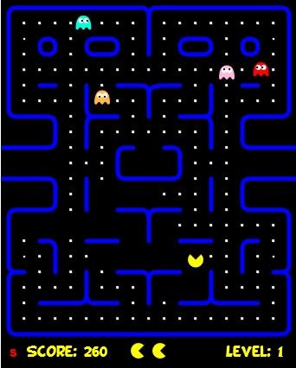

ghostX: [46cm,164cm,140cm,60cm]
[48cm,162cm,140cm,60cm]
[50cm,160cm,140cm,60cm]
ghostY: [10cm,40cm,44cm,56cm]
[10cm,40cm,42cm,58cm]
[10cm,40cm,40cm,60cm]
ghostDirection: [3,2,0,1]
[3,2,0,1]
[3,2,0,1]
pacManX: 120cm
120cm
120cm
pacManY: 164cm
162cm
160cm
NewPacManDir: 0
NewPacManDir: 0
NewPacManDir: 0

Slide 17
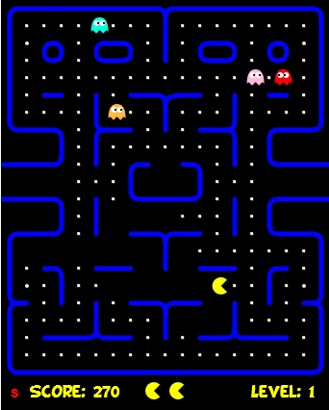
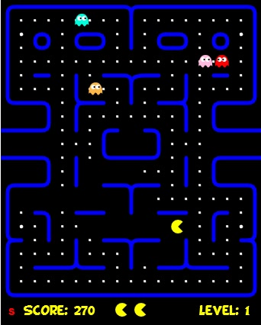
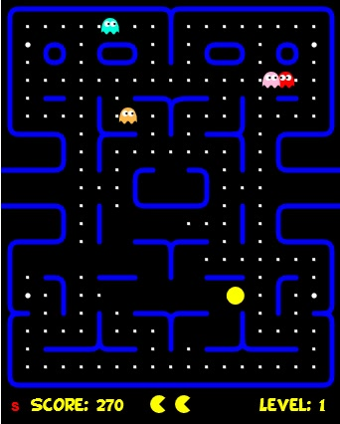
[52cm,158cm,142cm,62cm]
[54cm,156cm,144cm,64cm]
[56cm,154cm,146cm,66cm]
[10cm,40cm,40cm,60cm]
[10cm,40cm,40cm,60cm]
[10cm,40cm,40cm,60cm]
[3,2,3,3]
[3,2,3,3]
[3,2,3,3]
122cm
124cm
126cm
160cm
160cm
160cm
NewPacManDir: 3
NewPacManDir: 3
NewPacManDir: 3

Slide 18
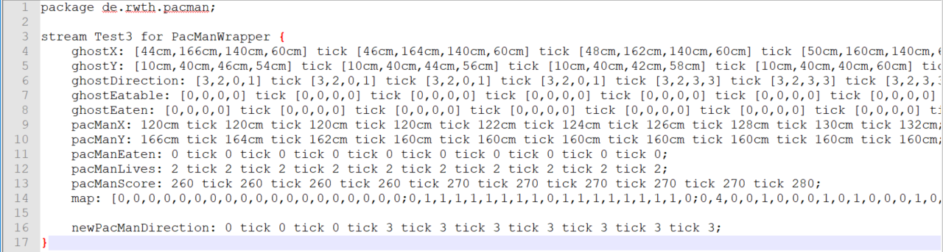

Slide 19
Test 5
PacMan prefers a pill over a biscuit

Slide 20
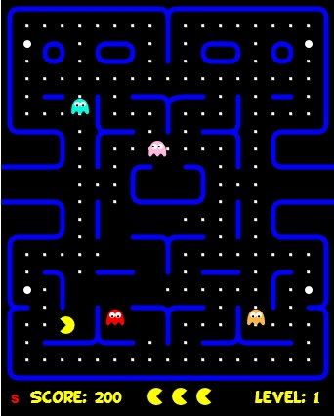
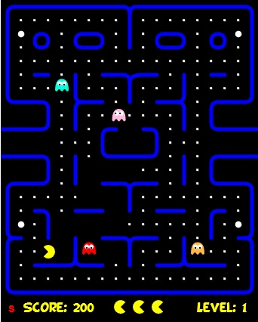
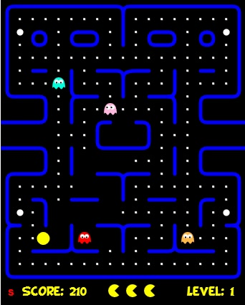
pacManX: 32cm
30cm
28cm
pacManY: 180cm
180cm
180cm
NewPacManDir: 2
NewPacManDir: 2
NewPacManDir: 2

Slide 21
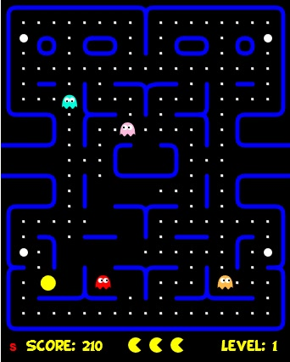
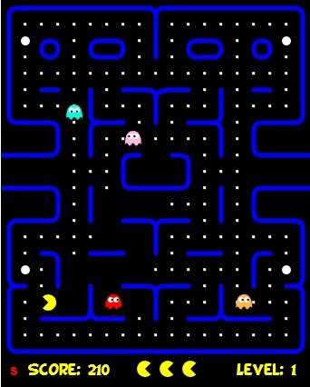
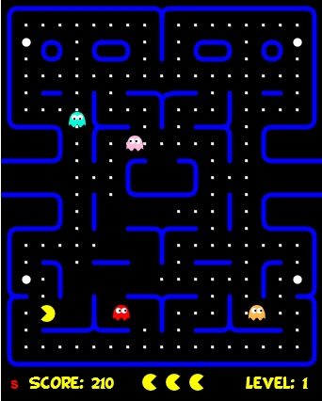
26cm
24cm
22cm
180cm
180cm
180cm
NewPacManDir: 2
NewPacManDir: 2
NewPacManDir: 2

Slide 22
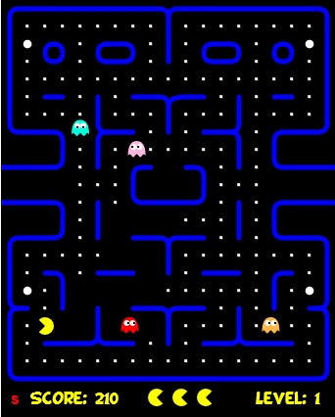
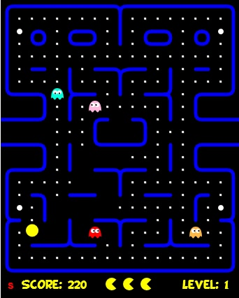
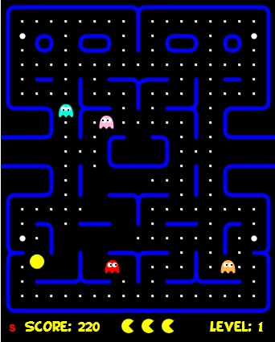
20cm
20cm
20cm
180cm
178cm
176cm
NewPacManDir: 2
NewPacManDir: 0
NewPacManDir: 0

Slide 23
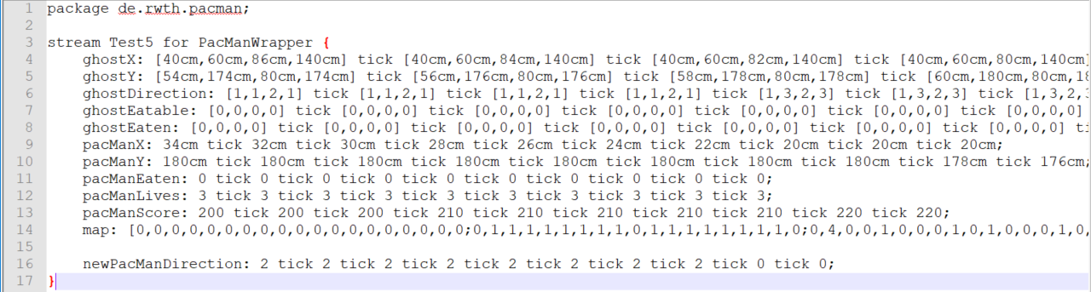
Stream Test

