Slide 1
Modelling Super Mario in EmbeddedMontiArc
Presentation
Philipp Haller
Software Engineering
RWTH Aachen
http://www.se-rwth.de/
Notes:
Nicht löschen: Vorlage V32

Slide 2
Structure
1.
Motivation
2.
Game
3.
Simulator
4.
Model
5.
Problems & Conclusion

Slide 3
Motivation
Autonomous Vehicles will play a big role in our future
Robots
Cars
Importance of DSLs
Automization
Control structures
EmbeddedMontiArc DSL for Cyber-Physical Systems
Component and Connectors

Slide 4
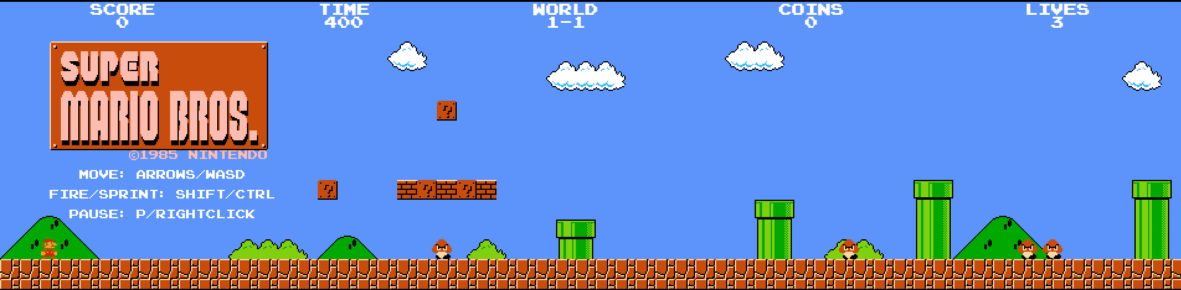
The Game
Super Mario Bros
Developed by Nintendo in 1985
HTML5 / JavaScript rewrite by Josh Goldberg

Slide 5
Simulator
Data Structures
FSM.GroupHolder.groups.
Character
Scenery
Solids
Interaction – Simulating key presses
Direction (left / right)
Jump (up)
Crouch (down)
Cyclic Data Extraction, Execution and Simulation of input
Notes:
20Hz

Slide 6
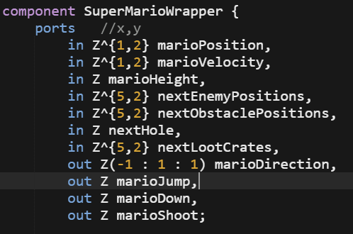
Simulator - Simplification

Slide 7
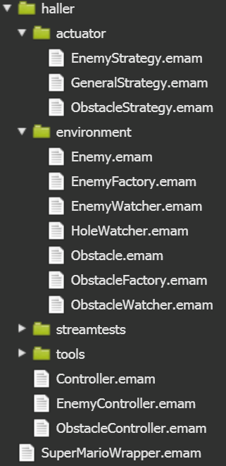
Modelling
Actuator Package
Different Strategies
Environment Package
Enemies
Obstacles
Hole
Tools Package
GetVelocity
Or
Controller
EnemyController
ObstacleController

Slide 8
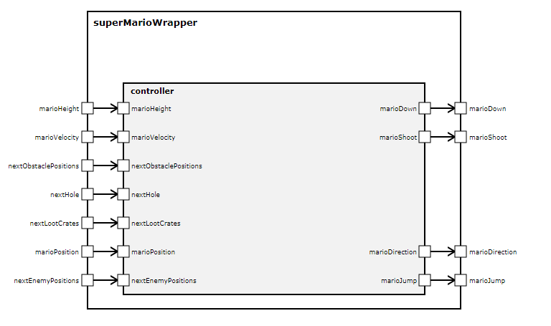
Modelling - Wrapper

Slide 9
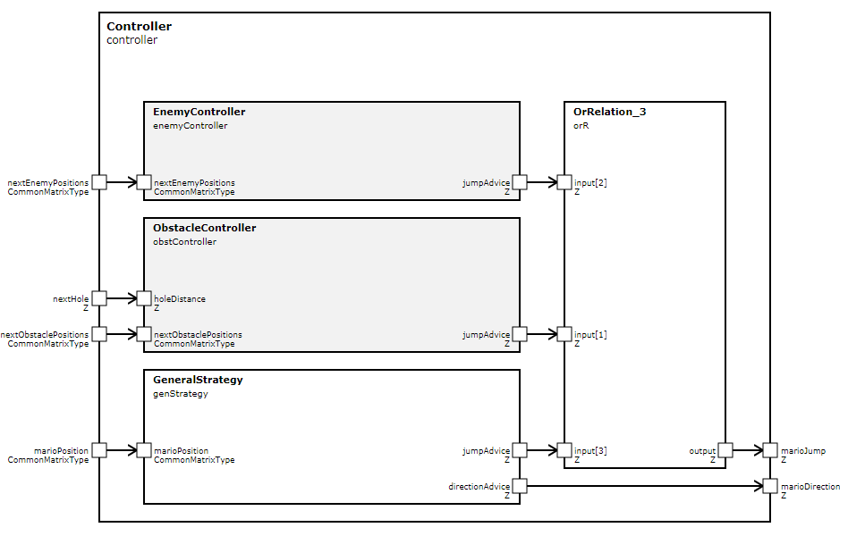
Modelling – Controller

Slide 10
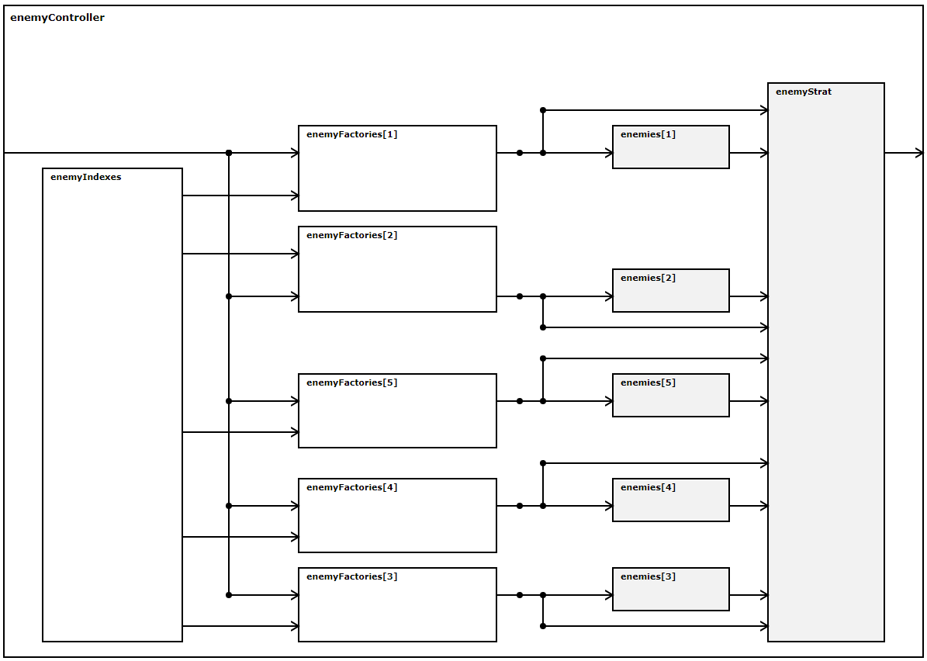
Modelling – EnemyController
Notes:
In den Enemies werden noch zusätzlich Geschwindigkeiten zur Richtungsbestimmung errechnet
Obstacle Controller sehr ähnlich, bis darauf das keine Geschwindigkeiten errechnet werden.

Slide 11
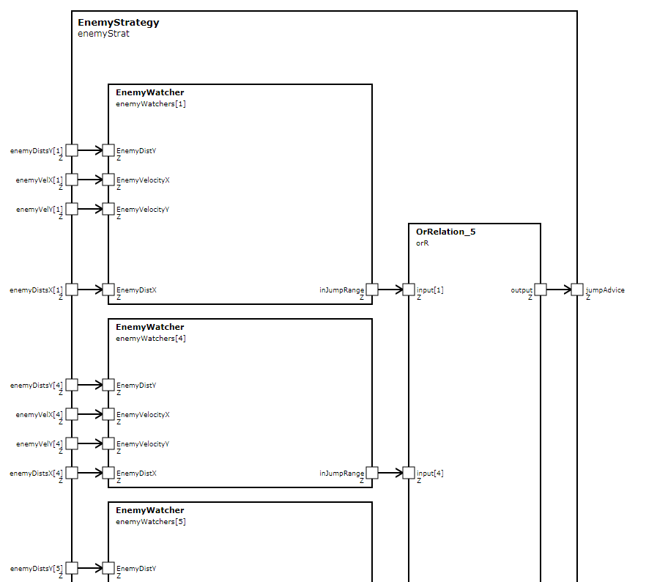
Modelling – EnemyStrategy

Slide 12
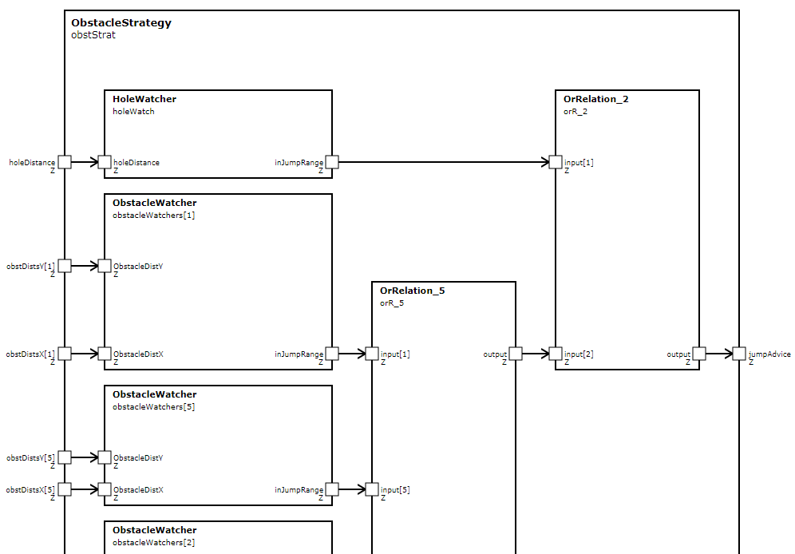
Modelling – ObstacleStrategy

Slide 13
Problems & Conclusion
Language is easy to use and understand
Good visualization of model hierarchy
Error finding is a tedious process
Small errors like typos or wrong connections are hard to find
CoCo and console errors aren‘t displayed in the IDE
Missing CoCos
Wrong naming
„In“ port connected to another „in“ port
Occasionally “wrong” models can only be detected in c-code.
IDE does not save when it says it does

Slide 14
Thank you for your attention!

Slide 15
Modelling Super Mario in EmbeddedMontiArc
Live Demo
Philipp Haller
Software Engineering
RWTH Aachen
http://www.se-rwth.de/
Notes:
Nicht löschen: Vorlage V32

Slide 16
Structure
1.
Showcase of current level solving
2.
Taking an alternative route
3.
Problems on the way
4.
Modelling
5.
Problems & Conclusion
Notes:
2. Making a small change in the model to see an alternative level route
3. We will then see, that we need to alter the model
4. Actual modeling
5. ?

Slide 17
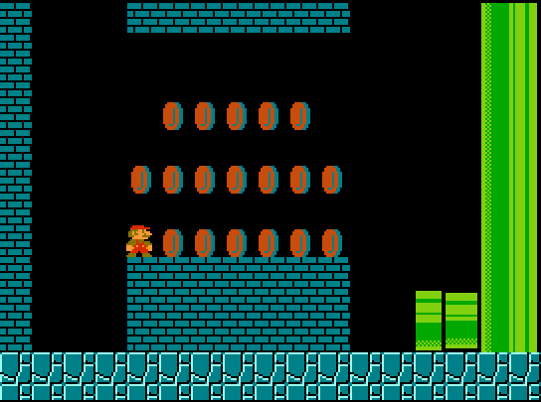
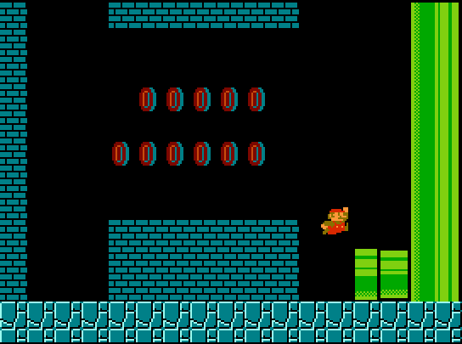
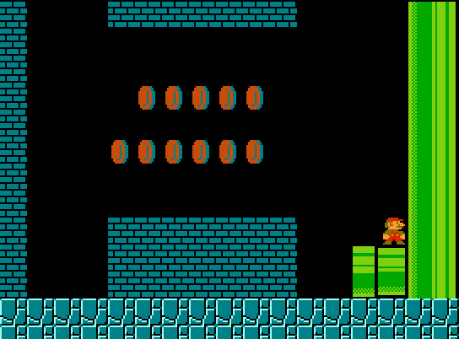
Live Demo

Slide 18
Live Demo

