Slide 1

Aachen, 17. May 2018
Chair of Software Engineering
RWTH Aachen

Slide 2






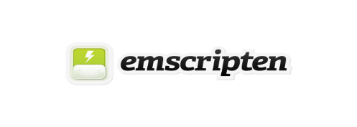



Language Integration (Current State)
System-Provided
Process
Developer-Provided
pom.xml
Calls MontiCore
Replaces Java with C++
Calls AntLR C++ Generator
Grammar.mc4
Runs Docker Container
Generates .g4
Syntax Validation
Generator
Gluecode
Runtime
Outline
Generates Parser
Makefile
Runtime
Generates
WebAssembly
Syntax Highlighting
Included in Plugin
Plugin

Slide 3
Language Integration (Future State)
System-Provided
Process
Developer-Provided
Generator
Grammar.mc4
Generates .g4
Syntax Validation
Generator
Generates Parser
Outline
Runtime
Generated
Gluecode
Runtime
Generates
WebAssembly
Syntax Highlighting
Included in Plugin
Plugin

Slide 4
Language Integration (Further in the Future State)
System-Provided
Process
Developer-Provided
Generator
Grammar.mc4
Generates .g4
Syntax Validation
Outline
Generator
Generates Parser
Runtime
Generated
Generates
WebAssembly
Runtime
Syntax Highlighting
Included in Plugin
Plugin

Slide 5
Language Integration (Might Never Happen Final State)
System-Provided
Process
Developer-Provided
Generator
Grammar.mc4
Generates .g4
Syntax Validation
Outline
Generator
Generates Parser
Runtime
Generated
Generates
WebAssembly
Autocompletion
Runtime
Jump To Definition
Syntax Highlighting
Included in Plugin
Plugin

