Slide 1
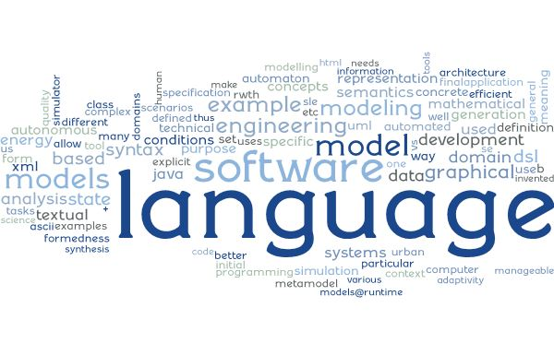
Software Language Engineering Language Characteristics (“Steckbrief”) for EmbeddedMontiArcDL
NN, NN, …
Software Engineering RWTH Aachen University
http://www.se-rwth.de/
Farbe!
Notes:
((Nicht löschen: V27 Sonderform für Script))

Slide 2
Language/Tool at a Glance
Name: EmbeddedMontiArcDL
Developed by: Thomas Timmermanns
Based on: -
Purpose of the language / tool:
Integrates CNNArch and MontiMath into EmbeddedMontiArc as implementation languages
Contains generator which combines CNNArch and MontiMath
Generator uses configuration language CNNTrain to get training parameters for a neural network constructed with CNNArch

Slide 3
Technical Briefing
Can be found in: github:
https://github.com/EmbeddedMontiArc/EmbeddedMontiArcDL
Open accessible: Yes
MC version: 4.5.4 (on April, 11th, 18)
Uses: CNNArch, CNNTrain, MontiMath, EMAM2CPP,
EmbeddedMontiArcBehavior, EmbeddedMontiArcMath
Current state:
Stable

Slide 4
Language Details (1: Syntax)
Grammars: EMADL.mc4
#of Nonterminals: 3
state of grammar: stable
Most interesting nonterminals: BehaviorEmbedding
Comments:
Extends EmbeddedMontiArcBehavior, CNNArch and MontiMath
Very simple grammar

Slide 5
Language Details (2: CoCo’s)
#of coco’s: 2
state of coco: stable
Cocos explained here: not yet documented
Cocos implemented here: ./src/main/java/de/monticore/lang/monticar/emadl/_cocos/
Comments:
Uses additionally cocos of EmbeddedMontiArc, CNNArch, MontiMath and CNNTrain

Slide 6
Language Details (3: Symbols)
#of Symbol-creating nonterminals: 1
#of Symbol-Kinds: 1
List of nonterminals creating symbols: Symbol-Kind:
EMADLCompilationUnit EMADLCompilationUnitKind
Comments:
Uses nonterminals and symboltable creators of EmbeddedMontiArc, CNNArch and MontiMath
Nonterminal BehaviorEmbedding produces either the nonterminal Architecture (with ArchitectureSymbol) of CNNArch or MathStatements (with MathStatementsSymbol) of MontiMath

Slide 7
Language Details (4: Scopes)
#of Scope-creating nonterminals: 1
#of Scopes: 1
List of nonterminals with scopes: Their function:
Artifact Scope artifact name
EMADLCompilationUnit contains EMACompilationUnit
Comments:
Uses scopes of EmbeddedMontiArc, CNNArch and MontiMath
ArchitectureSymbol of CNNArch is added into the scope of the ExpandedComponentInstanceSymbol and the ComponentSymbol
MathStatementsSymbol is only added into the scope of the ComponentSymbol

Slide 8
Backend: Functionality
What functions are offered?
Complete component generator for implementation languages CNNArch and MontiMath
Uses EMAM2CPP generator for math language and component interfaces
Generates C++ component and predictor for a CNNArch-network
Generates Python code for a separate trainer of the neural network which has to be called before deployment
Generated code requires MxNet
See thesis: Modeling Languages for Deep Learning based Cyber-Physical Systems

Slide 9
Plans for Tools and Language
Future of the language/tool?

