Slide 1
Software architectures of distributed multi-user simulation of autonomous driving vehicles
Petyo Ilov
Master Thesis
Chair of Software Engineering
RWTH Aachen

Slide 2
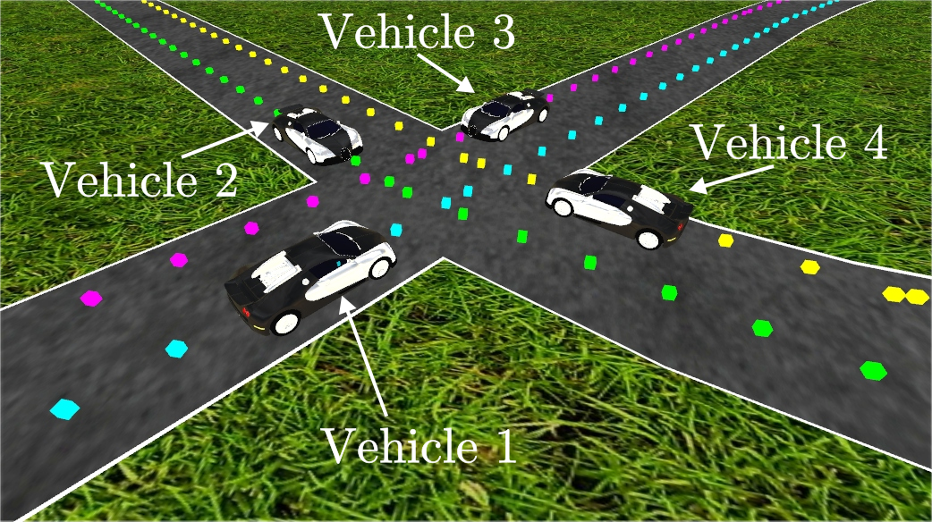
Simulator: Overview
Aggregate of components:
  sensors, controllers, simulator, co-simulators, etc.
Provides extension points for additional simulators
Simulation and visualization split in 2 separete applications

Slide 3
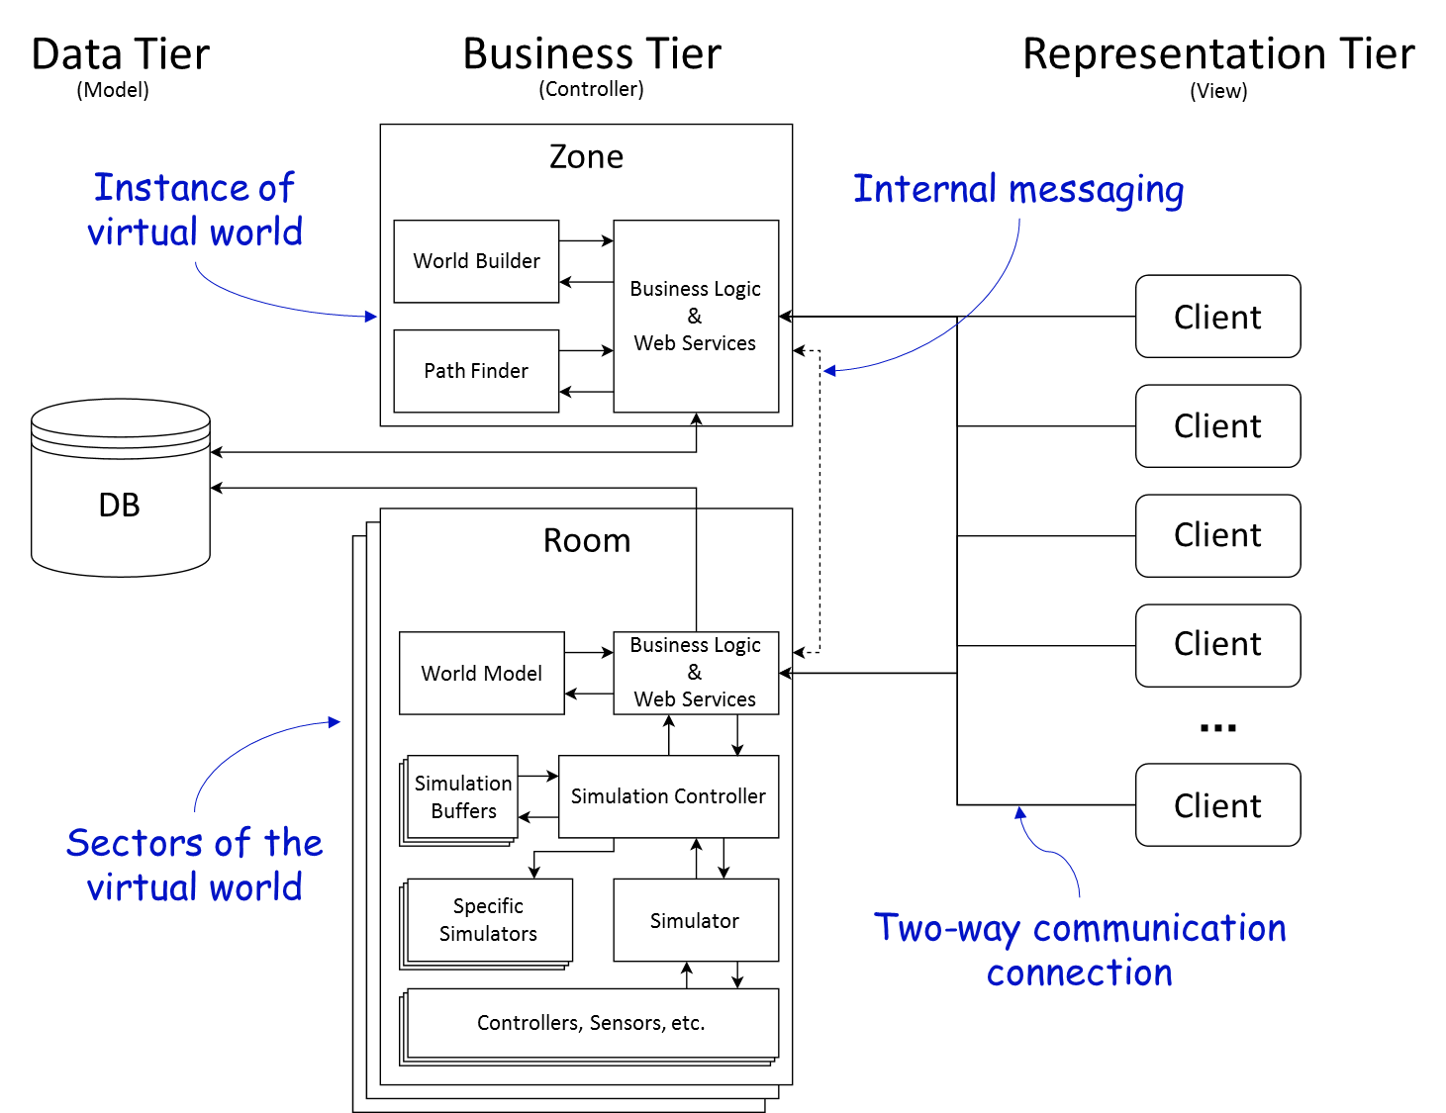
Architecture: Overview

Slide 4
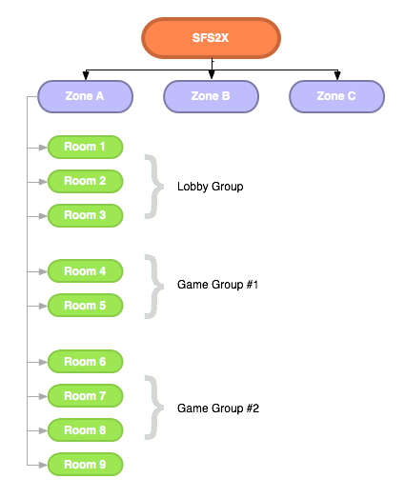
Architecture: Extension scopes
SmartFoxServer
Instances of
games, virtual worlds, etc
Game rooms
(e.g. sectors)

Slide 5
Architecture: Benefits
Client/Server architecture:
  Single authority
  Consistency
  Security
Three-tier architecture and MVC pattern
  Separation of Concerns
  Loose coupling
  Scalability
SmartFoxServer architecture
  Scope management
  Segregation
  Hot-deployment

Slide 6
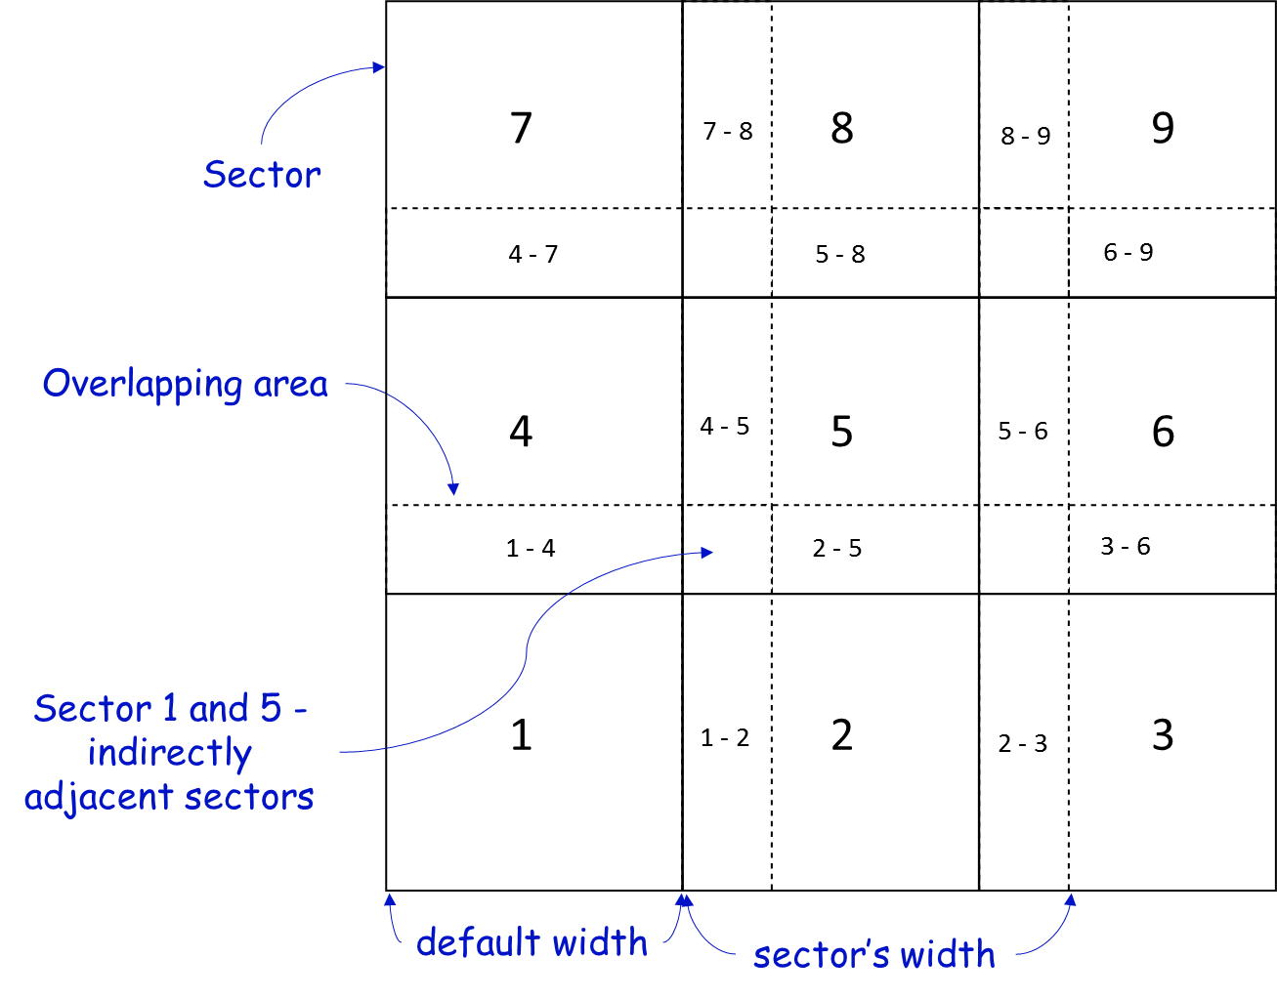
Map splitting approach: Overview

Slide 7
Map splitting approach: Benefits
Handling of broad virtual world
Improved scalability
Segregation
Eased synchronization, due to overlapping areas

Slide 8
Path finding: Prerequisites
Preprocessing of entry/exit nodes for all sectors
Preprocessing of path matrices for all sectors
Querying paths for multiple sectors, source and target nodes with a single SQL query
  SELECT * FROM path WHERE sector_id IN (?)
  AND source IN (?) AND target IN (?);
Tracking visited sectors
Sharing database connection for better performance

Slide 9
Path finding: Workflow
Search for direct paths between source and target nodes
  If such exist, return the shortest path
Else find all exit nodes of current sector(s)
Find all paths from source node to exit nodes
Repeat step 1) using all the exit nodes from step 3) as source nodes
  If there are returned paths, find the shortest path from the result of step 3), which has a target node equal to the source node of the first path of the returned list of paths.
    Prepend this path to the list of returned paths and return that list.
  Otherwise return empty list.

Slide 10
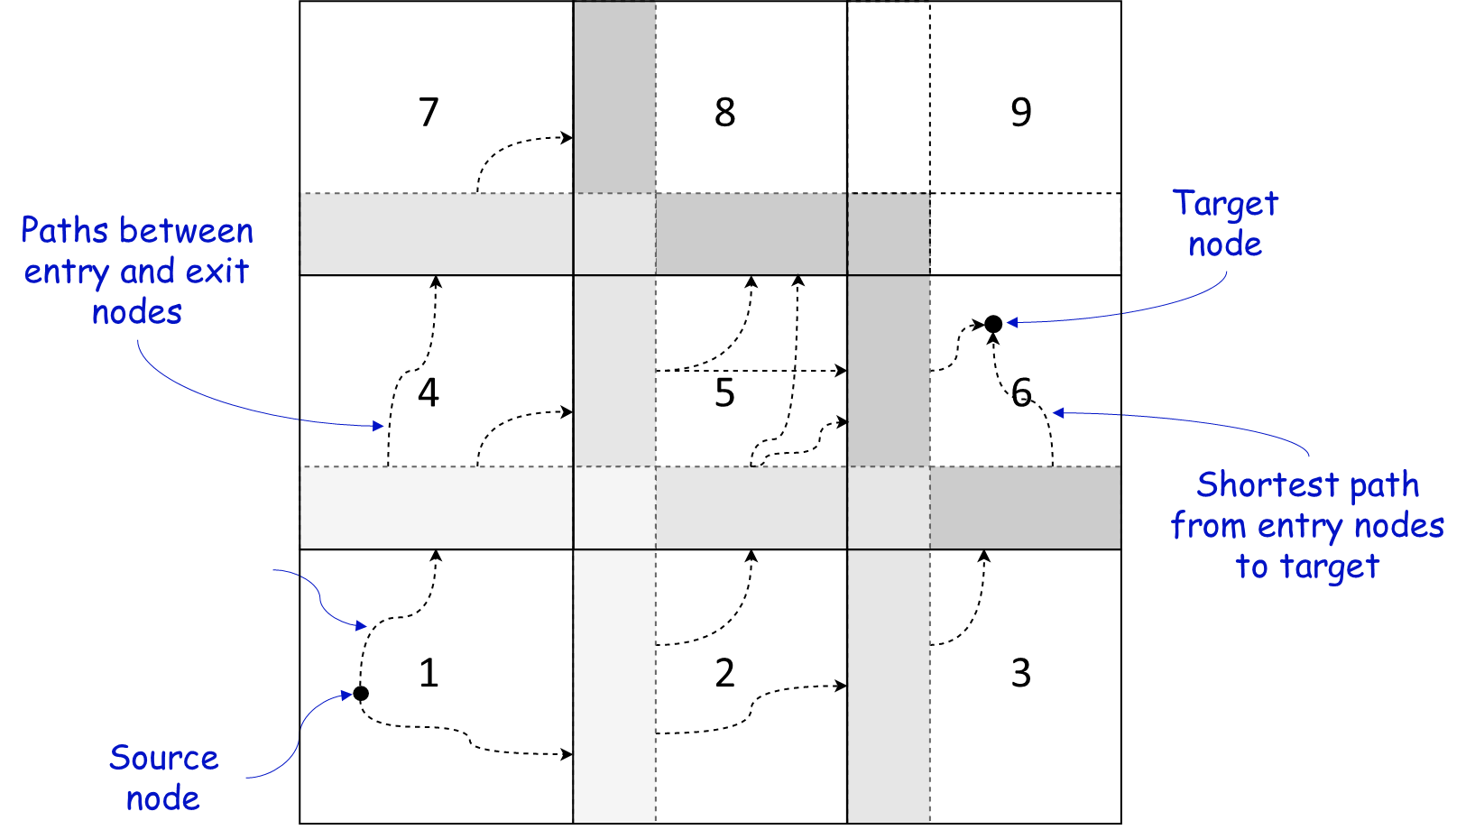
Path finding: Sample
Paths from
source to exit
nodes

Slide 11
Simulation
Loose coupling between WebServices and Simulator
Allows for additional simulators to work with the main simulator
Mediator in means of simulation buffers
  Independent visualization of simulation and vice versa
Loose coupling between simulators of different sectors
Addition/removal of vehicles during simulation
Easy and fast to obtain virtual world data
Persistent scenarios
F_{n}
F₁
Frame Data
Frame Data
Blocking Queue (Buffer)

Slide 12
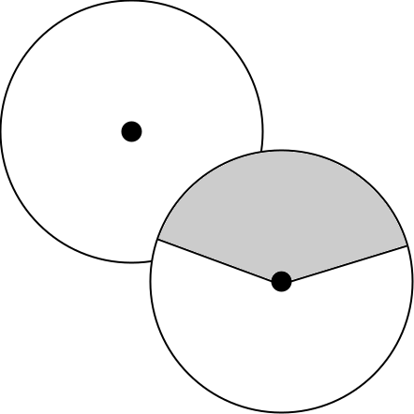
Future work
Area of Interest
Saving simulation frames into permanent mediator, e.g. files, database
Visualizing simulations from archive
Further integration for model testing
View region
Area of Interest
Vehicle

Slide 13
Conclusion
Scalable architecture
Distributed simulation
Persistent map data and scenarios
Optimized map data loading and path finding
Automated deployment of code deliverables
Allows for hot-deployment, thus automatic deployment of new versions in run-time
Cross-platform server support
Configurable web-server and simulator
Hosted client application, thus easy to update
Web-based client application, thus cross-platform

Slide 14
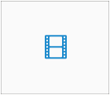
Demo

Slide 15
End
Thank you for your attention.

