Slide 1
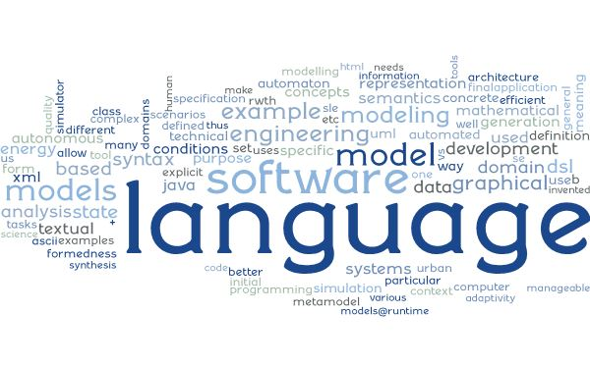
Software Language Engineering Language Characteristics (“Steckbrief”) for EmbeddedMontiArcDL
NN, NN, …
Software Engineering RWTH Aachen University
http://www.se-rwth.de/
Farbe!
Notes:
((Nicht löschen: V27 Sonderform für Script))

Slide 2
Language/Tool at a Glance
Name: EmbeddedMontiArcDL
Developed by: Thomas Timmermanns
Based on: -
Purpose of the language / tool:
Integrates CNNArch and MontiMath into EmbeddedMontiArc as implementation languages
Contains generator which combines CNNArch and MontiMath
Generator uses configuration language CNNTrain to get training parameters for a neural network constructed with CNNArch

Slide 3
Technical Briefing
Can be found in: github:
https://github.com/EmbeddedMontiArc/EmbeddedMontiArcDL
Open accessible: Yes
MC version: 4.5.4 (on April, 11th, 18)
Uses: CNNArch, CNNTrain, MontiMath, EMAM2CPP,
EmbeddedMontiArcBehavior, EmbeddedMontiArcMath
Current state:
In development
Issues: CNNTrain not yet integrated, parameters do not work with CNNArch, three-dimensional matrices are not implemented in MontiMath/EMAM2CPP but currently required by CNNArch

Slide 4
Language Details (1: Syntax)
Grammars: EMADL.mc4
#of Nonterminals: 3
state of grammar: stable
Most interesting nonterminals: BehaviorEmbedding
Comments:
Extends EmbeddedMontiArcBehavior, CNNArch and MontiMath
Very simple grammar

Slide 5
Language Details (2: CoCo’s)
#of coco’s: 2
state of coco: stable
Cocos explained here: not yet documented
Cocos implemented here: ./src/main/java/de/monticore/lang/monticar/emadl/_cocos/
Comments:
Uses additionally cocos of EmbeddedMontiArc, CNNArch, MontiMath and CNNTrain

Slide 6
Language Details (3: Symbols)
#of Symbol-creating nonterminals: 1
#of Symbol-Kinds: 1
List of nonterminals creating symbols: Symbol-Kind:
EMADLCompilationUnit EMADLCompilationUnitKind
Comments:
Uses nonterminals and symboltable creators of EmbeddedMontiArc, CNNArch and MontiMath
Nonterminal BehaviorEmbedding produces either the nonterminal Architecture (with ArchitectureSymbol) of CNNArch or MathStatements (with MathStatementsSymbol) of MontiMath

Slide 7
Language Details (4: Scopes)
#of Scope-creating nonterminals: 1
#of Scopes: 1
List of nonterminals with scopes: Their function:
Artifact Scope artifact name
EMADLCompilationUnit contains EMACompilationUnit
Comments:
Uses scopes of EmbeddedMontiArc, CNNArch and MontiMath

Slide 8
Backend: Functionality
What functions are offered?
Complete component generator for implementation languages CNNArch and MontiMath
Uses EMAM2CPP generator for math language and component interfaces
Generates C++ component and predictor for a CNNArch-network
Generates Python code for a separate trainer of the neural network which has to be called before deployment
Generated code requires MxNet
See thesis (not yet finished)

Slide 9
Plans for Tools and Language
Future of the language/tool?
Fix current issues
Evaluation of the generated code

