Slide 1
Improvements to OCL Implementation within the Monti-Core workbench
Ferdinand Mehlan
Seminar
am Lehrstuhl für Software Engineering
RWTH Aachen

Slide 2
Introduction to OCL
Object Constraint Language (OCL)
Part of UML
Define invariants on runtime objects
Uses information of classdiagrams
Formulated on class-level,
semantics applied on object-level
CD
Time
bool lessThan(Time other)
startTime
closeTime
OCL
context Auction a inv:
a.startTime.lessThan(a.closeTime)
Auction
String name

Slide 3
Outline
1.
Improvements: Grammar
2.
Improvements: Types in OCL
3.
Online Tool

Slide 4
Improvements: Grammar
MontiCore language workbench
For Domain Specific Languages (DSLs)
Generate from Grammar (Parser, AST, Symboltable, Tools)
Minor Improvements:
  Don‘t parse empty strings
  Fix disparities to specification
grammar
OCL
grammar OCL {
CompilationUnit =
("package" package:(Name || ".")+ ";")?
(ImportStatement)*
OCLFile;
// ...
}
package example.ocl;
import example.cd.Auction;
ocl myOCLDefs{
// ...
}

Slide 5
Improvements: Grammar
Expressions
  Rules that can be nested
  E.g. expr + expr , !expr
MontiCore 3.x
  No left recursion
  Nodes dependent on
  each other
  Changes break tools
  Strict heirarchy
  Specific Nodes for
  different expressions
grammar
grammar OCL {
PlusMinusExpr implements Expression =
left:PlusMinusExpr operator:["+" | "-"] right:PlusMinusExpr
|
("(" paren: PlusMinusExpr ")" | nextHigherPrec: MultDivModExpr)
;
MultDivModExpr implements Expression =
left:MultDivModExpr operator:["*" | "/" | "%"] right:MultDivModExpr
|
("(" paren: MultDivModExpr ")" | nextHigherPrec:LogicalORExpr)
;
}

Slide 6
Improvements: Grammar
MontiCore 4.x
  Direct left recursion
  Cleaner grammar
  All expressions in one rule
  Not extensible
  No visitor pattern on
  different expressions for tools
grammar
grammar OCL {
Expression =
Expression operator:["*" | "/" | "%"] Expression
|
Expression operator:["+" | "-"] Expression;
}

Slide 7
Improvements: Grammar
MontiCore 4.5.3+
  Indirect left recursion
  Easy to read
  Priorities for expressions
  Visitor pattern on each
  node for tools
  Extensible
grammar
grammar OCL {
interface Expression;
PlusExpression implements Expression<20> =
Expression "+" Expression;
MinusExpression implements Expression<20> =
Expression "-" Expression;
MultExpression implements Expression<30> =
Expression "*" Expression;
DivExpression implements Expression<30> =
Expression "/" Expression;
}

Slide 8
Improvements: Types in OCL
1.
Improvements: Grammar
2.
Improvements: Types in OCL
3.
Online Tool

Slide 9
Types in OCL
OCL a type-less language
Uses CD information to navigate
Concept: Automatically check correct navigation
OCL
context Auction a inv:
let
b = a.bidder; // Set<Person>
m = b.message; // List<Message>
t = {mess.time | mess in m}; // Collection<Time>
in
b == this.message

Slide 10
Types in OCL
CD
Auction
Person
…
* participants *
…
-int numberOfBids
#String auctionName
auctions
bidder
#String name
-boolean isActive
{ordered} *
1
Message
Company
…
…
{ordered} *
#Time time
#String name
OCL
context Auction a inv:
let
b = a.bidder; // Set<Person>
m = b.message; // List<Message>
t = {mess.time | mess in m}; // Collection<Time>
in
b == this.message

Slide 11
Types in OCL
Navigation with the point operator using:
  Association names, role names, class names, class fields
  Specification mode (arrow direction is ignored)
  Implicit variables (this, super)
  Implicit flattening
OCL
context Auction a inv:
a.participants.name != Set{}
context Auction a inv:
a.bidder.name != Set{}
context Auction a inv:
a.person.name != Set{}

Slide 12
Types in OCL
CD
Auction
Person
…
* participants *
…
-int numberOfBids
#String auctionName
auctions
bidder
#String name
-boolean isActive
{ordered} *
1
Message
Company
…
…
{ordered} *
#Time time
#String name
OCL
context Auction a inv:
a.participants.name != Set{}
context Auction a inv:
a.bidder.name != Set{}
context Auction a inv:
a.person.name != Set{}

Slide 13
Types in OCL
Build OCL symboltable and infer types
Symbol OCLVariable for variable name and type
Symbol CDType for type
Automatically resolve types from CD symboltable
  Check for illegal navigation
¹ | package ocl;
² | import cd.AuctionCD;
³ | ocl myRule {
⁴
⁵ | context Auction a inv:
⁷ | let
⁸ | m1 = a.message;
⁹ | m2 = List{ m | m in a.bidder.message } ;
¹⁰ | in
¹¹ | m1 == m2
¹³ | }
OCLVariable
CDType

Slide 14
Types in OCL
Inferring type of m2:
  Infer type of m
  Infer type of a.bidder.message
M2 is of type List<Message>
¹ | package ocl;
² | import cd.AuctionCD;
³ | ocl myRule {
⁴
⁵ | context Auction a inv:
⁷ | let
⁸ | m1 = a.message;
⁹ | m2 = List{ m | m in a.bidder.message } ;
¹⁰ | in
¹¹ | m1 == m2
¹³ | }
OCLVariable
CDType

Slide 15
Online Tool
1.
Improvements: Grammar
2.
Improvements: Types in OCL
3.
Online Tool

Slide 16
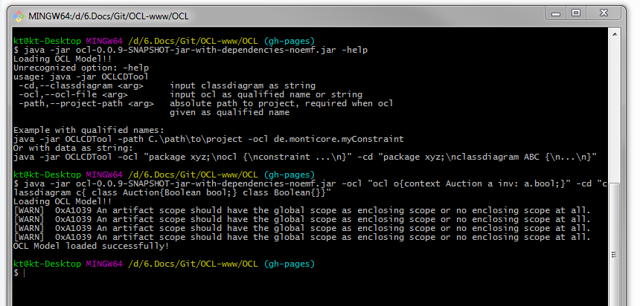
Online Tool
CLI Tool to load and verify correct OCL
Idea: Integrate tool into online interface
CheerpJ by learningTech: Java -> JS transpiller
Online IDE by Jean-Marc Ronck

Slide 17
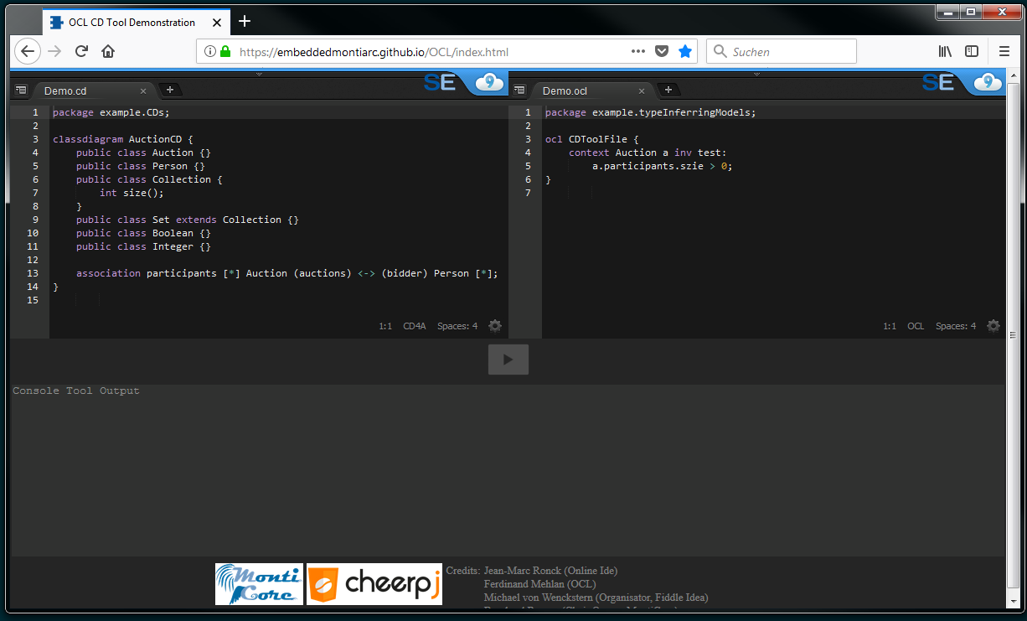
Online Tool
https://embeddedmontiarc.github.io/OCL/index.html

Slide 18
Thank you for your attention!

