Slide 1
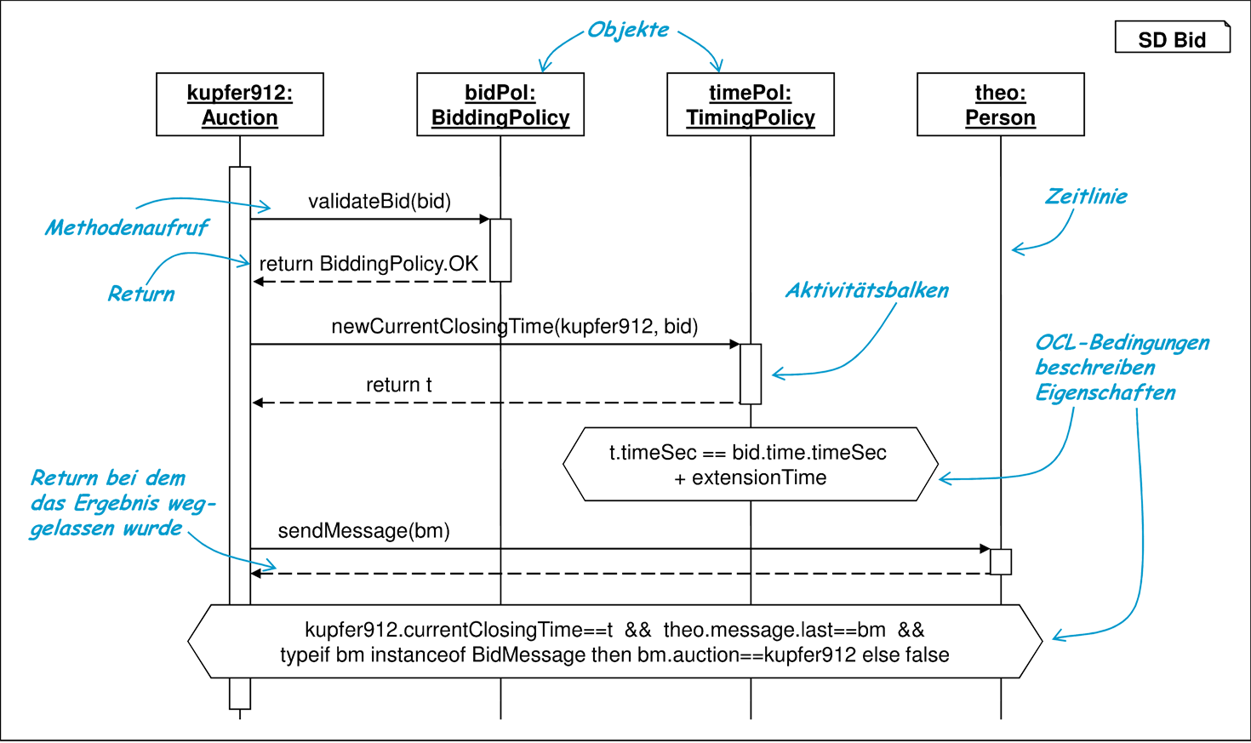
SD-Language
Sequence Diagram Language based on MontiCore
Christian Broering
Brian Sinkovec
Christian Volkmann
16.07.2020

Slide 2
Sequence Diagram Overview

Slide 3
Sequence what?
* taken from B.Rumpe : Modellierung mit UML (http://mbse.se-rwth.de/book1/)

Slide 4
Grammar

Slide 5
SequenceDiagram, SDBody, SDElement
1
2
3
4
5
6
7
8
9
10
11
12
13
symbol scope SequenceDiagram =
Stereotype? SDModifier*
“sequencediagram” Name “{“
SDObject*
SDBody
“}”
;
scope SDBody = SDElement*;
interface SDElement;
interface SDModifier;
MC
1
2
3
4
5
6
7
complete sequencediagram MySD {
// SD objects ...
// SD body ...
}
SD

Slide 6
SDObject
1
2
3
4
5
6
7
8
9
// ...
myObj : MyType;
yourObj;
visible objWithMod;
// ...
SD
1
2
3
4
SDObject implements Variable =
Stereotype? SDModifier*
Name (“:” MCObjectType)? “;”
;
MC

Slide 7
SDInteraction, SDSendMessage
1
2
3
4
5
6
7
8
9
10
11
12
13
14
15
interface SDInteraction
extends SDElement;
SDSendMessage
implements SDInteraction =
SDSource? “->” SDTarget? “:”
SDAction (“;” | SDActivityBar)
;
interface SDSource;
interface SDTarget;
interface SDAction;
SDActivityBar = “{“ SDElement* “}”;
MC
1
2
3
4
5
6
7
8
9
// ...
a -> b : foo();
a -> b : bar() {
b -> c : foobar();
}
// ...
SD

Slide 8
SDNew, SDReturn, SDThrow
1
2
3
4
5
6
7
8
9
10
11
12
13
14
SDNew implements
SDInteraction, Variable =
SDSource? “->”
declarationType:MCObjectType Name
“=“ “new”
initializationType:MCObjectType
Arguments (“;” | SDActivityBar)
;
SDReturn implements SDAction =
(“return” Expression?)?;
SDThrow implements SDAction =
“throw” MCObjectType Arguments?;
MC
1
2
3
4
5
6
7
8
9
// ...
a -> B b = new B();
a <- b : return;
a <- c : throw Exception();
// ...
SD

Slide 9
SDIncompleteExpression, SDCondition, SDVariableDeclaration
1
2
3
4
5
6
7
8
9
10
SDIncompleteExpression implements
Expression = “...”;
SDCondition implements SDElement =
key(“assert”) Expression “;”;
SDVariableDeclaration implements
SDElement =
“let” MCType Name “=“
assignment:Expression “;”;
MC
1
2
3
4
5
6
7
8
9
// ...
a -> b : foo(...);
let m = a.bar;
assert m == 2;
// ...
SD

Slide 10
Context Conditions

Slide 11
Different Kinds of Context Conditions
General
Package name matches folder name
File extension is .sd
Modifier
SequenceDiagram is complete, but any object is visible
Interactions
Referenced implies Declared
Return call matches with a previous send call
Interaction has at least on source or target
Static methods are not invoked on objects
Method invoked exists in target type
Objects
every object has a unique name
Naming Conventions
Objects start with lower case
Types start with upper case
Object Construction
Type checks

Slide 12
Type Check of Object Construction (invalid example)
Animal
CD
1
2
3
4
5
6
7
sequencediagram MySD {
z : ZooDB;
z -> Animal d = new Dog();
z -> Animal c = new Plane();
}
Dog
Plane
SD
z:ZooDB
SD
new Dog()
d:Dog
new Plane()
c:Plane

Slide 13
Type Check of Object Construction (invalid example)
Animal
CD
1
2
3
4
5
6
7
sequencediagram MySD {
z : ZooDB;
z -> Animal d = new Dog();
z -> Animal c = new Plane();
}
Dog
Plane
SD
z:ZooDB
SD
new Dog()
d:Dog
new Plane()
c:Plane

Slide 14
Type Check of Object Construction (invalid example)
Animal
CD
1
2
3
4
5
6
7
sequencediagram MySD {
z : ZooDB;
z -> Animal d = new Dog();
z -> Animal c = new Plane();
}
Dog
Plane
SD
z:ZooDB
SD
new Dog()
d:Dog
new Plane()
c:Plane

Slide 15
Return only after method call (valid example)
SD
a:A
b:B
1
2
3
4
5
6
7
sequencediagram MySD {
a : A;
b : B;
a -> b : foo();
a <- b : return;
}
SD
foo()
return

Slide 16
Return only after method call (invalid example)
SD
a:A
b:B
1
2
3
4
5
6
7
sequencediagram MySD {
a : A;
b : B;
// a -> b : foo();
a <- b : return;
}
SD
return

Slide 17
Method Action Valid (valid example)
B
CD
stored as OOTypeSymbol
in symbol table
foo(String s)
1
2
3
4
5
6
7
sequencediagram MySD {
a : A;
b : B;
a -> b : foo();
}
SD
a:A
a:B
SD
foo()

Slide 18
Method Action Valid (invalid example)
B
CD
stored as OOTypeSymbol
in symbol table
1
2
3
4
5
6
7
sequencediagram MySD {
a : A;
b : B;
a -> b : foo();
}
SD
a:A
a:B
SD
foo()

Slide 19
Method Action Valid (invalid example)
B
CD
stored as OOTypeSymbol
in symbol table
foo(String s)
1
2
3
4
5
6
7
sequencediagram MySD {
a : A;
b : B;
a -> b : foo(42);
}
SD
a:A
a:B
SD
foo(42)
int, not a string

Slide 20
Symboltable

Slide 21
Symboltable Data Structure
Two symbol kinds
SequenceDiagramSymbol
VariableSymbol
SequenceDiagramSymbol spans a scope
this scope spans another scope (SDBodyScope)
SD4DGlobalScope
CD
*
SD4DArtifactScope
scope spanning symbol
1
SequenceDiagramSymbol
SDBody scope
1
1
SD4DScope
*
VariableSymbol
* SD4D short for SD4Development

Slide 22
Example – Symboltable
SD Bid
:SequenceDiagramSymbol
OD
kupfer912:Auction
theo:Person
name = „Bid“
scope spanning symbol
new BidMessage(…)
bm:BidMessage
:SD4DScope
name = „Bid“
let int m = theo.message.size
sendMessage(bm)
return

Slide 23
Example – Symboltable
SD Bid
:SequenceDiagramSymbol
OD
kupfer912:Auction
theo:Person
name = „Bid“
scope spanning symbol
new BidMessage(…)
bm:BidMessage
:SD4DScope
name = „Bid“
let int m = theo.message.size
sendMessage(bm)
return

Slide 24
Example – Symboltable
SD Bid
:SequenceDiagramSymbol
OD
kupfer912:Auction
theo:Person
name = „Bid“
new BidMessage(…)
bm:BidMessage
:SD4DScope
name = „Bid“
let int m = theo.message.size
sendMessage(bm)
:VariableSymbol
return
name = „kupfer912“
type = Auction
:VariableSymbol
name = „theo“
type = Person

Slide 25
Example – Symboltable
SD Bid
:SequenceDiagramSymbol
OD
kupfer912:Auction
theo:Person
name = „Bid“
empty name
for body scope
new BidMessage(…)
bm:BidMessage
:SD4DScope
:SD4DScope
name = „Bid“
name = „“
let int m = theo.message.size
sendMessage(bm)
:VariableSymbol
return
name = „kupfer912“
type = Auction
:VariableSymbol
name = „theo“
type = Person

Slide 26
Example – Symboltable
SD Bid
:SequenceDiagramSymbol
OD
kupfer912:Auction
theo:Person
name = „Bid“
empty name
for body scope
new BidMessage(…)
bm:BidMessage
:SD4DScope
:SD4DScope
name = „Bid“
name = „“
let int m = theo.message.size
sendMessage(bm)
:VariableSymbol
return
name = „kupfer912“
type = Auction
:VariableSymbol
name = „theo“
type = Person

Slide 27
Example – Symboltable
SD Bid
:SequenceDiagramSymbol
OD
kupfer912:Auction
theo:Person
name = „Bid“
new BidMessage(…)
bm:BidMessage
:SD4DScope
:SD4DScope
name = „Bid“
name = „“
let int m = theo.message.size
sendMessage(bm)
:VariableSymbol
:VariableSymbol
return
name = „kupfer912“
name = „bm“
type = Auction
type = BidMessage
:VariableSymbol
:VariableSymbol
name = „theo“
name = „m“
type = Person
type = int

Slide 28
DeSer

Slide 29
DeSer in Action
1
2
3
4
5
6
7
8
9
10
11
12
13
14
15
16
17
18
19
20
21
22
{
“kind”: “SD4DArtifactScope”,
“name”: “MySD”,
“sequenceDiagramSymbols”: [
{ “kind”: “SequenceDiagramSymbol”, “name”: “MySD” }
],
“subScopes”: [{
“kind”: “SD4DScope”,
“spanningSymbol”: { “kind”: “SequenceDiagramSymbol”, “name”: “MySD” },
“variableSymbols”: [
{ “kind”: “VariableSymbol”, “name”: “kupfer912”, “type”: “Auction” }
],
“subScopes”: [{
“kind”: “SD4DScope”,
“name”: “”,
“variableSymbols”: [
{ “kind”: “VariableSymbol”, “name”: “bm”, “type”: “BidMessage” },
{ “kind”: “VariableSymbol”, “name”: “m”, “type”: “int” }
]
}]
}]
}
JSON
1
2
3
4
5
6
7
8
9
10
11
sequencediagram MySD {
kupfer912 : Auction;
// ...
kupfer912 -> BidMessage bm =
new BidMessage();
let int m = bm.size;
// ...
}
SD
deserialized
serialized

Slide 30
DeSer in Action
1
2
3
4
5
6
7
8
9
10
11
12
13
14
15
16
17
18
19
20
21
22
{
“kind”: “SD4DArtifactScope”,
“name”: “MySD”,
“sequenceDiagramSymbols”: [
{ “kind”: “SequenceDiagramSymbol”, “name”: “MySD” }
],
“subScopes”: [{
“kind”: “SD4DScope”,
“spanningSymbol”: { “kind”: “SequenceDiagramSymbol”, “name”: “MySD” },
“variableSymbols”: [
{ “kind”: “VariableSymbol”, “name”: “kupfer912”, “type”: “Auction” }
],
“subScopes”: [{
“kind”: “SD4DScope”,
“name”: “”,
“variableSymbols”: [
{ “kind”: “VariableSymbol”, “name”: “bm”, “type”: “BidMessage” },
{ “kind”: “VariableSymbol”, “name”: “m”, “type”: “int” }
]
}]
}]
}
JSON
1
2
3
4
5
6
7
8
9
10
11
sequencediagram MySD {
kupfer912 : Auction;
// ...
kupfer912 -> BidMessage bm =
new BidMessage();
let int m = bm.size;
// ...
}
SD

Slide 31
DeSer in Action
1
2
3
4
5
6
7
8
9
10
11
12
13
14
15
16
17
18
19
20
21
22
{
“kind”: “SD4DArtifactScope”,
“name”: “MySD”,
“sequenceDiagramSymbols”: [
{ “kind”: “SequenceDiagramSymbol”, “name”: “MySD” }
],
“subScopes”: [{
“kind”: “SD4DScope”,
“spanningSymbol”: { “kind”: “SequenceDiagramSymbol”, “name”: “MySD” },
“variableSymbols”: [
{ “kind”: “VariableSymbol”, “name”: “kupfer912”, “type”: “Auction” }
],
“subScopes”: [{
“kind”: “SD4DScope”,
“name”: “”,
“variableSymbols”: [
{ “kind”: “VariableSymbol”, “name”: “bm”, “type”: “BidMessage” },
{ “kind”: “VariableSymbol”, “name”: “m”, “type”: “int” }
]
}]
}]
}
JSON
1
2
3
4
5
6
7
8
9
10
11
sequencediagram MySD {
kupfer912 : Auction;
// ...
kupfer912 -> BidMessage bm =
new BidMessage();
let int m = bm.size;
// ...
}
SD

Slide 32
DeSer in Action
1
2
3
4
5
6
7
8
9
10
11
12
13
14
15
16
17
18
19
20
21
22
{
“kind”: “SD4DArtifactScope”,
“name”: “MySD”,
“sequenceDiagramSymbols”: [
{ “kind”: “SequenceDiagramSymbol”, “name”: “MySD” }
],
“subScopes”: [{
“kind”: “SD4DScope”,
“spanningSymbol”: { “kind”: “SequenceDiagramSymbol”, “name”: “MySD” },
“variableSymbols”: [
{ “kind”: “VariableSymbol”, “name”: “kupfer912”, “type”: “Auction” }
],
“subScopes”: [{
“kind”: “SD4DScope”,
“name”: “”,
“variableSymbols”: [
{ “kind”: “VariableSymbol”, “name”: “bm”, “type”: “BidMessage” },
{ “kind”: “VariableSymbol”, “name”: “m”, “type”: “int” }
]
}]
}]
}
JSON
1
2
3
4
5
6
7
8
9
10
11
sequencediagram MySD {
kupfer912 : Auction;
// ...
kupfer912 -> BidMessage bm =
new BidMessage();
let int m = bm.size;
// ...
}
SD

Slide 33
DeSer in Action
1
2
3
4
5
6
7
8
9
10
11
12
13
14
15
16
17
18
19
20
21
22
{
“kind”: “SD4DArtifactScope”,
“name”: “MySD”,
“sequenceDiagramSymbols”: [
{ “kind”: “SequenceDiagramSymbol”, “name”: “MySD” }
],
“subScopes”: [{
“kind”: “SD4DScope”,
“spanningSymbol”: { “kind”: “SequenceDiagramSymbol”, “name”: “MySD” },
“variableSymbols”: [
{ “kind”: “VariableSymbol”, “name”: “kupfer912”, “type”: “Auction” }
],
“subScopes”: [{
“kind”: “SD4DScope”,
“name”: “”,
“variableSymbols”: [
{ “kind”: “VariableSymbol”, “name”: “bm”, “type”: “BidMessage” },
{ “kind”: “VariableSymbol”, “name”: “m”, “type”: “int” }
]
}]
}]
}
JSON
1
2
3
4
5
6
7
8
9
10
11
sequencediagram MySD {
kupfer912 : Auction;
// ...
kupfer912 -> BidMessage bm =
new BidMessage();
let int m = bm.size;
// ...
}
SD

Slide 34
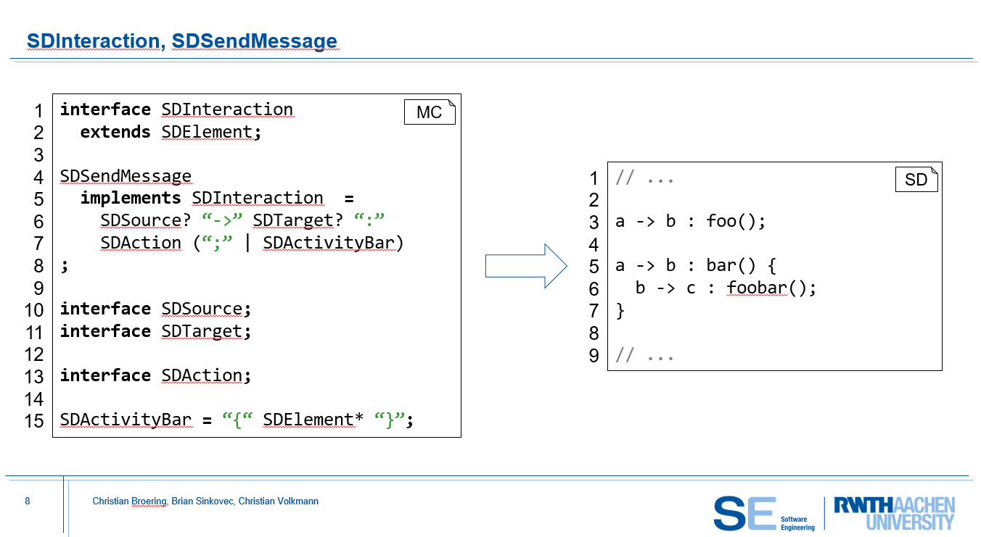
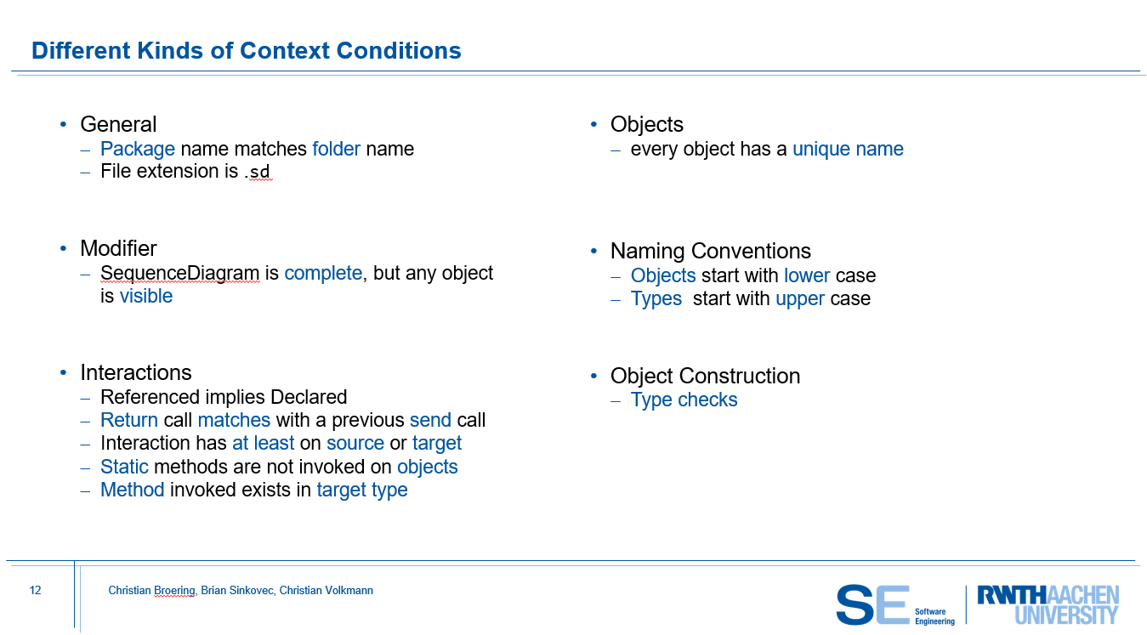
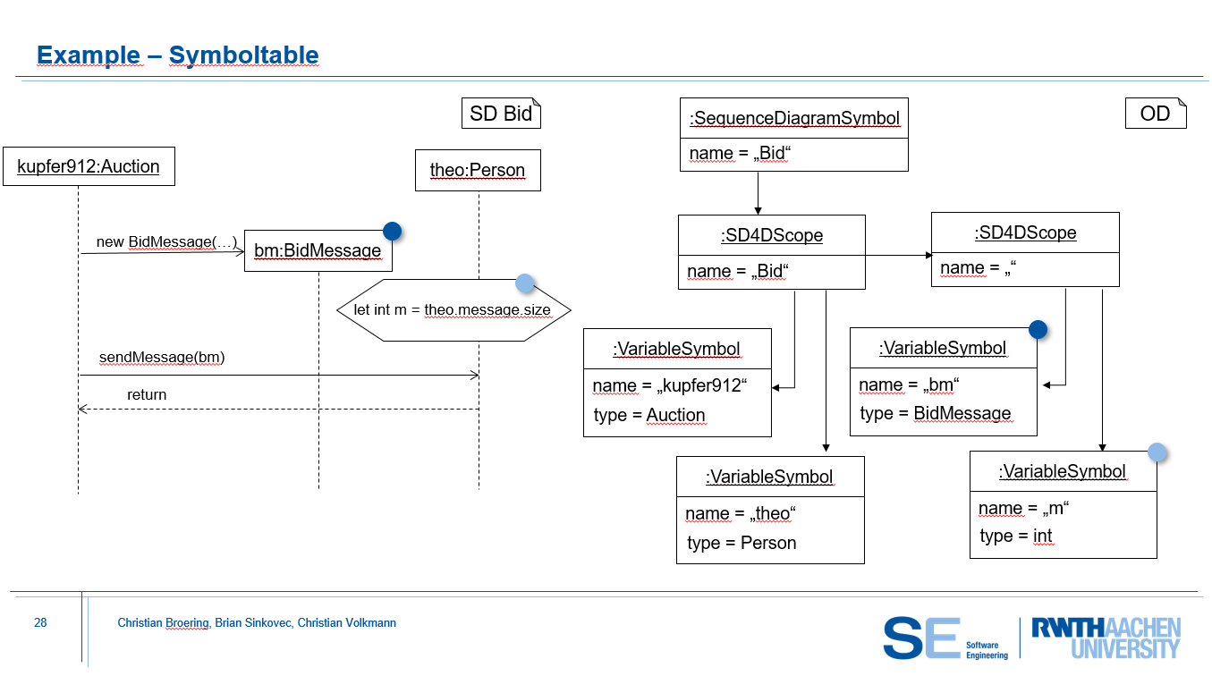
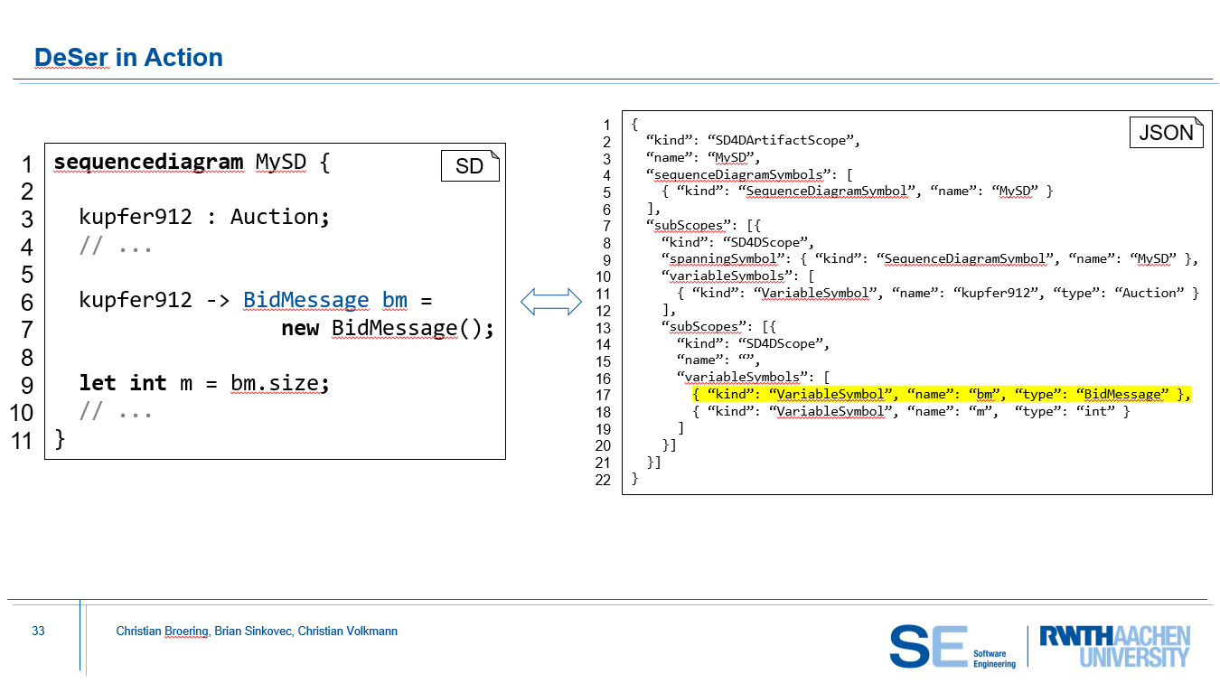
Summary

Slide 35
SD4Development + SDBasis Context Conditions
ConstructorObjectNameNamingConventionCoco
CorrectObjectConstructionTypesCoco
EndCallHasSourceOrTargetCoco
MethodActionRefersToCorrectTargetCoco
MethodActionValidCoco
ReturnOnlyAfterMethodCoco
CommonFileExtensionCoco
ImportStatementsValidCoco
ObjectNameNamingConventionCoco
PackageNameIsFolderNameCoco
ReferencedObjectSourceDeclaredCoco
ReferencedObjectTargetDeclaredCoco
SDNameIsArtifactNameCoco
SendMessageHasSourceOrTargetCoco
TypeNamingConventionCoco
UniqueObjectNamingCoco

Slide 36
Running Example
SD
kupfer912:Auction
theo:Person
Log
new BidMessage(…)
bm:BidMessage
let int m = theo.message.size
sendMessage(bm)
return

