Slide 1





Towards Content-Oriented Orchestration for Virtual Information Centric Networking
Long HOANG MAI & Guillaume DOYEN, on behalf of the Doctor consortium
Troyes University of Technology – Charles Delaunay Institute
Contact : guillaume.doyen@utt.fr
ICNRG Interim Meeting (IETF #101) – London – March 18, 2018

Slide 2
Locks for an ICN deployment
A pragmatic approach
  A progressive migration performed according to opportunities
    Services that would benefit from an ICN stack at most
    Topological locations (access, edge, core) that best fit with ICN Traffic Engineering features (e.g. symmetric routing, caching)
  Management and security frameworks are required
  Cohabitation with IP can be handled through NFV
    Isolation of network protocol stacks (keeps IP as a common substrate)
    Cost effective solution by using commodity servers
  This is the position of the 2014-2018 Doctor Project
    Funded by the (French) National Research Agency (ANR)
    Selected NDN as a target ICN technology

Slide 3


Content-Oriented MANO - PoC
Tenant Network Controller
TOSCA
Descriptors
TOSCA PROCESSOR
TOSCA
Parser
Cyber
CAPTOR
Orchestrator engine
NFV Orchestrator
EM
EM
EM
NFD Agent
MMT Probe
NFD Agent
MMT Probe
NFD Agent
MMT Probe
NS
Catalogue
VNF
Catalogue
NFVI Resources
NFV Instances
vnf-em
Or-Vnfm
router
iGW
eGW
VNF
Manager
MMT
Operator
NFVI
Ve-Vnfm-em
Virtual Computing
Virtual Storage
Virtual Network
Vi-Vnfm
Virtualisation Layer
Virtualised
Infrastructure
Manager
Nf-vi
Or-Vi
Computing
Resources
Storage
Resources
Network
Resources
Infrastructure Controller

Slide 4
Content-Oriented MANO - PoC
Management
  NDN VNF monitoring (ext. of NFD mgmt protocol)
  Design and implementation of micro-detectors [IM 2015, WIFS 2015]
  Event correlation [NOMS 2018]
  A management Dashboard (partner Montimage)
Orchestration
  A TOSCA extension
    Specifying an NDN service topology
    Specifying dynamic policies
  Implementation of a NDN orchestrator
    A chain of MANO Components processing

Slide 5
A TOSCA extension for ICN (1)
Virtual Deployment Unit
  Abstraction describing the virtual resources over which a VNF will be executed
Virtual Network Function
  The piece of software that will be executed on a VDU
  NDN router, ingress gateway, egress gateway and NDN firewall
Virtual Link
  Resources required to link two VDUs
Connection Point
  The connection capability which associates a VDU to a virtual link
Forwarding Path and Graph
  a list of VNFs that a particular set of NDN packets will follow
  Uses content prefixes instead of L2/L3 flow specifications

Slide 6
A TOSCA extension for ICN (1)
Policies
  Event-Condition-Action rules to apply dynamically
  Signature verification policy: change the NDN router mode (signature verification to be applied on data packets)
  The firewall policy: configure, at runtime, firewalls mode and configuration (i.e., white and black lists);
  The scaling policy: monitor VNFs performance metrics and enforce a scaling-out action when a threshold is crossed

Slide 7
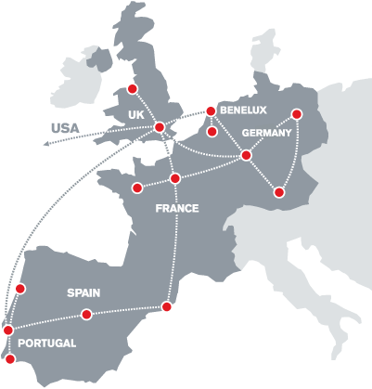
Demonstration scenario
European telco topology
  ClaraNet (6 PoP part of)
  Points of Presence (PoP) made available through the Internet Zoo Topology Dataset
Different NDN VNFs
  NDN routers
  Signature verification module
  NDN Firewall
  Ingress/egress gateways (not included)
The whole network is deployed through virtualized means
  1 PoP in 1 Openstack VM
NDN compromised server sends poisoned content
Attack mitigation through dynamic orchestration
By claranet (claranet) [CC0], via Wikimedia Commons

Slide 8
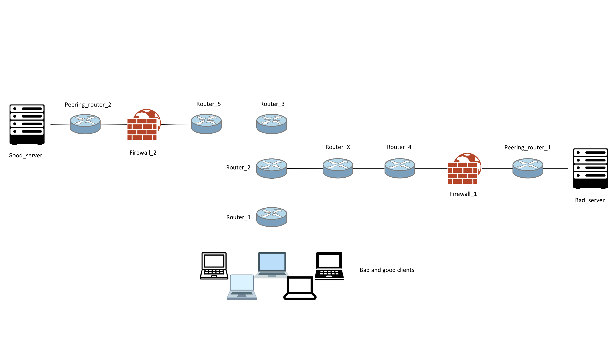
Topology
London POP
VDU6 – ID3
VDU9 – ID9
VDU7 – ID5 -
VDU4 – ID6
VDU8 – ID7
Lisbon POP
Berlin POP
VDU2 – ID2
VDUX – ID10
VDU3 – ID4
MADRID
VDU5 – ID8
Amsterdam POP
VDU1

Slide 9
TOSCA VNF and VDU specifications
router_2:
type: tosca.nodes.nfv.doctor.VNF
properties:
id: 2
vendor: orange
version: 1.0
requirements:
- VDU: VDU2
firewall_1:
type: tosca.nodes.nfv.doctor.VNF.firewall
properties:
id: 6
vendor: orange
version: 1.0
configuration:
mode: accept
rules:
- action: append-drop
prefix: [/foo]
requirements:
- VDU: VDU4
VDU2:
type: tosca.nodes.nfv.doctor.VDU
properties:
name: VDU2
sw_image: maouadj/ndn_router:v1
config: /doctor/launch_nfd_router.sh
flavor: medium
placement_policy: ['popLocation==uk’]
VDU4:
type: tosca.nodes.nfv.doctor.VDU
properties:
name: VDU4
sw_image: maouadj/ndn_firewall:v1
config: /doctor/launch_ndn_firewall.sh
flavor: medium
placement_policy: ['popLocation==netherlands']

Slide 10
TOSCA VL and CP specifications
VL1:
type: tosca.nodes.nfv.doctor.VnfVirtualLinkDesc
properties:
name: VL1
connectivity_type: VXLAN
VDU1_VL1_CP:
type: tosca.nodes.nfv.doctor.Cpd
properties:
name: VDU1_VL1_CP
layer_protocol: VXLAN
requirements:
- virtual_link: VL1
- virtual_binding: VDU1

Slide 11
TOSCA Forwarding Path Specification
http_from_r2_to_as1:
type: tosca.nodes.nfv.doctor.FP
description: creates path for /http from r2 to as1
properties:
id: 2
policy:
type: NDN
prefix: [/com/google]
path:
- forwarder: router_2
capability: VDU2_VL10_CP
- forwarder: router_x
capability: VDUX_VL10_CP
- forwarder: router_x
capability: VDUX_VL2_CP
- forwarder: router_4
capability: VDU3_VL2_CP
- forwarder: router_4
capability: VDU3_VL3_CP
- forwarder: firewall_1
capability: VDU4_VL3_CP
- forwarder: firewall_1
capability: VDU4_VL4_CP
- forwarder: peering_router_1
capability: VDU5_VL4_CP

Slide 12

Dynamic orchestration for CPA mitigation
London POP
VDU6 – ID3
VDU9 – ID9
VDU7 – ID5 -
VDU4 – ID6
VDU8 – ID7
Lisbon POP
Berlin POP
VDU2 – ID2
VDUX – ID10
VDU3 – ID4
MADRID
VDU5 – ID8
Amsterdam POP
VDU1

Slide 13
Content Poisoning Attack scenario
Legitimate user
  Requests content among 1 million whose popularity follows zifp law
  Average rate of 10 Interests/s following a Poisson law
Attacker consumer
  Send Interests for popular contents
  Top most 1% (10 000 contents) at the 64 Interests/s fixed rate
Network
  Setup with a multicast routing strategy
  Do not enforce signature verification for performance purposes
Attacker provider
  Pushes poisoned Data to routers
Legitimate user
  Detects invalid signatures and asks for newer version of the same content
  Competes with the attacker client

Slide 14
TOSCA policies specifications
Dynamically starts the signature verification enforcement if a CPA alert is raised
policies:
- CPA_countermeasure:
type: tosca.policies.nfv.doctor.security.signature_verification
targets: [router_4, router_5]
triggers:
peeringPoint1_verification:
event_type: tosca.nfv.doctor.security.alert.cpa
condition:
constraint: triggred_by router_2
action:
action_type: update_router_mode
mode: signing
target_router: router_4

Slide 15
TOSCA Policies Specification
Dynamically updates the firewall black list with prefixes whose signature is invalid
policies:
- update_firewall:
type: tosca.policies.nfv.doctor.ndn.security.update_firewall
targets: [firewall_1, firewall_2]
triggers:
peering_point_1:
event_type: tosca.nfv.doctor.security.alert.poisoned_content
condition:
constraint: triggred_by router_4
action:
action_type: update_firewall
target_firewall: firewall_1

Slide 16
TOSCA Policies Specification
Dynamically spawn NDN routers to cope with the resource exhaustion due to signature verification
policies:
- scaling_out_policy:
type: tosca.policies.nfv.doctor.ndn.scaling
targets: [router_4, router_5]
triggers:
scale_out:
meter_name: PIT
event_type: tosca.policies.nfv.doctor.ndn.utilization
condition:
constraint: pending_interests greater_than 10
threshold: 10
comparison_operator: gt
period: 10
action:
action_type: scale_out
number: 3

Slide 17
Outline
Context
  On the maturity of the ICN paradigm
  Locks for an ICN deployment
On the road for an ICN deployment
  Service migration
  Management and security
  Infrastructure means
Leveraging NFV as an ICN enabler
  Opportunities and challenges
  Proposition of a Network Function Virtualization Infrastructure
  ICN Management and Orchestration
Demonstration
Conclusion and perspectives

Slide 18
Conclusion and perspectives
An ongoing work toward the design and implementation of NFV-MANO components for NFV
  A proof of concept of the whole architecture
  Code availability
    https://github.com/DOCTOR-ANR
Doctor and ICNRG
  Doctor is open to serve ICNRG efforts to push forward the deployment and standardization of this network paradigm
Future work
  Evaluate the benefits of an NDN virtual network carrying web traffic with real end-users
  Further explore the content orchestration
  Explore micro-services orchestration for NDN

Slide 19
Questions ?

Slide 20
References
M. Vahlenkamp, F. Schneider, D. Kutscher and J. Seedorf, "Enabling Information Centric Networking in IP Networks Using SDN," Future Networks and Services (SDN4FNS), 2013 IEEE SDN for, Trento, 2013, pp. 1-6.
S. Salsano, N. Blefari-Melazzi, A. Detti, G. Morabito, L. Veltri, "Information centric networking over SDN and OpenFlow: Architectural aspects and experiments on the OFELIA testbed", Computer Networks, Volume 57, Issue 16, 13 November 2013, Pages 3207-3221, ISSN 1389-1286
N. L. M. van Adrichem and F. A. Kuipers, "NDNFlow: Software-defined Named Data Networking," Network Softwarization (NetSoft), 2015 1st IEEE Conference on, London, 2015, pp. 1-5.
X. N. Nguyen, D. Saucez and T. Turletti, "Efficient caching in content-centric networks using OpenFlow," INFOCOM, 2013 Proceedings IEEE, Turin, 2013, pp. 1-2.
Peyman TalebiFard, Ravishankar Ravindran, Asit Chakraborti, Jianli Pan, Anu Mercian, Guoqiang Wang, Victor C.M. Leung, "An Information Centric Networking approach towards contextualized edge service," 2015 12th Annual IEEE Consumer Communications and Networking Conference (CCNC), Las Vegas, NV, 2015, pp. 250-255.
Pedro Henrique V. Guimaraes, Lyno Henrique G. Ferraz, Joao Vitor Torres, Diogo M. F. Mattos, Andres F. Murillo P., Martin E. Andreoni L., Igor D. Alvarenga, Claudia S. C. Rodrigues, Otto Carlos M. B. Duarte, “Experimenting Content-Centric Networks in the Future Internet Testbed Environment”, ICC 2013 Workshops, IEEE, 2013.
Salvatore Signorello, Radu State, Jérôme François, Olivier Festor:NDN.p4: Programming information-centric data-planes. NetSoft 2016: 384-389

Slide 21
Related Project publications
[NOMS 2018] Hoang Long Mai, Tan Nguyen, Guillaume Doyen, Rémi Cogranne, Wissam Mallouli, Edgardo Montes de Oca, Olivier Festor. Towards a Security Monitoring Plane for Named Data Networking and its Application against Content Poisoning Attack. To appear in NOMS 2018 - 2018 IEEE/IFIP Network Operations and Management Symposium
[IM 2017] Tan N. Nguyen, Xavier Marchal, Guillaume Doyen, Thibault Cholez, Rémi Cogranne. Content Poisoning in Named Data Networking: Comprehensive characterization of real deployment. IM 2017: 72-80
[ICN 2016] Xavier Marchal, Moustapha El Aoun, Bertrand Mathieu, Wissam Mallouli, Thibault Cholez, Guillaume Doyen, Patrick Truong, Alain Ploix, Edgardo Montes de Oca. A virtualized and monitored NDN infrastructure featuring a NDN/HTTP gateway. ICN 2016: 225-226
[IM 2015] Tan N. Nguyen, Rémi Cogranne, Guillaume Doyen. An optimal statistical test for robust detection against interest flooding attacks in CCN. IM 2015: 252-260
[WIFS 2015] Tan N. Nguyen, Rémi Cogranne, Guillaume Doyen, Florent Retraint:Detection of interest flooding attacks in Named Data Networking using hypothesis testing. WIFS 2015: 1-6

Slide 22
Outline
Context
Leveraging NFV as an ICN enabler
  Overall architecture
  NDN Monitoring and management
  NFV Orchestration
Demonstration
  Initial orchestrated deployment
  Dynamic Content Poisoning Attack mitigation
Conclusion and perspectives

Slide 23
Outline
Context
Leveraging NFV as an ICN enabler
  Overall architecture
  NDN Monitoring and management
  NFV Orchestration
Demonstration
  Initial orchestrated deployment
  Dynamic Content Poisoning Attack mitigation
Conclusion and perspectives

Slide 24
On the maturity of the ICN paradigm
On the design part
  One decade of research and development
  Basic topics have been covered
  Advanced subjects are on interest
On the implementation part
  Functional implementations are available
  Open testbeds are also deployed
  Device manufacturers start implementing ICN stacks
-> ICN is ready for deployment considerations

Slide 25
NFD monitoring [NOMS 2018]
Component | Metric | Description
Faces | In Interest | Periodic number of incoming Interests
 | In Data | Periodic number of incoming Data
 | In NACK | Periodic number of incoming NACK
 | Out Interest | Periodic number of outgoing Interests
 | Out Data | Periodic number of outgoing Data
 | Out NACK | Periodic number of outgoing NACK
 | Drop Interest | Periodic number of dropped Interests
 | Drop Data | Periodic number of dropped Data
 | Drop NACK | Periodic number of dropped NACK
Content Store | CS Insert | Periodic number of Data insert in CS
 | CS Miss | Periodic number of cache miss in CS
 | CS Hit | Periodic number of cache hit in CS
Pending Interest Table | PIT Create | Periodic number of PIT entries created
 | PIT Update | Periodic number of updates in PIT
 | PIT Delete | Periodic number of PIT entries deleted
 | PIT unsatisfied | Periodic number of PIT entries unsatisfied
 | PIT Size | Periodic number of PIT entries
 | PIT Entries time | Average time in PIT for entries

Slide 26
NDN Event Management [NOMS 2018]
Understanding NFD pipelines for anomaly detection
Correlating events

Slide 27
NDN Orchestration
NFVO Core
  Initial deployment of a NDN service
    Deploy virtual networks
    Deploy virtual units
    Connect virtual units to virtual networks
    Retrieve VDU and networks configurations (NDN Engine)
    Make sure that VNFs are in the correct state
    Engage VNFs configuration (NDN Engine)
    Start monitoring probes and event correlators
NDN Engine
  Generates the appropriate NDN configurations for each VNF
    NDN paths and strategies + NFVI information (IP addresses, identifiers, etc.) -> FIB entries

Slide 28
NDN Orchestration
VNF Manager
  Responsible for the life-cycle management of NDN VNF
  VNF <-> VNFM <-> NFVO
    Receives initial configurations and dynamic reconfigurations from NFVO and pushes them into VNFS
    Sends notifications (security alerts) from VNF and send them the NFVO

Slide 29
Outline
Context
Leveraging NFV as an ICN enabler
  Overall architecture
  NDN Monitoring and management
  NFV Orchestration
Demonstration
  Initial orchestrated deployment
  Dynamic Content Poisoning Attack mitigation
Conclusion and perspectives

Slide 30
ETSI NFV MANO
Os-Ma
NFV
Orchestrator
OSS/BSS
Or-Vnfm
EM 1
EM 2
EM 3
Ve-Vnfm
VNF
Manager(s)
Service, VNF and Infrastructure Description
VNF 1
VNF 2
VNF 3
Vn-Nf
Vi-Vnfm
NFVI
Virtual Computing
Virtual Storage
Virtual Network
Virtualised
Infrastructure
Manager(s)
Nf-Vi
Or-Vi
Virtualisation Layer
Vl-Ha
Hardware resources
Computing
Hardware
Storage
Hardware
Network
Hardware
NFV Management and Orchestration
Source : ETSI GS NFV-MAN 001

