Slide 1

Machine Learning for
Bio-Image-Analysis
22.11.2022
Volker Bäcker, Jean-Bernard Fiche,
Cedric Hassen Khodja

Slide 2

Introduction
What is bio-image analysis?
How is it done without machine learning?
What is machine learning?
How is bio-image analysis done
with machine learning?

Slide 3
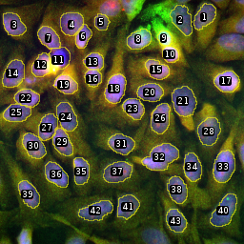
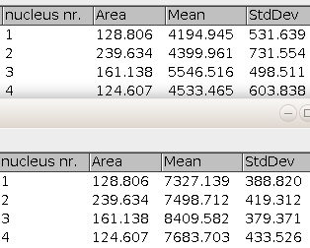
Bio-Image-Analysis
“The extraction of information from digital images in the context of biological research”

Slide 4
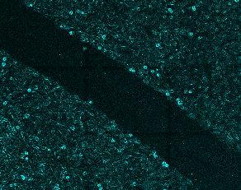

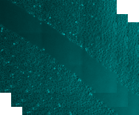
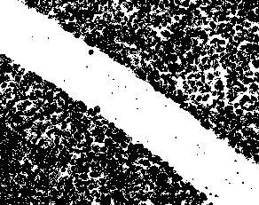
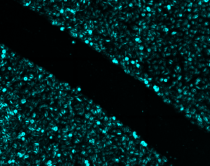

The Image-Analysis Workflow
input images
image features
sobel
variance
pre-processing
segmentation
post-processing

Slide 5
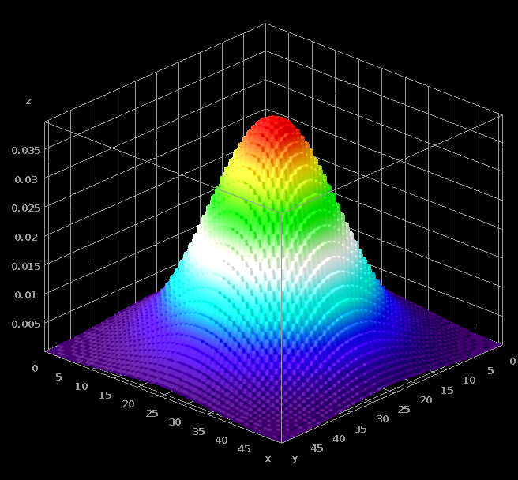
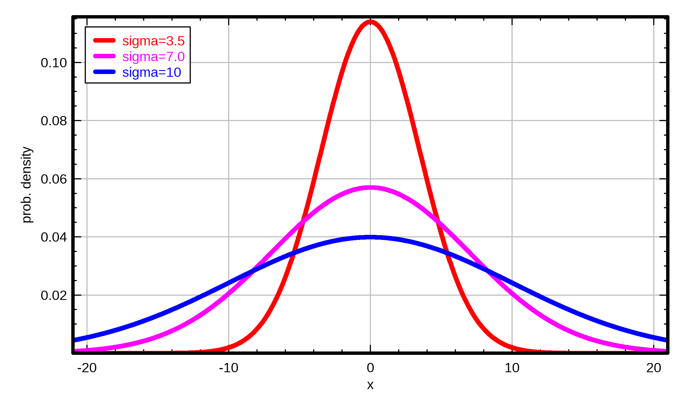
Select a scale
Use “Gaussian blur”-filter to select a scale
  Low-pass filter
  Removes high frequencies from the images
    The higher sigma the lower the remaining frequencies

Slide 6
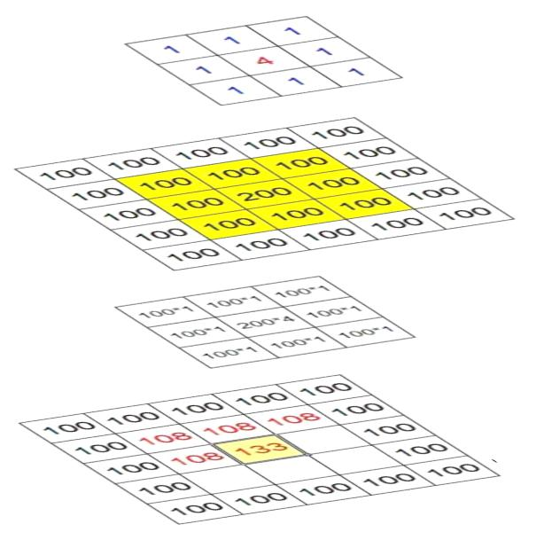
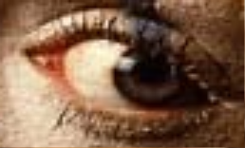


Convolution
kernel
image
product
result
image

Slide 7
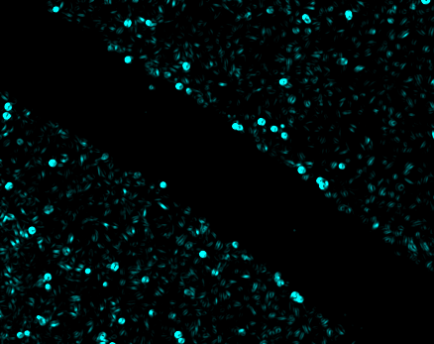
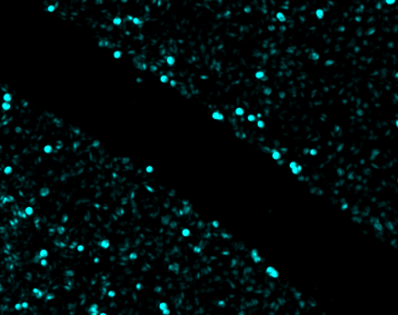
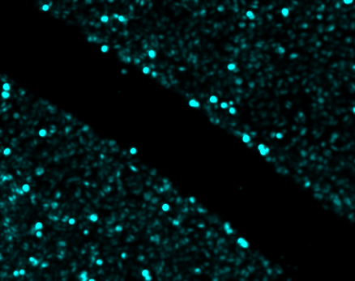
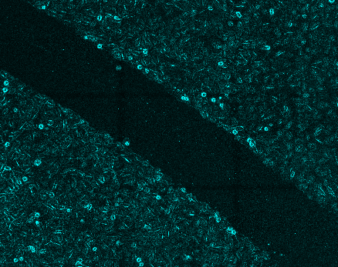
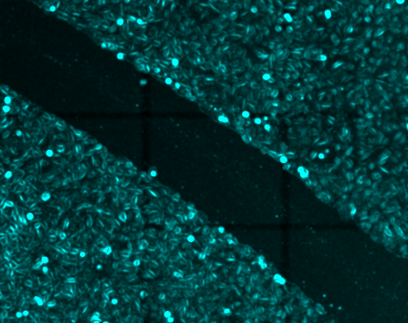

Image features at different scales
scale
σ=3.5
σ=7
σ=10
feature
variance
sobel

Slide 8
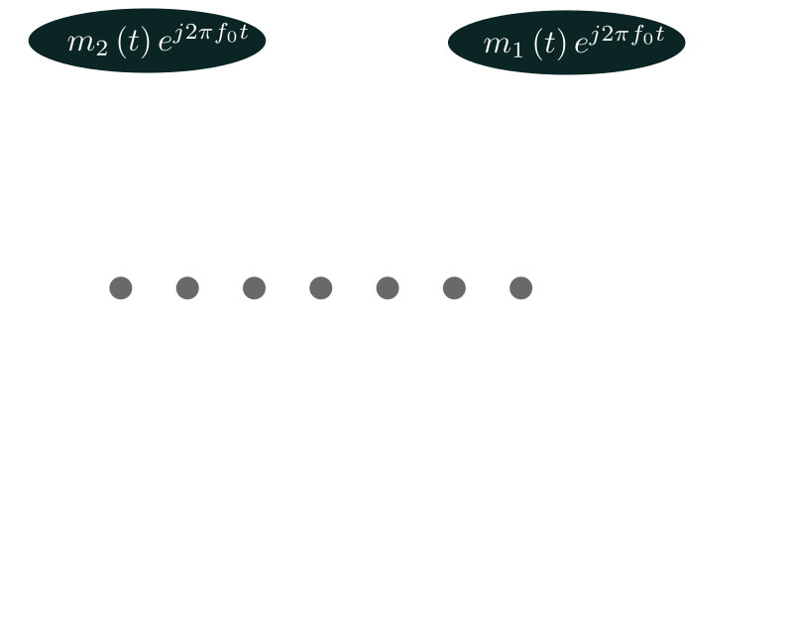
Machine Learning
Machine learning algorithms build a mathematical model of sample data, known as ”training data”, in order to make predictions or decisions without being explicitly programmed to perform the task.

Slide 9
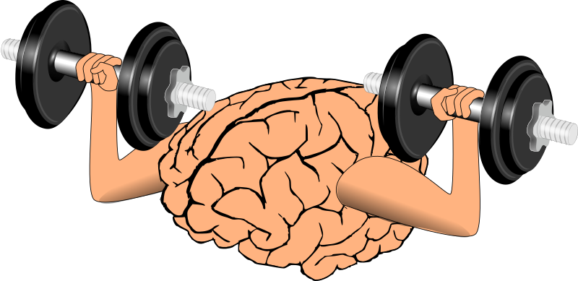

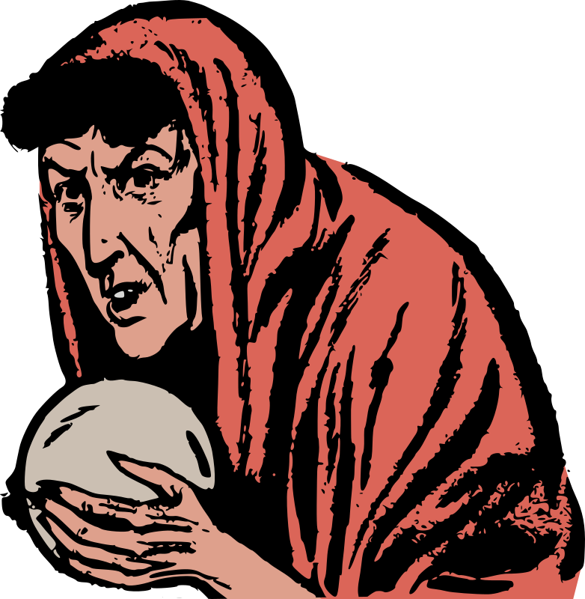
Machine Learning
Training
a model is learned from training data
Validation
the trained model is validated against test data
Application
use the trained model to make predictions on new data

Slide 10
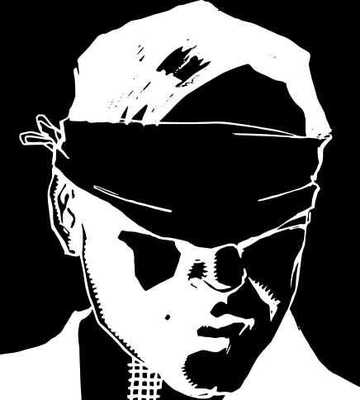

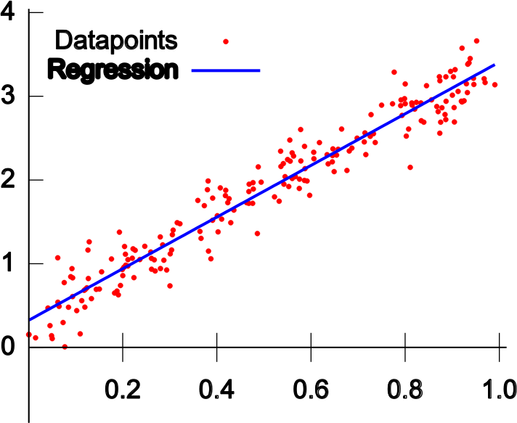

Machine Learning vocabulary
Supervised
  a model is learned from pairs of input and output data
Unsupervised
  a model is learned from the inherent structure of the input data alone
Classification
  the result is a category
Regression
  the result is a real number

Slide 11
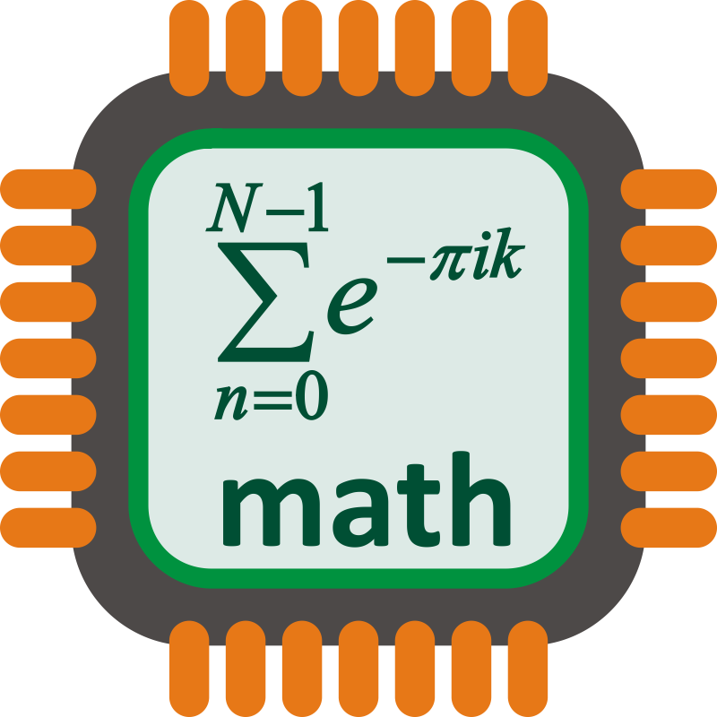
Machine Learning
How is that even possible?
ML algorithm implements
a mathematical model with
a number of model parameters
given the training data,
find parameter values that minimize the prediction error

Slide 12
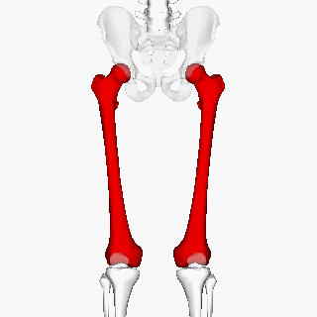

Machine Learning
Example 1 - linear regression
estimate
body height f(x)
given the
femur length x.
model
ω₁, ω₂ model parameter
Femur length (cm) | Height (cm)
45 | 153
44 | 168
44 | 177
47 | 180
44 | 171
50 | 168
training data

Slide 13
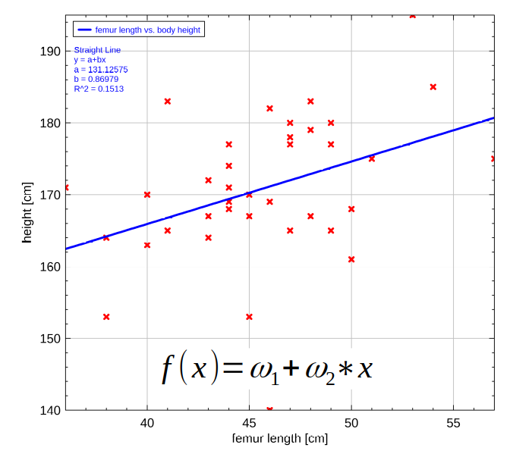
Example 1 -
Linear regression
find parameters ω₁, ω₂,
so that error between training data and model is minimal

Slide 14
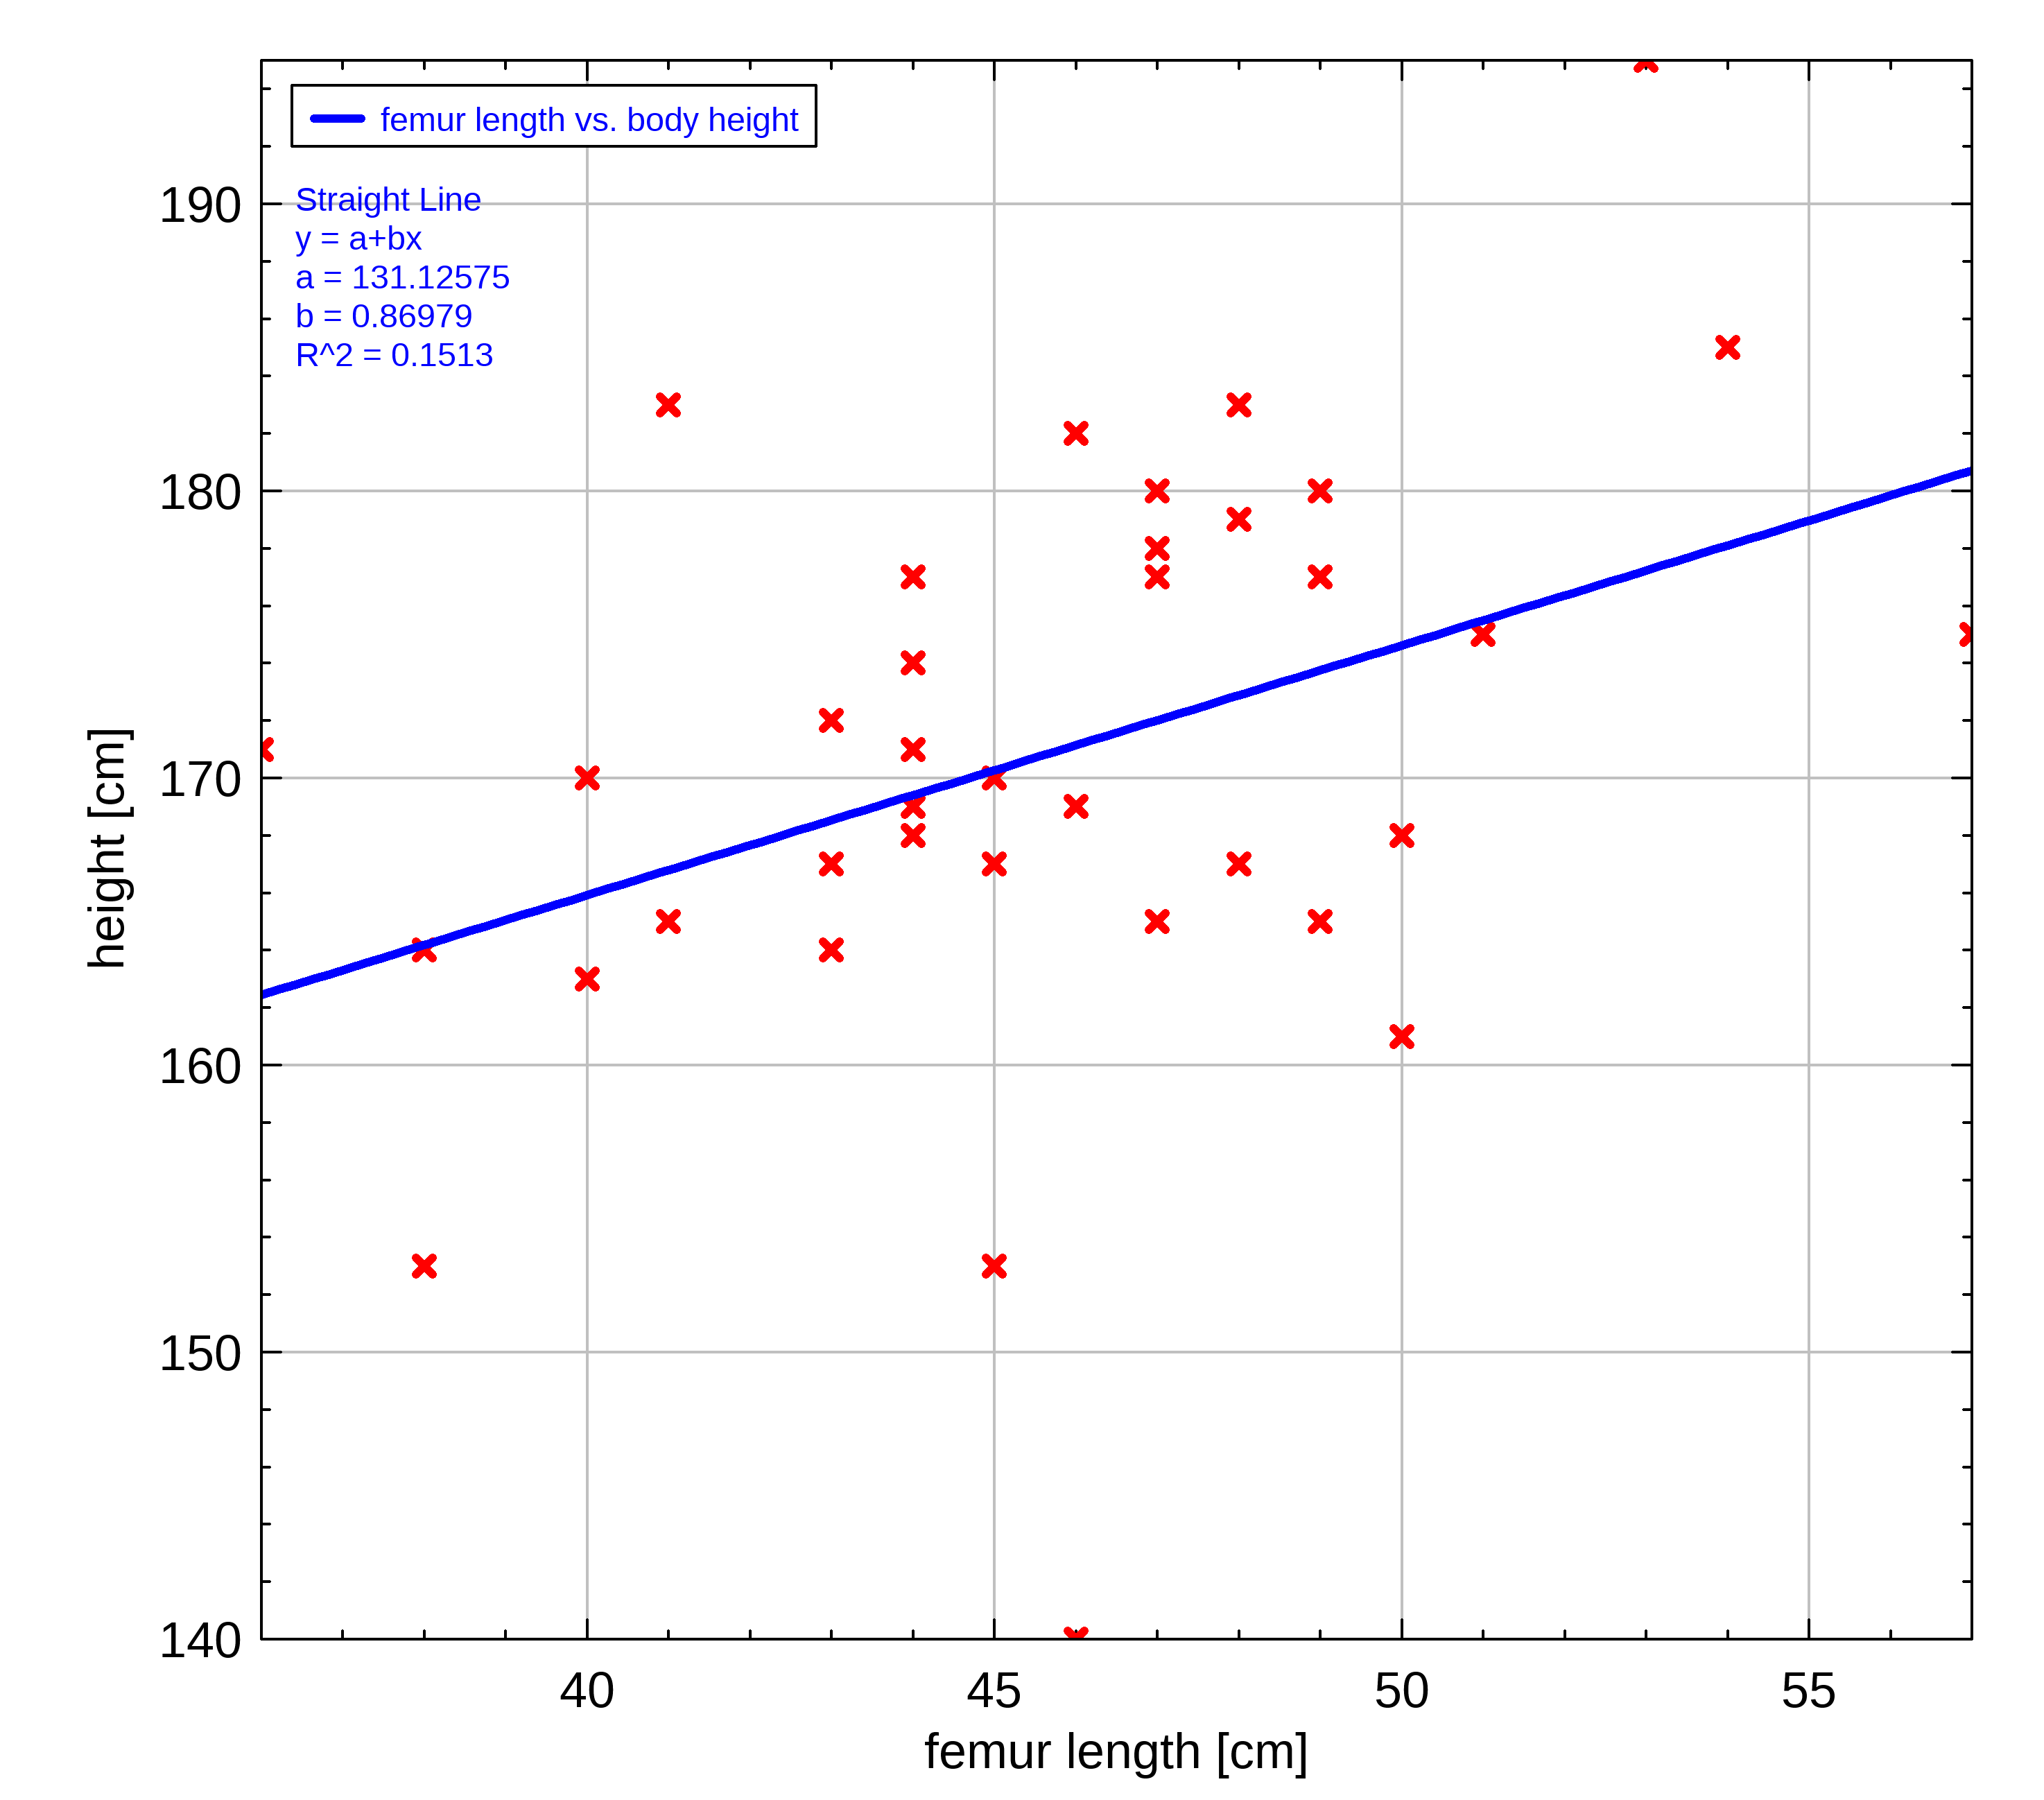
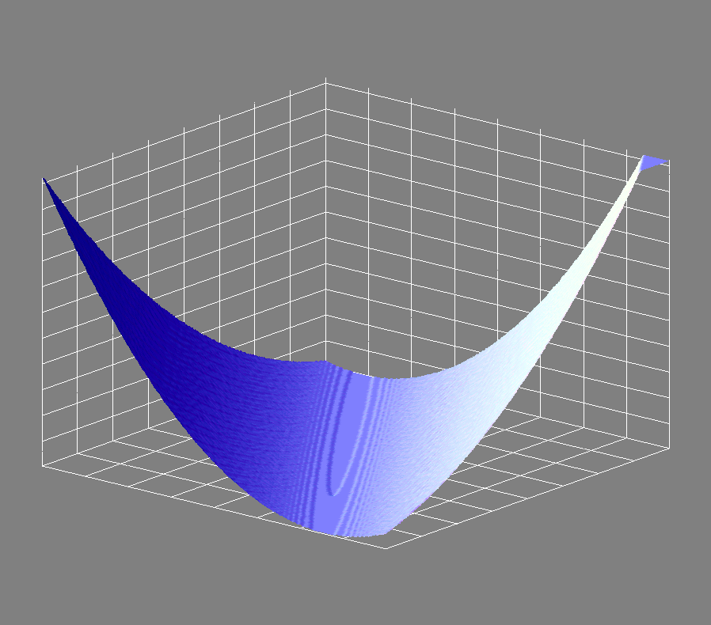
Example 1 -
Squared Loss function

Slide 15
Example 1
Loss function
find the minimum of the loss function
by using gradient descent

Slide 16
Example 1
Predictions

Slide 17
Femur example
Supervised or Unsupervised?
Classification or Regression?
Supervised
  a model is learned from pairs of input and output data
Unsupervised
  a model is learned from the inherent structure of the input data alone
Classification
  the result is a category
Regression
  the result is a real number

Slide 18






The programs
ImageJ/FIJI
Weka / LabKit
Ilastik
QuPath
Cellprofiler / Cellprofiler Analyst
Orbit

Slide 19
ImageJ/FIJI
Demo ImageJ 01
  Open image
  Threshold
  Binary Watershed
  Compare to GT

Slide 20
ImageJ/FIJI
Demo ImageJ 02
  Revert Image
  Laplacian of Gaussian (scale 3)
  Threshold (Yen)
  Binary Watershed
  Compare to GT

Slide 21
Ilastik
Demo Ilastik 01
  import image(s)
  select features and scales
  name classes
  select training data
  export result
  batch

Slide 22
Exercises 01

Slide 23
Clustering
A machine learning method
  Unsupervised
  Classification

Slide 24
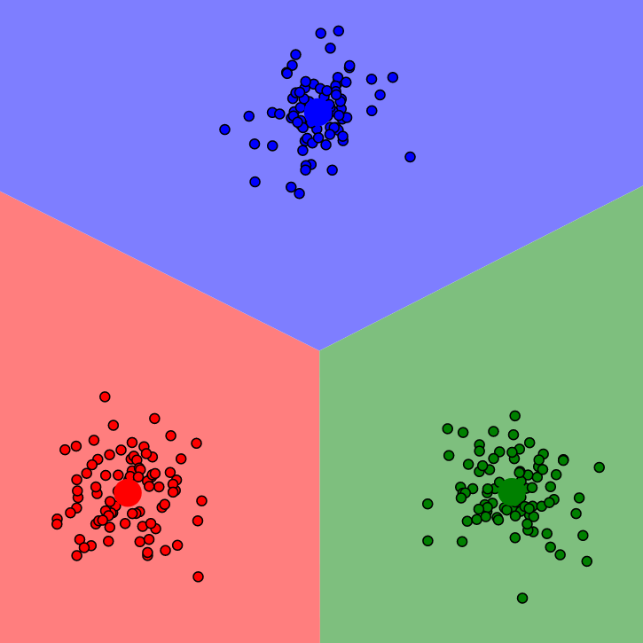
Clustering
Clustering
  Group objects in a way that
    objects in the same cluster are more similar to each other
    than to objects in other clusters

Slide 25
Clustering algorithms
K-means
DBScan
hierarchical clustering
expectation-maximization
...

Slide 26
k-means clustering
Partition the feature-space into k-clusters
Each feature-vector belongs to the cluster with nearest mean
Algorithm:
  Start with k initial means
  Repeat until convergence
    Assign feature-vectors to clusters
    Recalculate the means of the clusters

Slide 27
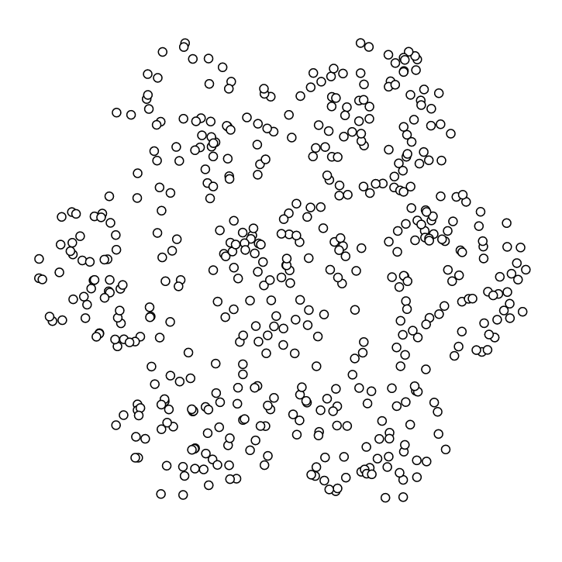
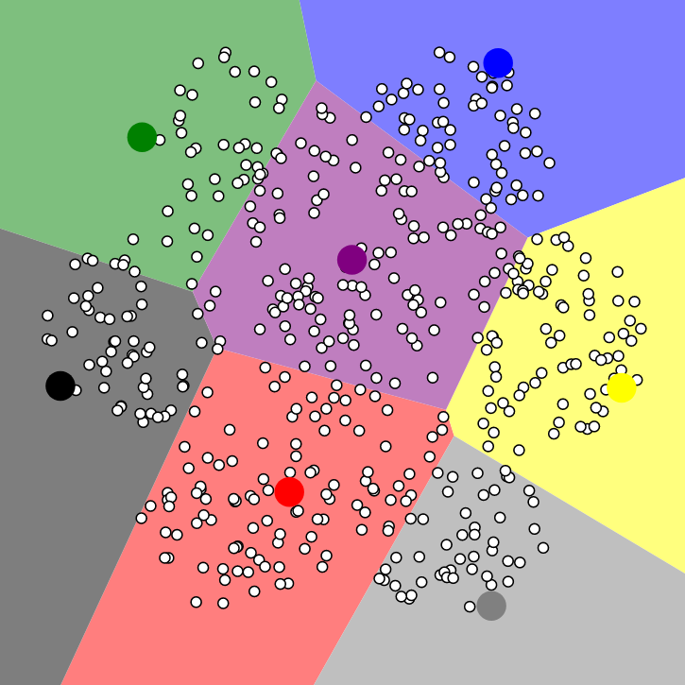
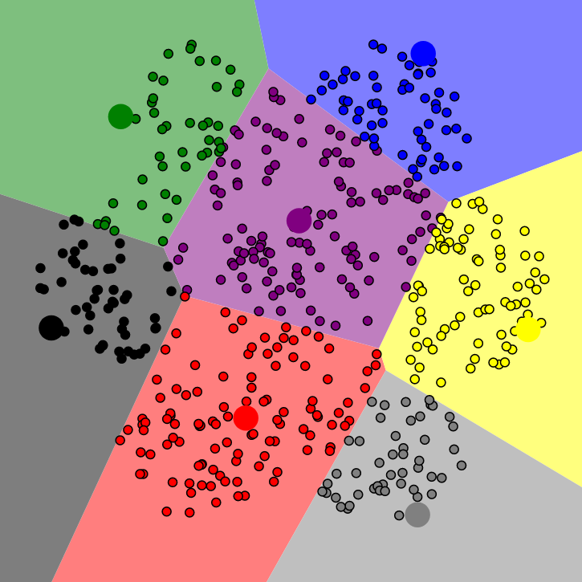
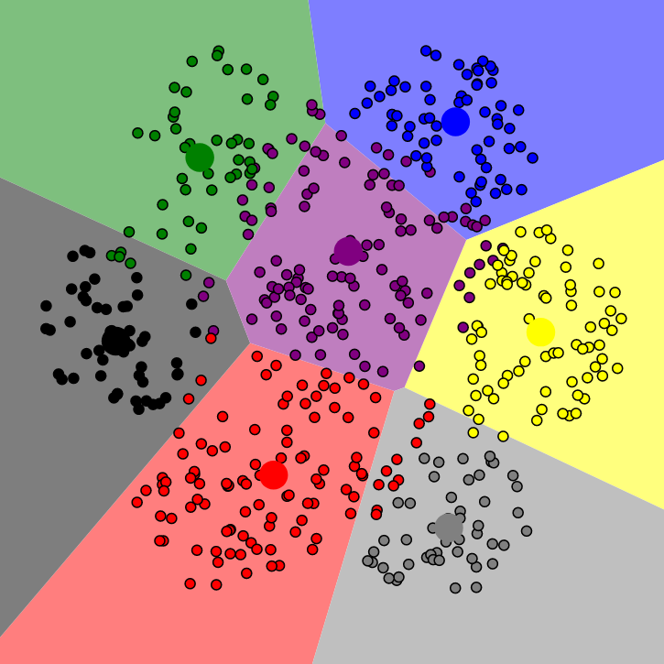
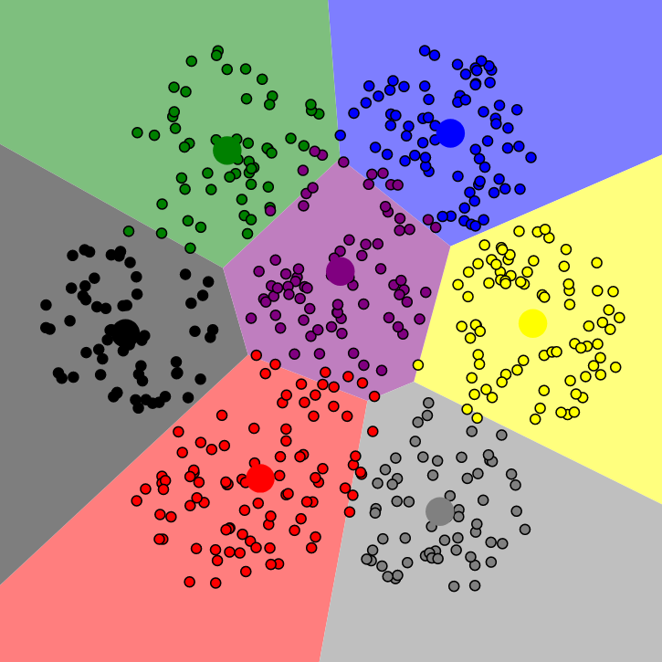

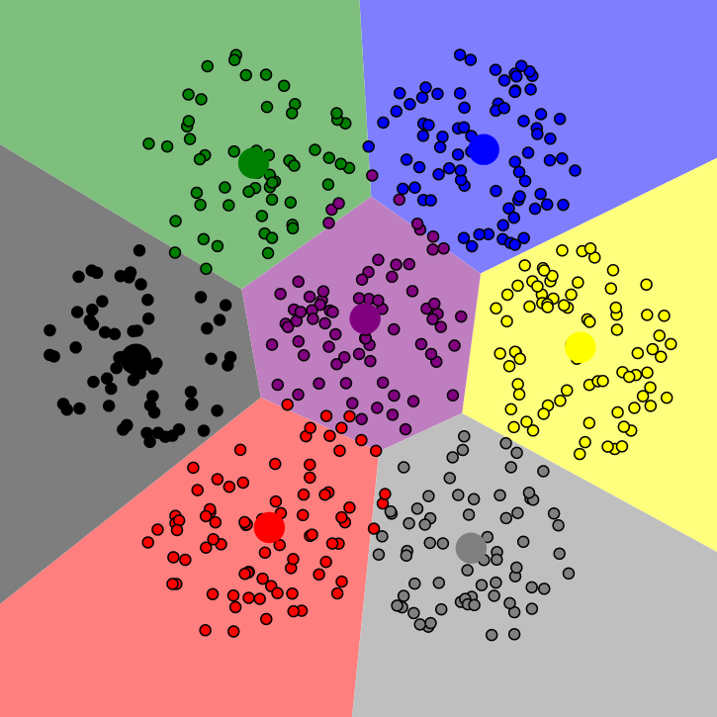
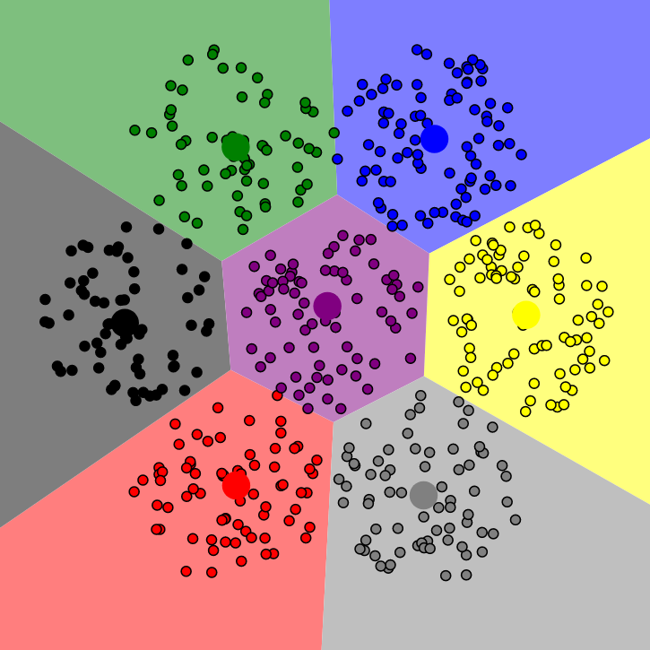



K-means example

Slide 28
K-means clustering in machine learning
Training phase:
  randomly select a number of feature vectors
    for example 5% of the data
  run the k-means clustering on the selected feature vectors
  the resulting means are the classifier
Classification of unknown data:
  Calculate the feature vector
  Assign it to the cluster with the nearest mean

Slide 29
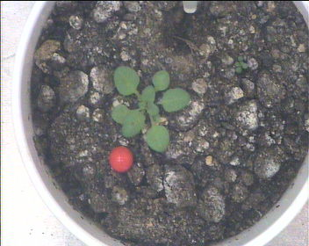
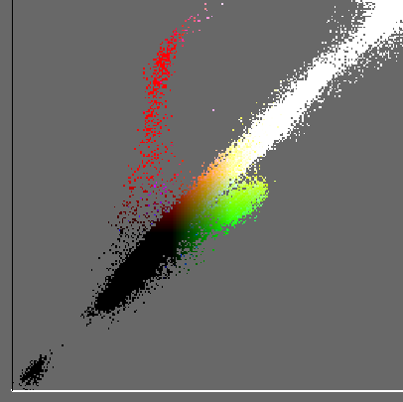
Classify pixels by color
Input Image
RGB
R
G

Slide 30
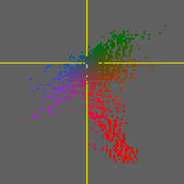
CIEL*a*b* color-space
a*
CIEL*a*b* color-space
  L = lightness
  a = green (-) to red (+)
  b = yellow (-) to blue (+)
Designed, so that
  distances correspond to perceived distances between colors.
b*

Slide 31
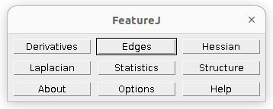
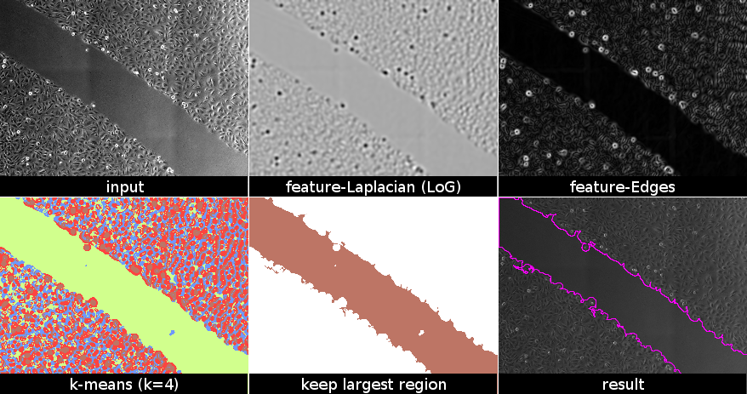
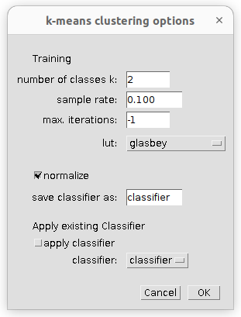
K-means clustering of other features

Slide 32
Software
FeatureJ
MorphoLibJ
k-means segmentation
  Jython script
  Based on
  org.apache.commons.math3.ml.clustering

Slide 33
Exercises 02

