Slide 1
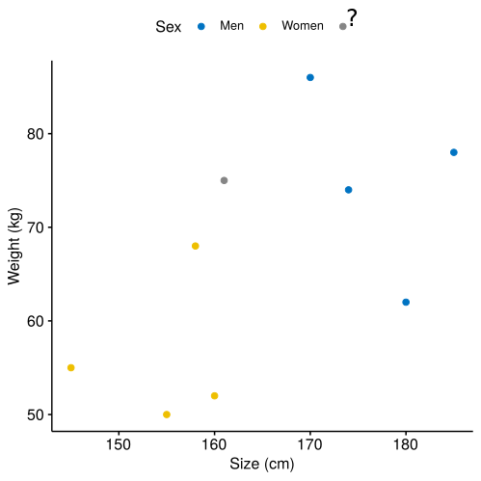

Slide 4
Introduction of the cost parameter C. C is too high: overfitting. C is too low: underfitting.

Slide 6
