Slide 1



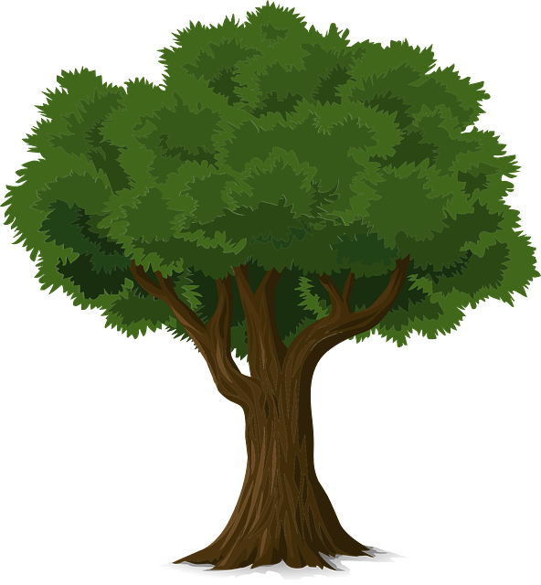

RANDOM FOREST

Slide 2

Is diameter >= 30
False
True
Is color yellow ?
False
True

Slide 3
Entropy
Entropy is a
measure of
disorder,
of uncertainty
In a dataset.
Information
gain
Leaf node
Decision node
Root node

Slide 4
Entropy
Entropy is a
measure of
disorder,
of uncertainty
in a dataset.
E1
High Entropy

Slide 5
E1
High Entropy
Entropy
Entropy is a
measure of
disorder,
of uncertainty
in a dataset.
After splitting
Decision split
E2
Lower entropy
Set 1
Set 1
Set 2

Slide 6
Entropy
Information
Gain
It is the
measure of
decrease in
entropy after
dataset is split
Leaf node
Decision node
Root node

Slide 7
Information
Gain
It is the
measure of
decrease in
entropy after
dataset is split
E1
High Entropy
After splitting
Decision split
E2
Lower entropy
Set 1
Set 1
Set 2
Information gain = E1 - E2

Slide 8
Entropy
Information
Gain
Leaf node
caries the
classification
of the decision
Decision node
Decision node
has two branch
Root node
The top of the
decision tree is
known as the
root node

Slide 9
Root node
The top of the
decision tree is
known as the
root node
Decision node
Decision node
has two branch
Leaf node
caries the
classification
of the decision
Set 1
Set 2

Slide 10
Root node
The top of the
decision tree is
known as the
root node
Set 1
Set 2

Slide 11
Use case :
To classify the
Different types of
Fruits based on features

Slide 12
Use case :
To classify the
Different types of
Fruits based on features
The dataset is looking
messy and the entropy
is high in this case

Slide 13
Use case :
To classify the
Different types of
Fruits based on features
The dataset is looking
messy and the entropy
is high in this case
Color Diameter Label
Red 30 Cherry
Yellow 80 Lemon
Red 90 Apple
Red 30 Cherry
Yellow 80 Lemon
Red 90 Apple
We looking for a high information
gain to split the dataset
Training dataset
How to split the data

Slide 14
We split the data
After the split,
entropy has decreases
considerably.
Is diameter > 30 ?
This node has an
entropy equals to zero.
No split is required.
False
True

Slide 15
We split the data
After the split,
entropy has decreases
considerably.
Is diameter > 30 ?
This node has an
entropy equals to zero.
No split is required.
False
True
This node require a split
to decrease the entropy.

Slide 16
We split the data
After the split,
entropy has decreases
considerably.
Is diameter > 30 ?
This node has an
entropy equals to zero.
No split is required.
False
True
This node require a split
to decrease the entropy.
Is color yellow ?

Slide 17
Let this be tree 1
Is diameter > 30
False
True
Is color yellow ?
False
True

Slide 18
Let this be tree 2
Is color red ?
False
True
Is available all year ?
False
True

Slide 19
Let this be tree 3
Is diameter <= 30
False
True
Is color yellow ?
False
True

Slide 20
Let this be tree 3
Is diameter <= 30
False
True
Is color yellow ?
False
True

Slide 21
Tree 1
Tree 2
Tree 3
Is diameter <= 30
Is diameter >= 30
Is color red ?
False
True
False
True
False
True
Is color yellow ?
Is available all year ?
Is color yellow ?
False
True
False
True
False
True

Slide 22

Now lets try to classify this fruit
Is diameter >= 30
False
True
Tree 1 classify this fruit as a lemon
Is color yellow ?
False
True

Slide 23
Now lets try to classify this fruit
Is color red ?
False
True
Tree 2 classify this fruit as an apple
Is available all year ?
False
True

Slide 24
Now lets try to classify this fruit
Is diameter <= 30
False
True
Tree 3 classify this fruit as a lemon
Is color yellow ?
False
True

Slide 25
Tree 1
Tree 2
Tree 3
Is diameter <= 30
Is diameter >= 30
Is color red ?
False
True
False
True
False
True
Is color yellow ?
Is available all year ?
Is color yellow ?
False
True
False
True
False
True

Slide 26
Majority votes
Final decision

Slide 27
