Slide 1
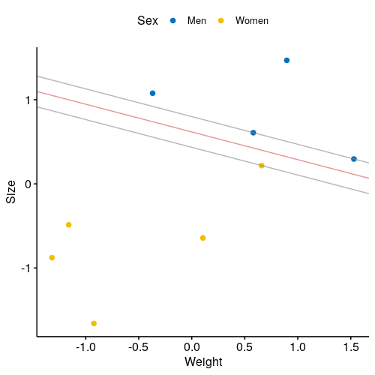
C = 100
C = 50

Slide 2
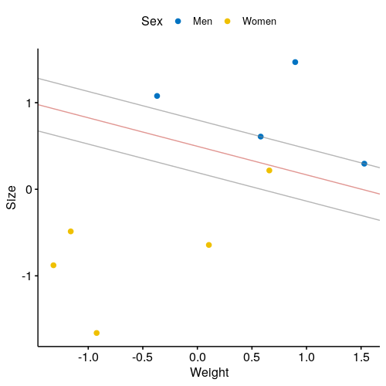
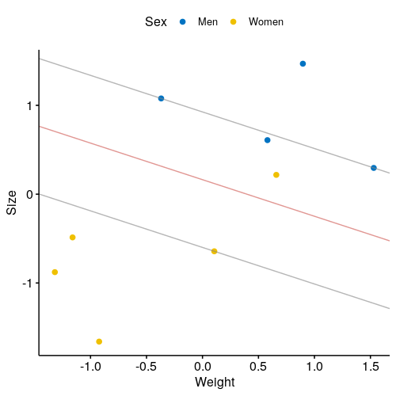
C = 10
C = 1

Slide 3
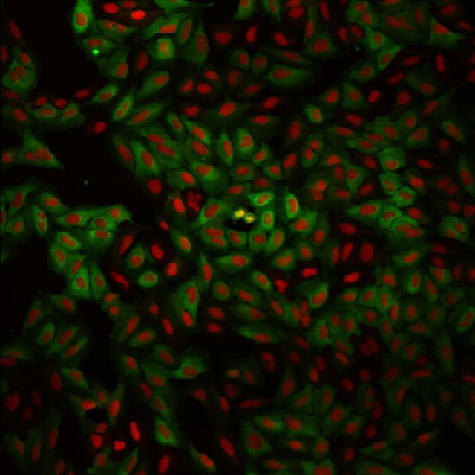
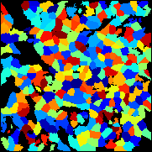
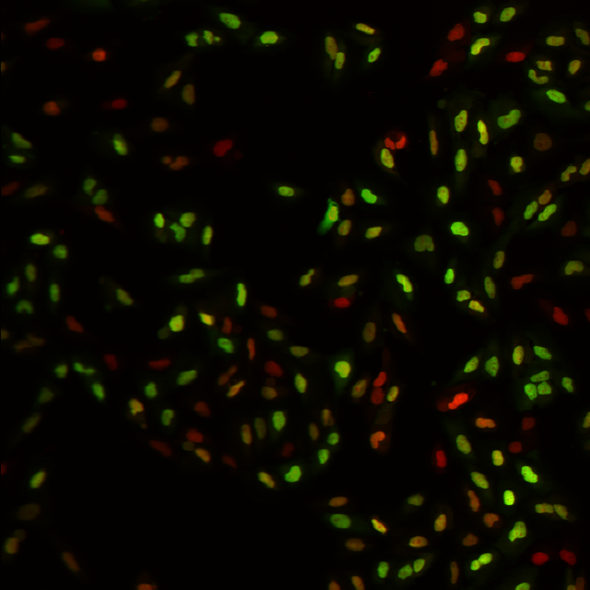
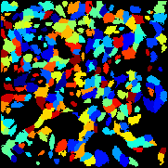
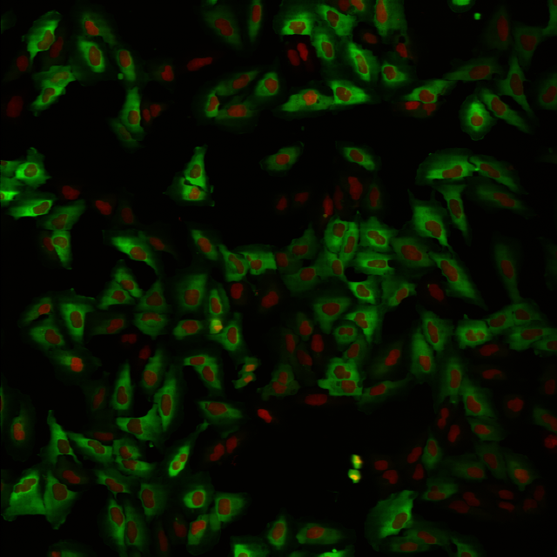
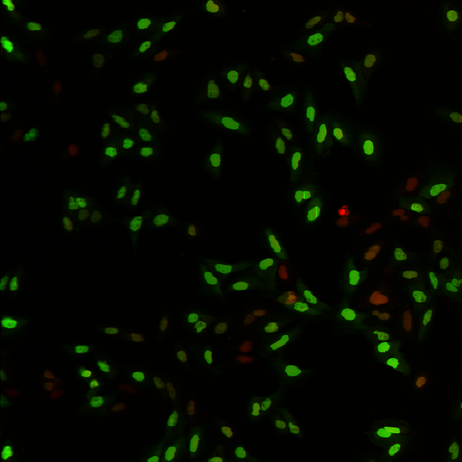
Object Detection
Feature extraction & Training
Images
Segmented Images
Classification
Negatives Cells
Negatives Cells
Positives Cells

Slide 4
Importing libraries
Importing the dataset
Dividing data into
attributes and labels
Import instruction
read_csv method
from Panda library
drop method
from Panda library
Making prediction on
the testing set
Training the model on
the training set
Dividing the data into
training and testing
sets
predict method from the
RandomForestClassifier
class
RandomForestClassifier
library from the ensemble
of scikit-learn.
Fit method from the
RandomForestClassifier class
train_test_split method
from the model_selecton
of scikit-learn
Evaluating the model
confusion_matrix method
from scikit-learn metrics library

Slide 5
Importing libraries
Importing the dataset
Dividing data into
attributes and labels
Import instruction
read_csv method
from Panda library
drop method
from Panda library
Making prediction on
the testing set
Training the model on
the training set
Dividing the data into
training and testing
sets
predict method from the
RandomForestClassifier
class
RandomForestClassifier
library from the ensemble
of scikit-learn.
Fit method from the
RandomForestClassifier class
train_test_split method
from the model_selecton
of scikit-learn
Evaluating the model
confusion_matrix method
from scikit-learn metrics library

Slide 6
Importing the
new dataset
Making prediction on
the new dataset
Model Accuracy
read_csv method
from Panda library
predict method from the SVC class

