Slide 1

α‑AGI Insight v1
Beyond Human Foresight
A zero‑data, offline‑first, meta‑agentic forecasting demo: map AGI‑driven sector phase transitions and actionable decision frontiers.
Notes:
[Sources]
- https://svs.gsfc.nasa.gov/31197 (background image source: carina_nebula_00000_print.jpg)
[/Sources]

Slide 2
Executive brief
Demo master presentation
What this demo delivers
MODE
ENGINE
OUTPUT
Offline‑first
Meta‑Agentic
Decision frontier
Runs with or without API keys
Falls back to local tree‑search runtime
3‑D scatter: effectiveness × risk × complexity
In one run, you obtain:
A calibrated capability curve and scenario controls (episodes, curve parameters, offline mode).
A population of candidate innovations evaluated across competing objectives (effectiveness, risk, complexity).
Operational outputs: first affected step/year, live agent status, and exportable results for decision playbooks.
α‑AGI Insight v1 — Beyond Human Foresight (Demo)
01 / 19
Notes:
[Sources]
- https://github.com/MontrealAI/AGI-Alpha-Agent-v0 (offline fallback + Insight demo CLI, and dashboard “3‑D scatter chart of effectiveness vs. risk vs. complexity”)
[/Sources]

Slide 3
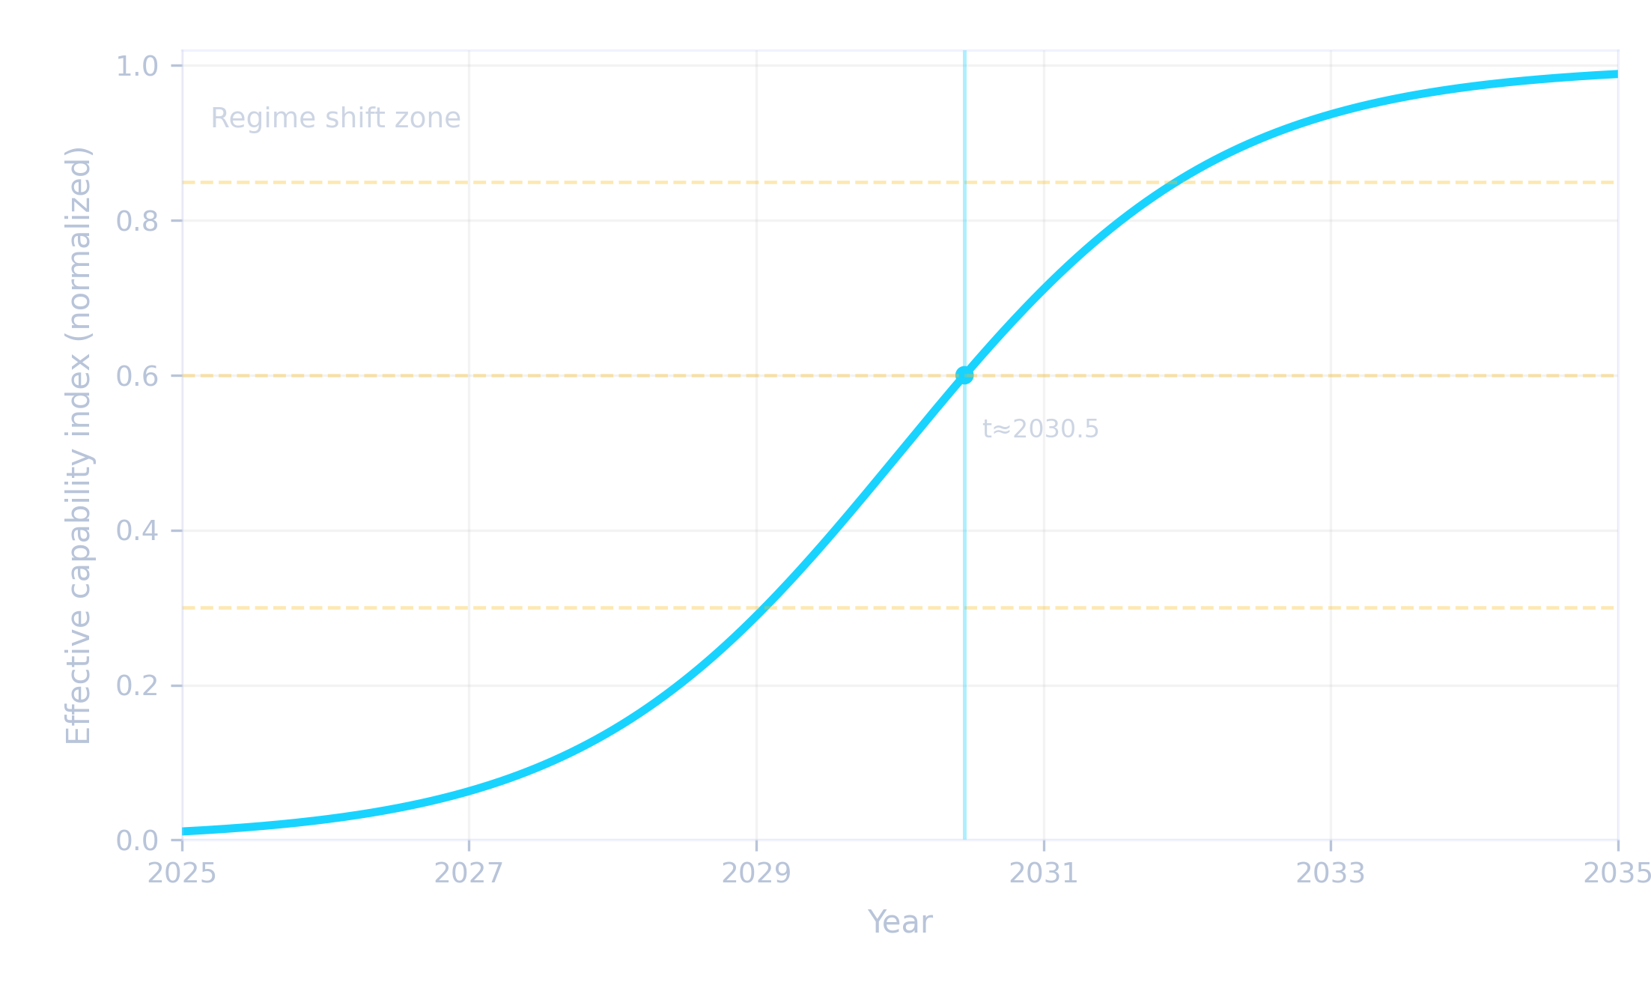
The discontinuity problem
From smooth trends to regime shifts
AGI impact is not linear — it arrives as phase change
This demo operationalizes “tipping points” as thresholds on a capability trajectory, then explores response options under competing objectives.
Capability curve (illustrative)
Interpretation
Thresholds represent domain susceptibility (automation → design → discovery).
Crossing a threshold is a regime shift: decisions must change, not just pace.
The demo’s role: explore the option space, then surface robust strategies.
α‑AGI Insight v1 — Beyond Human Foresight (Demo)
02 / 19
Notes:
[Sources]
- https://github.com/MontrealAI/AGI-Alpha-Agent-v0 (Insight demo description and runtime selection; capability curve is illustrative)
[/Sources]

Slide 4

System at a glance
Orchestration → search → outputs
α‑AGI Insight v1: meta‑agentic orchestration around an offline‑capable search loop
Pipeline
Foresight becomes infrastructure
Inputs
Run scenarios fast. Audit runs. Export decisions.
Sectors JSON, curve parameters, episodes, offline flags
Orchestrator
Runtime selection, status, health, agent coordination
Search loop
Meta‑Agentic Tree Search (offline fallback)
CLI and web modes; can run headless.
Health/status endpoints + agent heartbeats.
Local audit ledger for traceability; optional pinning via gateway.
Decision outputs
Affected steps/years, frontier scatter, logs & exports
α‑AGI Insight v1 — Beyond Human Foresight (Demo)
03 / 19
Notes:
[Sources]
- https://github.com/MontrealAI/AGI-Alpha-Agent-v0 (Insight demo: CLI, runtime fallback; health/status endpoints; audit ledger path; IPFS gateway env var)
- https://unsplash.com/photos/servers-illuminate-a-futuristic-cityscape-with-a-data-center-ISP9CdRYS28 (image)
[/Sources]

Slide 5
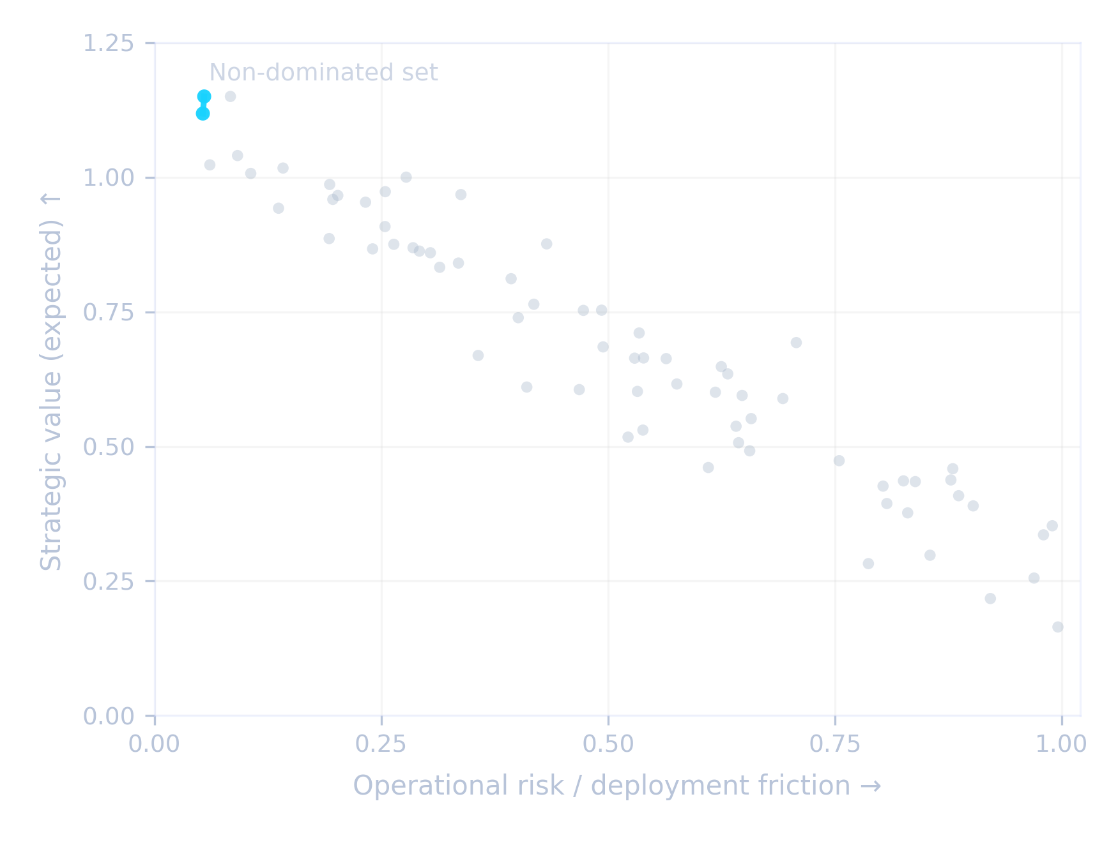
Core mechanism I
Meta‑Agentic Tree Search
Offline‑capable search loop: explore → evaluate → retain the frontier
The demo automatically falls back to a local Meta‑Agentic Tree Search when API credentials are absent.
Search loop (conceptual)
Decision frontier (illustrative projection)
Generate
Simulate
Mutate
Score
Select
α‑AGI Insight v1 — Beyond Human Foresight (Demo)
04 / 19
Notes:
[Sources]
- https://github.com/MontrealAI/AGI-Alpha-Agent-v0 ("falls back to the local Meta‑Agentic Tree Search" when API credentials are absent; dashboard “3‑D scatter chart of effectiveness vs. risk vs. complexity”)
[/Sources]

Slide 6
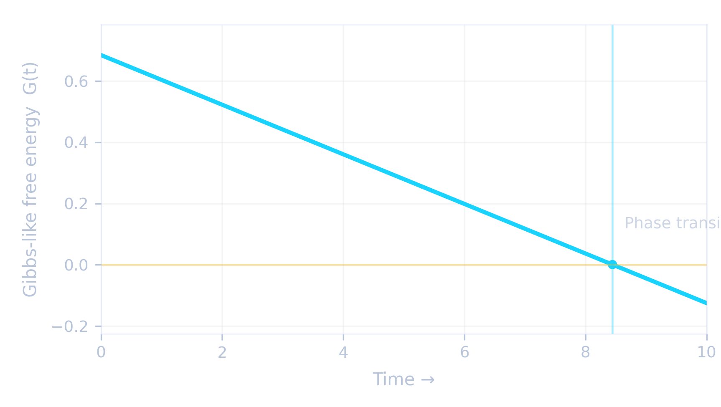
Core mechanism II
Energy–entropy controls
Thermodynamic lens: stability vs uncertainty as scenario controls
The demo exposes explicit “energy” and “entropy” knobs. A useful interpretation is a free‑energy threshold that marks regime change.
Model sketch (interpretation)
Phase marker (illustrative)
G = E − T·S
E (energy): structural stability / barriers to change.
S (entropy): uncertainty / degrees of freedom exploited by new capability.
T: capability “temperature” — increases over time via the configured curve.
Crossing G ≤ 0 is a natural marker for “phase transition”.
“Energy” and “entropy” are first‑class CLI parameters for the Insight simulation.
α‑AGI Insight v1 — Beyond Human Foresight (Demo)
05 / 19
Notes:
[Sources]
- https://github.com/MontrealAI/AGI-Alpha-Agent-v0 (Insight CLI example includes --energy and --entropy parameters; free‑energy equation shown is an interpretation layer)
[/Sources]

Slide 7

Core mechanism III
Orchestration, governance, observability
Operational control surface: status, health, tokens, TLS, sandbox limits
A practical system is one you can deploy, observe, constrain, and audit.
Sandboxed execution
+ bounded resources
Deployment & runtime controls (from the demo)
AGI_INSIGHT_OFFLINE
Force local inference models
AGI_INSIGHT_LEDGER_PATH
Local audit ledger path (audit.db)
AGI_INSIGHT_BUS_CERT / KEY / TOKEN
Secure gRPC transport and auth
API_TOKEN
Bearer token required by REST API
SANDBOX_CPU_SEC / SANDBOX_MEM_MB
Resource limits for sandboxed code
Health: /healthz • Live status: /status • Metrics: /metrics
α‑AGI Insight v1 — Beyond Human Foresight (Demo)
06 / 19
Notes:
[Sources]
- https://github.com/MontrealAI/AGI-Alpha-Agent-v0 (supported env vars incl. AGI_INSIGHT_OFFLINE, AGI_INSIGHT_LEDGER_PATH, bus TLS vars, API_TOKEN, sandbox limits; metrics endpoint; /healthz and /status described)
- https://unsplash.com/photos/a-rack-of-servers-in-a-server-room-2JJ3wBHu4_0 (image)
[/Sources]

Slide 8
Outputs
From raw simulation to decisions
The deliverable is a decision surface, not a single forecast
Interpret outputs as: “what becomes possible” + “what becomes fragile” + “which moves dominate under constraints.”
Disruption map
Option frontier
Operational trace
Affected step/year output (CLI + dashboard).
Attach to sector definitions for repeatable runs.
Use as an early‑warning system.
Population evaluated across objectives.
3‑D scatter in dashboard: effectiveness × risk × complexity.
Pick robust points, not “best” points.
Audit ledger persisted to a local DB path.
Health, status, and metrics endpoints for observability.
Offline runs available by design.
α‑AGI Insight v1 — Beyond Human Foresight (Demo)
07 / 19
Notes:
[Sources]
- https://github.com/MontrealAI/AGI-Alpha-Agent-v0 (CLI output example; dashboard 3‑D scatter; audit ledger path; health/status endpoints; offline mode guidance)
[/Sources]

Slide 9
Workflow
From sectors to runs
A reproducible run is a compact contract: parameters → outputs → ledger
1
Define sectors
Provide a sectors JSON (sample file path is included in the repo).
alpha-agi-insight-v1 --episodes 5
2
Select runtime
Use hosted models when configured; otherwise the demo falls back to the offline search loop.
3
Run episodes
CLI wrapper: alpha-agi-insight-v1 --episodes N (or python -m ...).
4
Inspect status
Use /status or agents-status to monitor heartbeats and restart counts.
5
Export decisions
Review the final population scatter, affected steps/years, and persist the ledger.
α‑AGI Insight v1 — Beyond Human Foresight (Demo)
08 / 19
Notes:
[Sources]
- https://github.com/MontrealAI/AGI-Alpha-Agent-v0 (sample sectors file path; Insight CLI; agents-status; /status endpoint; runtime fallback)
[/Sources]

Slide 10
Offline‑first by design
Air‑gapped execution
Runs anywhere: local search loop + optional local inference
Guarantee no network access with one flag; package includes guidance for wheelhouse installs and cached assets.
Guarantee offline execution
Air‑gapped operational profile
Prebuild a local wheel cache (wheels/) for installation.
Optional: set LLAMA_MODEL_PATH to a local .gguf weight for inference.
Build browser assets to enable offline web demo caching.
AGI_INSIGHT_OFFLINE=1 alpha-agi-insight-v1 --episodes 5
If OPENAI_API_KEY is empty, the demo uses offline mode automatically.
When the host cannot reach the internet, demos continue using cached data; optional downloads are skipped.
Offline guidance includes wheelhouse builds and local model weights.
α‑AGI Insight v1 — Beyond Human Foresight (Demo)
09 / 19
Notes:
[Sources]
- https://github.com/MontrealAI/AGI-Alpha-Agent-v0 (offline fallback behavior; AGI_INSIGHT_OFFLINE=1; wheelhouse steps; LLAMA_MODEL_PATH; offline asset build steps)
[/Sources]

Slide 11
Web console
Real‑time monitoring
Dashboard & API: monitor, steer, and validate runs in real time
The repo documents a web workflow (uvicorn + React client + Docker Compose) and defines service health criteria.
Stack (as described)
“Healthy when…”
FastAPI orchestrator
REST: /healthz, /status, /metrics
:8000/healthz returns 200 for orchestrator.
:8000/status exposes heartbeats and restart counts.
:8080 returns 200 for web container.
Web client (React)
npm ci → npm run dev/build
Compose/Helm
Web UI at :8080; API at :8000
Streamlit/minimal UI
Fallback UI for headless servers
Live plot:
3‑D scatter
(effectiveness, risk, complexity)
α‑AGI Insight v1 — Beyond Human Foresight (Demo)
10 / 19
Notes:
[Sources]
- https://github.com/MontrealAI/AGI-Alpha-Agent-v0 (web dashboard quick-start; health criteria for Compose stack; /healthz and /status; 3‑D scatter plot description; /metrics endpoint)
[/Sources]

Slide 12
Deployment
From laptop to cluster
Operational paths: Compose, Helm, and edge runner
The repository documents resource‑restricted agents and persistent storage for the audit ledger.
Docker Compose
Helm (Kubernetes)
Edge runner
cp .env.sample .env
docker compose up --build
# dashboard: http://localhost:8080
helm upgrade --install alpha-demo \
./infrastructure/helm-chart \
--values ./infrastructure/helm-chart/values.yaml \
--set env.RUN_MODE=web
# optional audit-ledger persistence:
# --set persistence.enabled=true \
# --set persistence.size=5Gi
python edge_runner.py \
--agents manufacturing,energy \
--cycle 60 --loglevel info
# forwards to: alpha_factory_v1.edge_runner
α‑AGI Insight v1 — Beyond Human Foresight (Demo)
11 / 19
Notes:
[Sources]
- https://github.com/MontrealAI/AGI-Alpha-Agent-v0 (deployment recipes: Compose/Helm; edge_runner; agents service resource limits and network_mode: none; audit ledger persistence guidance)
[/Sources]

Slide 13
Safety & security posture
Production‑minded constraints
Constrain power: isolate execution, require tokens, encrypt transport, log everything
Sandbox bounds
API tokens
Secure bus
CPU and memory limits for sandboxed code paths.
REST API requires API_TOKEN; fail fast when unchanged.
gRPC bus can use cert/key/token; TLS can be enforced.
Network isolation
Observability
Governance hooks
Agents can run without outbound network access (Compose hardening).
Metrics at /metrics; traces and dashboards described in repo.
Repo documents governance & compliance primitives and policy runbook.
α‑AGI Insight v1 — Beyond Human Foresight (Demo)
12 / 19
Notes:
[Sources]
- https://github.com/MontrealAI/AGI-Alpha-Agent-v0 (sandbox limits env vars; API_TOKEN; gRPC bus TLS vars; network_mode none; /metrics; governance & policy runbook references)
[/Sources]

Slide 14
Strategic interpretation
Game theory as a decision lens
Game theory lens: when the payoff matrix changes, equilibria move
Use the demo outputs to identify when incumbency advantages invert and which strategic moves remain dominant under uncertainty.
Decision patterns to test
Concrete hook to the demo
Commitment timing: pre‑position capabilities before thresholds are crossed.
Cooperation vs competition: where coordination becomes a dominant response.
Information asymmetry: who sees the regime shift first, and how fast do others adapt?
Option value: choose frontiers that preserve maneuverability under shock.
Use the 3‑D scatter to select strategies that dominate along a constraint (e.g., low risk at fixed effectiveness).
Use affected steps/years as the “move horizon” for investment and policy sequencing.
Use the ledger + parameters to run adversarial “what‑if” counterfactuals.
α‑AGI Insight v1 — Beyond Human Foresight (Demo)
13 / 19
Notes:
[Sources]
- https://github.com/MontrealAI/AGI-Alpha-Agent-v0 (3‑D scatter output; affected steps/years output; audit ledger persistence)
[/Sources]

Slide 15
Analytical lens
Hamiltonians & constraints
Hamiltonian lens: optimize value under invariants
The demo’s multi‑objective population can be treated as an energy landscape: local maxima, global frontiers, and constraint‑induced trajectories.
Conceptual mapping
Why this matters
H(x) = −V(x) + λ₁·Risk(x) + λ₂·Complexity(x)
It turns debates (“should we move fast?”) into parameterized trade‑offs.
It makes governance measurable: choose λ values, then test stability.
It supports portfolio thinking: allocate across multiple frontier points.
x: a strategy or innovation candidate.
V: value / effectiveness; penalties encode constraints.
Vary λ to sweep policies: “risk‑tight” vs “speed‑first”.
The frontier is the set of non‑dominated solutions across λ.
α‑AGI Insight v1 — Beyond Human Foresight (Demo)
14 / 19
Notes:
[Sources]
- https://github.com/MontrealAI/AGI-Alpha-Agent-v0 (dashboard objective axes: effectiveness vs. risk vs. complexity; equation shown is an interpretation layer)
[/Sources]

Slide 16

Autopoiesis
Self‑maintaining design loops
Meta‑agentic systems behave like living organizations: they generate, select, and reconfigure
The project defines “Meta‑Agentic” as second‑order agency over a population of agents and interaction rules.
Sense
Synthesize
Select
Stabilize
Adapt
Read environment + parameters + cached data
Generate candidates + plans
Retain the frontier under constraints
Persist ledger + deployable artifacts
Re‑run counterfactuals; update policy weights
Cycle repeats — with new constraints, new objectives, and new external signals.
α‑AGI Insight v1 — Beyond Human Foresight (Demo)
15 / 19
Notes:
[Sources]
- https://github.com/MontrealAI/AGI-Alpha-Agent-v0 (definition of Meta‑Agentic; system description sections referenced)
[/Sources]

Slide 17
Strategic value
Compounding advantage
Why this matters: compounding advantage accrues to superior foresight
A practical foresight engine shifts decision latency from months to minutes — and makes counterfactual testing routine.
Capital allocation
Invest before thresholds; exit brittle positions before shocks.
Industrial policy
Sequence training, safety, and standards against the move horizon.
Product strategy
Select frontier points aligned to risk appetite and time‑to‑ship.
Security posture
Run air‑gapped, token‑gated, observable deployments as baseline.
Scientific & energy regimes
Target high‑leverage discovery loops; treat compute/energy as a civilizational resource.
α‑AGI Insight v1 — Beyond Human Foresight (Demo)
16 / 19
Notes:
[Sources]
- https://github.com/MontrealAI/AGI-Alpha-Agent-v0 (offline-first claim; CLI + web tooling; deployment and security controls enabling fast iterative scenario runs)
[/Sources]

Slide 18
Interpretation & limits
How to use outputs responsibly
This is a demo forecasting engine — treat outputs as structured hypotheses
Rigor comes from repeatability: parameter sweeps, adversarial counterfactuals, and audited runs — not from a single run.
Best practices
Common failure modes
Run ensembles: vary curve, energy/entropy, mutation/crossover rates.
Use offline mode for reproducible air‑gapped runs.
Log and compare results via the audit ledger path.
Treat 3‑D scatter as a negotiation space between stakeholders.
Overconfidence in a single trajectory (ignore uncertainty).
Optimizing for one metric while silently increasing another (risk/complexity).
Skipping governance: running without tokens/TLS in sensitive contexts.
Treating the demo as “truth” rather than a disciplined generator of hypotheses.
α‑AGI Insight v1 — Beyond Human Foresight (Demo)
17 / 19
Notes:
[Sources]
- https://github.com/MontrealAI/AGI-Alpha-Agent-v0 (parameters for offline runs; audit ledger path; security controls; 3‑D scatter objective axes)
[/Sources]

Slide 19
Foresight becomes a system.
Run • Observe • Constrain • Audit • Decide
α‑AGI Insight v1 (Demo) operationalizes the transition from speculation to repeatable strategic simulation.
Thank you.
Notes:
[Sources]
- https://unsplash.com/photos/servers-illuminate-a-futuristic-cityscape-with-a-data-center-ISP9CdRYS28 (background image)
- https://github.com/MontrealAI/AGI-Alpha-Agent-v0 (system description, offline capability, deployment guidance)
[/Sources]

