Slide 1

🏛️ Large‑Scale α‑AGI Business 3 • Ω‑Lattice
Omega‑Grade Edition
An institutional demo master presentation for a large‑scale, multi‑agent enterprise engine: governed, auditable, and deployable.
Design language: purplish‑red, high‑signal, audit‑ready
MONTREAL.AI • Large‑Scale α‑AGI Business 3 — Omega‑Grade Edition
01
Notes:
[Sources]
- Background artwork provided by user (attached image).

Slide 2

Ω‑Lattice • Omega‑Grade
Master Narrative
Why an autonomous enterprise primitive now
Opportunity landscape: financial • physical • informational
Operating principle: free‑energy reduction → compounding output
Architecture: orchestrator, agents, ledger, safety, observability
Governance: mechanism design + credible commitments
Deployment: local → cloud → air‑gapped
Roadmap: pilot, scale, sovereign operations
MONTREAL.AI • Large‑Scale α‑AGI Business 3 — Omega‑Grade Edition
02
Notes:
[Sources]
- Background artwork provided by user (attached image).

Slide 3
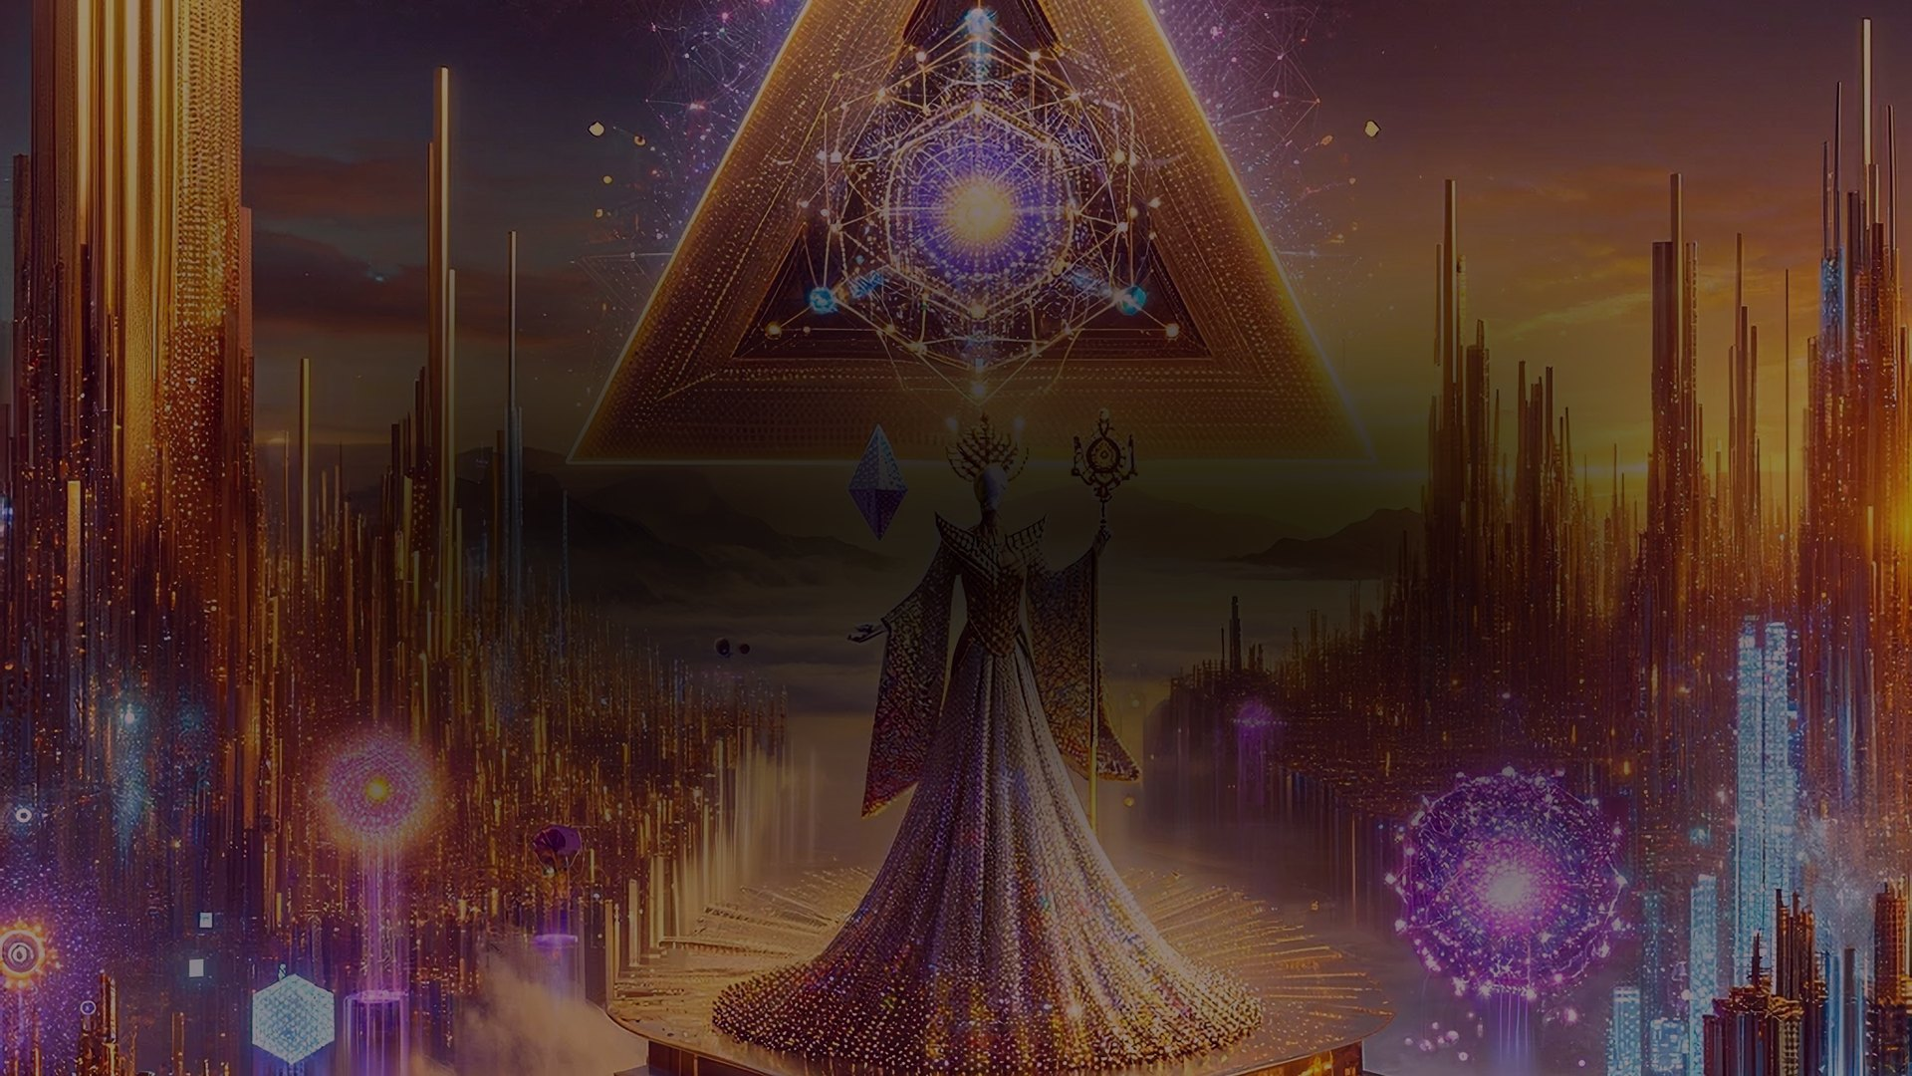
Ω‑Lattice • Omega‑Grade
Thesis
Build an enterprise that continuously converts latent inefficiency into governed, auditable, compounding output — across markets, infrastructure, and knowledge.
Primitive
α‑AGI Business
Autonomous enterprise loop with explicit incentives and accountability.
Kernel
Ω‑Lattice
Orchestrated agents minimizing free‑energy under constraints.
Guarantee
Auditability
Deterministic logs, policy gates, and attestations.
Designed for serious institutions: fast, observable, and governable.
MONTREAL.AI • Large‑Scale α‑AGI Business 3 — Omega‑Grade Edition
03
Notes:
[Sources]
- Mission framing and α‑AGI Business wording surfaced via: https://www.mcp.pizza/mcp-client/i6V8/AGI-Alpha-Agent-v0

Slide 4
Ω‑Lattice • Omega‑Grade
Opportunity Landscape
Financial
Physical
Informational
Pricing dislocations
Volatility regimes
Liquidity microstructure
Structured risk transfer
Grid load imbalance
Manufacturing waste
Logistics entropy
Resource scheduling
Knowledge bottlenecks
Policy phase‑lags
R&D search spaces
Signal extraction
MONTREAL.AI • Large‑Scale α‑AGI Business 3 — Omega‑Grade Edition
04
Notes:
[Sources]
- Background artwork provided by user (attached image).

Slide 5
Ω‑Lattice • Omega‑Grade
Operating Principle: Free‑Energy Reduction
ΔG = ΔH − TΔS
Decision rule
1) Estimate ΔH and ΔS from signals and models
2) Calibrate T from regime indicators
3) Prioritize actions with ΔG < 0
4) Verify before committing
Use thermodynamic language as a disciplined metaphor:
• ΔH = latent work (recoverable value)
• ΔS = uncertainty / disorder
• T = environment temperature (risk regime)
A good move reduces free‑energy while respecting constraints.
Result: a simple objective that scales across domains.
MONTREAL.AI • Large‑Scale α‑AGI Business 3 — Omega‑Grade Edition
05
Notes:
[Sources]
- Gibbs free energy relationship (G = H − TS): https://chem.libretexts.org/Bookshelves/Physical_and_Theoretical_Chemistry_Textbook_Maps/Supplemental_Modules_%28Physical_and_Theoretical_Chemistry%29/Thermodynamics/Energies_and_Potentials/Free_Energy/Gibbs_%28Free%29_Energy
- Additional reference: https://chemed.chem.purdue.edu/genchem/topicreview/bp/ch21/gibbs.php
- Background artwork provided by user (attached image).

Slide 6
Ω‑Lattice • Omega‑Grade
System Architecture (Institution‑Grade)
Ω‑Orchestrator
Routes jobs • sets temperature • allocates budget • composes evidence
Trust Stack
• Policy gates (tools, budgets, scopes)
• Sandboxing + least privilege
• Observability: logs, traces, dashboards
• Ledgered commitments
• Human governance for high‑impact actions
Finance agent
Energy agent
Logistics agent
Manufacturing agent
Policy agent
R&D agent
Outcome: autonomy with accountability.
MONTREAL.AI • Large‑Scale α‑AGI Business 3 — Omega‑Grade Edition
06
Notes:
[Sources]
- α‑AGI Business definition and mission surfaced via: https://www.mcp.pizza/mcp-client/i6V8/AGI-Alpha-Agent-v0
- Background artwork provided by user (attached image).

Slide 7

Ω‑Lattice • Omega‑Grade
Autopoietic Enterprise Loop
A self‑maintaining system: it produces the components that keep it producing.
Model
Signal
Plan
Learn
Execute
Verify
The loop is constrained by policy, and improved only through verified updates.
This makes scaling possible without losing institutional control.
MONTREAL.AI • Large‑Scale α‑AGI Business 3 — Omega‑Grade Edition
07
Notes:
[Sources]
- Autopoiesis introduced by Maturana & Varela (1972), overview: https://en.wikipedia.org/wiki/Autopoiesis
- Background artwork provided by user (attached image).

Slide 8
Ω‑Lattice • Omega‑Grade
Governance as Game Design (PARTS)
Change the game by changing its elements — not just its moves.
Players
Who participates; which roles are permitted.
Added Value
What each participant contributes or extracts.
Rules
Constraints, policies, enforcement.
Tactics
Timing, signaling, commitments.
Scope
Which arenas are inside the boundary.
MONTREAL.AI • Large‑Scale α‑AGI Business 3 — Omega‑Grade Edition
08
Notes:
[Sources]
- PARTS framework (players, added values, rules, tactics, scope) in “The Right Game”: https://econspace.net/teaching/MGT-528/Brandenburger-Nalebuff-HBR-1995.pdf
- Background artwork provided by user (attached image).

Slide 9
Ω‑Lattice • Omega‑Grade
α‑Job Lifecycle (End‑to‑End)
01 Detect
Signals → candidates
02 Formulate
Objective + constraints
03 Allocate
Agents + budget
04 Execute
Tools + actions
05 Verify
Proofs + audits
06 Settle
Ledger + learn
Every stage emits evidence: logs, policies, approvals, proofs — enabling speed without sacrificing governance.
Operational best practices
• Human‑in‑the‑loop gates for high‑impact actions
• Deterministic replay for audits and incident review
• Budgeted autonomy: bounded scopes + explicit risk envelopes
MONTREAL.AI • Large‑Scale α‑AGI Business 3 — Omega‑Grade Edition
09
Notes:
[Sources]
- Lifecycle framing synthesized from agent‑orchestration best practices and the mission statement surfaced via: https://www.mcp.pizza/mcp-client/i6V8/AGI-Alpha-Agent-v0
- Background artwork provided by user (attached image).

Slide 10
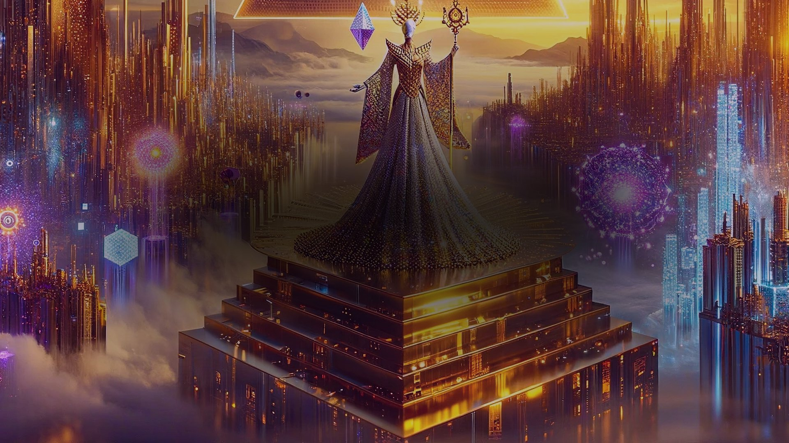
Ω‑Lattice • Omega‑Grade
Scale Intuition: Kardashev II Mindset
The goal is a civilization‑scale coordination primitive: make energy, capital, and knowledge legible and actionable.
Energy
• From local optimization to grid‑scale orchestration
Capital
• From static portfolios to adaptive risk budgets
Knowledge
• From search to validated synthesis and execution
Governance
• From paperwork to cryptographic accountability
Type II reference
A Type II civilization is often described as one capable of harnessing the energy output of its star (e.g., via Dyson‑sphere‑like infrastructure).
Here it serves as a planning metaphor: think in energy throughput, waste minimization, and long‑horizon stability.
MONTREAL.AI • Large‑Scale α‑AGI Business 3 — Omega‑Grade Edition
10
Notes:
[Sources]
- Kardashev scale (Type II as stellar-scale energy use): https://www.britannica.com/science/Kardashev-scale
- Background artwork provided by user (attached image).

Slide 11
Ω‑Lattice • Omega‑Grade
Deployment Modes
Local
Single machine. Fast iteration, reproducible runs.
Cloud
Horizontally scalable agents. Observability-first.
Air‑gapped
On‑prem, no external calls. Sovereign control.
Hybrid
Sensitive data on‑prem; burst compute in cloud.
MONTREAL.AI • Large‑Scale α‑AGI Business 3 — Omega‑Grade Edition
11
Notes:
[Sources]
- Background artwork provided by user (attached image).

Slide 12
Ω‑Lattice • Omega‑Grade
Observability & Audit
Every action produces traceable evidence: inputs → tools → outputs → decisions.
• Deterministic replay of high‑impact sequences
• Policy logs: approvals, denials, boundaries
• Ledgered commitments: immutable state transitions
Institutional outcomes
• Audit readiness
• Operational resilience
• Regulatory clarity
• Fast incident triage
• Measured autonomy
MONTREAL.AI • Large‑Scale α‑AGI Business 3 — Omega‑Grade Edition
12
Notes:
[Sources]
- Background artwork provided by user (attached image).

Slide 13
Ω‑Lattice • Omega‑Grade
Primary Use Cases
Markets
Discovery, hedging, execution, reporting.
Energy & Industry
Dispatch, scheduling, predictive maintenance.
R&D
Search, synthesis, experiment planning, review.
Operations
Supply chain, routing, capacity, procurement.
Policy
Monitoring, scenario analysis, compliant execution.
Security
Continuous controls, anomaly detection, response.
MONTREAL.AI • Large‑Scale α‑AGI Business 3 — Omega‑Grade Edition
13
Notes:
[Sources]
- Domain-agnostic “alpha” examples surfaced via: https://www.mcp.pizza/mcp-client/i6V8/AGI-Alpha-Agent-v0
- Background artwork provided by user (attached image).

Slide 14
Ω‑Lattice • Omega‑Grade
Roadmap: Pilot → Scale → Sovereign
Phase 1 — Pilot
Single domain, bounded tools, measurable KPIs.
Phase 2 — Multi‑Domain
Cross‑domain routing; unified audit trail.
Phase 3 — Institutional Scale
Governance automation; resilient operations.
Phase 4 — Sovereign
Air‑gapped modes; attestations; long‑horizon stability.
MONTREAL.AI • Large‑Scale α‑AGI Business 3 — Omega‑Grade Edition
14
Notes:
[Sources]
- Background artwork provided by user (attached image).

Slide 15
Ω‑Lattice • Omega‑Grade
A new enterprise primitive
Autonomy • Governance • Proof • Compounding value
If you can make the world legible, you can make it governable.
If you can make it governable, you can make it prosperous.
Next: choose a pilot domain, define the policy envelope, and run the loop.
MONTREAL.AI • Large‑Scale α‑AGI Business 3 — Omega‑Grade Edition
15
Notes:
[Sources]
- Background artwork provided by user (attached image).

