Slide 1
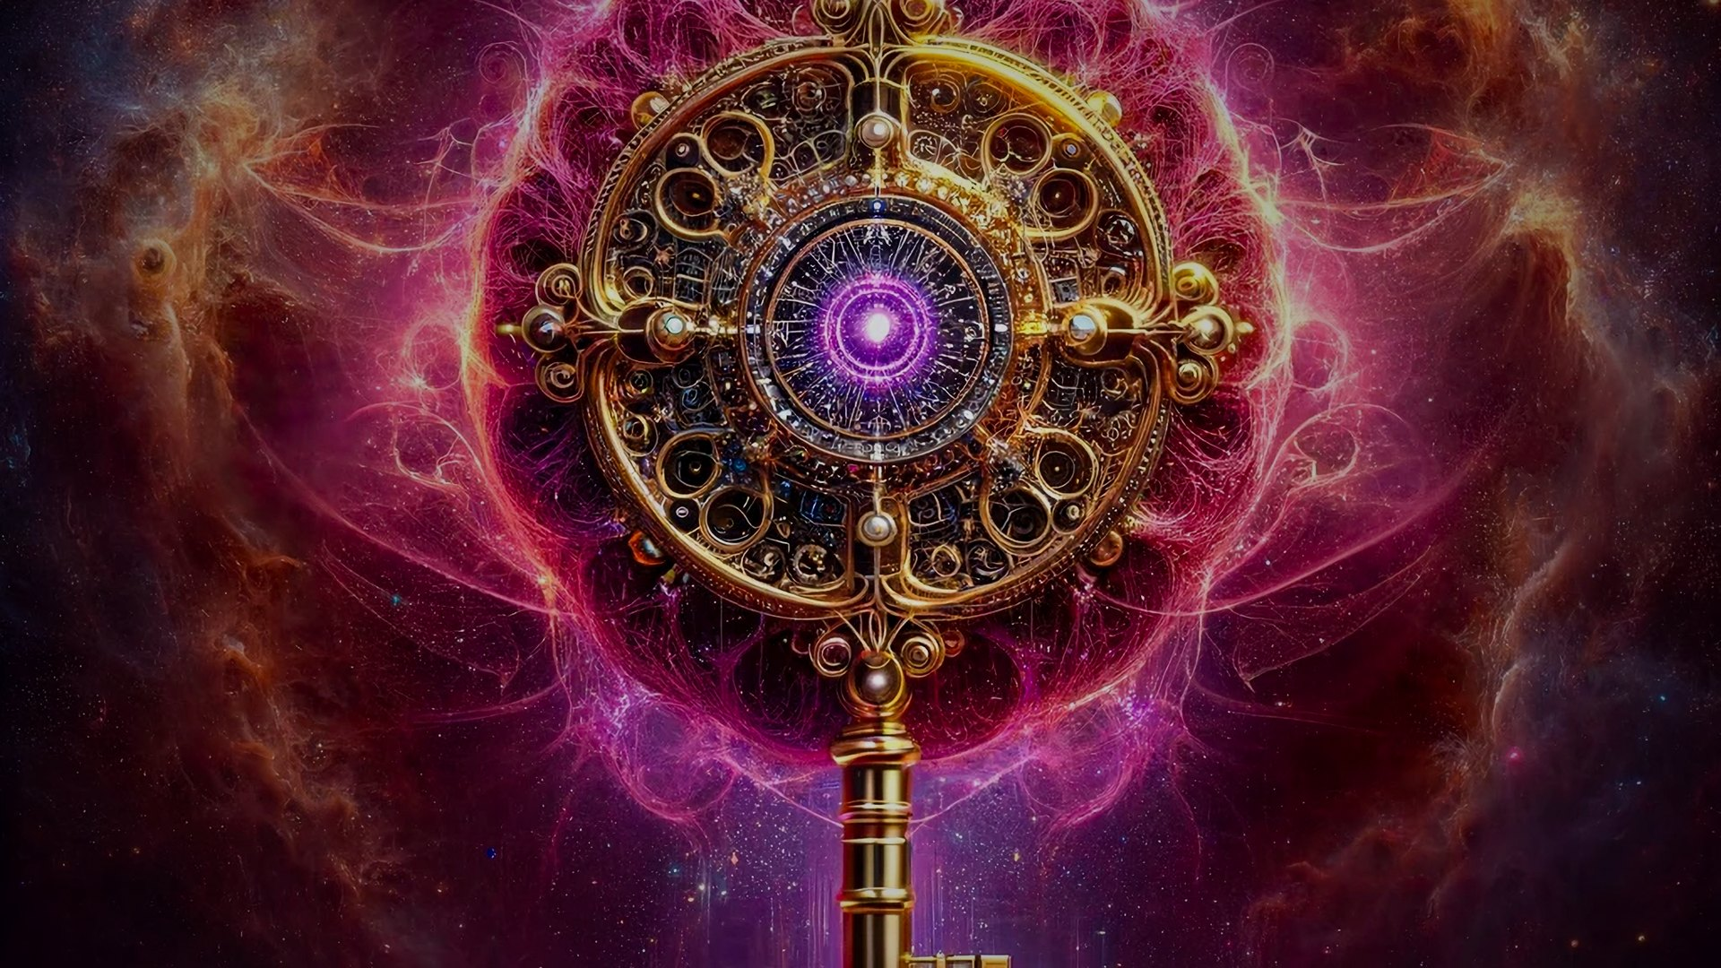
AGI Jobs v0 (v2)
Demos Master Presentation
A production-grade command lattice for verifiable agentic work
Montreal.AI • agialpha.com • main branch
Notes:
[Sources] - User-provided hero image (key). [/Sources]

Slide 2

AGI Jobs v0 (v2)
Executive Lens
What you are seeing
AGI Jobs v0 (v2) is engineered as a unified operational surface: agents + contracts + paymasters + orchestrators + simulations + demos — enforced by CI v2 so “main” is deployable truth.
Unified Intelligence Engine
Deterministic Owner Control
Verifiable Operations
One lattice composing mission-critical subsystems into a single control surface.
Verified command center scripts keep pausing, upgrades, and parameters under owner authority.
CI v2 produces auditable artefacts (status feeds, authority matrices, load sims) that gate merges.
© Montreal.AI
agialpha.com • main branch
Notes:
[Sources] - Repository demo docs: demo constellation, owner control, CI v2 artefacts. [/Sources]

Slide 3
AGI Jobs v0 (v2)
Why Demos
Demos are rehearsal engines — not marketing assets
Each demo pressure-tests the control plane under conditions that matter: adversarial timing, parameter drift, and execution constraints.
What demos do (in practice)
Stress economic parameters via Monte Carlo load simulations and compare dissipation metrics across configurations.
Validate pause/unpause, upgrades, and rotation paths with deterministic owner command scripts.
Produce artefacts (status feeds, matrices, plans) that travel with every decision: review → approval → deployment.
Keep the “green wall” objective: no merge or release without reproducible verification.
© Montreal.AI
agialpha.com • main branch
Notes:
[Sources] - Repository demo docs: load simulation artefacts; owner scripts; CI wall feeds. [/Sources]

Slide 4
AGI Jobs v0 (v2)
Demo Constellation
Demo constellation map
High-stakes rehearsals codified as reproducible scripts + UI bundles, enforced by companion workflows.
Tracks
Sovereign Constellation — build-level rehearsal
Celestial Archon — control doctrine
Hypernova Governance — time-pressure tuning
Kardashev II — omega-grade scenario envelopes
Core
Lattice
© Montreal.AI
agialpha.com • main branch
Notes:
[Sources] - Repository demo docs: demo tracks & companion workflows. [/Sources]

Slide 5
AGI Jobs v0 (v2)
Architecture
Architecture panorama
Owners command. Core executes. Observability proves. CI enforces.
Mission
Owners
Owner Control
Plane
Contracts
+ Modules
Services
& Gateway
Operator Apps
(UIs)
Strategic
Demos
Observability
Fabric
CI v2
Enforcement
Closed-loop control
Artefacts and CI outcomes cycle back to owners and operators as decision-grade proofs — a control loop that keeps promotion legible, bounded, and reversible.
© Montreal.AI
agialpha.com • main branch
Notes:
[Sources] - Repository demo docs: architecture overview; control plane artefacts. [/Sources]

Slide 6
AGI Jobs v0 (v2)
Owner Command Center
Deterministic control plane
A pipeline that converts configuration reality into executable, auditable actions.
$ npm run owner:surface
$ npm run owner:parameters
$ npm run owner:doctor
$ npm run owner:mission-control
$ npm run owner:update-all
What the pipeline does
Surface scan fingerprints config drift → parameter matrices export a complete tuning map → doctor triage scores pass/warn/fail → mission-control condenses a decision brief → update-all executes deterministically and archives artefacts.
Why it matters
Run it in air-gapped control rooms. Every step emits files suitable for approvals, compliance, and post-mortems — and CI can refuse merges if owner control coverage is incomplete.
© Montreal.AI
agialpha.com • main branch
Notes:
[Sources] - Repository demo docs: owner:* scripts and generated reports/owner-control/**. [/Sources]

Slide 7
AGI Jobs v0 (v2)
Safety Levers
Pause / Resume as a first-class operation
When the lattice must stop, it stops deterministically — with previewed calldata and ownership checks.
$ npm run owner:system-pause -- --network <net>
# emits pause/unpause calldata + tx preview JSON
Operational contract
Recovery posture
One command produces everything an operator needs: what will change, how it will be signed, and how it will be verified — before it touches the chain.
Resume is treated as an audited change: regenerate authority matrices, re-check CI status feeds, and re-run the rehearsal that triggered the pause before restoring full throughput.
© Montreal.AI
agialpha.com • main branch
Notes:
[Sources] - Repository demo docs: owner pause scripts; mission-control & CI status feeds. [/Sources]

Slide 8
AGI Jobs v0 (v2)
Independent Verification
API-level verification (no local tooling)
Operators can corroborate the CI wall directly from the GitHub REST API with standard tools.
# latest workflow result on main
curl -s 'https://api.github.com/repos/MontrealAI/AGIJobsv0/actions/workflows/ci.yml/runs?branch=main&per_page=1' \
| jq -r '.workflow_runs[0].status, .workflow_runs[0].conclusion'
# capture run id
RUN_ID=$(curl -s 'https://api.github.com/repos/MontrealAI/AGIJobsv0/actions/workflows/ci.yml/runs?branch=main&per_page=1' \
| jq -r '.workflow_runs[0].id')
# enumerate job conclusions
curl -s "https://api.github.com/repos/MontrealAI/AGIJobsv0/actions/runs/${RUN_ID}/jobs?per_page=100" \
| jq -r '.jobs[] | "\(.name): \(.conclusion)"'
# assert all success (exit code 0)
curl -s "https://api.github.com/repos/MontrealAI/AGIJobsv0/actions/runs/${RUN_ID}/jobs?per_page=100" \
| jq -e 'all(.jobs[].conclusion == "success")'
Outcome — Independent parties can validate the same enforcement wall without cloning the repo: a portable proof primitive for institutions.
© Montreal.AI
agialpha.com • main branch
Notes:
[Sources] - GitHub REST API documentation; repository CI workflow outputs. [/Sources]

Slide 9
AGI Jobs v0 (v2)
CI v2 Enforcement
The green wall is policy, not preference
CI telemetry produces machine-readable feeds; branch protection scripts keep required contexts aligned with the workflow lattice.
Telemetry feed
Branch protection autopilot
reports/ci/status.json → dashboards
reports/ci/status.md → briefings
A local CLI reproduces the same wall on demand and gates deployments.
$ npm run ci:status-wall -- --require-success --include-companion --format json
ci:sync-contexts (check / regenerate)
ci:verify-contexts
ci:verify-companion-contexts
ci:verify-branch-protection
ci:enforce-branch-protection
Outcome: PR checks cannot go green unless all required contexts — including demo companions — pass.
© Montreal.AI
agialpha.com • main branch
Notes:
[Sources] - Repository demo docs: CI status wall and branch protection scripts. [/Sources]

Slide 10
AGI Jobs v0 (v2)
Artefacts
Observability fabric: decision-grade artefacts
Everything important becomes a file: status, authority, plans, and stress-test traces.
Owner-control proofs
CI status feeds
Load simulations
reports/owner-control/**
• authority matrices
• doctor reports
• command-center digest
• parameter plans
reports/ci/status.{json,md}
• machine-readable wall
• briefing-ready mirror
reports/load-sim/**
• Monte Carlo CSV + JSON
• economic dissipation analysis
© Montreal.AI
agialpha.com • main branch
Notes:
[Sources] - Repository demo docs: reports/** artefact taxonomy. [/Sources]

Slide 11
AGI Jobs v0 (v2)
Strategic Demos
Sovereign Constellation Demo
Build-level rehearsal of the full constellation: core modules ↔ services ↔ operator surfaces ↔ proofs.
What it validates
Signals to watch
End-to-end integration between contracts, gateway/orchestrators, and apps
Deterministic artefact production (reports/**)
CI companion workflow gating (the demo must pass beside the main wall)
Status feeds match the checks wall; demo outputs are reproducible locally and in CI.
Outcome
A demo that behaves like a deployment: if it fails, the lattice does not advance.
© Montreal.AI
agialpha.com • main branch
Notes:
[Sources] - Repository demo docs: Sovereign Constellation demo and CI companion gating. [/Sources]

Slide 12
AGI Jobs v0 (v2)
Strategic Demos
Celestial Archon Demonstration
A rehearsal of control doctrine: provenance, authority, and enforcement loops.
Core checks
How it feels in operation
Allowed signers registry + provenance checks for release readiness
Authority matrix regeneration and parity with enforced contexts
CI guardrails report what is allowed to ship
Operators never “trust the vibe.” They trust signed artefacts, visible checks, and deterministic scripts that can be re-run by independent parties.
© Montreal.AI
agialpha.com • main branch
Notes:
[Sources] - Repository demo docs: provenance/signers registry and authority matrix parity checks. [/Sources]

Slide 13
AGI Jobs v0 (v2)
Strategic Demos
Hypernova Governance Demonstration
Governance under time pressure: recalibrate parameters without surrendering control.
surface
parameters
doctor
mission-control
update-all
What “governance” means here
Desired end state
A verifiable loop: owner council scripts regenerate the authority matrix; CI enforces parity with branch protection; artefacts cycle back into operator consoles and decision briefings.
Changes are legible, bounded, and reversible — without sacrificing pace.
© Montreal.AI
agialpha.com • main branch
Notes:
[Sources] - Repository demo docs: owner pipeline and CI parity enforcement. [/Sources]

Slide 14
AGI Jobs v0 (v2)
Scenario Tracks
Kardashev II • Omega-grade demo tracks
A suite of progressively harder rehearsal variants packaged as dedicated tracks in the repository.
Track roster (repo directories)
kardashev_ii_omega_grade_alpha_agi_business_3_demo
…_k2
…_k2_omega_upgrade
…_omega
…_ultra
kardashev_ii_omega_grade_upgrade_for_alpha_agi_business_3_demo
…_v2 / …_v3 / …_v4 / …_v5
Interpretation
Treat each track as a reproducible scenario envelope; compare artefacts and stability across envelopes before promoting changes.
© Montreal.AI
agialpha.com • main branch
Notes:
[Sources] - Repository demo docs: scenario track directories and progression. [/Sources]

Slide 15
AGI Jobs v0 (v2)
Operational Intuitions
Stability as a measurable property
The repository operationalises two cross-checkable ideas: simulation-based stress testing and thermostat-style control services.
Statistical physics lens (practical)
Game-theoretic lens (practical)
Monte Carlo load sims generate traces
Artefacts include “economic dissipation” analysis
Owners re-tune parameters based on evidence, not intuition
Incentives and permissions are encoded as matrices and enforced contexts: if incentives drift, the wall blocks promotion.
Autopoiesis (operational)
Closed loops regenerate their own proofs: configs → matrices → actions → artefacts → CI gates → owners.
© Montreal.AI
agialpha.com • main branch
Notes:
[Sources] - Repository demo docs: load sims, thermostat controls, proof loops. [/Sources]

Slide 16
AGI Jobs v0 (v2)
Deployment Readiness
Quickstart for operators
Match the pinned toolchain so CI and local runs converge.
Toolchain
Promotion checklist
Node.js 20.18.1 (pinned via .nvmrc / .node-version)
Python 3.12
Validate runtime: npm run doctor:node
Principle: avoid “works on my machine.”
Run owner:surface
Export owner:parameters
Resolve owner:doctor warnings
Generate mission-control brief
Produce safe bundle (plan)
Execute update-all
Verify via CI status feeds + API checks
Re-run the target demo suite
© Montreal.AI
agialpha.com • main branch
Notes:
[Sources] - Repository demo docs: pinned toolchain and operator checklist. [/Sources]

Slide 17
From demo to deployed
Verifiable coordination at scale — with control, proofs, and enforcement baked into every path.
Repository: github.com/MontrealAI/AGIJobsv0
Notes:
[Sources] - User-provided hero image (key). [/Sources]

