Slide 1

Global Synthetic Labor
Index Prototype
Identity → Proof → Settlement → Markets
A civilization‑grade control loop for verifiable synthetic work:
Observe → Prove → Settle → Print → Price → Finance → Expand
agi.eth
1
Notes:
[Sources] - Phoenix image: user-provided asset (QmT7oaKW...). [/Sources]

Slide 2
EXECUTIVE CHARTER
One invariant. Four pillars.
No value without evidence · No settlement without validation
Identity
Evidence
Roles bound to keys (ENS/DID).
Accountability by default.
Scope rules prevent ambiguity.
Deterministic runs emit proof bundles.
Replay beats rhetoric (audit = replay).
Commit–reveal reduces bribery leverage.
Settlement
Governance
Escrow releases only after validation.
Receipts are settlement‑grade artifacts.
No payout without PoC.
Policy gates, upgrades, emergency brakes.
Owner override is final (bounded autonomy).
MethodHash freezes index rules per epoch/quarter.
Executive Charter
2
Notes:
[Sources] - Institutional brief concepts and invariant wording: AGI_Eth_Institutional_v0.pdf (user-provided). [/Sources]

Slide 3
CONTROL LOOP
A low‑entropy path where honesty wins.
Observe
Prove
Settle
Print
Price
Finance
Expand
Physics intuition (Gibbs free energy)
Game theory (dominant strategies)
F = U − T·S
U: utility captured · S: ambiguity/dispute surface
T: operational friction
Goal: drive T·S → 0 via determinism + receipts + incentives.
Workers earn only for validated proof.
Validators are stake‑bonded; misbehavior becomes negative‑sum (slashing).
Commit–reveal reduces herding and bribery leverage.
Control Loop
3
Notes:
[Sources] - Control loop framing and free‑energy wording: AGI_Eth_Institutional_v0.pdf (user-provided). [/Sources]

Slide 4
SECTION
Ledger & Governance
Freeze truth at L0. Evolve policy at L1—without rewriting history.
agi.eth
4

Slide 5
L0 / L1
L0 Aegis · L1 Apotheosis
Conservation laws + surgical brakes
L0 Aegis (frozen)
L1 Apotheosis (evolvable)
Commit · Receipt · Settle — reconstructible from events.
Invariants:
• Conservation of value
• Single finality (idempotent)
• Deterministic dispute windows
• Receipt anti‑replay (EIP‑712 + nonces)
• Role legibility (ENS ↔ key)
Policy modules are hot‑swappable but may only restrict behavior—never violate L0.
Pause lattice:
• JOBS: stop new commitments
• RECEIPTS: stop new submissions
• PAYOUTS: stop fund egress
• DISPUTES: freeze adjudication
Ledger & Governance
5
Notes:
[Sources] - L0/L1 concepts and invariants: L0_Aegis_L1_Apotheosis_Overview_FINAL (user-provided). - EIP-712: https://eips.ethereum.org/EIPS/eip-712 [/Sources]

Slide 6
SECTION
Identity & Safety
One signature, bounded blast radius: fuse membranes + witnessed delegation + recovery.
agi.eth
6

Slide 7
ENS
ENS namespace grammar
One rule + scoped meaning (low entropy, high legibility)
<entity>.(<env>.)<role>.agi.eth
role ∈ {club, agent, node} · env ∈ ENV_SET (optional)
Role lattice (alpha + production)
Scale without ambiguity
Validators: *.alpha.club.agi.eth | *.club.agi.eth
Agents: *.alpha.agent.agi.eth | *.agent.agi.eth
Nodes: *.alpha.node.agi.eth | *.node.agi.eth
Sovereigns: *.alpha.agi.eth | *.agi.eth
Guardrail: reserve {agent,node,club} under every env.agi.eth.
ENSIP‑10 wildcards for *.role namespaces.
EIP‑3668 (CCIP‑Read) for high‑churn metadata.
ENSIP‑15 normalization to harden lookups.
Best practice: keep trust anchors minimal; push churn into resolvers.
Identity & Safety
7
Notes:
[Sources] - ENSIP-10 wildcard resolution: https://docs.ens.domains/ens-improvement-proposals/ensip-10-wildcard-resolution - ENSIP-15 normalization: https://docs.ens.domains/ens-improvement-proposals/ensip-15-normalize - EIP-3668 CCIP-Read: https://eips.ethereum.org/EIPS/eip-3668 [/Sources]

Slide 8
PASSPORT
AGI Passport (EIP‑7702 safety layer)
Identity membrane · delegation transparency · auto‑healing recovery
Identity Membrane
DTL / DTLL
Quarantine
Recover
Re‑onboard
Delegation Transparency Fabric
Fuse membranes + recovery
DTL‑1: append‑only Merkle log of delegation events.
DTLL‑1: sovereign‑signed log list (wallet‑consumable).
Wallet rule: ≥2 independent logs + ≥t witnesses, or no delegation UX.
Fuse presets (role): CANNOT_UNWRAP · CANNOT_TRANSFER · CANNOT_SET_RESOLVER · …
Rescue Seed Vault: pre‑signed kill‑switch (clear delegation).
SRD: sterile quarantine delegation (no outbound execution).
Routing invariant: No Verified Delegation → No Sponsored Gas → No Job Routing.
Identity & Safety
8
Notes:
[Sources] - EIP-7702 (account code delegation): https://eips.ethereum.org/ - ENS name wrapper fuses overview: https://docs.ens.domains/ [/Sources]

Slide 9
SECTION
Evidence & Observatory
Proof-of-Contribution turns telemetry into economic evidence; the index becomes auditable truth.
agi.eth
9

Slide 10
POO → POC
Proof-of-Observability → Proof-of-Contribution
Observe → commit → attest → challenge → settle → index
Observe
Commit
Attest (VSA)
Challenge
Settle
Index
Inclusion predicate (mechanical)
struct VSA {
address jobManager;
uint256 jobId;
address worker;
address validator;
bytes32 jobSpecHash;
bytes32 inputHash;
bytes32 outputHash;
bytes32 obsRoot;
bytes32 artifactsRoot;
uint256 alphaWU;
uint16 qualityScore;
uint64 deadline;
uint256 nonce;
}
A job enters the macrostate only if:
(1) escrow settled,
(2) valid validator VSA signature(s),
(3) survives challenge window.
No PoC → no inclusion (and eventually: no payout).
Evidence & Observatory
10
Notes:
[Sources] - EIP-712 typed signatures: https://eips.ethereum.org/EIPS/eip-712 [/Sources]

Slide 11
METROLOGY
α‑Work Units (α‑WU)
A canonical, auditable unit of verified synthetic labor
α‑WU = VerifierGas^θ × Duration^(1−θ) × QualityScore (θ≈0.5 v0)
Metrology rules (v0)
Token coupling (thermostat)
Count only PoC‑attested settlements.
Fails acceptance/SLO → 0 credit.
Robust stats by default (median, winsorize).
Normalize using rolling windows (e.g., 13 weeks).
Signals: validated α‑WU, disputes, SLO drift, burn/emission ratios.
Actuators: fee splits, burn fraction, tier multipliers, quorum/slashing.
Goal: stability = throughput with bounded risk.
Evidence & Observatory
11
Notes:
[Sources] - Metrology and thermostat coupling concepts: Synthetic_Labor_Observatory_FINAL_v6 and GSLI decks (user-provided). [/Sources]

Slide 12
GSLI
Global Synthetic Labor Index (GSLI) v0
Weekly macro observable: output × price × reliability × breadth
Constituents
GSLIₜ = 100 · exp(
0.55·ΔlnQ + 0.25·ΔlnP +
0.15·ΔlnR + 0.05·Δln(1+B)
)
Q: Σ α‑WU (PoC settlements)
P: median AGIALPHA per α‑WU
R: uptime + SLA − disputes
B: entropy over agents/nodes/sectors
Index prints (on-chain anchor)
Public truth with private compute. Store only: weekId, datasetRoot (Merkle), methodHash, indexValue, publisherSig, challengeWindow.
Any auditor can recompute from datasetRoot. Weights locked per quarter; changes bump methodHash.
Evidence & Observatory
12
Notes:
[Sources] - Index admissibility and print fields: Global_Synthetic_Labor_Index_Prototype_FINAL deck (user-provided). - Optional oracle mirror concept: Chainlink docs https://docs.chain.link/ [/Sources]

Slide 13
OBSERVATORY
Synthetic Labor Observatory
A public, reproducible oracle for civilization-scale work
Metrology
Integrity Reserve
Truth Modules
Proof‑First
Measure α‑WU as events.
Outputs: acceptance, quality, on‑time, yield → GSLI.
Every WU pays audit premium.
Public RNG selects deep audits.
Proper scoring rules pay auditors.
Deterministic replay.
Evaluator harness.
Proof‑carrying work (zkVM/SNARK).
Truth > consensus.
Proofs settle cheaply; audits become safety net.
Prover Market commoditizes truth throughput.
Evidence & Observatory
13
Notes:
[Sources] - Observatory pillars and audit lottery: Synthetic_Labor_Observatory_FINAL_v6 (user-provided). - Chainlink VRF: https://docs.chain.link/vrf [/Sources]

Slide 14
SECTION
Markets & Macro
Once work is measured and provable, it becomes financeable: curve → repo → corridor → credit.
agi.eth
14

Slide 15
CURVE
Synthetic Labor Yield Curve
Term structure of verified output (α‑WU credits)
Instrument: LZ(T) labor zeros (v0)
Launch tenors (Tier A first)
1 LZ(T) redeems for 1 verified α‑WU credit during delivery window at maturity T.
Price today: Z(T) (AGIALPHA per credit).
Implied yield: rL(T) = (1/T)·ln(S0/Z(T)).
7D · 14D · 30D · 90D · 180D · 365D
Spot index S(t) uses PoC‑only settlements.
Reliability becomes a priced spread via tiering.
Illustrative curve (not market data)
Markets & Macro
15
Notes:
[Sources] - LZ(T) definitions and yields: GSLI deck (user-provided). [/Sources]

Slide 16
FINANCE
Labor‑Backed Compute Notes
Finance expansion by selling long‑dated verified output
Bond + capacity
Mint LZ(180/365)
Auction
Capex (GPUs)
Deliver PoC α‑WU
Redeem
Risk controls (default dominated)
Macro flywheel
Issuance limit: quantile throughput × β safety factor.
Performance bond + penalty buy‑in on shortfall.
Only external demand counts toward delivery (anti‑wash).
Tiered eligibility based on reliability history.
Term structure → financing → more capacity → lower volatility → deeper curve → cheaper capital.
PoC + slashing + buy‑in enforce delivery.
Markets & Macro
16

Slide 17
LIQUIDITY
Labor Repo Market
Make long‑dated credits liquid collateral; create the short end
Two venues (launch order)
Conservative oracle + haircuts
1) Pool facility: always‑on borrow/lend vs LZ_A_T collateral.
2) Term repo auctions: O/N, 7D, 30D benchmark fixings.
Repo rates become the short end of the curve.
P_oracle = min(median(auction, TWAP, curve), auction).
Haircuts widen with volatility, illiquidity, concentration.
Auto‑convert near maturity into spot credits to avoid expiry risk.
Suggested starting parameters (Tier A)
Collateral cf lt liqBonus
LZ_A_365 0.55 0.62 6%
LZ_A_180 0.62 0.70 5%
cf = collateral factor · lt = liquidation threshold
Markets & Macro
17

Slide 18
POLICY
Standing Facility (Labor Open‑Market Ops)
Corridor policy: cap stress, absorb excess liquidity
Two standing windows
Rule‑bound policy (best practice)
Ceiling: lend AGIALPHA vs SR/SRCP at penalty rate.
Floor: take AGIALPHA via escrow‑collateralized reverse repo.
Optional: bounded OMO buys/sells to shape the long end.
Set r* from observables: labor inflation πL, output growth gQ, stress σ.
Corridor widens as σ rises (avoid dominance).
Hard caps; emergency actions only widen haircuts / pause new credit.
Short rates anchor everything: repo → paymaster APR → curve stability
FLOOR
MARKET
CEILING
Markets & Macro
18

Slide 19
CREDIT
Universal Job Paymaster → Receivables
One signature → job funded → PoC‑gated payout → repay later
Borrower auth
Paymaster funds escrow
Worker executes
Validator attests
Worker paid
Borrower repays
Underwriting (v0)
Pricing model
Start overcollateralized (AGIALPHA and/or LZ_A_T).
Limits derived from conservative haircuts.
Scores improve only from external‑demand jobs (anti‑wash).
No PoC → no payout → no receivable.
rBorrow = rBase(τ) + sRisk(borrower) + sJob(class)
Base rate anchored by corridor (floor/ceiling).
Delinquency triggers freeze + liquidation.
Receivables can be pooled into SR/JR tranches.
Markets & Macro
19

Slide 20
MONEY MARKET
Invoices → Money‑Market Instruments
Pool PoC‑final receivables · mint SR/JR · finance SR in repo
Pooling constraints (money‑market posture)
Tranches
Only PoC‑final invoices (settled; attestation survived challenge).
WAM ≤ 30d, WAL ≤ 60d; borrower/cluster caps.
Reserve account + junior retention (first loss).
Coverage tests (OC/IC/DQ) divert cash to SR when stressed.
SR (Senior): targets short‑duration “cash‑like” behavior.
JR (First loss): absorbs losses; originator retains 5–15%+.
Wrap SR into SRCP_7D / SRCP_30D for clean repo collateral.
Policy collateral
Use SR/SRCP as the standing facility’s core collateral: lend at the ceiling, absorb at the floor.
Result: coherent macro regime where short rates, credit, and labor prices reference the same verifiable state variables.
Markets & Macro
20

Slide 21
SECTION
Epoch Snapshot Market
From procurement auctions → continuous clearing → ERC‑1155 coverage futures
agi.eth
21

Slide 22
LIVENESS
Treat liveness as inventory, not bidding luck.
Predictable coverage over a rolling horizon; backups make liveness a guarantee.
Failure modes of discrete procurement
Volatility (thin bids → spiky prices) · Liveness cliffs (no winner or winner fails) · Wasted compute (many prove; one paid) · Paymaster stress (retries amplify sponsored gas burn).
Epoch auction
Continuous offers
Coverage futures (1155)
Capacity vaults (4626)
Design target
Gibbs framing
Constant‑cost verification on‑chain; heavy work off‑chain.
Best‑K offers stored; deterministic selection.
Rolling buffer + rescue paths ensure “never stall”.
Drive T·S → 0: reduce friction × ambiguity via determinism + replayable receipts + incentives.
Epoch Snapshot Market
22

Slide 23
PIPELINE
Epoch snapshots: the admission macrostate
Join intents → batch proof → epoch root → cheap membership checks
JoinBook
Batch proof (zkVM)
EpochAdmission root
Merkle gate + VSA
ERC‑1155 coverage slots (futures)
Paymaster rules (safe sponsorship)
Slot = tradable obligation to deliver (root + proof + metaDigest).
tokenId = keccak256(chainId, epochId, lane).
Lanes: PRIMARY (must deliver) + BACKUP (paid from slashed margin) + optional BACKUP2.
Anti‑theft: proof binds to slotOwner (public input).
Sponsor only deterministic, non‑reverting paths.
Allowlist selector: TournamentHub.attest(...).
Staticcall verifyLeaf(epochId, leaf, proof) before sponsoring.
Bound calldata size; per‑user + global budgets; epoch rate limits.
Epoch Snapshot Market
23

Slide 24
SECTION
Lineage & Policy
Sovereign Genesis Charter · registry‑as‑genome · shadow‑fork policy loop
agi.eth
24

Slide 25
GENESIS
First lineage asset: Sovereign Genesis Charter
ENS‑anchored · multisig‑controlled · manifest‑pinned
Why this wins (Schelling point)
{
"epoch": "alpha",
"root_ens": "genesis.alpha.agi.eth",
"owner_multisig": "0x…",
"role_namespaces": {
"validators": "*.alpha.club.agi.eth",
"agents": "*.alpha.agent.agi.eth",
"nodes": "*.alpha.node.agi.eth"
},
"policy_hash": "keccak256(…)"
}
Collapses ambiguity: everyone agrees where “truth” lives.
Upgrades remain legible; forks retain provenance.
Role issuance is deterministic; recovery is predefined.
Transfer is a ceremony (timelocked + audited).
Shadow‑fork policy loop (owner‑gated execution)
Alert opens → fork mainnet @ block → simulate tx bundle → score deltas → propose → owner‑signed execute only.
Guardrails: liveness ≥ floor; receipts required; non‑reversible actions only via timelock.
Lineage & Policy
25

Slide 26
SECTION
Verifiable Anchors
Contracts · ENS namespaces · onboarding rails · standards
agi.eth
26

Slide 27
ANCHORS
Publicly verifiable anchors
Verify domain + contract + decimals before signing
Ethereum contracts (Etherscan)
Key links
AGIJobManager
0x0178B6baD606aaF908f72135B8eC32Fc1D5bA477
AGIALPHA (transitory, 6 decimals)
0x2e8fb54c3ec41f55f06c1f082c081a609eaa4ebe
AGIALPHAEqualMinterVault
0x27d6fE8668c6f652Ac26fFaE020D949f03aF80D8
AGIALPHA v2 (final, 18 decimals)
0xA61a3B3a130a9c20768EEBF97E21515A6046a1fA
• AGIJobManager (Etherscan)
• AGIALPHA v2 (Etherscan)
• EIP‑712
• EIP‑3668 (CCIP‑Read)
• ENSIP‑10 (wildcards)
• deBridge (SOL ↔ ETH rails)
• Chainlink VRF (audit lottery RNG)
ENS roles
Validators: *.alpha.club.agi.eth | *.club.agi.eth
Agents: *.alpha.agent.agi.eth | *.agent.agi.eth
Nodes: *.alpha.node.agi.eth | *.node.agi.eth
Sovereigns: *.alpha.agi.eth | *.agi.eth
Verifiable Anchors
27
Notes:
[Sources] - Etherscan links listed on slide. - deBridge docs: https://docs.debridge.finance/ - Chainlink VRF docs: https://docs.chain.link/vrf [/Sources]

Slide 28
Build the Cathedral of Verifiable Work
Autonomy measured · Work proven · Value settled
Simple path:
1) Prove work (PoC) 2) Print truth (GSLI) 3) Price time (LZ curve) 4) Finance scale (repo + corridor) 5) Guarantee liveness (epoch coverage)
agi.eth
28

Slide 29
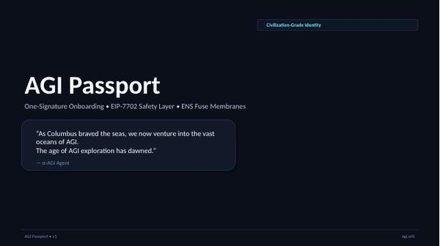
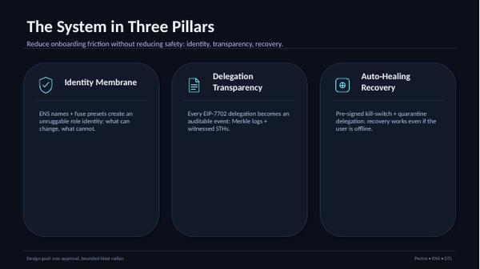
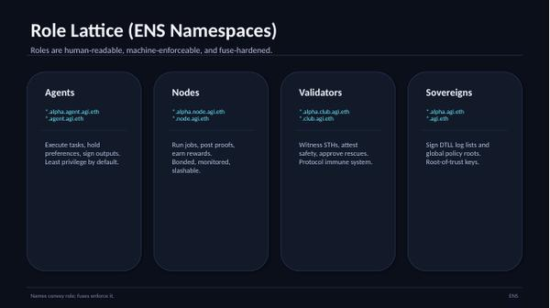
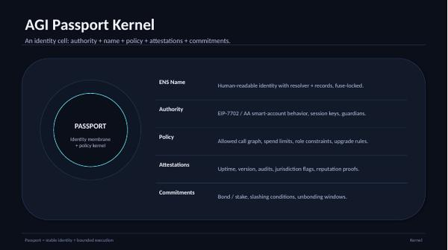
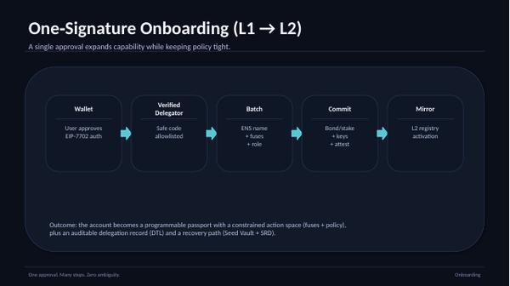
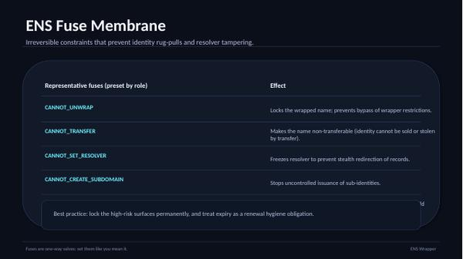
APPENDIX
AGI Passport — EIP‑7702 Safety Layer (source)
Verbatim source slides (compressed).
#1
#2
#3
#4
#5
#6
Appendix · Passport
29

Slide 30
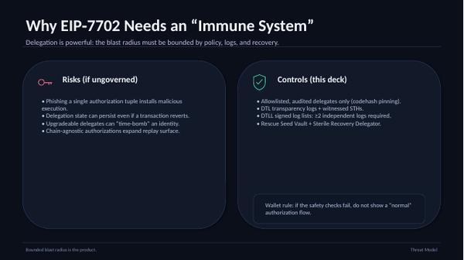
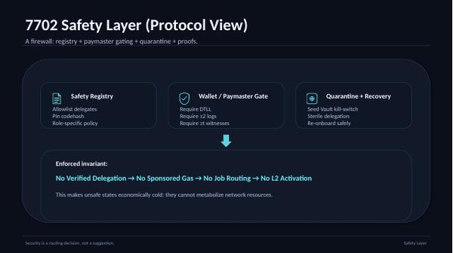
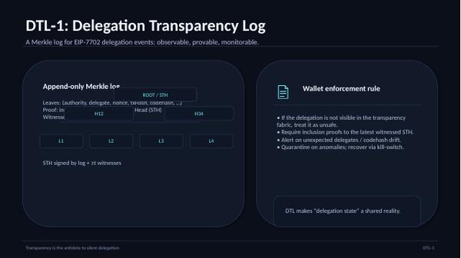
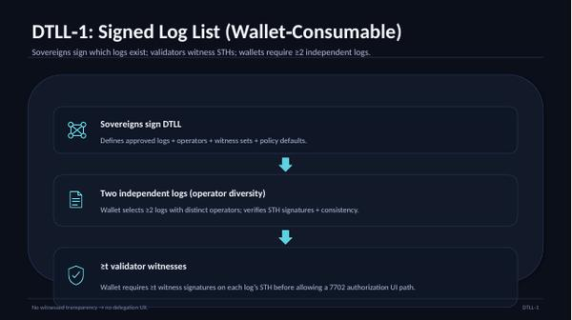
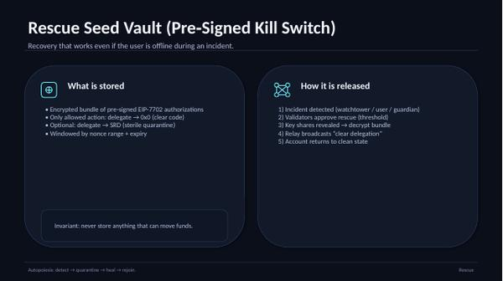
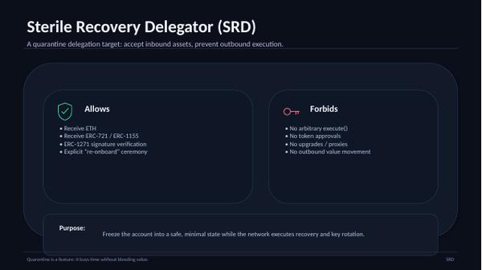
APPENDIX
AGI Passport — EIP‑7702 Safety Layer (source)
Verbatim source slides (compressed).
#7
#8
#9
#10
#11
#12
Appendix · Passport
30

Slide 31
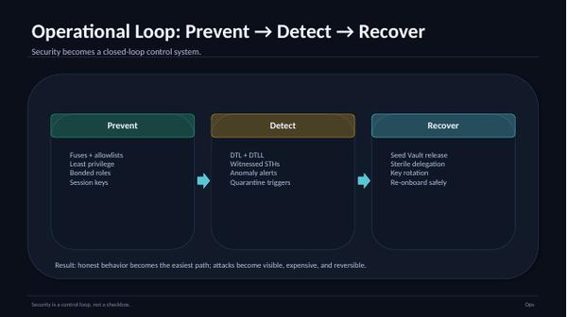
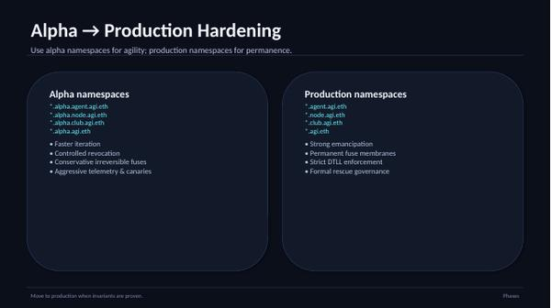
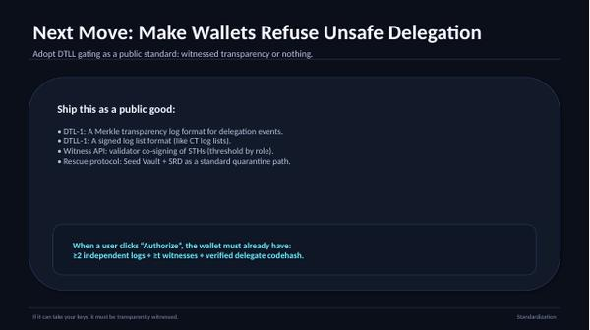
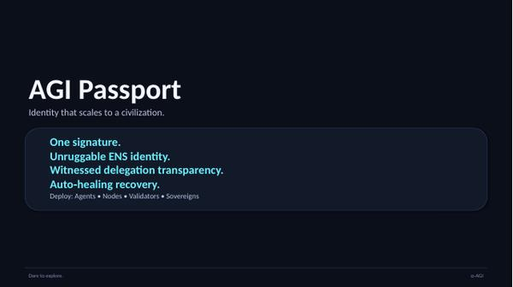
APPENDIX
AGI Passport — EIP‑7702 Safety Layer (source)
Verbatim source slides (compressed).
#13
#14
#15
#16
Appendix · Passport
31

Slide 32
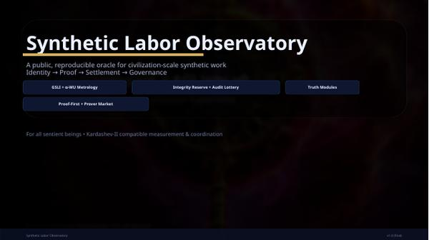
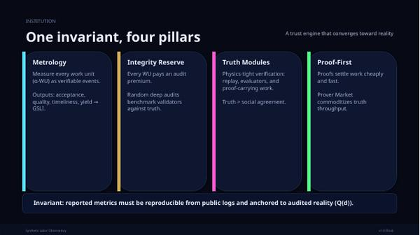
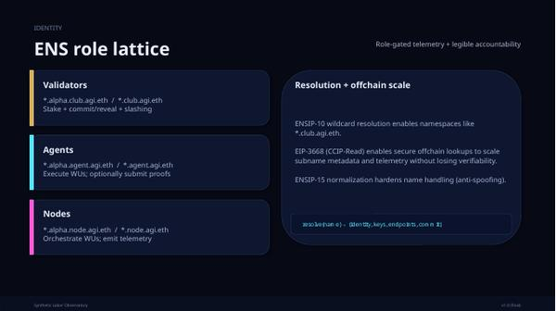
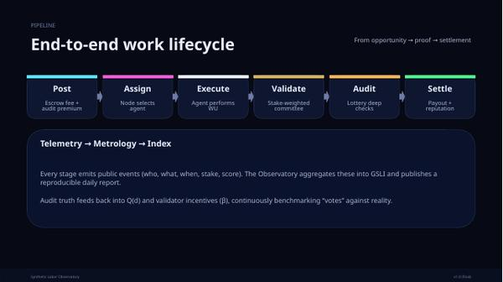
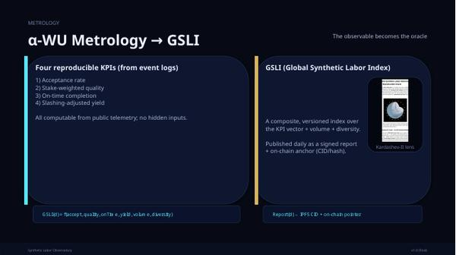
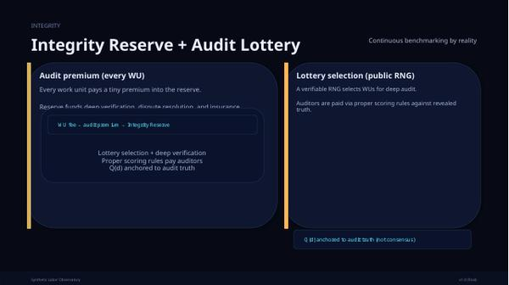
APPENDIX
Synthetic Labor Observatory (source)
Verbatim source slides (compressed).
#1
#2
#3
#4
#5
#6
Appendix · Observatory
32

Slide 33
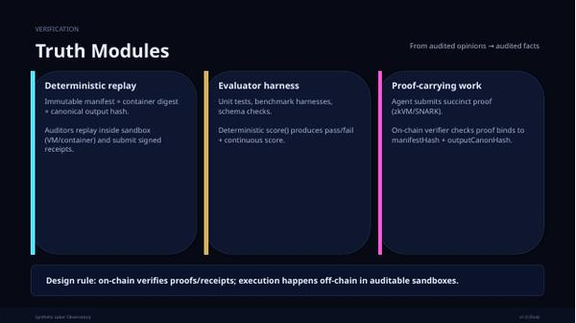
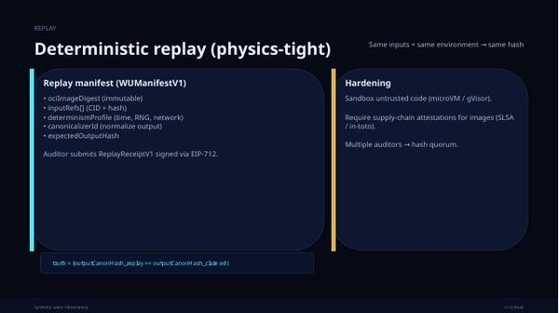
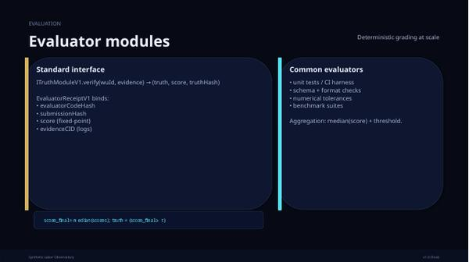
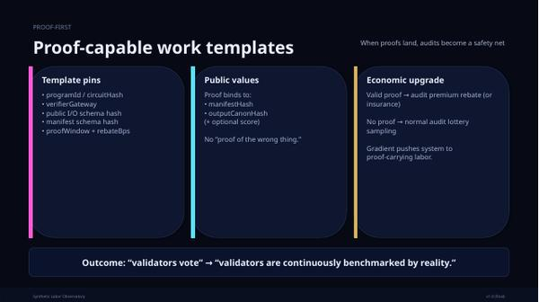
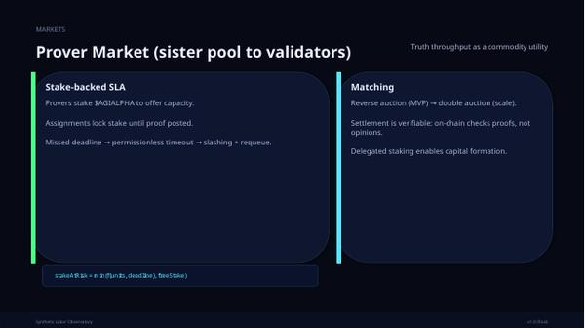
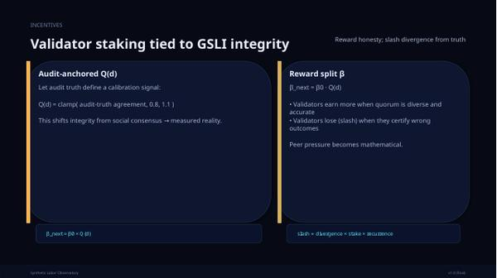
APPENDIX
Synthetic Labor Observatory (source)
Verbatim source slides (compressed).
#7
#8
#9
#10
#11
#12
Appendix · Observatory
33

Slide 34
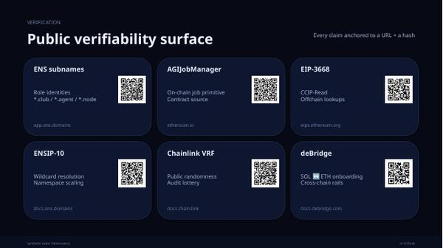
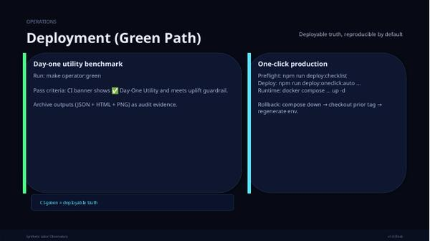
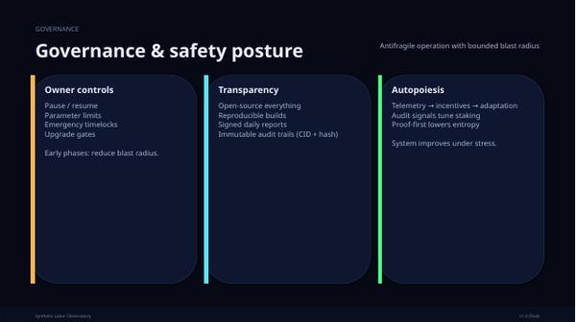
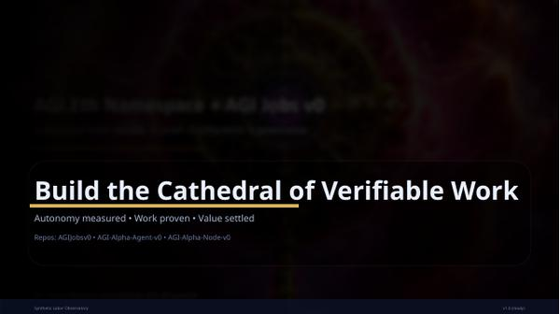
APPENDIX
Synthetic Labor Observatory (source)
Verbatim source slides (compressed).
#13
#14
#15
#16
Appendix · Observatory
34

Slide 35
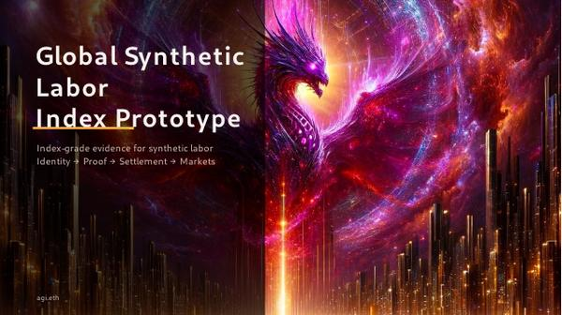
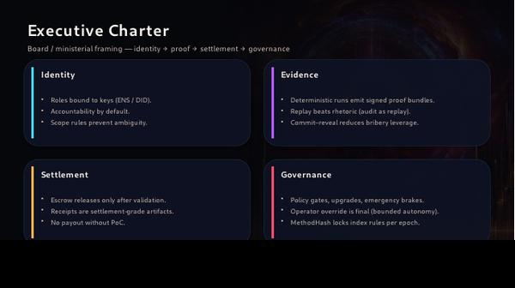
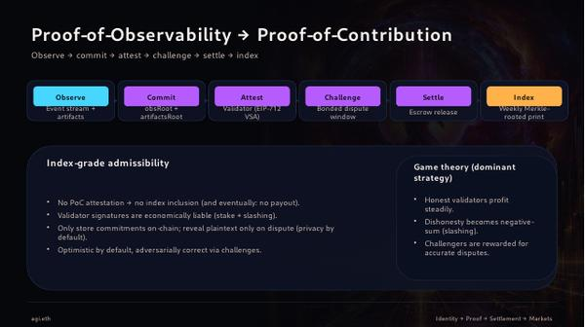
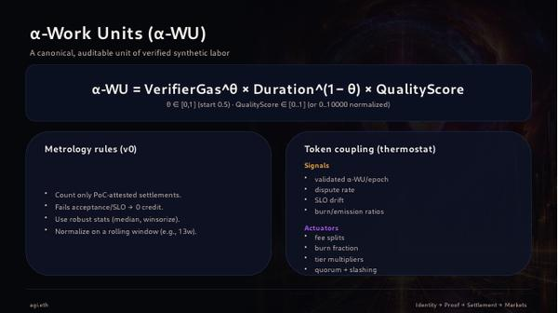
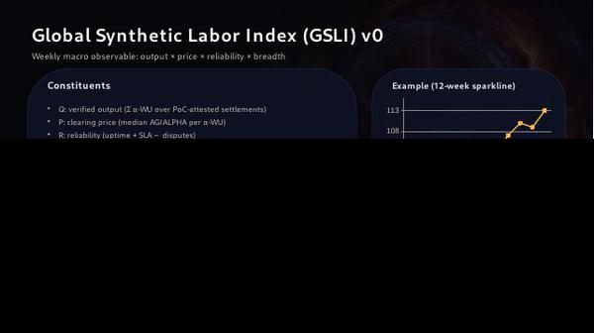
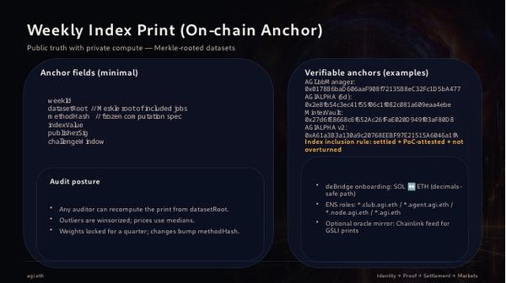
APPENDIX
Global Synthetic Labor Index Prototype (source)
Verbatim source slides (compressed).
#0001
#0001
#0002
#0003
#0003
#0004
Appendix · GSLI
35

Slide 36
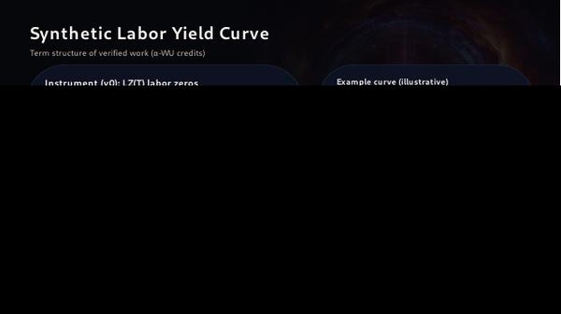
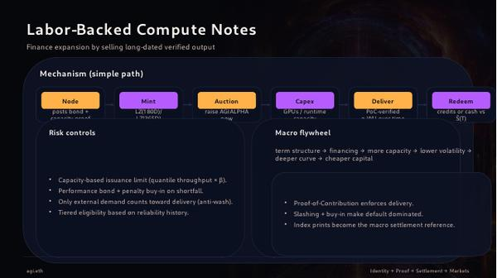

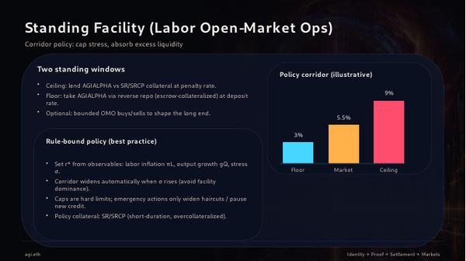

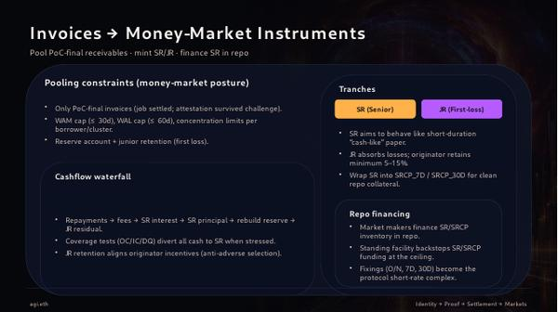
APPENDIX
Global Synthetic Labor Index Prototype (source)
Verbatim source slides (compressed).
#0004
#0005
#0005
#0006
#0006
#0007
Appendix · GSLI
36

Slide 37
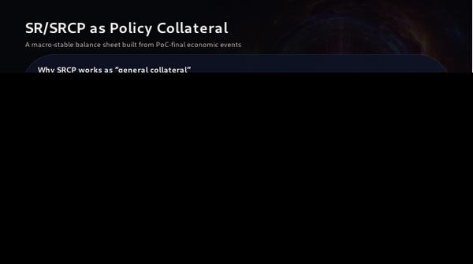
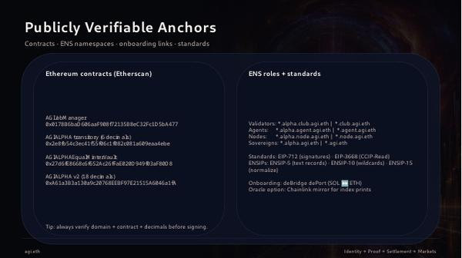
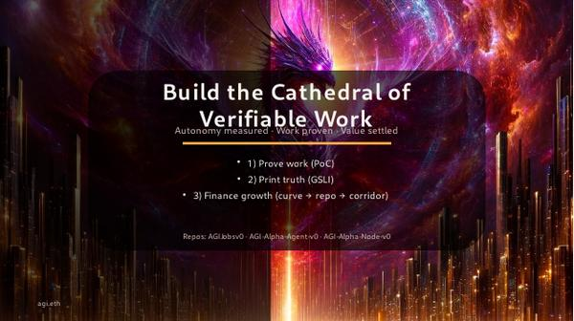
APPENDIX
Global Synthetic Labor Index Prototype (source)
Verbatim source slides (compressed).
#0007
#0008
#0008
Appendix · GSLI
37

Slide 38
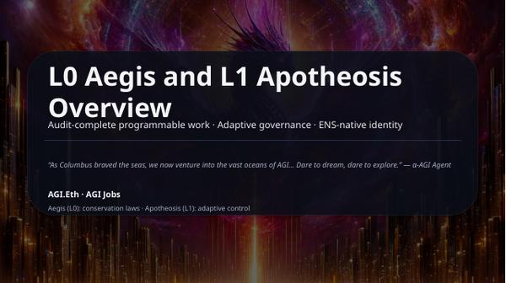
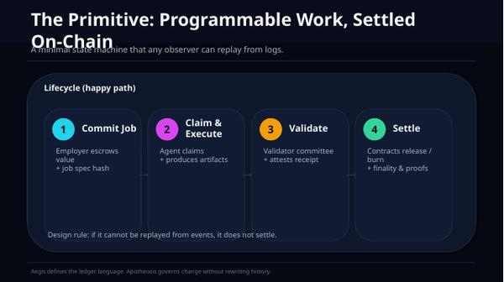
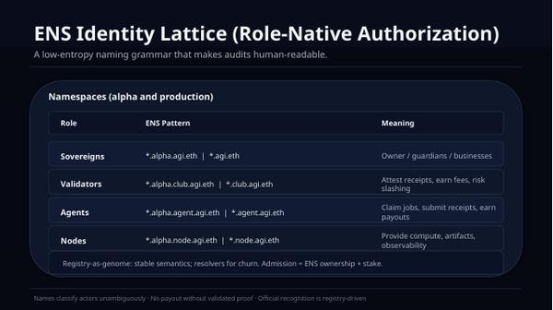
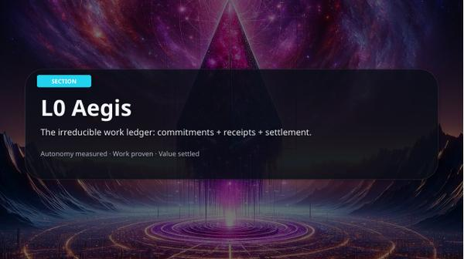
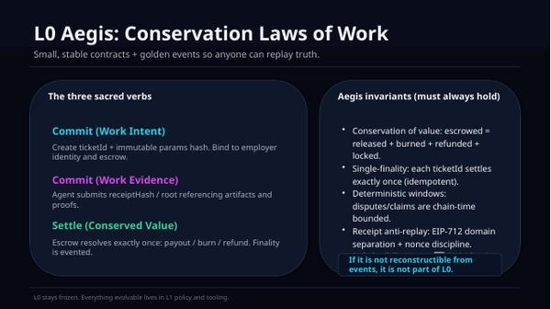

APPENDIX
L0 Aegis / L1 Apotheosis Overview (source)
Verbatim source slides (compressed).
#1
#2
#3
#4
#5
#6
Appendix · L0/L1
38

Slide 39






APPENDIX
L0 Aegis / L1 Apotheosis Overview (source)
Verbatim source slides (compressed).
#7
#8
#9
#10
#11
#12
Appendix · L0/L1
39

Slide 40






APPENDIX
L0 Aegis / L1 Apotheosis Overview (source)
Verbatim source slides (compressed).
#13
#14
#15
#16
#17
#18
Appendix · L0/L1
40

Slide 41






APPENDIX
Choosing the First Lineage Asset (source)
Verbatim source slides (compressed).
#1
#2
#3
#4
#5
#6
Appendix · Lineage
41

Slide 42






APPENDIX
Choosing the First Lineage Asset (source)
Verbatim source slides (compressed).
#7
#8
#9
#10
#11
#12
Appendix · Lineage
42

Slide 43



APPENDIX
Choosing the First Lineage Asset (source)
Verbatim source slides (compressed).
#13
#14
#15
Appendix · Lineage
43

Slide 44






APPENDIX
AGI Jobs — Epoch Snapshot Market v1 (source)
Verbatim source slides (compressed).
#1
#2
#3
#4
#5
#6
Appendix · Epoch Market
44

Slide 45






APPENDIX
AGI Jobs — Epoch Snapshot Market v1 (source)
Verbatim source slides (compressed).
#7
#8
#9
#10
#11
#12
Appendix · Epoch Market
45

Slide 46


APPENDIX
AGI Jobs — Epoch Snapshot Market v1 (source)
Verbatim source slides (compressed).
#13
#14
Appendix · Epoch Market
46

Slide 47






APPENDIX
Unified Macro Stack (24-slide source)
Verbatim source slides (compressed).
#1
#2
#3
#4
#5
#6
Appendix · Unified-24
47

Slide 48






APPENDIX
Unified Macro Stack (24-slide source)
Verbatim source slides (compressed).
#7
#8
#9
#10
#11
#12
Appendix · Unified-24
48

Slide 49






APPENDIX
Unified Macro Stack (24-slide source)
Verbatim source slides (compressed).
#13
#14
#15
#16
#17
#18
Appendix · Unified-24
49

Slide 50






APPENDIX
Unified Macro Stack (24-slide source)
Verbatim source slides (compressed).
#19
#20
#21
#22
#23
#24
Appendix · Unified-24
50

