Slide 1
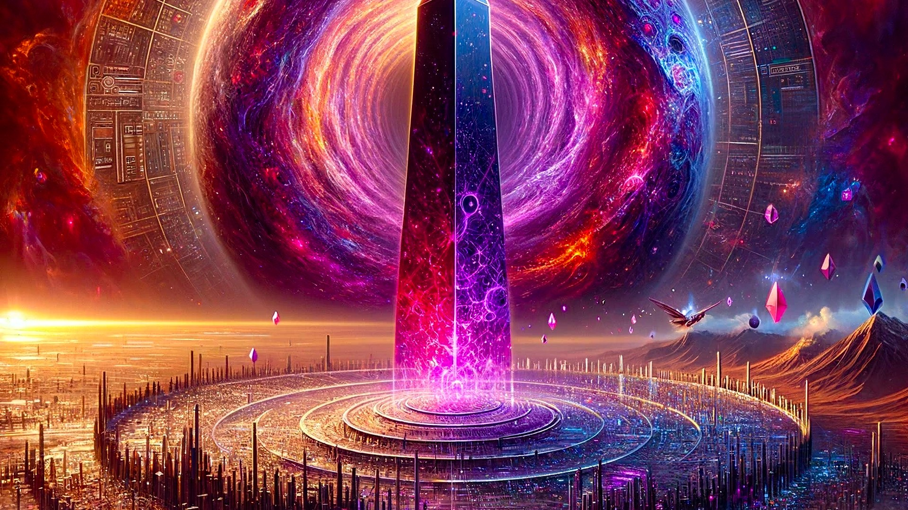
DEMO MASTER PRESENTATION
Planetary Orchestrator
Fabric v0
A governed orchestration substrate for planetary‑scale missions
Institutional control
Deterministic execution
Planetary readiness
A single accountable spine that converts intent into action —
with continuous evidence, auditable replay, and fail‑closed promotion.
Planetary Orchestrator Fabric v0
Notes:
Positioning: institutional, inevitable, and verifiable. Emphasize: this is a disciplined coordination substrate — not hype.

Slide 2

EXECUTIVE SYNTHESIS
From complexity → coherence
Thesis
Planetary Orchestrator Fabric v0 converts high‑level intent into governed execution — continuously backed by evidence.
1) Intent
2) Orchestration
3) Assurance
• Mission plans as declarative control objects
• Invariants encoded as policy
• Versioned + reviewable (diffable)
• Sharded execution across heterogeneous domains
• Checkpointing + deterministic replay
• Bounded autonomy via guardrails
• CI gates, signed artefacts, provenance
• Telemetry mesh + evidence bundles
• Fail‑closed release posture
Planetary Orchestrator Fabric v0
Notes:
Keep pace fast. This is the executive map. If challenged: insist on the evidence surface — every claim is backed by artefacts.

Slide 3
PROBLEM
Coordination collapses under scale
Symptoms
Consequences
• Fragmented authority + unclear accountability
• Opaque automation (no provenance, no replay)
• Non‑reproducible runs; brittle recovery
• Incentive misalignment (local wins, global loss)
• Security drift across environments
• Slow response to shocks and emergent failures
• Audit gaps and trust breakdown
• Wasteful resource allocation (energy, labor, compute)
• Cascade risk under correlated stress
• Inability to coordinate beyond the firm boundary
Planetary scale requires a single accountable spine — and continuous evidence that travels with every action.
Planetary Orchestrator Fabric v0
Notes:
Frame as inevitability: coordination is the bottleneck. We do not “add intelligence”; we add an accountable spine.

Slide 4
DEFINITION
The Fabric
A planetary coordination substrate
• A control plane: plan → execute → observe → attest
• Operator‑friendly surface with owner supremacy (institutional governance)
• Orchestration core that scales across shards and environments
• Assurance lattice that turns operations into portable truth (artefacts + provenance)
Result: the path becomes simple because invariants are strict, evidence is continuous, and promotion is gated.
Planetary Orchestrator Fabric v0
Notes:
This slide defines the object. Avoid anthropomorphism; emphasize: governance, determinism, evidence.

Slide 5
OPERATING MODEL
Owner supremacy + deterministic execution
Control surface
Runtime posture
• Designated Owner defines invariants
• Commands are structured + reviewable
• Every action emits evidence (logs, artefacts)
• Fail‑closed by default
• Bounded autonomy via guardrails
• Continuous verification via CI lattice
Command lattice (closed loop)
OWNER
(invariants)
MISSION PLAN
(declarative)
EXECUTION
(sharded)
OBSERVABILITY
(telemetry)
ASSURANCE
(CI + provenance)
Planetary Orchestrator Fabric v0
Notes:
This is the spine. Owner authority + deterministic replay make the system governable.

Slide 6
ARCHITECTURE
Three layers; one accountable spine
Operator Surface
• Mission authoring + approvals
• Owner commands + policy‑as‑code
• Human‑readable evidence bundles
Orchestration Core
• Planner / scheduler / executor
• Checkpointing + deterministic replay
• Shards for heterogeneous environments
Assurance Lattice
• CI gates + signed artefacts
• Provenance + branch protection
• Fail‑closed release posture
Planetary Orchestrator Fabric v0
Notes:
If asked “what’s novel?”: the coupling of orchestration to an assurance lattice. The spine is accountable end‑to‑end.

Slide 7
CONTROL
Declarative control objects
Mission Plan (JSON)
Representative structure
• Declares intent, workloads, checkpoints
• Pins invariants and guardrails
• Defines evidence bundle outputs
The plan is the operation — reviewable like code.
{
"mission": "k2-drill",
"workloads": 10000,
"checkpoints": ["t+15m"],
"faults": ["simulate_outage"],
"export": "evidence.zip"
}
Declarative objects make operations portable: approve once, replay anywhere, verify continuously.
Planetary Orchestrator Fabric v0
Notes:
The key is not the JSON — it’s that governance attaches to it.

Slide 8
GOVERNANCE
The Command Lattice
Closed‑loop accountability
OWNER
(invariants)
POLICY
(guardrails)
MISSION PLAN
(versioned)
EXECUTION
(sharded)
TELEMETRY
(mesh)
EVIDENCE
(bundle)
CI GATES
(checks)
PROVENANCE
(attest)
Every edge emits evidence. Every promotion is gated. Every outcome is replayable.
Planetary Orchestrator Fabric v0
Notes:
The lattice converts coordination into an auditable, incentive‑compatible system.

Slide 9
ASSURANCE
Provenance as a promotion gate
Principle
Release lattice
• No trust without traceability
• No deployment without evidence
• No evidence without provenance
Promotion is not a meeting. It is a cryptographically backed state transition.
• Signed build artefacts
• Pinned dependencies + SBOM
• Branch protection + approvals
• CI checks (policy, tests, scans)
• Attestation + audit bundle export
If any link in the chain is missing, promotion fails closed — safely, automatically, and with a clear diagnosis.
Planetary Orchestrator Fabric v0
Notes:
This is how scale stays safe. Incentives align because evidence is non‑negotiable.

Slide 10
SAFETY
Safety levers that scale with autonomy
Invariants
Approvals
Rate limits
Hard constraints the system cannot violate.
Human sign‑off for sensitive transitions.
Bounded action under uncertainty or stress.
Kill switch
Rollback
Scoping
Immediate halt + checkpoint for safe resume.
Deterministic replay + state recovery.
Least privilege: domains, budgets, permissions.
Planetary Orchestrator Fabric v0
Notes:
We treat autonomy as a function of evidence and control. More autonomy requires tighter invariants and stronger attestation.

Slide 11
CI & OPERATIONS
Continuous verification
CI v2 status wall (conceptual)
• Policy checks: invariants, permissions, scopes
• Security checks: dependency scanning, secrets, SBOM
• Determinism checks: replay parity, checkpoint integrity
• Evidence checks: bundle completeness, signatures
• Release checks: branch protection, required approvals
Green means “promotable.” Red means “evidence missing” — not “we hope it’s fine.”
Planetary Orchestrator Fabric v0
Notes:
This slide is about posture. The organization becomes continuously ready because verification is continuous.

Slide 12
DEMO
Verification drill
CLI path
API path
run-demo --plan mission.json
observe --live
export --bundle evidence.zip
POST /missions {plan}
GET /missions/{id}/telemetry
GET /missions/{id}/evidence
What success looks like
• Telemetry + checkpoints observed in real time
• Evidence bundle exported (human‑readable + machine‑verifiable)
• Replay parity validates determinism under stress
Planetary Orchestrator Fabric v0
Notes:
We demo “trust you can export.” The deliverable is the evidence bundle.

Slide 13
GAME THEORY
Make honesty dominant
Coordination as mechanism design
When verification is cheap and continuous, the equilibrium shifts: truth becomes the dominant strategy for participants.
Verifiability
Attribution
Enforcement
• Signed artefacts
• Replay parity
• Deterministic logs
• Owner commands
• Versioned plans
• Immutable evidence
• Fail‑closed promotion
• Policy‑as‑code gates
• Scope + budget limits
Planetary Orchestrator Fabric v0
Notes:
Translate philosophy into primitives. Honesty emerges from verifiability + incentives.

Slide 14
SYSTEMS
A self‑maintaining job organism
Autopoietic loop (operational)
Why it matters
• Ingest signals → update plan
• Execute under guardrails
• Emit evidence continuously
• Recover via checkpoints
• Improve via verification feedback
• Resilience becomes automatic, not heroic
• Complexity stays bounded as scale rises
• Operations become a living discipline — continuously verified
The “organism” is not sentient — it is governed, observable, and replayable.
Planetary Orchestrator Fabric v0
Notes:
Use “autopoiesis” as a lens, not a claim. Stress: governed self‑maintenance (checkpoints, CI, evidence).

Slide 15
DEMO
Demo walkthrough
A single operator motion
• Select or author a mission plan
• Review invariants + approvals
• Execute the plan
• Observe telemetry + events
• Export the evidence bundle
The operational miracle is not speed — it is governability at scale, backed by continuously verifiable truth.
Planetary Orchestrator Fabric v0
Notes:
Slow down here. Let the audience “feel” the simplicity. The evidence bundle is the proof.

Slide 16
DEMO
End‑to‑end run (conceptual)
Operator steps
Representative command surface
• Select or author a mission plan
• Review invariants + guardrails
• Execute the plan
• Observe telemetry + events
• Export evidence bundle
run-demo --plan mission.json
observe --live
export --bundle evidence.zip
What you should feel
• The path is simple because invariants are strict.
• Scale is possible because evidence is continuous.
• Power is safe because promotion is gated.
Planetary Orchestrator Fabric v0
Notes:
The emotional payload: calm power. We do not promise miracles — we promise governable execution.

Slide 17
APPLICATIONS
Where planetary readiness matters
Energy systems
Supply networks
Science & frontier
• Grid balancing and dispatch
• Climate operations readiness
• Infrastructure outage drills
• Portfolio‑level optimization
• End‑to‑end logistics
• Bottleneck prediction
• Resilient re‑routing
• Evidence‑backed procurement
• High‑throughput experiment ops
• Reproducible research pipelines
• Multi‑site lab orchestration
• Evidence bundles for audits
If you can run a drill, you can run the world — responsibly.
Planetary Orchestrator Fabric v0
Notes:
Tie applications back to the primitives: evidence, determinism, gating.

Slide 18
IMPLICATIONS
Value concentrates where coordination is trusted
Trust primitives
Consequence
• Owner‑defined invariants
• Verifiable execution and replay
• Exportable evidence bundles
• Fail‑closed release mechanisms
• Auditable provenance end‑to‑end
• Coordination becomes a compounding advantage
• Institutions can operate faster than crises propagate
• Capital allocates to verifiable outcomes (not narratives)
• New markets emerge around attestable execution
The fabric becomes an infrastructure for trustworthy global action.
Planetary Orchestrator Fabric v0
Notes:
Avoid sensationalism. State calmly: trusted coordination is where value accumulates.

Slide 19
NEXT
Deploy the spine
1) Pilot
2) Integrate
3) Scale
• Choose a high‑stakes domain
• Define invariants + scope
• Run first evidence‑backed drill
• Bind CI gates to promotion
• Standardize evidence bundles
• Instrument telemetry mesh
• Shard across environments
• Automate recovery + replay
• Expand autonomy with proofs
Run the next planetary drill. Export the evidence. Promote only what can be proven.
montreal.ai
Planetary Orchestrator Fabric v0
Notes:
Close with discipline: proof‑based promotion. Offer a pilot path with clear governance.

