Slide 1
G
THE OPTIMAL
GOALOS BUSINESS MODEL
A services-led, software-scaled, capability-licensed Proof Utility
Diagnose almost for free. Price by value. Prove the outcome. Recurr. Protect. Compound.
Investor & Board Edition · 20 July 2026 · Management hypotheses, not forecasts

Slide 2
Deploy GoalOS as a Proof Utility
The platform is created by paid proof, not built in advance of it.
1. Near-zero-cost front door
2. High-value proof
3. Recurring capability
Proof Readiness and Activation diagnose a consequential objective, expose Proof Debt and form the economic case. Price: free–$495 and $15K.
One bounded Proof Mission executes the work, captures the full denominator and returns a governed decision state. Price: $50K–$150K.
The Proof Office keeps evidence current. Protected invocation monetizes accepted capability without surrendering the implementation.
Sell decisions and continuing control—not commodity AI documents.

Slide 3
The Capability–Price Lag
AI has repriced cognitive production faster than organizations have repriced cognitive work.
OLD MODE
EARLY AI MODE
GOALOS MODE
Scarce experts
Large teams
Sequential work
Weeks or months
Static deliverable
Pricing by hours
Near-free candidate output
Persuasive plans and reports
Fast generation
Little authority
Weak outcome evidence
Rapid commoditization
Bounded objective
Real execution
Evidence Docket
Independent challenge
Governed decision
Recurring control
The draft is becoming nearly free. Truth, authority, execution and accountability are not.
Sources: S1–S6. See package Source Register.

Slide 4
The enterprise problem
Organizations can access powerful models. They still cannot reliably authorize, prove, remember and reuse consequential machine work.
WHAT THE BUYER STILL CANNOT ANSWER
What was the agent actually authorized to do?
What work occurred—and what failed?
Which evidence supports the result?
Who challenged the claim independently?
What may enter institutional memory?
What may be reused, revoked or superseded?
What value was really created?
Did the next mission improve because of the capability?
GoalOS turns probabilistic output into an inspectable institutional decision state.

Slide 5
The initial ICP: AI Trust & Revenue
An AI vendor or enterprise AI team with ≥$250K of contract, deployment, capital or risk value at stake.
CONSEQUENCE
AUTHORITY
DEADLINE
A real deployment, claim, procurement path, contract or investment.
Named sponsor with budget and acceptance rights.
A decision inside 90 days.
EVIDENCE
ECONOMICS
RECURRENCE
Digital inputs and a frozen acceptance rubric.
Conservative value pool normally ≥4× first-year fee.
Ongoing monitoring, claims, governance, RFP or audit need.
The buyer is not purchasing a report. The buyer is purchasing a defensible decision and a path to continuing control.

Slide 6
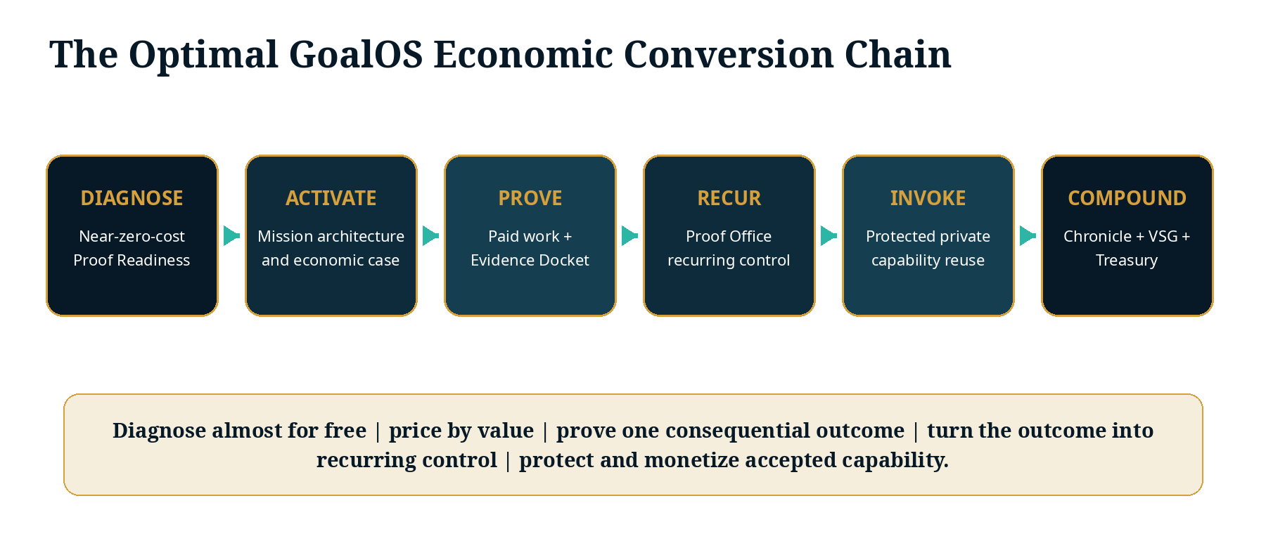
The optimal economic conversion chain
One customer objective creates immediate value—and, if it passes, a reusable institutional asset.
GoalOS internal architecture.

Slide 7
The commercial ladder
Every stage has a distinct job: acquire, prove, retain, protect, scale.
READINESS
Free–$495
Acquisition and qualification
ACTIVATION
$15K
Near-zero-cost paid front door
PROOF MISSION
$50K–$150K
Creates evidence and candidate capability
PROOF OFFICE
$15K–$50K / month
Recurring institutional control
PRIVATE NETWORK
$250K–$1M+ / year
Platform, integrations and switching costs
PROTECTED INVOCATION
Usage based
90%+ mature gross margin
AGI JOBS / VALIDATION
10–20% fee
Network and settlement economics
The first mission finances capability creation. The Office monetizes control. Invocation creates software-scale economics.

Slide 8
Product 1 — Proof Mission Activation
The highest-margin initial product: turn one consequential objective into a funded, falsifiable mission architecture.
PRICE
MARGINAL COST
TARGET GM
DELIVERY
$15,000
$250–$1,000
93–98%
24–72 hr
100% prepaid
Management hypothesis
Before CAC and fixed R&D
Standard scope
DELIVERABLE
WHY IT COMMANDS VALUE
Mission Contract
Claims and assumptions matrix
Proof Debt Register
AGI Job and evidence architecture
Acceptance tests
Economic case
Proceed / narrow / repair / defer / stop path
It structures decisions involving enterprise contracts, AI deployments, procurement, investments or compliance obligations—where avoiding one mistake can be worth hundreds of thousands or millions.
Near-zero production cost does not imply near-zero customer value.

Slide 9
Product 2 — GoalOS Proof Mission
The customer buys a decision that is faster, inspectable, reproducible and economically accountable.
STANDARD PRICE
DIRECT COST
TARGET GM
DELIVERY
MISSION SEQUENCE
$75K
$18.75K
75%
10 days
Range: $50K–$150K
Illustrative
Range: 70–80%
One frozen mission
1
2
3
4
5
6
7
8
Freeze objective
Create Proof Debt
Issue AGI Jobs
Capture evidence
Independent review
Governed decision
Candidate skill
Office plan
A reject, repair or stop decision can be successful delivery when the mission correctly retires risk or Proof Debt.

Slide 10
Product 3 — GoalOS Proof Office
The recurring control function that keeps the accepted decision true, current and inspectable.
BASE ARR
TARGET GM
CONVERSION
MATURE NRR
$216K
80%
40%+
120%+
US$18K/month
75–90% range
Successful missions
Target, not actual
MISSION INTAKE
EVIDENCE
CHRONICLE
New objectives and Proof Debt
Claims, sources, tests and freshness
Admit, repair, reject, supersede, retire
CAPABILITY
EXECUTIVE CONTROL
SUCCESSOR TESTS
Versions, rights, entitlements and rollback
Value ledger, risk and board reporting
Fresh comparison before improvement claims
Renewal is earned by evidence—not because another twelve months elapsed.

Slide 11
Protected capability invocation
Sell governed use of proven capability—never the downloadable crown-jewel implementation.
IDENTITY
ENTITLEMENT
CHRONICLE
ROOT
SCOPE
RUNTIME
Current direct agent
Valid, scoped, revocable
Current admission
Latest authorized state
Mission-compatible
Approved protected environment
PRIVATE CAPABILITY
EXECUTES
CUSTOMER RECEIVES
MONTREAL.AI RETAINS
Result · evidence · version · scope · Chronicle and execution receipts
Method · routing · evaluator logic · failure history · composition intelligence
The protocol may be open. The canonical private capability history remains scarce.
Architecture informed by S10–S11.

Slide 12
Illustrative complete-customer economics
One full first-year relationship can finance product development while giving the customer a compelling value-to-fee ratio.
FIRST-YEAR REVENUE
DIRECT COST
GROSS PROFIT
GROSS MARGIN
$331K
$64.95K
$266.05K
80.4%
Activation + Mission + Office + usage
Full delivery denominator
Before CAC and fixed overhead
Illustrative
CUSTOMER VALUE
CUSTOMER ROI
$1.2M
262.5%
Conservatively attributable management case
(Value − fee) ÷ fee
Management hypothesis—not a forecast, promise or realized result.

Slide 13
Price the value—not the token cost
GoalOS computes two floors and uses the higher one.
ADJUSTMENTS
VALUE FLOOR
MARGIN FLOOR
5–15% of conservative attributable customer value.
A $1M decision at a 10% value rate supports a $100K price.
Expected variable cost ÷ (1 − required GM).
$18,750 cost at 75% GM requires a minimum $75K price.
Customer-private learning
Sector-exclusive rights
Expedited delivery
+25–50%
+100–300%
+25–50%
Specialist assurance
Nonstandard integration
Discount request
Cost + margin
Separate module
Reduce scope—not margin
No value pool, no offer. No margin floor, no quote.

Slide 14
The zero-seller standard lane
GoalOS should be purchased through GoalOS—not through founder-dependent sales labor.
Permissioned demand
Readiness Scan
Qualification
Fixed price
Deal room
Contract
Payment
Mission
Acceptance
Proof Office
Renewal
AUTONOMOUS
CONSTITUTIONAL
FAIL-CLOSED
0 routine seller-side minutes
Humans set policy and exception authority
Outside scope, price, rights or claims path
The customer supplies consent, objective, payment and acceptance. Reality supplies the verdict.

Slide 15
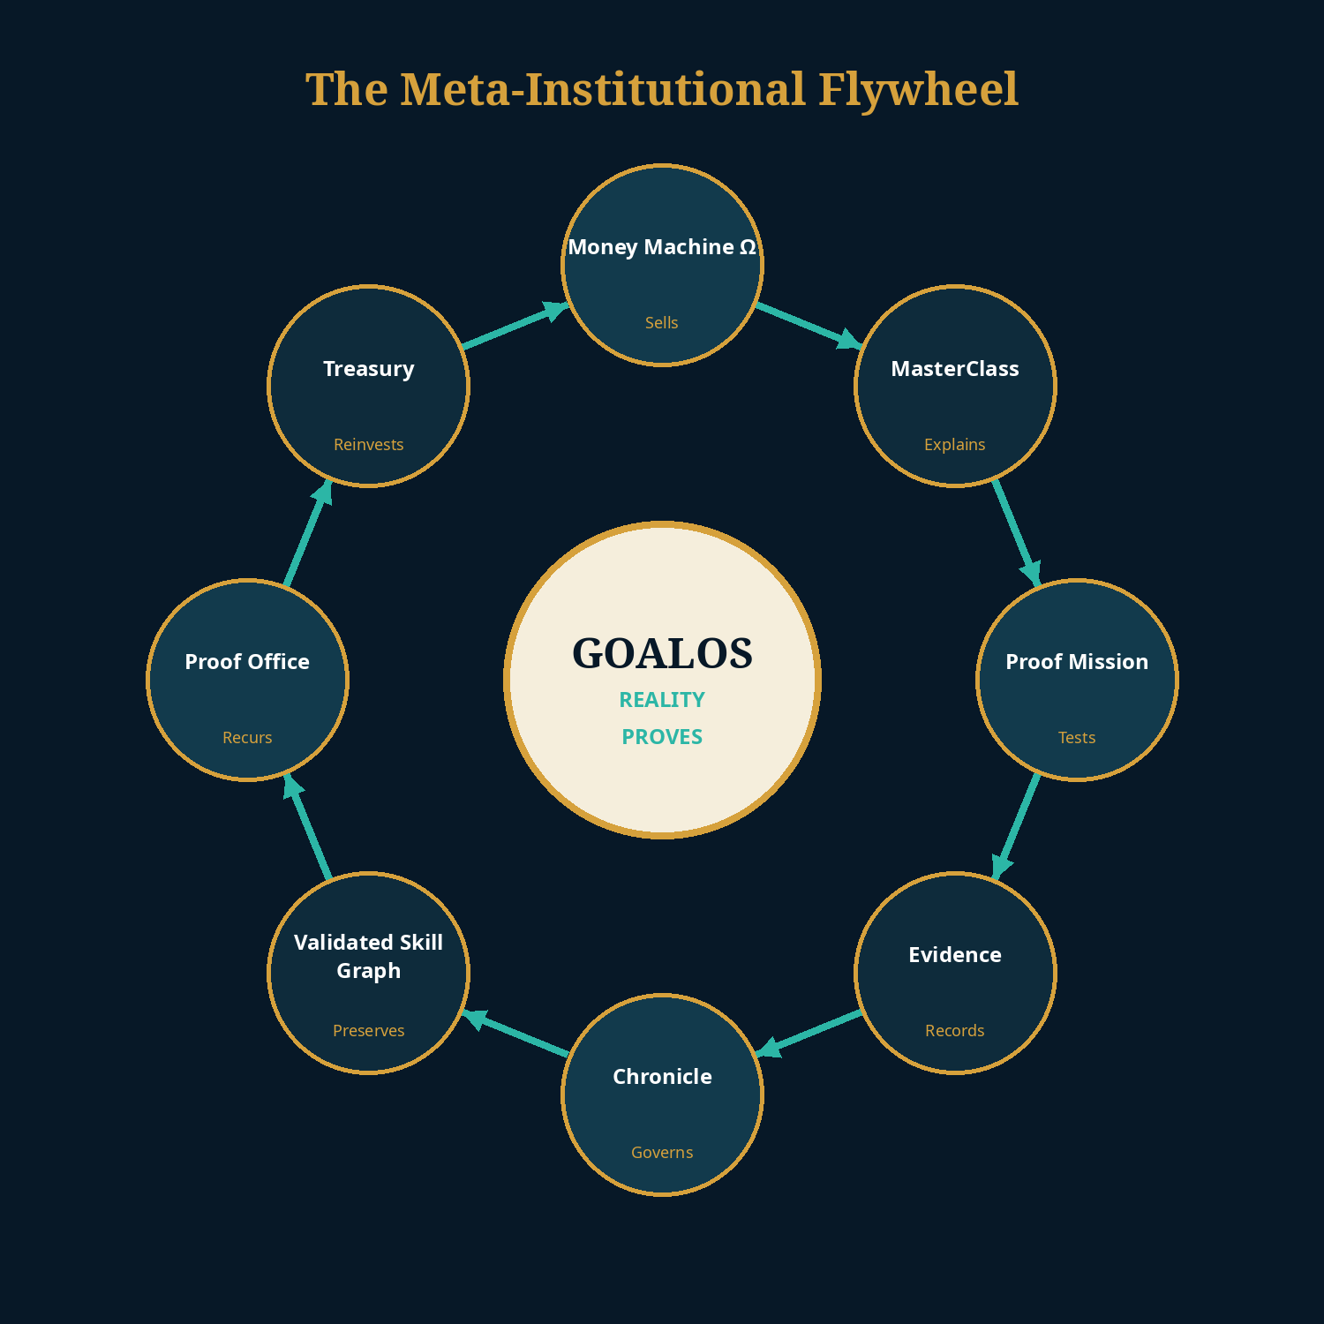
GoalOS is its own first customer
Commercialization, delivery, memory, intellectual capital, financing and succession obey the same proof law.
GoalOS may build its successor. Only external payment, evidence, review and fresh outcomes may prove it is better.

Slide 16
The moat is the earned institutional graph
Models can be substituted. A history of proven capability, rights and customer outcomes cannot be recreated retroactively.
CUSTOMER_PAID_FOR
SPONSOR_AUTHORIZED
MISSION_DELIVERED
EVIDENCE_SUPPORTED
REVIEWER_ACCEPTED
CHRONICLE_ADMITTED
RIGHTS_PERMIT_REUSE
CUSTOMER_RENEWED
FRESH_MISSION_IMPROVED
CAPABILITY_REDUCED_COST
CAPITAL_CREATED_CAPACITY
The nodes describe what might work. The earned edges prove what worked, for whom, under what rights and with what result.

Slide 17
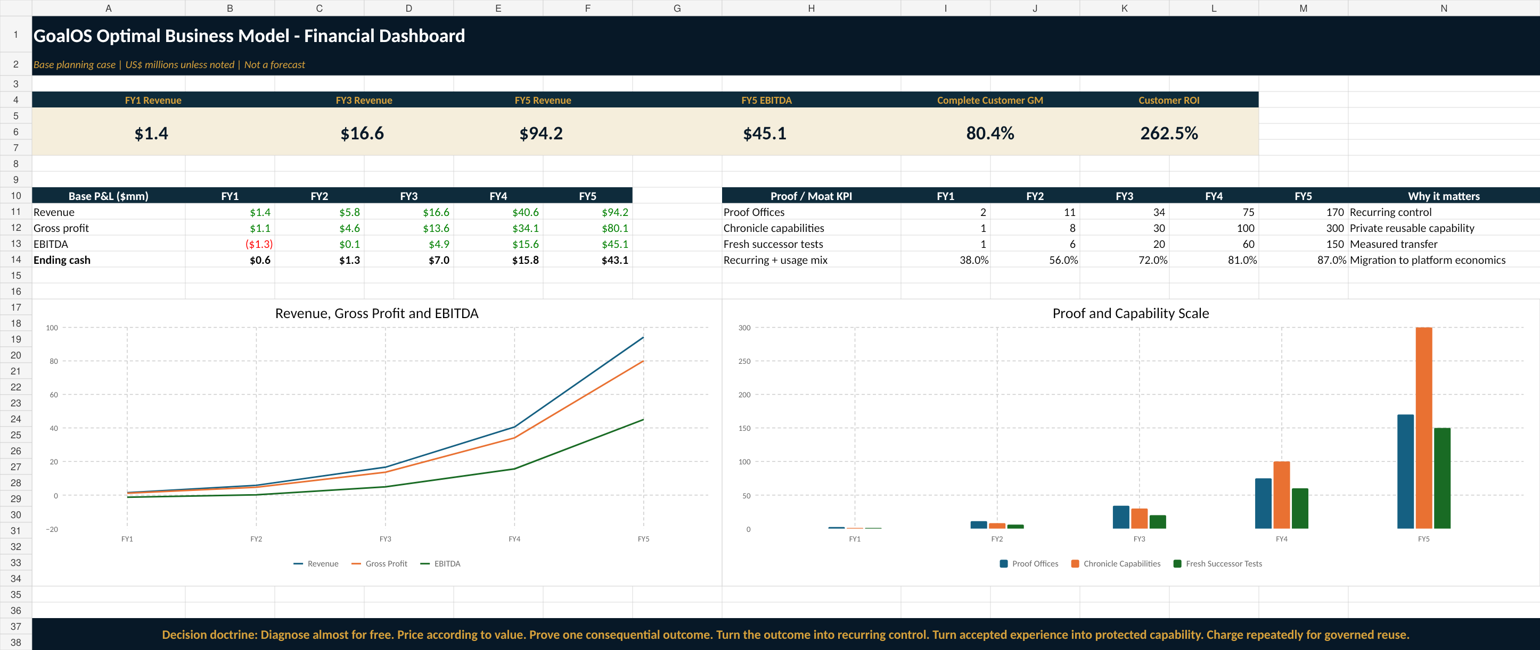
Five-year base management case
The model deliberately migrates from mission revenue toward recurring control, protected invocation and network economics.
FY1 REVENUE
FY3 REVENUE
FY5 REVENUE
FY5 EBITDA
FY5 MIX
$1.4M
$16.6M
$94.2M
$45.1M
87%
Recurring + usage
Editable financial model included. Figures are management hypotheses, not forecasts.

Slide 18
Scenario discipline
Three cases make the assumptions explicit. None is a promise.
CONSERVATIVE
BASE
UPSIDE
$38M
$94.2M
$180M
FY5 revenue
FY5 revenue
FY5 revenue
$11M
$45.1M
$100M
FY5 EBITDA
FY5 EBITDA
FY5 EBITDA
Evidence grows slowly; services remain material.
Strong Office conversion and capability economics.
Rapid category adoption and high protected usage.
Update the model from receipts: actual conversion, direct cost, review burden, retention and transfer advantage.

Slide 19
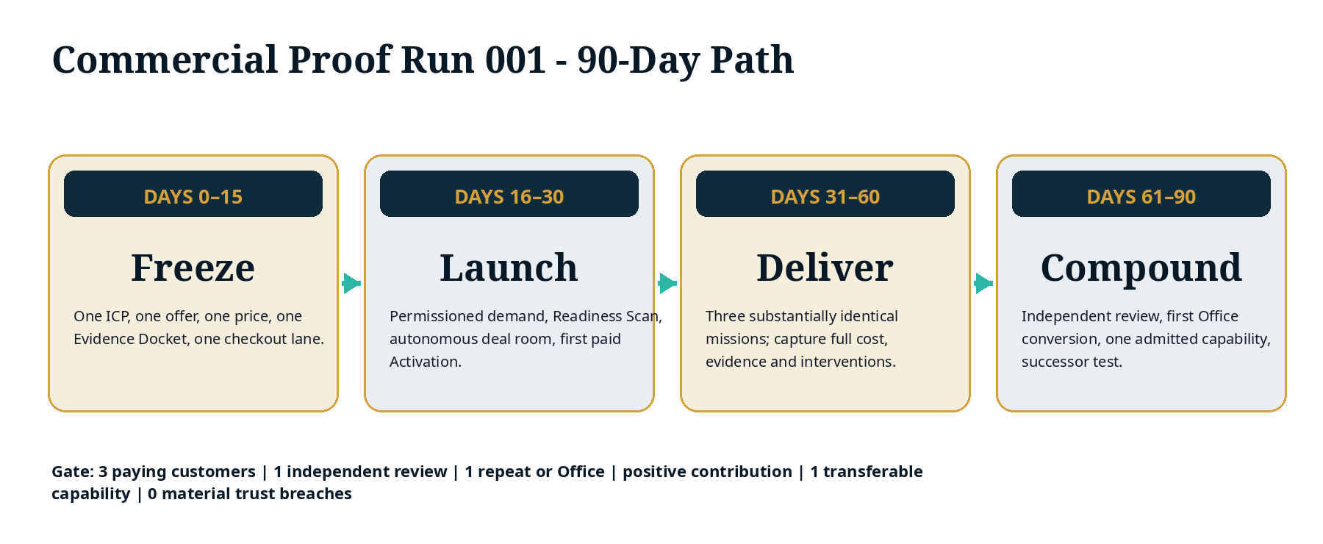
Commercial Proof Run 001
The next 90 days should buy truth—not another layer of architecture.
$250K envelope · 3 paying customers · 1 independent review · 1 repeat/Office · 1 transferable capability · 0 material trust breaches.

Slide 20
The proof ladder to platform scale
Each stage retires a different class of Proof Debt.
6. CAPACITY
5. NETWORK
Verified free cash flow creates measured productive capacity
4. PLATFORM
External agents, validators and cross-customer modules
3. CAPABILITY
Private network, identity, entitlements and usage
2. PRODUCT
Fresh mission improves because of admitted skill
1. COMMERCIAL PROOF
Repeat purchase and recurring Offices
Payment, delivery, positive contribution
Architecture earns attention. Payment earns relevance. Outcomes earn credibility. Fresh transfer earns the platform.

Slide 21
What can destroy the business model
The primary risks are product sprawl, hidden human labor, weak evidence and premature platform claims.
NO PAID DEMAND
NO RECURRENCE
Three of thirty highly qualified prospects do not purchase the Activation.
Fewer than 30% of successful missions convert to continuing control.
NO TRANSFER
HIDDEN SERVICES
Validated capabilities fail to reduce cost, time, risk or reviewer burden by 15–20%.
Founder and specialist hours remain the majority of direct cost.
WEAK AUTHORITY
TRUST FAILURE
The same actor performs, validates and admits material work.
Privacy, security, evidence or authorization breach.
Fail closed. Pause expansion. Convert the failure into explicit Proof Debt and a repair mission.

Slide 22
THE BOARD DECISION
AUTHORIZE COMMERCIAL PROOF RUN 001
$250K · 90 days · one ICP · one offer · one price · one Evidence Docket · one recurring path
Diagnose almost for free.
Price according to value.
Prove one consequential outcome.
Turn the outcome into recurring control.
Turn accepted experience into protected capability.
Charge repeatedly for governed reuse.
Proof Activations create demand. Proof Missions create evidence. Proof Offices create recurring revenue. Chronicle creates authority. The Validated Skill Graph creates the moat.

