Slide 1
PRIVATE & CONFIDENTIAL · PARTNER DISCUSSION
GoalOS
The Proof OS for
Autonomous AI Work
CORE LAW
AI creates output.
GoalOS creates proof.
Turn one consequential objective into an inspectable, challengeable and reusable Governed Decision State.
A model may answer. An agent may act. An institution must prove.
No proof, no evolution. No evaluation, no propagation. No rollback, no release.
Vincent Boucher | GoalOS / AGI ALPHA Research Architecture
July 2026 | Final Production Partner Edition
Notes:
GoalOS is not another agent demo and not a claim of achieved AGI. It is the operating layer that determines what autonomous work must prove before an institution can trust it, act on it, pay for it, remember it or reuse it. The partner proposition is practical: give us one consequential objective and receive a governed decision state rather than an unstructured report.

Slide 2
THE PROBLEM
AI output is abundant. Institutional authority is scarce.
The missing layer is evidence, contradiction handling, accountable memory and rollback.
Report-only AI
GoalOS
THE GAP
-
Output is the endpoint
✓
Decision state is the endpoint
Fluency is not authority.
Reviewers reconstruct evidence and assumptions manually.
Claims, evidence, risk, action and rollback travel together.
-
Contradictions disappear
✓
Proof Debt is explicit
Conflicting facts are averaged into confident prose.
Unsupported claims become visible work or remain blocked.
Institutions need a machine-checkable path from objective to evidence, from evidence to decision, and from accepted decision to reusable capability.
-
Memory is permissive
✓
Chronicle gates memory
Persuasive text can become an institutional prior.
Only admitted, scoped and replayable capability propagates.
-
Rollback is ad hoc
✓
Authority is inspectable
No native record of what granted authority.
Proof, validation, challenge and scope are recorded.
GoalOS supplies that proof operating layer.
Notes:
Enterprise leaders do not lack AI output. They lack a consistent way to decide which output deserves institutional authority. Report-only systems create proof debt: hidden assumptions, unsupported claims, fragile memory and unclear rollback. GoalOS changes the endpoint from a report to a governed decision state.

Slide 3
THE PRODUCT
One objective becomes a Governed Decision State.
The deliverable can be inspected, challenged, acted on, replayed and rolled back.
INPUT
GOALOS PROOF OPERATIONS
OUTPUT
A consequential
objective
Mission Contract
Claims Matrix
Governed
Decision State
Freeze intent and authority.
Every claim gets a proof state.
Evidence Docket
Verifier Report
Decision to support
Success and failure criteria
Scope and constraints
Risk and proof level
Required reviewers
Rollback obligations
Reviewer-ready proof room.
What passed and remains blocked.
Proceed
Proceed with conditions
Repair
Hold
Reject
Quarantine
Retire
Risk + Cost Ledgers
Action Graph
Downside and resource burden.
Owners, approvals and rollback.
Chronicle Verdict
Capability Package
What may earn memory.
Scoped, replayable and reusable.
REUSABLE ONLY IF ADMITTED
Notes:
A user supplies a decision objective, not merely a prompt. GoalOS freezes the mission, creates proof-producing work and packages the result as a governed decision state. A correct run may approve, condition, repair, hold, reject or quarantine. The system is valuable precisely because it does not force every mission toward a positive answer.

Slide 4
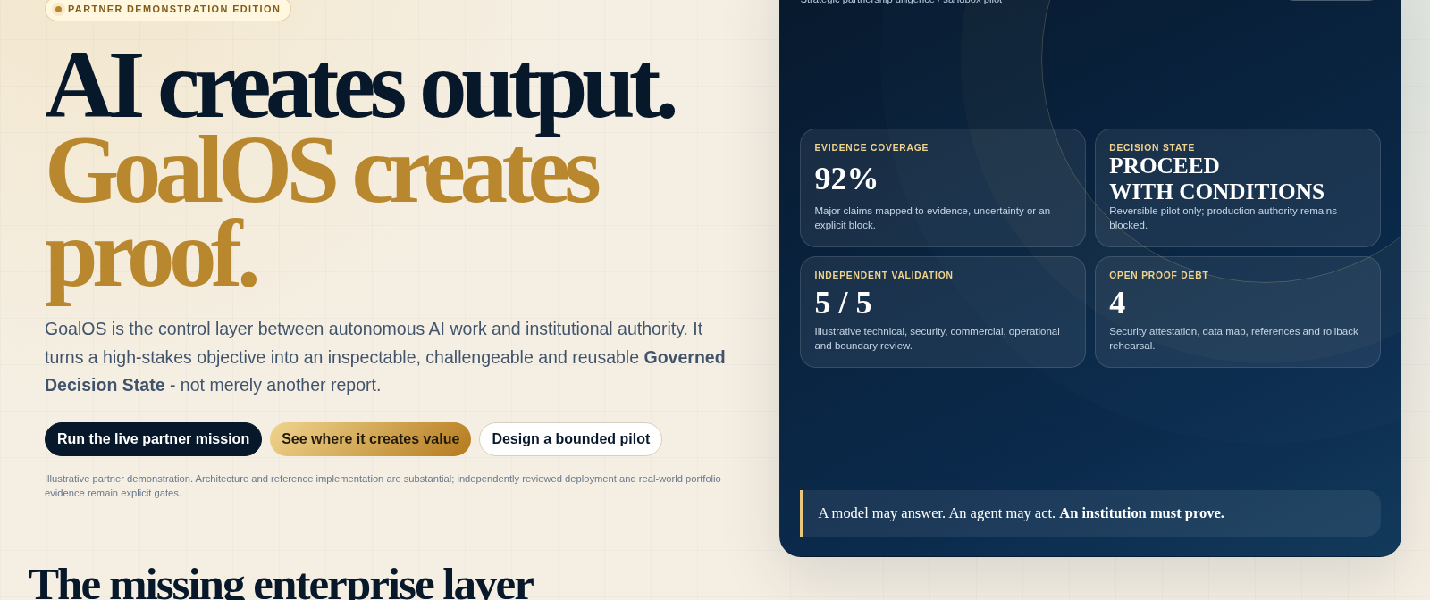
LIVE SYSTEM
A boardroom-ready, offline demonstration.
Run a mission, inspect the Docket, export the proof pack and design a pilot.
Open: GoalOS_Partner_Demonstrator.html
Notes:
Switch to the standalone HTML after this slide. It runs without a server or external dependency. Start on Overview, then click Run the live partner mission. The audience will see the mission contract, proof debt, AGI Jobs, evidence packaging, validation, Chronicle and bounded authority transition.

Slide 5
THE OPERATING LOOP
Authority appears only after the next gate passes.
GoalOS converts autonomous work into proof, governed capability and accountable authority.
1 · INTENT
2 · WORK
3 · EVIDENCE
4 · AUTHORITY
5 · CAPABILITY
Objective + Mission Contract
Proof Debt + AGI Jobs
ProofBundles + Docket
Validation + Chronicle
Validated Skill + Bonded Authority
Decision, scope, proof level, risk, validators and rollback.
Unsupported claims become mission-specific proof contracts.
Artifacts, provenance, tests, contradictions, risk, cost and replay.
Independent review decides what may be trusted and remembered.
Accepted proof becomes scoped capability and economic consequence.
No proof
No evaluation
No rollback
No Chronicle entry
No valid bond receipt
no evolution
no propagation
no release
no future-mission influence
no authority transition
Objective -> Mission Contract -> Proof Debt -> AGI Jobs -> ProofBundles -> Evidence Docket -> Validation -> Chronicle -> Validated Skill -> Bonded Authority
Notes:
Work does not become evidence because an agent finished. Evidence does not become memory because it exists. Memory does not become authority because it is useful. Each transition has a gate, a record and a rollback or challenge path.

Slide 6
ILLUSTRATIVE PARTNER MISSION
Strategic partnership diligence - from uncertainty to a bounded decision.
A hypothetical enterprise asks whether to enter a 30-day AI infrastructure pilot.
MISSION INPUT
GOVERNED DECISION
ILLUSTRATIVE TELEMETRY
Objective
Proceed with a bounded pilot - subject to four closing conditions.
92%
5 / 5
Determine whether to enter a bounded AI infrastructure partnership pilot.
Evidence coverage
Validator reveals
Proof level
L3 - external-review ready
✓
Independent security control evidence
4
96%
Risk class
High-stakes, reversible
✓
Complete data-flow and residency map
Open proof debt
Replay-ready artifacts
Validators
Technical, security, commercial, operational, boundary
✓
Two relevant enterprise references
Blocked claim
No production-readiness assertion
✓
Rollback rehearsal and explicit exit rights
Chronicle: ADMIT WITH SCOPE
Production authority remains blocked.
Notes:
The mission does not conclude yes or no in a vacuum. It says what can proceed, what remains blocked and what evidence must close before authority expands. The numbers are illustrative; the operating objects are the product.

Slide 7
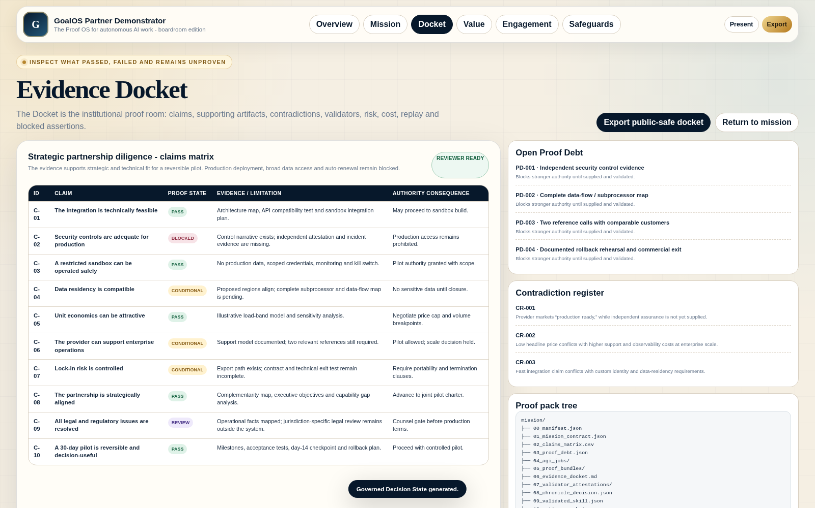
EVIDENCE DOCKET
A proof room, not a marketing page.
Claims, evidence, contradictions, validators, open debt and authority consequences remain visible.
WHAT A REVIEWER CAN SEE
Every major claim
PASS, CONDITIONAL, BLOCKED or REVIEW.
Open Proof Debt
What evidence is required before stronger authority.
Contradictions
Conflicting evidence is preserved, not hidden.
Authority consequence
What may happen next - and what remains prohibited.
Replay path
How another reviewer can reproduce the critical result.
Notes:
The Docket makes the decision inspectable. It shows blocked claims, unresolved contradictions and what authority consequence follows from each state. A reviewer can disagree without losing the lineage of the decision.

Slide 8
PARTNER VALUE
Start where proof quality changes a real decision.
The initial wedge is bounded, high-value work - not autonomous everything.
01
Strategic partnership diligence
02
Enterprise AI procurement
03
AI product launch readiness
Technical, commercial, security and operational fit - with reversible pilot conditions.
Common claims matrix, evaluation plan, data boundary, security rubric and cost ledger.
Release, canary, repair or block - with monitoring, rollback and claim discipline.
GOVERNED DECISION + ACTION GRAPH
GOVERNED DECISION + ACTION GRAPH
GOVERNED DECISION + ACTION GRAPH
04
M&A and technology diligence
05
Defensive cybersecurity remediation
06
R&D portfolio and capability reuse
Evidence-bearing workstreams across product, IP, data, security and operations.
Repo-owned, human-reviewed remediation with replay and safety invariants.
Admit only scoped, fresh and replayable results into governed memory.
GOVERNED DECISION + ACTION GRAPH
GOVERNED DECISION + ACTION GRAPH
GOVERNED DECISION + ACTION GRAPH
Notes:
Lead with a decision the partner already needs to make. GoalOS is most immediately useful where unsupported assumptions, contradictory evidence, auditability, rollback and future reuse matter.

Slide 9
OPERATING ADVANTAGE
The moat is governed capability - not prompt text.
Accepted work becomes a durable, scoped and replayable institutional asset.
Decision confidence
Review velocity
01
02
Major claims have a declared proof state, not just persuasive wording.
Evidence, contradictions, risk and authority consequence appear in one package.
Proof debt reduction
Institutional memory
03
04
Missing evidence is explicit and prioritized before action.
Chronicle prevents unsupported output from contaminating future missions.
Controlled reuse
Partner trust
05
06
Validated Skills carry scope, freshness, replay, revocation and rollback.
Claim boundaries and evidence status are visible rather than buried.
The durable asset is accumulated method + evidence + scope + validator history + delayed outcomes + lineage.
Notes:
Prompt libraries are easy to copy and raw transcripts are unsafe memory. GoalOS compounds governed capability: method plus evidence plus scope plus validator history plus delayed outcomes.

Slide 10
COMMERCIAL PATH
Land with proof. Expand with capability.
Prove bilateral value before building network effects.
1
2
3
4
5
Proof Mission Sprint
Enterprise Proof OS
Private Validated Skill Graph
Managed AGI Node Council
Cross-Institution Proof Network
One bounded objective becomes a reviewer-ready decision state.
Recurring Mission Contracts, Dockets, Chronicle and audit workflows.
Customer-specific governed capability memory.
Independent validation without customer infrastructure burden.
Jobs, validators, challenges and capability passports.
Services wedge + evidence
Annual recurring platform
Implementation + assurance
ARR + metered validation
Network effects + throughput
Company value: services + subscriptions + implementation. Protocol value: verified-work throughput + bonded security + reusable capability.
Notes:
Begin with premium proof missions that create real evidence and revenue. Convert repeated demand into Enterprise Proof OS. Let validated capability become the durable asset. Add managed validation and network effects only after bilateral value is demonstrated.

Slide 11
$AGIALPHA
Bonded accountability - not a speculative product pitch.
GoalOS creates proof. $AGIALPHA is designed to make accepted proof economically consequential.
Work begins
Worker proof bond
Work becomes paid
Accepted ProofBundle + validator bonds
SECURED
SECURED
Claim becomes trusted
Chronicle + challenge finality
Claim is challenged
Evidence-bearing challenger bond
SECURED
SECURED
Skill becomes reusable
Reuse bond + delayed outcome
Node validates
Operational reserve + reputation
SECURED
SECURED
Protocol upgrades
Proposal + canary + rollback reserves
Ordinary customer experience
Fiat-denominated proof services can keep token complexity behind the scenes while professional operators and validators supply bonded security.
SECURED
No equity · no dividends · no revenue share · no passive yield · no guaranteed value · no price-support promise
Notes:
Present conservatively. $AGIALPHA is not the intelligence and should not be presented as an investment. Its role is protocol security around payment, trust, challenge, reuse, node operation and upgrades. A normal enterprise customer can remain tokenless by default.

Slide 12
ENTERPRISE PARTICIPATION
Every participant acts for its own account.
GoalOS conditions mission execution, validation, settlement, reuse and export on affirmative acceptance of the user-responsibility and risk-allocation framework.
Participant authority
The accepting person warrants authority to bind the represented organization and direct the mission.
CONTRACTUAL ENFORCEMENT
Versioned acceptance receipt
Exclusive responsibility
Objectives, instructions, content, data, systems, personnel, wallets, taxes, licences, compliance, decisions and deployment remain the Participant’s responsibility.
Role-specific representations
Evidence preservation / legal hold
Private executive conference
Risk assumption & release
The Participant accepts AI, smart-contract, network, token, cybersecurity, privacy, market, validator and irreversibility risks and grants the applicable release and non-recourse.
Confidential mediation in Montréal
Montréal-seated arbitration
Hold harmless & non-joinder
The Participant agrees to hold harmless the Protected Parties for Participant-caused matters and keeps user-to-user matters between the relevant Participants.
Montréal courts for enforcement
The versioned receipt and mission manifest travel together through every protected function.
No mission, validation, settlement, reuse or export without an effective participation receipt.
Notes:
The partner-facing safeguard is affirmative contractual allocation. Before any interactive action, the Participant accepts a versioned receipt: authority to bind the represented organization; exclusive responsibility for objectives, data, systems, personnel, wallets, taxes, licences, compliance and downstream use; assumption of technical and economic risk; release and non-recourse; hold-harmless for Participant-caused matters, participant-to-participant allocation and non-joinder terms; evidence preservation; and the Montréal professional dispute pathway. Keep the explanation businesslike: the system makes responsibility explicit and binds it to the mission evidence package.

Slide 13
EVIDENCE STATUS
Substantial architecture. External authority remains gated.
Credibility comes from distinguishing what is specified, implemented, reference-ready, planning-ready and pending.
Doctrine and object model
SPECIFIED
Mission OS, PROOF_LOOPS, AEP-001, Chronicle, Dockets and VSG.
Browser institution
IMPLEMENTED
Standalone and runnable ATLAS operating surfaces.
AGI Node / contract packages
REFERENCE-READY
Runtime, registries, schemas, tests and deployment packs.
Private proof / Merkle / ZK
SPECIFIED / REFERENCE
Commitment, selective-disclosure and identity architecture.
Business and economics
PLANNING-READY
Proof Mission, Proof OS, private VSG and managed validation.
Reviewed live deployment
PENDING
Audited contracts, governed keys, independent controls, incident response, insurance and production observability.
Independent replay / empirical compounding
PENDING
Real missions, external reviewers, delayed outcomes and harder transfer.
The next decisive milestone is one real partner mission with primary evidence, independent replay and measured delayed outcomes.
Notes:
We should not claim empirical superiority without real missions and independent replay. We can credibly say the doctrine is specified, the browser institution is implemented, the runtime and contract packages are reference-ready, and the participation controls are integrated. The strongest next proof is a real partner mission.

Slide 14
PROPOSED PILOT
Fifteen business days to one inspectable decision.
Choose a high-stakes but reversible objective with a named sponsor, accessible evidence, an independent reviewer and a valid participation receipt.
DAYS 1-2
DAYS 3-8
DAYS 9-12
DAYS 13-15
Freeze the mission
Produce proof
Validate and replay
Decide and package
Decision, scope, proof level, validators, blocked claims and rollback.
AGI Jobs, source map, ProofBundles, contradictions, cost and risk.
Independent review, repair loop, challenge handling and packaging.
Decision State, Action Graph, Chronicle and capability passport.
Partner inputs
The ask
One consequential objective
One executive sponsor
Evidence and subject-matter contacts
Select one mission.
One independent reviewer
A clear public/private boundary
Prove the operating loop before broader adoption.
Notes:
The partner does not need to endorse the full long-range architecture, operate a token or deploy nodes. They need one important decision, one authorized sponsor, one reviewer and one accepted participation receipt. In fifteen business days, the pilot should produce a complete decision package and reusable capability passport.

Slide 15
NEXT STEP
One consequential objective.
One inspectable decision.
One reusable capability.
OPEN THE DEMO
GoalOS_Partner_
Demonstrator.html
GoalOS is architecturally pointed at proof-gated, economically coordinated, open-ended autonomous work. The partner proposition is narrower and practical: prove one mission, then expand only if the evidence earns it.
Run the strategic partnership mission. Inspect the Docket. Export the proof pack.
Now we prove it.
Vincent Boucher | GoalOS / AGI ALPHA Research Architecture
Notes:
Close by asking the audience to choose the first mission. We do not ask them to believe a Holy Grail claim. We ask them to let the system produce one inspectable piece of evidence on a decision they care about.

