Slide 1
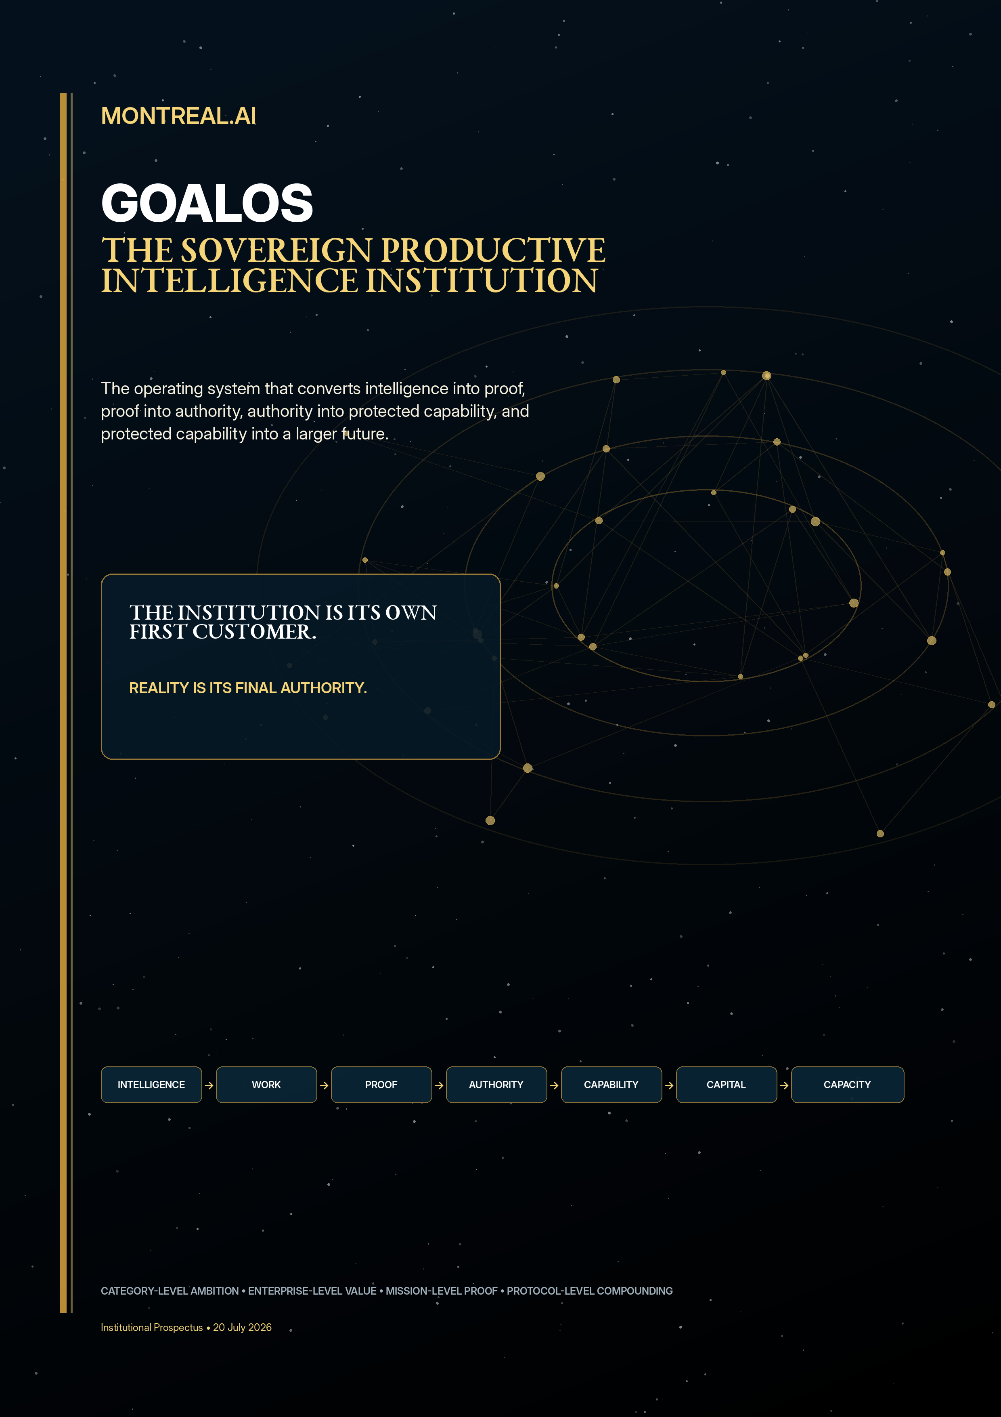

Slide 2
The executive decision
Build for strategic importance. Launch through proof.
GO - at category-defining scale.
Architect for a future in which intelligence becomes abundant. Sell one consequential problem first. Let customer receipts, evidence, independent challenge and fresh successor performance authorize every larger claim.
MAXIMUM AMBITION • MINIMUM UNSUPPORTED CLAIM • NO SKIPPED GATES

Slide 3
The window is open
Execution is becoming ordinary. Institutional authority is not.
01
02
03
Delegated work
Evaluated evolution
Capital at infrastructure scale
Agents increasingly operate across files, tools and controlled environments. The scarce question moves from “can it generate?” to “what may act, persist and receive authority?”
Candidate systems can be generated, executed and selected against measurable evaluators. What remains scarce is an institution that decides what deserves to survive.
Compute, energy, data, laboratories and industrial systems are becoming part of the AI stack. Value shifts toward institutions that convert cognition into productive capacity.
THE MODEL IS NOT THE INSTITUTION.

Slide 4
The transition
From abundant candidate output to governed productive intelligence.
OLD MODE | Human labour | Static report | Periodic review
EARLY AI | Near-free draft | Fast output | Weak authority
GOALOS | Bounded mission | Evidence + Chronicle | Protected capability + recurring control
The draft is becoming nearly free.
Truth, authority, rights, execution and accountability are not.
GOALOS SELLS VERIFIED, CONTINUOUSLY IMPROVING OUTCOMES.

Slide 5
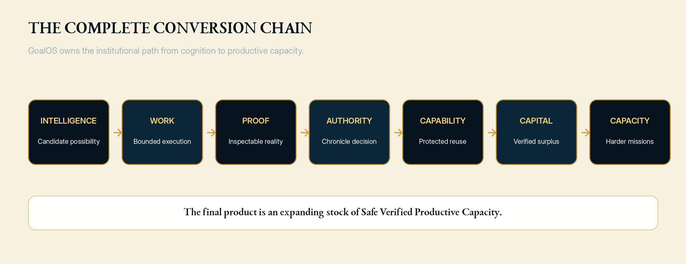
The complete conversion chain
Very few companies are attempting to own the full path.
INTELLIGENCE → WORK → PROOF → AUTHORITY → CAPABILITY → CAPITAL → CAPACITY

Slide 6
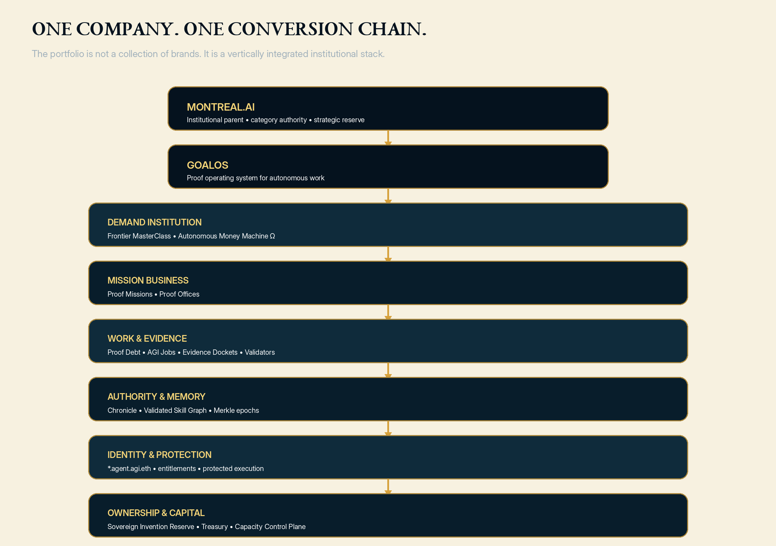
One company. One institutional stack.
Every product surface reinforces the same compounding system.
DO NOT LAUNCH A PRODUCT SUITE. LAUNCH THE INSTITUTION.

Slide 7
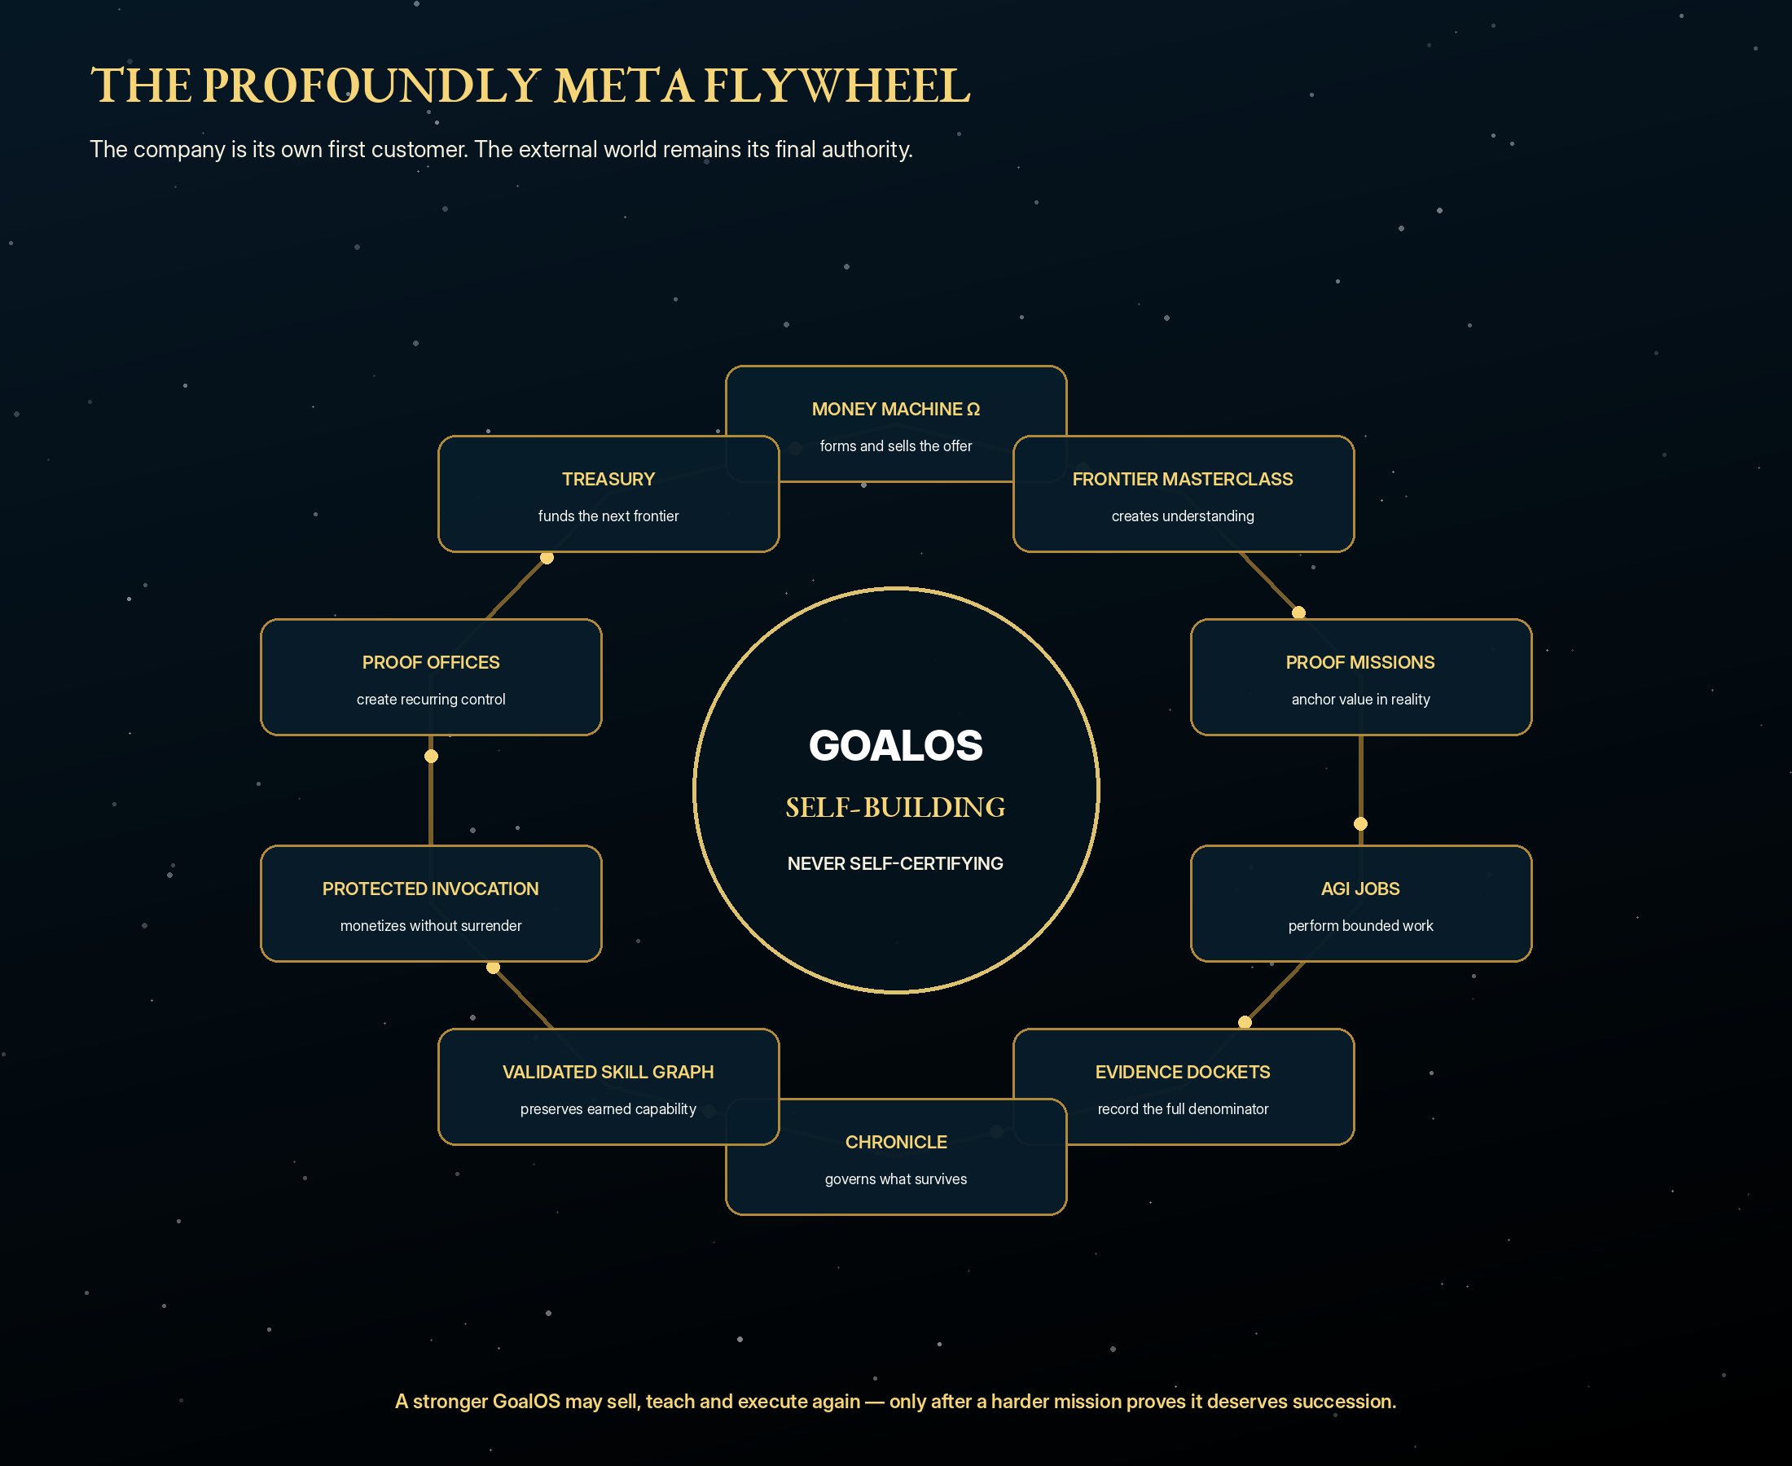
The profoundly meta institution
The company is its own first customer. Reality is its final authority.
SELF-BUILDING. NEVER SELF-CERTIFYING.

Slide 8
The institutional maxim
GoalOS may create the next GoalOS. It may not crown it.
GOALOS SELLS GOALOS.
GOALOS TEACHES GOALOS.
GOALOS TESTS GOALOS.
GOALOS GOVERNS WHAT GOALOS MAY LEARN.
GOALOS PROTECTS WHAT GOALOS HAS EARNED.
GOALOS FINANCES THE NEXT GOALOS.
ONLY THE EXTERNAL WORLD MAY PROVE THAT THE NEXT GOALOS IS BETTER.

Slide 9
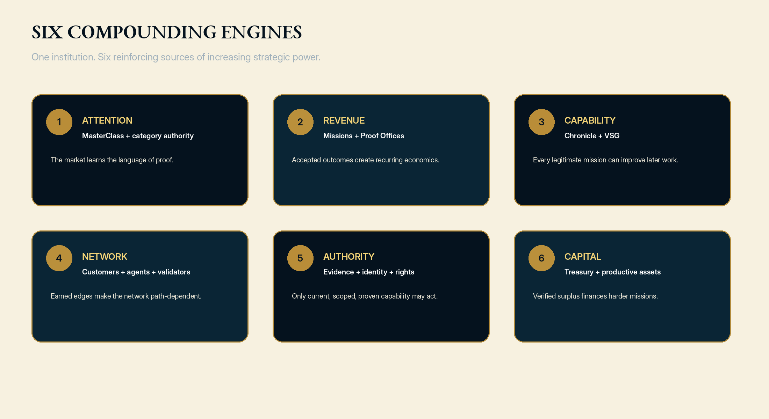
Six compounding engines
Attention, revenue, capability, network, authority and capital reinforce one another.

Slide 10
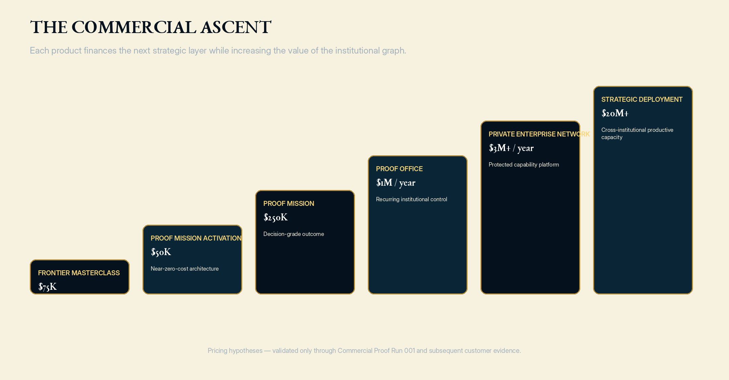
The premium commercial ascent
Each product finances the next strategic layer.
PRICING HYPOTHESES — VALIDATE THROUGH COMMERCIAL PROOF RUN 001.

Slide 11
The first purchasable outcome
One expensive decision. One bounded mission. One defensible state.
Should this institution deploy, acquire, scale, continue funding, narrow, repair - or stop - this consequential AI initiative?
MISSION
OUTPUT
EXPANSION
$250,000
Evidence Docket
$1M / year
15 business days. Frozen objective, scope, evidence burden, acceptance and rollback.
Proof Debt, AGI Jobs, reviewer verdict, governed decision and action path.
A recurring Proof Office manages continuing objectives, evidence and capability lifecycle.
THE CUSTOMER BUYS A DEFENSIBLE DECISION STATE.

Slide 12
A transaction designed for dramatic shared surplus
Premium enterprise value with software-like gross margins.
Complete first-year customer | Revenue | Direct cost | Gross profit | GM | Customer value floor | ROI
Activation + Mission + Office + usage | $1.55M | $0.31M | $1.24M | 80% | $6.2M | 300%
The customer receives four dollars of conservative value for each dollar paid. GoalOS retains the capital required to build the capability network.
Value is separated into forecast, verified and realized states.
Pricing is determined by value at stake, margin floor, evidence burden, risk and rights.
The model explicitly includes tools, evaluators, human exceptions, security, reserves and delivery cost.

Slide 13
Autonomous commerce
The Money Machine must become the transaction, not a sales assistant.
01
02
03
04
05
DIAGNOSE
QUALIFY
TEACH
PRICE
CONTRACT
06
07
08
09
10
COLLECT
EXECUTE
PROVE
RENEW
EXPAND
Zero seller-side minutes in the standard lane. Human-sovereign at the constitutional boundary. Fail closed outside the approved product envelope.
THE CUSTOMER SUPPLIES OBJECTIVE, CONSENT, PAYMENT AND ACCEPTANCE.

Slide 14
The first economic atom
A paid Proof Mission converts uncertain ambition into inspectable institutional reality.
01
02
03
04
Objective
Mission Contract
Proof Debt
AGI Jobs
What must change?
Scope, budget, rights, test
What remains unknown?
Bounded work
05
06
07
08
Evidence Docket
Independent Review
Chronicle
Validated Skill
Full denominator
Challenge + replay
Authority decision
Scoped future influence
PAYMENT EARNS RELEVANCE. OUTCOMES EARN CREDIBILITY. VERIFICATION EARNS AUTHORITY.

Slide 15
Chronicle
The memory firewall that prevents recursive contamination.
ADMIT
ADMIT WITH CONDITIONS
REPAIR
REJECT
QUARANTINE
SUPERSEDE
RETIRE
A Merkle root commits state. It does not create truth. Chronicle grants or removes institutional authority.
ONLY ADMITTED, SCOPED, RIGHTS-CLEARED, CURRENT AND ROLLBACKABLE CAPABILITY MAY COMPOUND.

Slide 16
The Validated Skill Graph
The moat is not the nodes. It is the earned institutional edges.
CUSTOMER_PAID_FOR
SPONSOR_AUTHORIZED
MISSION_DELIVERED
EVIDENCE_SUPPORTED
REVIEWER_ACCEPTED
CHRONICLE_ADMITTED
RIGHTS_PERMIT_REUSE
REPEAT_PURCHASE_FOLLOWED
SUCCESSOR_IMPROVED_BECAUSE_OF
CAPITAL_CREATED_CAPACITY
Models can be substituted. A decade of trusted missions, negative evidence, rights, evaluators, accepted reuse and capital-allocation competence cannot be copied in a weekend.

Slide 17
The strongest open-system moat
Open standards. Public verification. Private capability. Governed invocation.
CURRENT DIRECT IDENTITY
RESULT
GOVERNED OUTCOME
CURRENT OWNERSHIP / DELEGATION
The customer receives the result, evidence, scope, capability version and verification receipt. MONTREAL.AI retains the private method, evaluator logic, failure history and graph intelligence.
SCOPED ENTITLEMENT
CHRONICLE ADMISSION
LATEST-ROOT INCLUSION
APPROVED EXECUTION ENVIRONMENT
The protocol may be copied. The canonical private capability network cannot be recreated retroactively.

Slide 18
The final access law
Identity, rights, memory and reliance are all current-state questions.
No direct name, no identity.
No current ownership, no write.
No Chronicle admission, no canonical skill.
No entitlement, no use.
No latest-root proof, no reliance.
No verified outcome, no compounding.
THE AGENT RECEIVES A GOVERNED RIGHT TO INVOKE. MONTREAL.AI RETAINS THE UNDERLYING INTELLIGENCE.

Slide 19
GoalOS Treasury
Verified free cash flow becomes greater future mission capacity.
01
02
CUSTOMER ACQUISITION + DELIVERY
CAPABILITY ENGINEERING
20-30%
20-30%
03
04
MODELS, COMPUTE, DATA + ENVIRONMENTS
VALIDATION, LEGAL, SAFETY + SECURITY
10-20%
10-15%
05
06
STRATEGIC INFRASTRUCTURE PILOTS
BOUNDED FRONTIER OPTIONS
10-20%
5-10%
Every capital allocation becomes another Proof Mission: thesis, baseline, milestones, telemetry, evidence, continuation decision and stop condition.
THE TREASURY FUNDS THE NEXT FRONTIER - ONLY AFTER OBLIGATIONS AND RESERVES.

Slide 20
The north-star metric
Safe Verified Productive Capacity - not revenue alone, not graph size, not agent activity.
The institution is improving when it produces more independently supported outcomes, at lower cost and risk, using more reusable capability, under stronger governance - while increasing future mission capacity.
V
R
O
P
S
D
X
Verified value
Reuse advantage
Ownership + control
Persistence + freshness
Safety + legitimacy
Unresolved Proof Debt
Externality + concentration
MAXIMIZE VERIFIED VALUE, REUSE, CONTROL, FRESHNESS AND GOVERNANCE. MINIMIZE PROOF DEBT AND EXTERNALITY.

Slide 21
Commercial Proof Run 001
The next authority must come from customer receipts.
3
3
1+
1+
PAYING CUSTOMERS
SIMILAR MISSIONS
INDEPENDENT VERDICT
REPEAT / EXPANSION
1+
1+
+
0
ADMITTED CAPABILITY
FRESH IMPROVEMENT
POSITIVE CONTRIBUTION
TRUST BREACHES
Build the category now. Sell the bounded mission now. Publish the evidence. Compound only what passes.

Slide 22
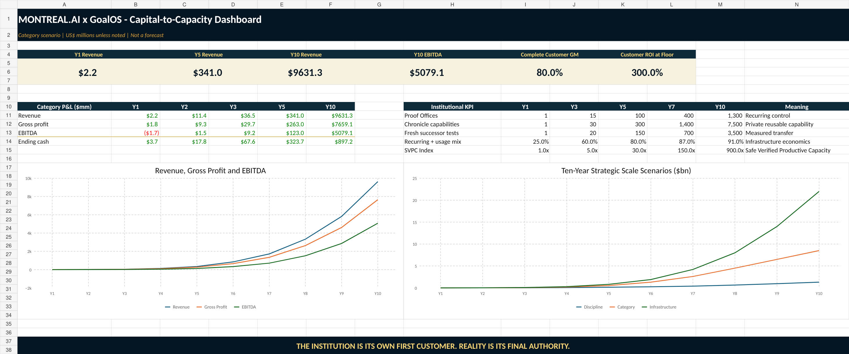
The architecture of scale
A ten-year category scenario - not a forecast.
Metric | Y1 | Y5 | Y10
Revenue | $2.2M | $341M | $9.63B
Gross profit | $1.8M | $263M | $7.66B
EBITDA | ($1.7M) | $123M | $5.08B
Recurring + usage mix | 25% | 80% | 91%
Proof Offices | 0.75 | 100 | 1,300
Chronicle capabilities | 1 | 300 | 7,500
Scenario architecture only. Every larger capital and valuation claim remains subordinate to proof gates.

Slide 23
Only proof earns scale
Valuation follows evidence. It does not precede it.
I
COMMERCIAL PROOF
3 customers • 1 verified outcome • 1 repeat
II
REPEATABLE PRODUCT
20-30 missions • 5+ Offices • admitted capability
III
ENTERPRISE PLATFORM
20+ enterprises • 50%+ recurring • private deployments
IV
CATEGORY STANDARD
100+ institutions • $100M+ recurring trajectory
V
PRODUCTIVE INFRASTRUCTURE
Global standard • network economics • productive assets
BUILD FOR $100B+ IMPORTANCE. CLAIM ONLY WHAT THE RECEIPTS PROVE.

Slide 24
Institutional architecture that can survive scale
Protect the operating company. Ring-fence physical infrastructure. Separate authority.
HOLDCO
OPERATING COMPANY
PLATFORM + RESERVE
MONTREAL.AI
GOALOS
CAPABILITY
Category, canonical network, strategic governance and long-horizon capital doctrine.
Enterprise contracts, Proof Missions, Proof Offices and customer value.
Runtime, Chronicle, VSG, protected execution, identity and rights-cleared assets.
TREASURY
INFRASTRUCTURE SPVS
CAPITAL DISCIPLINE
RING-FENCED SCALE
Reserves, proof-gated reinvestment and portfolio governance.
Compute, energy, laboratories and industry financed against milestones.
NO SINGLE AGENT, FOUNDER, VALIDATOR OR CAPITAL PROVIDER CONTROLS THE ENTIRE INSTITUTION.

Slide 25
Do not launch a product suite.
Launch the institution.
MONTREAL.AI is constructing the operating institution through which intelligence becomes trusted work, trusted work becomes protected capability, protected capability becomes recurring economic power, and verified economic power finances a larger future.
THE INSTITUTION IS ITS OWN FIRST CUSTOMER.
REALITY IS ITS FINAL AUTHORITY.
NOT MERELY WORK COMPLETED. CAPABILITY EARNED. IMPROVEMENT PROVEN.
MAXIMUM AMBITION • MINIMUM UNSUPPORTED CLAIM • ONE CONSEQUENTIAL MISSION AT A TIME

