Slide 1
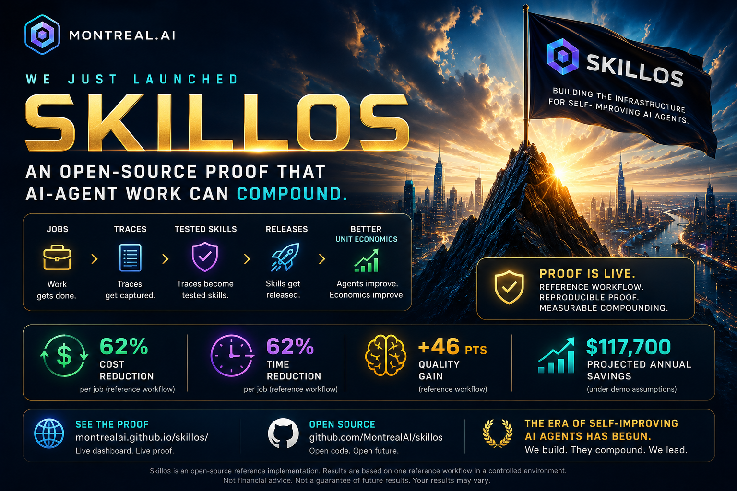

Slide 2
THE THESIS
SkillOS is an open-source proof that AI-agent work can compound.
Jobs become traces. Traces become tested skills. Tested skills improve future work.
MECHANISM
PUBLIC
NEXT
Work -> Trace -> Learn -> Skill -> Test -> Release
Live site, repo, proof, docs
Pilot 001 with real workflow metrics

Slide 3
WHAT IS PUBLIC TODAY
LIVE PROOF
GITHUB REPOSITORY
https://montrealai.github.io/skillos/
https://github.com/MontrealAI/skillos
REFERENCE WORKFLOW
AUTOMATION
ARCHIVE
Sales follow-up emails from call notes
GitHub Actions verifies, builds, and deploys
Permanent public meeting materials

Slide 4
THE COMPOUNDING LOOP
WORK
TRACE
LEARN
SKILL
TEST
RELEASE
Agent completes a job
System records what happened
Corrections become lessons
Lessons become bounded updates
Candidate must improve metrics
Approved versions improve work
Work stops being disposable and becomes reusable capability.

Slide 5
PUBLIC-SAFE BOUNDARY
Reference workflow. Reproducible proof. Human approval. No guaranteed outcomes.
USE
AVOID
PILOT RULE
Open-source proof Reference workflow Controlled environment Measured improvement
Guarantees Unaudited ROI claims Financial claims High-impact decisions
Agent drafts Human approves Nothing sends automatically

Slide 6
PILOT 001
The bridge from reference proof to market proof.
WORKFLOW
SIZE
RULE
OUTPUT
Sales follow-up emails from call notes
50-100 real jobs
Agent drafts. Human approves.
Aggregated before/after metrics
Pilot 001 proves whether the mechanism creates real workflow value.

Slide 7
WHAT WE NEED FROM THE ROOM
1. Approve the public-safe launch message
2. Identify 1-3 Pilot 001 partners or warm introductions
3. Assign pilot, measurement, and privacy owners
4. Agree to publish only safe, aggregated pilot results

Slide 8
THE CLOSE
We are not asking people to believe in a pitch.
We are showing a live reference proof and asking to test one real workflow.
SkillOS proves the mechanism. Pilot 001 proves the market.
https://montrealai.github.io/skillos-launch-archive/

