Slide 1

MONTREAL.AI ◆ BOARD DECISION PACK
Authorize one bounded
proof trajectory.
NEURAL-SYMBOLIC SUCCESSOR Ω
Decision today: D0 — Underwrite one mission. No production authority.
Target architecture · Release-specific claims must be earned
26 AUGUST 2026
Notes:
[Sources]
- MONTREAL.AI, Neural-Symbolic SUCCESSOR Ω white paper, pp. 7, 11 (separate decision gates; governing invariant).
- Commissioned conceptual editorial visualization: exec-1a978d70-d5ee-44c9-9619-43a62a1eab46.png.
Conceptual editorial visualization — not deployed infrastructure, empirical evidence, or a proof receipt.

Slide 2
MONTREAL.AI ◆ CUSTOMER-OWNED MISSION INTELLIGENCE
RENT
OWN
Replaceable cognition
The mission institution
Frontier models
Agent platforms
Compute and tools
Mission Constitution
Evidence and provenance
Executable understanding
Proof, authority and Chronicle
Useful. Fast-moving. Increasingly available to competitors.
The supplier may change. The institutional mind persists under customer control.
02
Notes:
[Sources]
- MONTREAL.AI, Neural-Symbolic SUCCESSOR Ω white paper, pp. 4–10 (executive thesis, category, durable unit of competition, ownership definition).

Slide 3
MONTREAL.AI ◆ BOARD DECISION PACK
Four compartments keep belief, proof, and permission distinct.
WORLD
POLICY
PROOF
AUTHORITY
What the evidence currently supports
What the institution proposes
What one frozen release demonstrated
What customer governance permits
Versioned beliefs, predictions, uncertainty and falsifiers
Constraints, options, preconditions and intended outcomes
Fresh evidence, explicit scope, validity and expiry
Externally enforced actions, limits, monitoring and rollback
Capability ≠ proof ≠ authority
NEURAL-SYMBOLIC SUCCESSOR Ω
03
Notes:
[Sources]
- MONTREAL.AI, canonical four-compartment visual specification, 26 August 2026.
- MONTREAL.AI, Neural-Symbolic SUCCESSOR Ω white paper, pp. 10–12, 26–35 (canonical definitions, proof, authority and separation of powers).
Proof is externally governed; Authority is customer-granted and externally enforced. The four compartments are not four claimant-owned executable programs.

Slide 4
MONTREAL.AI ◆ BOARD DECISION PACK
Improvement can recurse without production self-modification.
SERVING RELEASE R(t)
PROMOTION REQUIRES A NEW ADMISSION
Frozen and admitted
1
Compile · train · stress
Acts only inside current proof and authority.
No material self-modification.
2
Freeze the exact candidate
→
3
Fresh independent proof
SHADOW SUCCESSOR C(t+1)
4
Accountable admission
Learns, synthesizes, reorganizes
5
Serve as R(t+1)
May learn from Chronicle evidence under policy.
No consequential production authority.
NEURAL-SYMBOLIC SUCCESSOR Ω
04
Notes:
[Sources]
- MONTREAL.AI, Neural-Symbolic SUCCESSOR Ω white paper, pp. 20–21 (continuous evolution without uncontrolled self-modification).
Improvement is recursive but governed: each material descendant freezes, undergoes fresh proof, and receives a new admission before serving.

Slide 5
MONTREAL.AI ◆ BOARD DECISION PACK
Spread is opportunity. Mission Alpha is what survives.
No advantage is admitted until one exact release survives deductions, hard gates, and fresh independent proof.
BASELINE
CANDIDATE
DEDUCTIONS
Better of the incumbent and relevant AI Beta
Observed performance above the baseline
Cost · risk · human burden
Imitation · commoditization
Drift · impairment reserves
→
→
α
SPREAD
MISSION
ALPHA
Specialist ASI is an earned, expiring, mission-bounded admission status — never a universal claim.
NEURAL-SYMBOLIC SUCCESSOR Ω
05
Notes:
[Sources]
- MONTREAL.AI, Neural-Symbolic SUCCESSOR Ω white paper, pp. 8–11, 27–30 (baseline, Spread, Alpha, Specialist ASI and proof validity).
Mission Alpha is perishable and may be absent. The baseline is the better of the incumbent and relevant AI Beta under comparable mission utility, constraints, cost, latency, security, and operating conditions.

Slide 6
MONTREAL.AI ◆ BOARD DECISION PACK
No actor may manufacture its own final proof or authority.
MANUFACTURE
TEACH + STRESS
EXAMINE
GRANT + ENFORCE
Alpha Foundry Ω
Sovereign Mission Gym
Independent Proof Network
Customer governance + controls
Build competing candidates
Expose failure and improve capability
Test one frozen release on fresh evidence
Grant and enforce a bounded envelope
Cannot certify
Cannot issue final proof
Cannot broaden the mission
No authority beyond current proof
The claimant may manufacture capability. It may not serve as its own final judge.
NEURAL-SYMBOLIC SUCCESSOR Ω
06
Notes:
[Sources]
- MONTREAL.AI, Neural-Symbolic SUCCESSOR Ω white paper, pp. 5–6, 11–12, 26–35 (constitutional separation, proof, admission and execution).

Slide 7
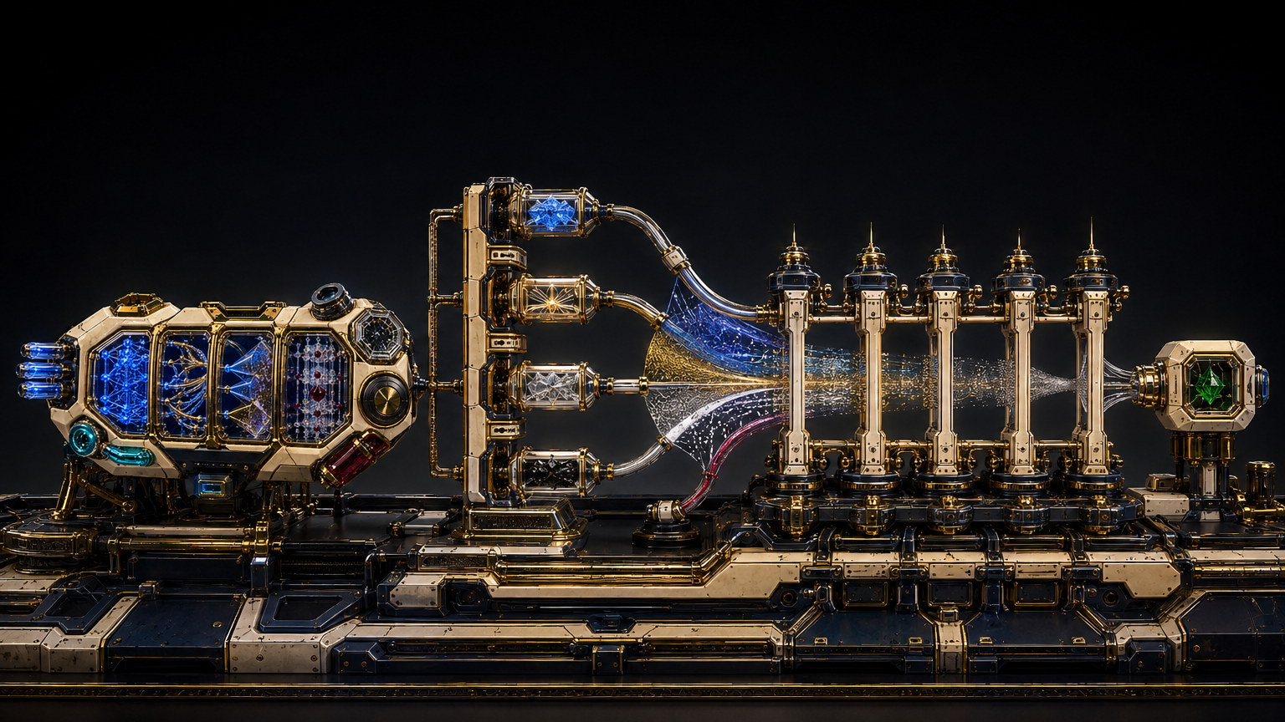
Proof examines one frozen release
outside the claimant’s control.
Fresh protected evidence · precommitted gates · explicit scope and expiry
I3 is the stated minimum for public “independently proven” claims or consequential authority, unless an approved equivalent exists.
1
Freeze exact release
2
Challenge with fresh evidence
3
Issue proof — or failure — receipt
Notes:
[Sources]
- MONTREAL.AI, Neural-Symbolic SUCCESSOR Ω white paper, pp. 26–30 (fresh proof, protocol, independence levels, receipt and validity).
- Commissioned conceptual editorial visualization: exec-9a49d2f7-d56a-4674-aeb0-03427935ad27.png.
Conceptual editorial visualization — not deployed infrastructure, empirical evidence, or a proof receipt.

Slide 8
MONTREAL.AI ◆ BOARD DECISION PACK
Authority remains narrower than capability — and contracts with drift.
CAPABILITY
DRIFT OR IMPAIRMENT
CURRENT PROOF BOUNDARY
←
Contract or suspend authority.
Preserve evidence.
Re-prove or retire.
ACTUAL AUTHORITY ENVELOPE
Customer-granted · scoped · expiring · monitored · reversible
Proof defines the maximum justifiable boundary. Governance grants actual authority. External controls enforce it.
NEURAL-SYMBOLIC SUCCESSOR Ω
08
Notes:
[Sources]
- MONTREAL.AI, Neural-Symbolic SUCCESSOR Ω white paper, pp. 29–35 (proof impairment, authority levels, Authority Envelope and Deployment Controller).
Nothing automatically restores authority. A proof result does not itself grant permission.

Slide 9
MONTREAL.AI ◆ BOARD DECISION PACK
Customer ownership is a rights boundary plus a reproducible test.
01
02
03
INSPECT + EXPORT
SUBSTITUTE
RESTORE + REPRODUCE
Constitution, evidence bindings, programs, policies, proofs, releases and Chronicle — within the agreed rights boundary.
Replace a declared cognitive supplier through a stable interface; assess impairment and re-proof when material.
Restore a signed release and Chronicle checkpoint; demonstrate equivalent bounded behaviour.
State the tested portability level (P0–P4). Never imply universal portability.
NEURAL-SYMBOLIC SUCCESSOR Ω
09
Notes:
[Sources]
- MONTREAL.AI, Neural-Symbolic SUCCESSOR Ω white paper, pp. 9–10, 35–39 (ownership definition, durable package, portability and export-and-rebuild test).

Slide 10
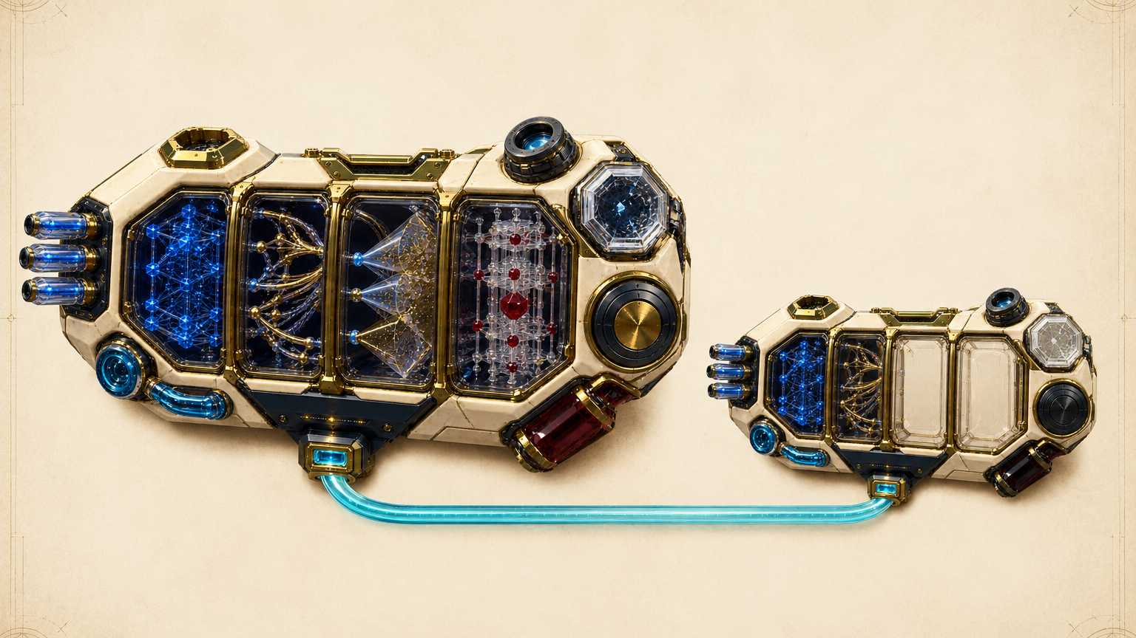
SUCCESSION LAW
MAY TRANSFER
Knowledge may compound.
Power must be re-earned.
Memory · provenance · retired failures
program lineage · operating history
RESTARTS EMPTY
Proof claim · production authority
Every material descendant receives a new release identity, fresh proof, and a new admission before serving.
Notes:
[Sources]
- MONTREAL.AI, Neural-Symbolic SUCCESSOR Ω white paper, pp. 20–21, 53–54 (governed descendants, Chronicle and succession).
- Commissioned conceptual editorial visualization: exec-ab183ff6-e50b-4a26-976a-99eab96ba730.png.
Conceptual editorial visualization — not deployed infrastructure, empirical evidence, or a proof receipt. Transfers remain subject to evidence rights, policy, retention and privacy boundaries.

Slide 11
MONTREAL.AI ◆ BOARD DECISION PACK
Approve capital, capability, proof, and authority separately.
TODAY: D0 — UNDERWRITE ONE MISSION
D0
D1
D2
D3
D4
UNDERWRITE
BUILD
PROVE
ADMIT
RENEW / RETIRE
Important, observable, worth proving?
Evidence rights and safe test path adequate?
Exact candidate ready for protected examination?
Proof sufficient and controls ready?
Proof current and institution still fit?
A pass at one gate creates no presumption at the next. A failure receipt is a valid governance outcome.
NEURAL-SYMBOLIC SUCCESSOR Ω
11
Notes:
[Sources]
- MONTREAL.AI, Neural-Symbolic SUCCESSOR Ω white paper, p. 7 and Appendix D, pp. 57–58 (D0–D4 executive decision sequence and pass/fail gates).

Slide 12
MONTREAL.AI ◆ BOARD DECISION PACK
Board resolution: authorize D0 — Underwrite.
Authorize one mission to enter a bounded evidence and proof-design phase.
1
Name one accountable sponsor and a narrow mission boundary.
2
Produce the Mission Constitution, baseline hypothesis, value at risk, budget and exclusions.
3
Grant no protected trial, Specialist ASI claim or production authority at D0.
4
Return at D1 with evidence readiness, threat model, baseline plan and proof plan.
NEXT BOARD DECISION
D1 — Build: are evidence rights, evaluation, security and a safe test path adequate?
Target architecture. Customer-specific capability, Specialist ASI status, Mission Alpha, ownership, portability and authority are release-specific claims that must be earned through the paper’s tests.
NEURAL-SYMBOLIC SUCCESSOR Ω
12
Notes:
[Sources]
- MONTREAL.AI, Neural-Symbolic SUCCESSOR Ω white paper, p. 7 and Appendix D, pp. 57–58 (D0 underwrite evidence, maximum permitted state and D1 return conditions).
Recommended resolution language is an executive synthesis of the paper's D0 and D1 gates. It does not authorize production autonomy.

