Slide 1
Product Lister
By Antti Minkkinen & James Pearce

Slide 2
Goals
Application for sharing and finding cheap prices for different products
Users can add products, connect products to shops and add prices to these products
Users can search for products

Slide 3
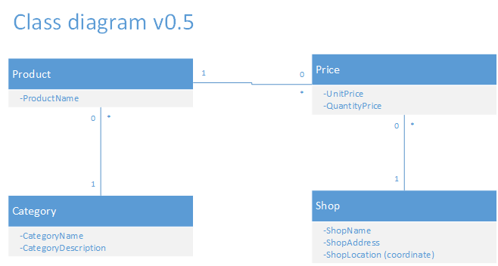
Class diagram

Slide 4
Problems
Can the user be trusted?
How to make the actual product

Slide 5
Demo

Slide 6
Thank you for listening
Questions?

