Slide 1
Product Lister
By Antti Minkkinen & James Pearce

Slide 2
Welcome
What we are going to show you
Goals
What it looks like
Possible future poblems
Demo

Slide 3
Goals
Application for sharing and listing prices for different products
Users can add products, connect products to shops with prices of the product at that shop
Users can search for products and the software will list all the shops it knows of with that product

Slide 4
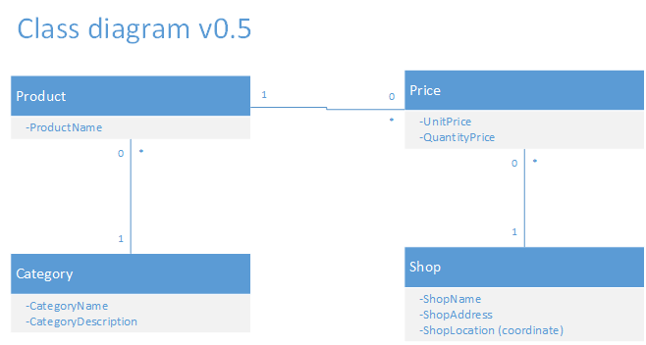
Class diagram

Slide 5
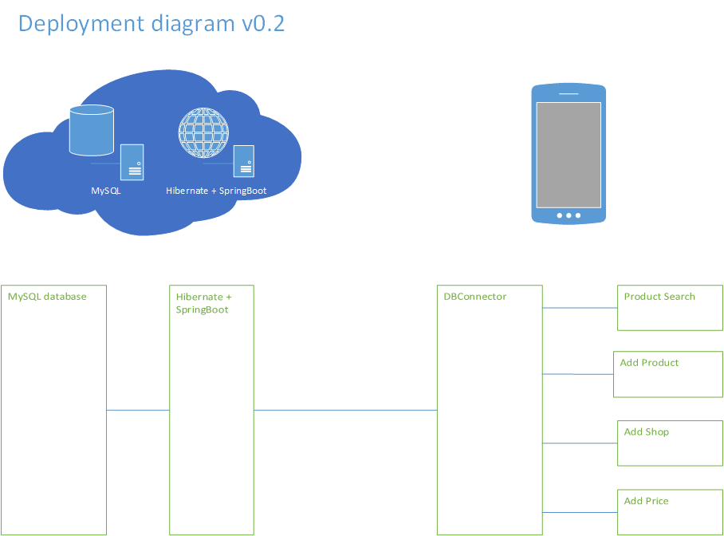

Slide 6
Problems
Can the user be trusted? Or will our application be full of profanity
How to make the actual product widespreadable

Slide 7
Demo
This is an awesome demo

Slide 8
Thank you for listening
Questions?

