Slide 1
Music Map
MAhantesh hiremath
303208716

Slide 2
Introduction
Music is One of the Most favored feeling around everybody in the world.
Music gave birth in Africa and Lived as American (USA Contributes 18%-25% to Global Music Revenue Every Year)

Slide 3
Data Collection
Data Source NMPA (National Music Publishers Association).
Cleaned Data Stored in .csv file extension.
Data Reference Link http://www.nmpa.org

Slide 4
Data Analysis
Analysis 1: (App.py)
Selecting the Country and Analysis Factor Application Generate the Image Showing Revenue Variation from 1995-2005
Ex:Country USA and Factor Radio Revenue/Online sale Revenue/Total Revenue(includes 9 factors)

Slide 5
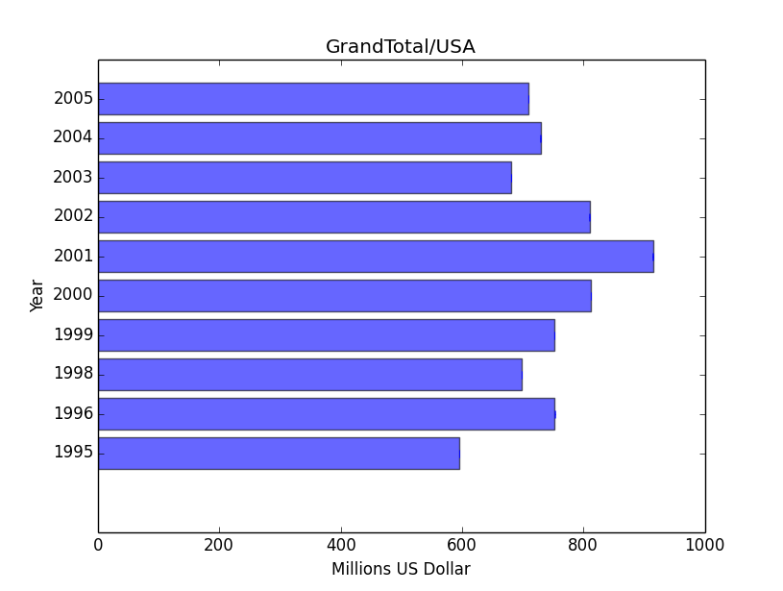
Data Application Image

Slide 6
Data Analysis
In 2012 out of 1000 people 114 people owns the Valid Music Unit.
In 1999 it was 221 people for every 1000 population
Ex:USA has Population 310 million where 36 million people has contributed >$6 each which is total Revenue(Where Sweden $37 each)

Slide 7
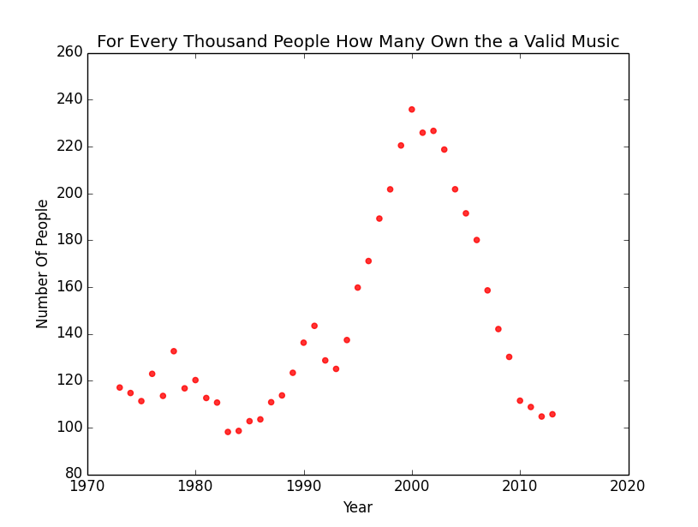
Data Analysis
Analysis 2:

Slide 8
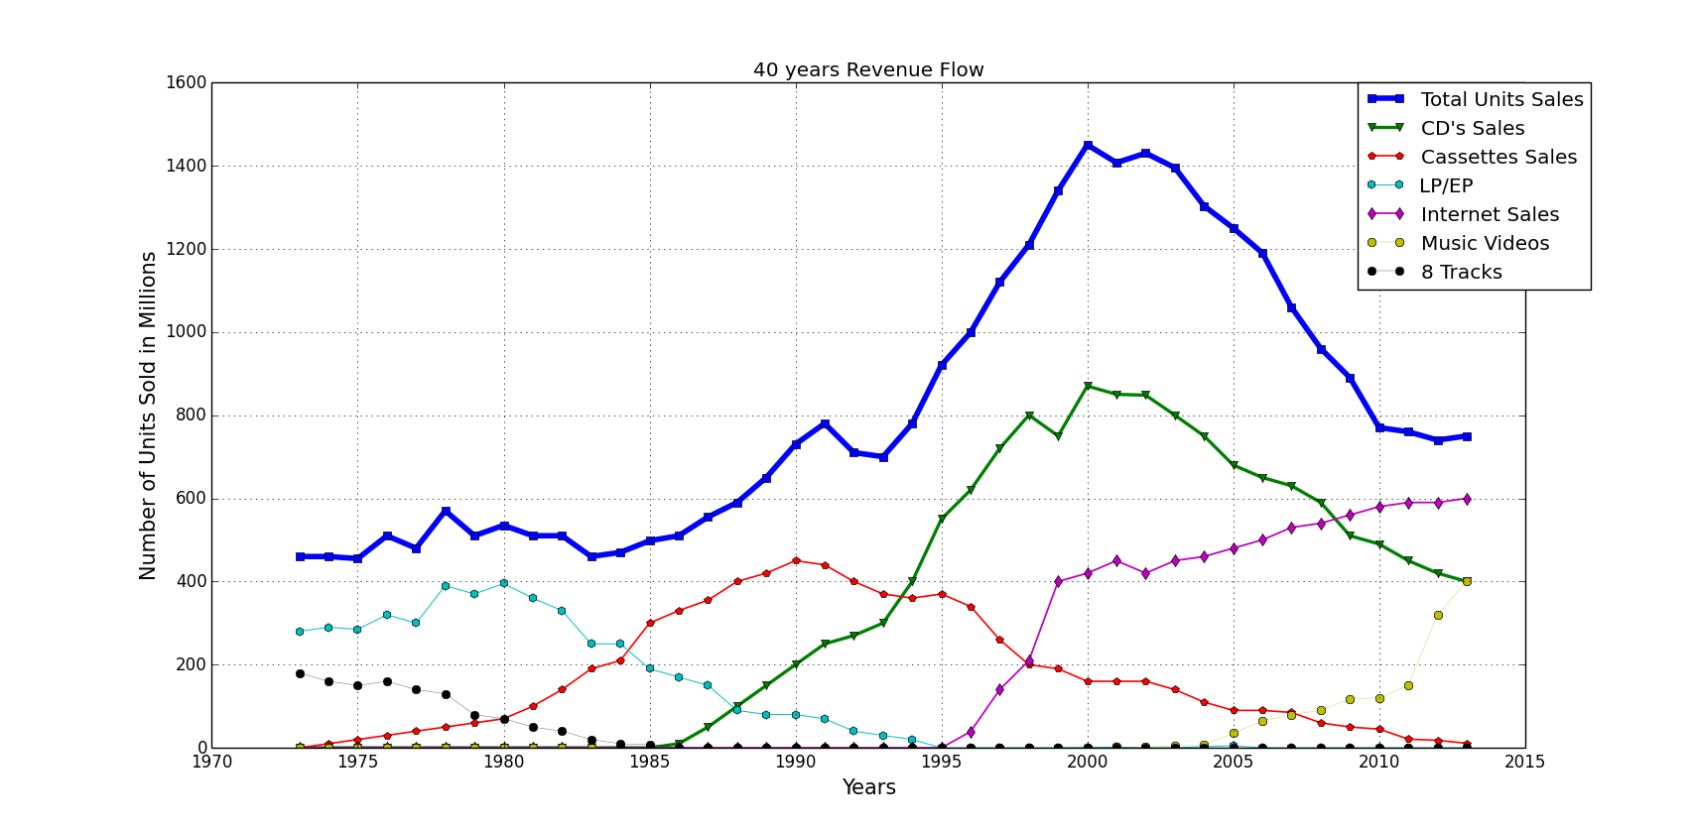
Data Visualisation

Slide 9
Observations
Music Industry was at its peak in 1999
When Napster Poped up with pear to pear File sharing. Which directly effected the sales of music in all Countries.

Slide 10
.
Thank you

