Slide 1
SQL Project Presentation on
“SQL-Based IPL Management System”
Presented By
Monty Kishan Vasita
Under The Guidance of:
Prof. Sandip Gupta

Slide 2
INDIAN PREMIER LEAGUE
MANAGEMENT SYSTEM

Slide 3
INTRODUCTION
The Indian Premier League (IPL) is a professional Twenty20 cricket league in India, widely regarded as one of the most popular and lucrative T20 leagues globally. Launched in 2008 by the Board of Control for Cricket in India (BCCI), the IPL features franchise teams representing different cities. Known for its high-octane cricket, star-studded line-ups, and innovative formats, the IPL has become a cricketing extravaganza, attracting top international players.
With its blend of entertainment and competitive cricket, the IPL has not only revolutionized the sport but has also gained a massive fan base, making it a premier event in the cricketing calendar.

Slide 4

TEAM PLAYING
CHENNAI SUPER KINGS
MUMBAI INDIANS
DELHI CAPITALS
PUNJAB KINGS
GUJRAT TITANS
RAJASTHAN ROYALS
ROYAL CHALLENGERS BANGALORE
KOLKATA KNIGHT RIDERS
LUCKNOW SUPER GIANTS
SUNRISERS HYDERABAD

Slide 5
OBJECTIVES
The Indian Premier League (IPL) Management system
1. Organize IPL Data
To create a database that stores and manages data about teams, players, matches, stadiums, sponsors, and tickets.
2. Simplify Data Access
To allow easy retrieval of information using SQL queries.
3. Analyze Performance
To analyze match results, player performance, and team statistics.
4. Support Decision-Making
To provide useful insights for IPL management, such as top-performing players or revenue from ticket sales.
5. Maintain Data Accuracy
To ensure the data is consistent and linked correctly using primary and foreign keys.
6. Solve Real-World Problems
To address business problems like finding the most successful team or the stadium with the highest attendance.
e

Slide 6
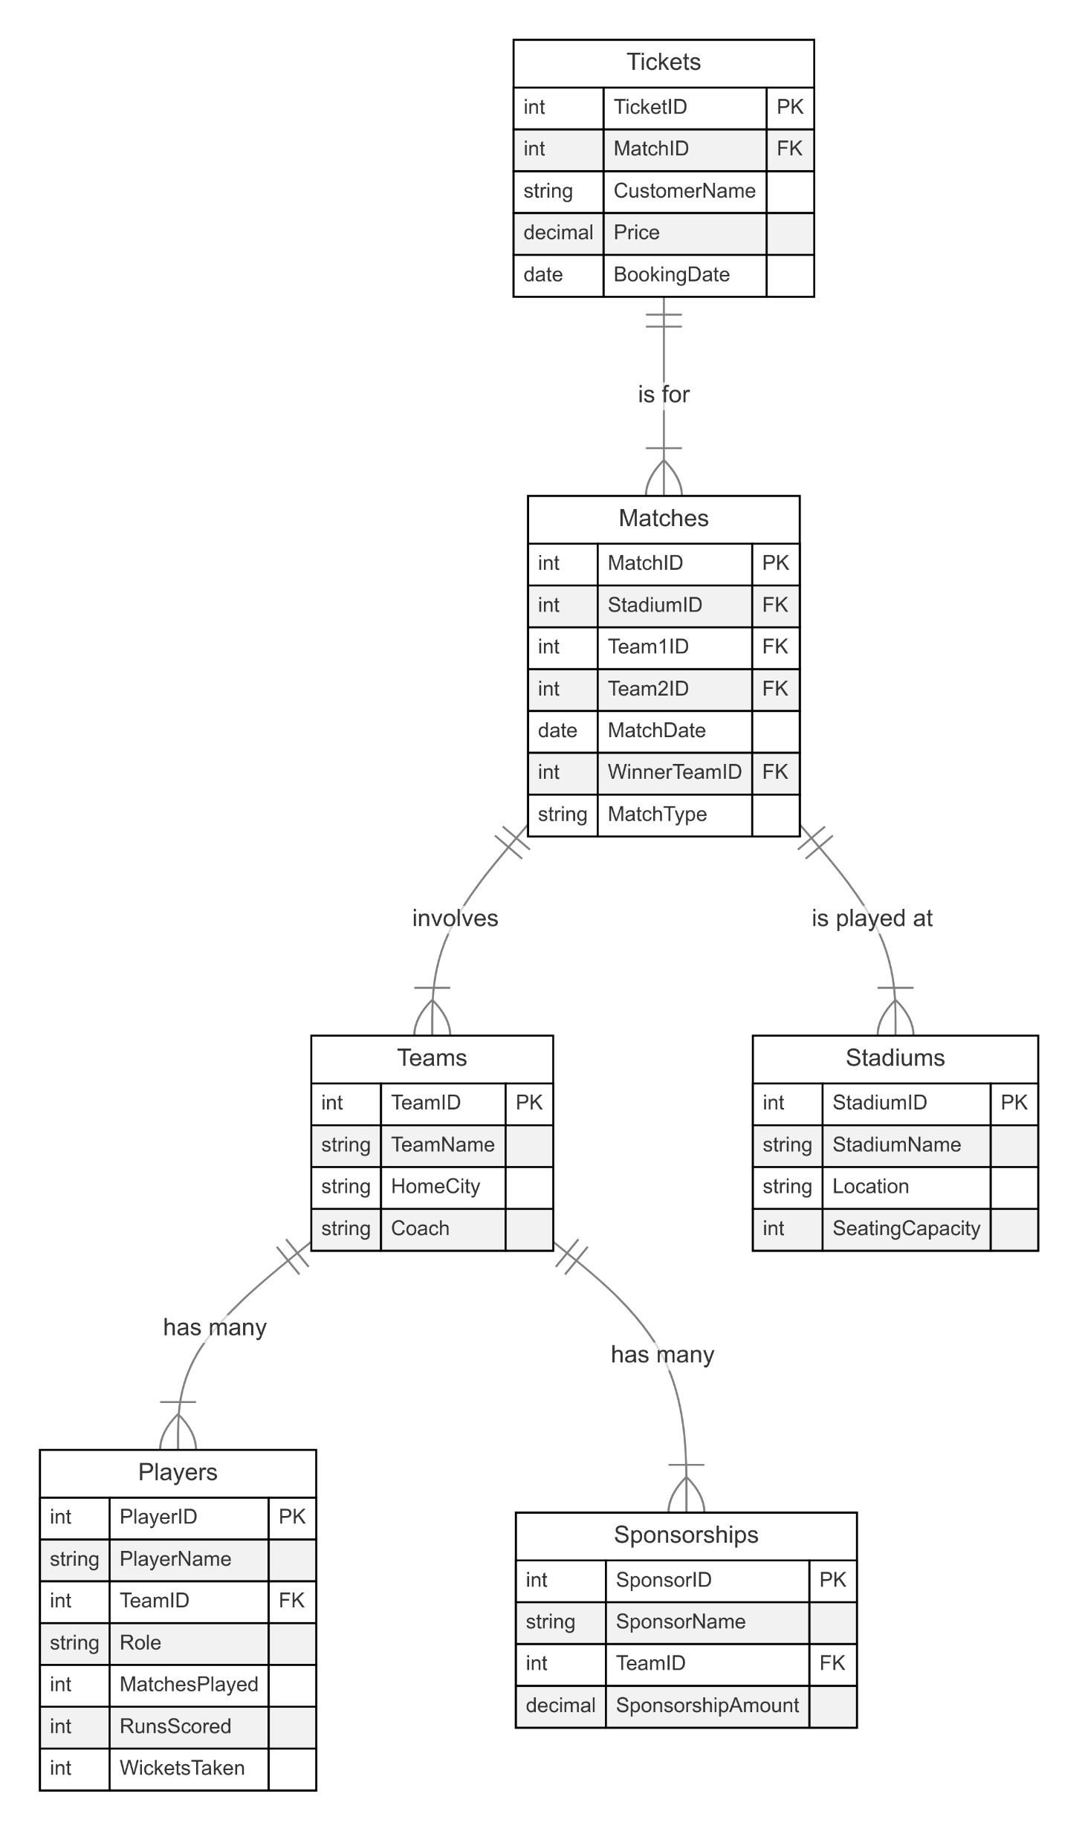
Entity Relationship (ER) Diagram
Entity 1 | Entity 2 | Relationship Type | Cardinality
Tickets | Matches | One-to-Many | 1 Match → Many Tickets
Matches | Teams | Many-to-Many | Many Matches ↔ Many Teams
Matches | Stadiums | One-to-Many | 1 Stadium → Many Matches
Teams | Players | One-to-Many | 1 Team → Many Players
Teams | Sponsorships | One-to-Many | 1 Team → Many Sponsorships
Matches (Winner) | Teams | One-to-Many | 1 Team → Many Matches

Slide 7
Problem Statements :
Category 1: Player Performance and Team Management
Identify the top-performing players across all teams based on their runs scored and wickets taken.
Which team has won the most matches in the dataset?
Determine the most consistent players in terms of performance over the matches played.
Find all players along with their team names.
Find the player with the highest runs scored.

Slide 8
Problem Statements :
Category 2: Match Analysis and Stadium Utilization
List all matches played along with the names of the teams that participated.
Find the stadium with the highest seating capacity.
List Team Name Along With Their Home Ground.
Find the total revenue generated from ticket sales for each stadium.

Slide 9
Problem Statements :
Category 3: Sponsorship and Financial Insights
Identify the most valuable sponsors based on their sponsorship amounts
List each team's name, their sponsors and the total sponsorship amount, sorted by the highest sponsorship.
Calculate the Total Sponsorship Revenue From All Sponsorships.
Which team has the lowest sponsorship amount?

Slide 10
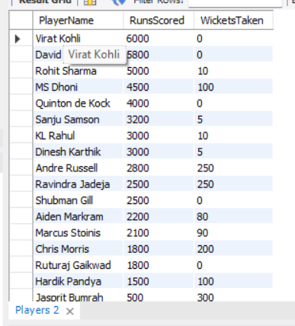

Identify the top-performing players across all teams based on their runs scored and wickets taken.
Query--
This query provides insights into the top-performing players in a dataset, ranking them based on their combined batting and bowling contributions. It highlights players who have excelled in both scoring runs and taking wickets, making them valuable assets to their teams.
Output--

Slide 11
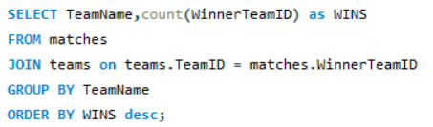
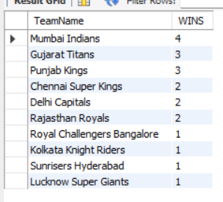
2. Which team has won the most matches in the dataset?
Query--
The query determines the team with the most wins by joining match and team data, counting wins for each team, and then ordering the results to show the team with the highest win count.
Output--

Slide 12
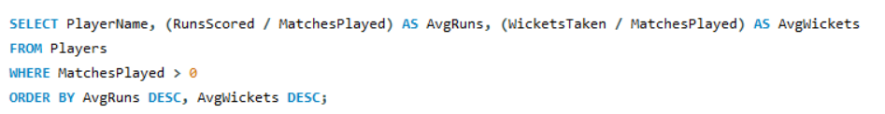
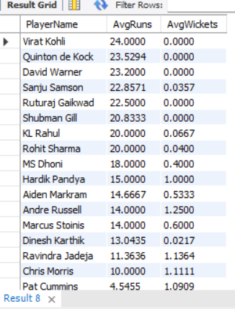
3. Determine the most consistent players in terms of performance over the matches played.
Query--
This query identifies the most consistent players by calculating their average runs and wickets per match, excluding players with zero matches played, and then ranking them based on these averages.
Output--

Slide 13

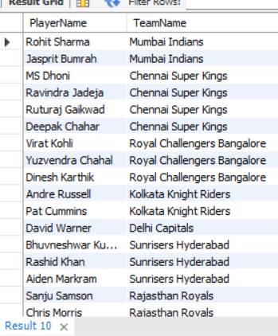
4. Find all players along with their team names.
Query--
This query retrieves a list of all players, associating each player with their corresponding team name. It achieves this by joining the players table with the teams table based on the TeamID
Output--

Slide 14


5. Find the player with the highest runs scored.
Query--
This query identifies the player with the highest number of runs scored. It does this by selecting all information from the Players table where the RunsScored value matches the maximum RunsScored value found within the same table.
Output--

Slide 15
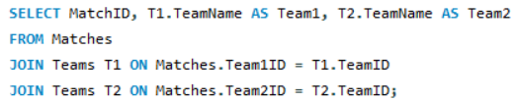
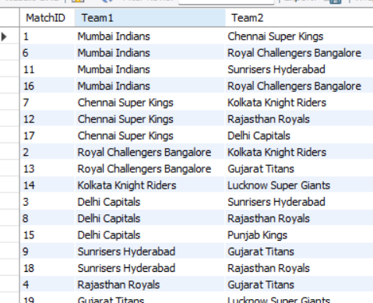
6. List all matches played along with the names of the teams that participated.
Query--
This query retrieves a list of all matches, including the unique match ID and the names of the two teams that participated in each match. It achieves this by joining the Matches table with the Teams table twice to associate each team's ID with its corresponding name.
Output--

Slide 16

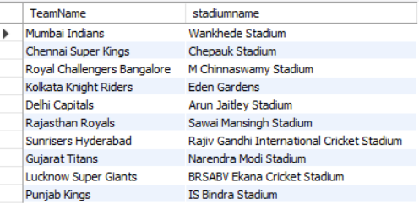
7. List Team Name Along With Their Home Ground.
Query--
This query retrieves each team's name along with their home stadium by joining team and stadium information based on the city where they play.
Output--

Slide 17


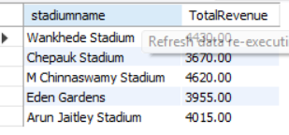
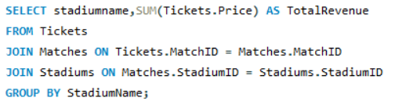
8. Find the stadium with the highest seating capacity.
Query--
Output--
9. Find the total revenue generated from ticket sales for each stadium.
Query--
Output--

Slide 18
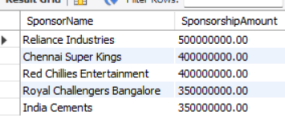



10. Identify the most valuable sponsors based on their sponsorship amounts.
Query--
Output--
11. Calculate the Total Sponsorship Revenue From All Sponsorships.
Query--
Output--

Slide 19
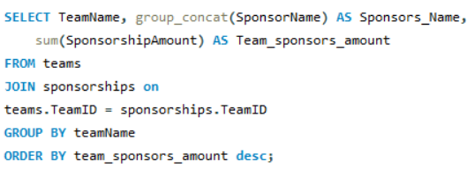
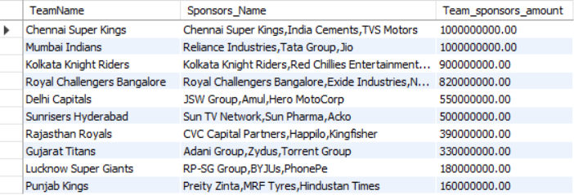
12. List each team's name, their sponsors and the total sponsorship amount, sorted by the highest sponsorship.
Query--
This query retrieves a list of teams, their associated sponsors, and the total sponsorship amount for each team. The results are then sorted in descending order based on the total sponsorship amount, highlighting the teams with the highest sponsorship values.
Output--

Slide 20
CONCLUSION :
This project demonstrates how SQL can analyze IPL data to uncover valuable insights about player performance, team sponsorships, and match outcomes. The database design and queries effectively solve business problems and provide actionable information for decision-making.

Slide 21
THANK YOU

