Slide 1

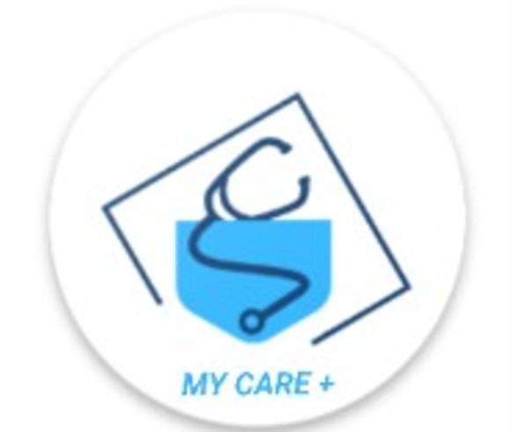
CMR COLLEGE OF ENGINEERING & TECHNOLOGY
Kandlakoya, Medchal, Hyderabad – 501401
Department of Computer Science and Engineering
MYCARE+
Name of the students:
Batch - 28
19H51A05N8 - M. MOUNIKA
19H51A05P0 - MOIN ASHIQ
19H51A05P4 - N. HARIKA
Under esteemed guidance of
Mrs. M. KAMALA

Slide 2
Outline
Abstract
Introduction
Literature survey
Research Objective of Presentation
Problem Definition
Implementation
UML Diagrams
Results
Conclusion
Future Work
Notes:
‹#›

Slide 3
Abstract
Notes:
‹#›

Slide 4

ABSTRACT
This project is based on the Mobile Application for Online Consultancy for people all around the world. This app basically allows us to Consult ourselves while sitting at our home.
From this application, a user can input their Symptoms and can get a list of diseases that they can have and provides basic information regarding that diseases. It also provides link for more Information.
Also provides option for finding nearby Hospitals
and Emergency Calls.

Slide 5
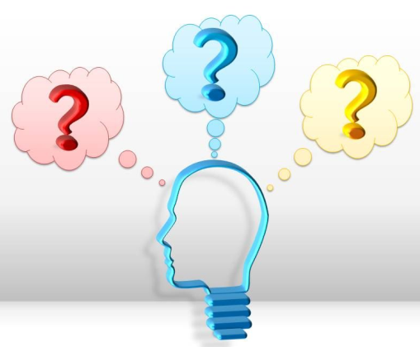
INTRODUCTION
Notes:
‹#›

Slide 6

Introduction
One of the increasing public concerns is human health. It is very important to maintain good health.
The patient monitoring and patient care is one of the major fields which lack proper knowledge in rural people.
This is due to 4'A's:-
Affordability
Accessibility
Awareness and
Availability.
Notes:
‹#›

Slide 7

Literature Survey
Notes:
‹#›

Slide 8
Literature survey
Paper -1 :
An Android phone Application for a health monitoring system
Published in : 2014 International Conference on (HNICEM).
Author : Jedd Emille Chua , John Amiel Zaldua , Thomas Joseph Sevilla , Michael Ray Orlino , Mark John Tapel.
Issue Year : 22 January 2015 at Palawan, Philippines.
Life-threatening conditions such as chronic diseases becoming more common, the need to change one's eating habits and to monitor one's lifestyle have become a necessity. However, going to the doctor frequently is very expensive, and preventive self-monitoring is now more practical and cost-effective.
Notes:
‹#›

Slide 9
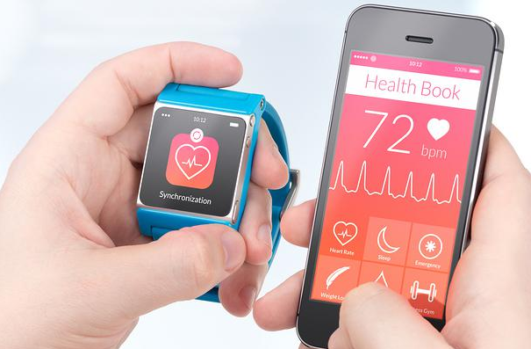
Paper – 2:
Smart Health Monitoring using android mobile devices
Published in : 2014 IEEE International Conference on Advanced Communications, Control and Computing Technologies
Author : K. Mathan Kumar , R.S. Venkatesan
Issue Year : 26 January 2015 at Ramanathapuram, India .
This project deals with a new reliable health monitoring system designed for affordable low cost wireless patient monitoring system. The monitoring signals are finally obtained in smartwatches and Android mobile devices. It detects blood pressure & body temperature.

Slide 10
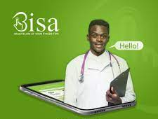
Existing systems:
1. Bisa Health App:
Bisa is a mobile application that allows users with an android or windows phone to interact directly with medical practitioners without having physical contact.
Demerits:
Paid consultancy.
Login is must & data is stored.
Can be used by third party apps.

Slide 11

2. Lybrate - Consult a Doctor App:
Lybrate services like online consulting by booking appointments, about managing diabetes of parents living in a different city, or finding solutions to various pediatric problems of kids.
Demerits:
Paid consultancy.
Only few diseases consultancy.
Must take appointment before.

Slide 12
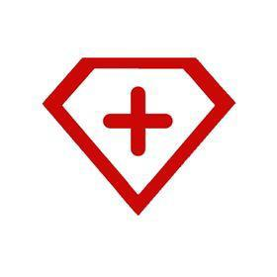
3. Superdoc - Ask A Doctor Online App
Use Superdoc to ask a doctor about health or medical queries and get answers instantly!. Can also live chat with a doctor, attach a picture of affected area or latest lab reports and get answers in few taps. Answer arrives in less than 15 minutes. Its free.
Demerits:
No physical contact.
Must contain lab reports or patient affected area picture.
Not fastest as physical contact apps.

Slide 13
Research objective
The main objective of this application is to help people to cure them and save their Time, Money and Resources, and save their Lives as well.
To Get List Of Diseases based on Symptoms entered by User.
To Get Locations Of Nearby Hospitals.
To Call Family / Ambulance In Case Of Any emergency.

Slide 14
Purpose
As we know in today’s rush it is difficult to take a Doctor’s appointment in Emergency. So, what to do until we get an appointment with Doctor.
That’s where this App’s comes into the action. A user can input their Symptoms and can get a list of Diseases they may poses.
With the help of this application one can prevent their Diseases from spreading more. This can save someone’s Life who cannot reach to the Doctor in case of Emergency. They can at least take some action for preventing their Disease.

Slide 15
Problem Definition
Notes:
‹#›

Slide 16
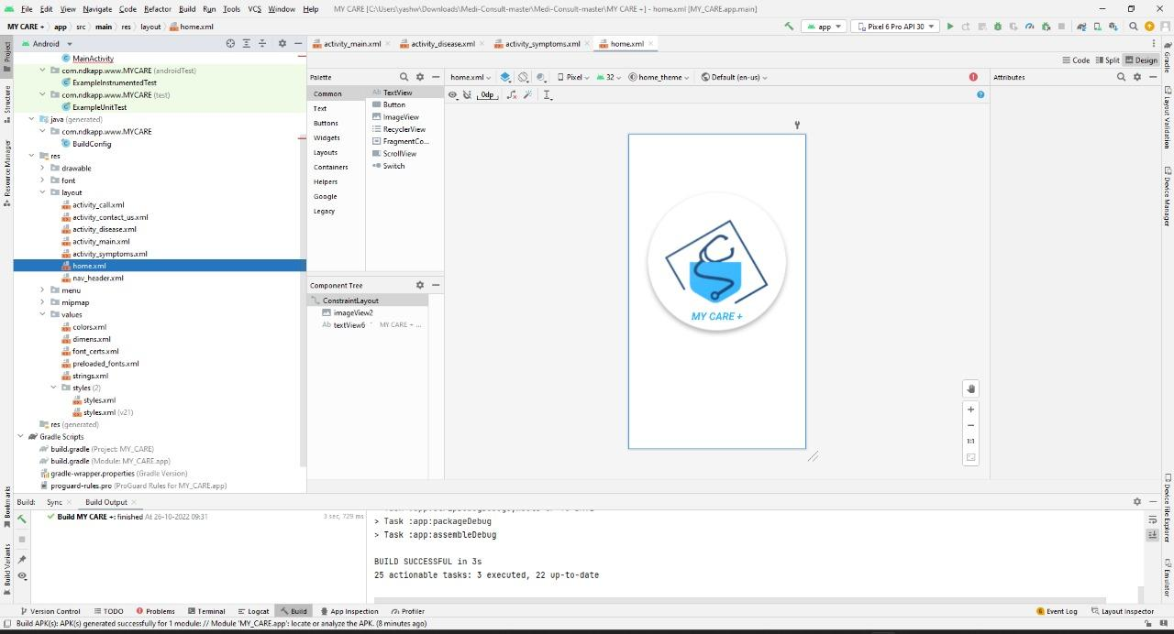
Problem Definition
This Project is entitled as Medi Consult. As the name itself suggest it is a Medical App. It takes Symptoms as user’s inputs and displays the list of Diseases as per priorities based on list of Symptoms provided by User.
Proposed solution:
Researching in the related field of Diseases
Creating a Design of flow
Connecting to Google Maps
Coding the logic
Make UI for application
Testing the application for runtime errors and bugs
Fixing the Bugs
Concluding the code and hence the project

Slide 17
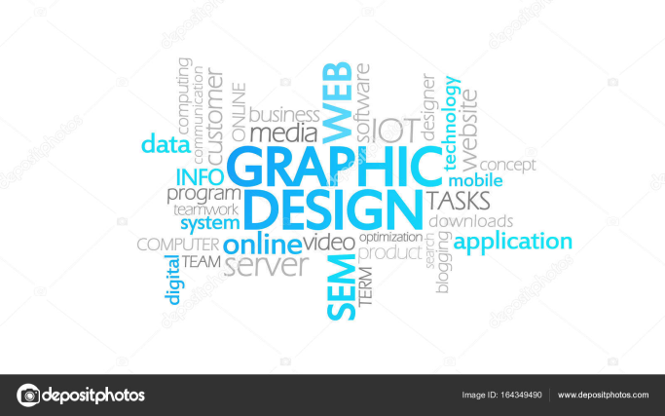
SYSTEM REQUIREMENTS
User Characteristics:
The application has been made very user friendly with basic Interface. Application is well organized with attractive UI. The UI is very simple and easy to use and understand.
Hardware Requirements
Processor: i3/i5/i7 8gen or above
Processor Speed: 2.16GHZ or above
RAM: 3 GB RAM or above
Storage: 20 GB hard disk or above
1280 X 800 MINIMUM SCREEN RESOLUTION
Software Requirements
Android Studio 3.4/3.5
JDK 11.0.1

Slide 18
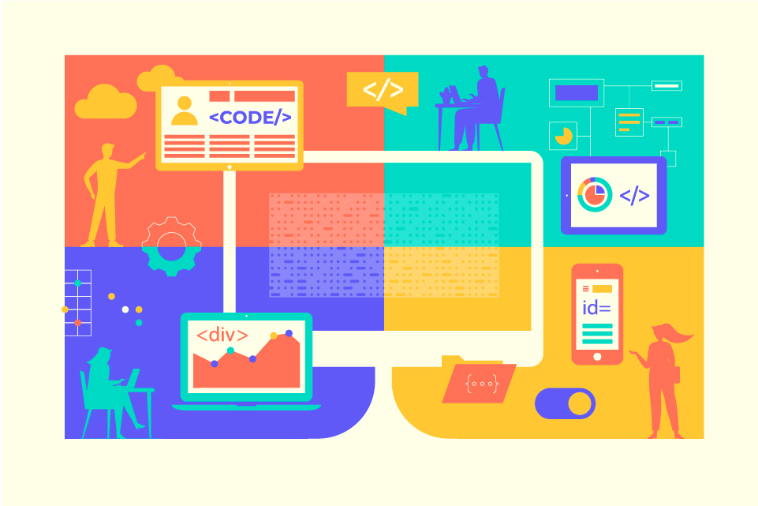
Implementation
Notes:
‹#›

Slide 19
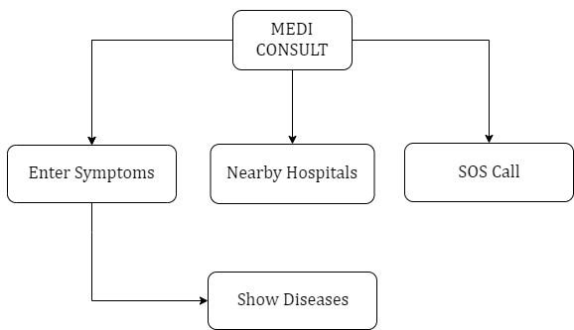
Proposed system architecture

Slide 20
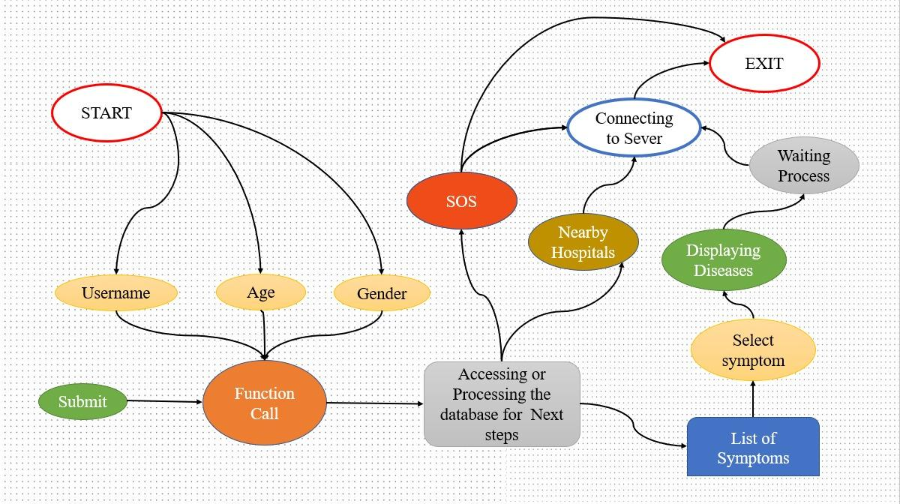
Data control flow diagram

Slide 21
UML diagrams

Slide 22
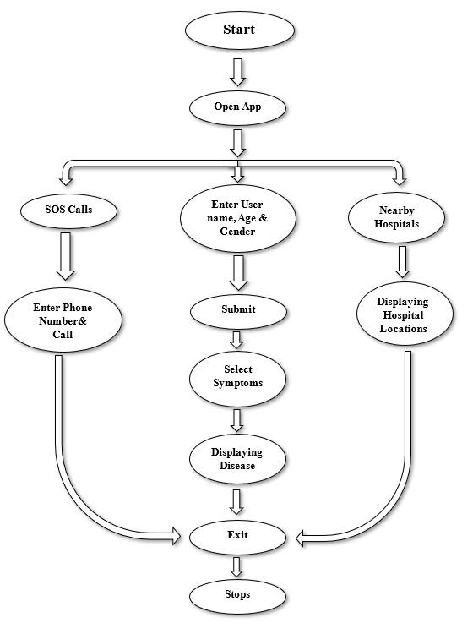
Activity diagram

Slide 23
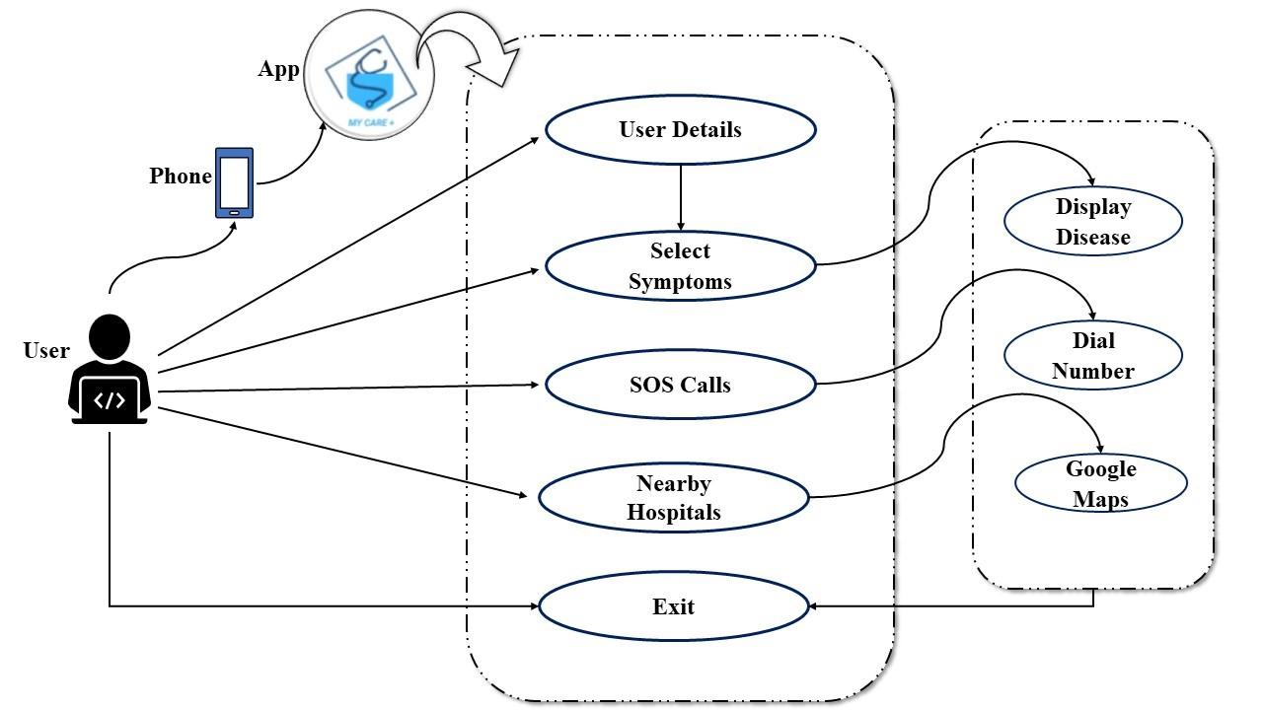
Use-case diagram

Slide 24
Result Analysis
UI Design
Testing
Implementation
Collection
Testing
Implementation
Data Collection
Requirements
Backend
Testing
Implementation
Google Maps Module
Testing
Implementation
Call & Mail Module
Testing
Implementation

Slide 25
1. Welcome Page

Slide 26
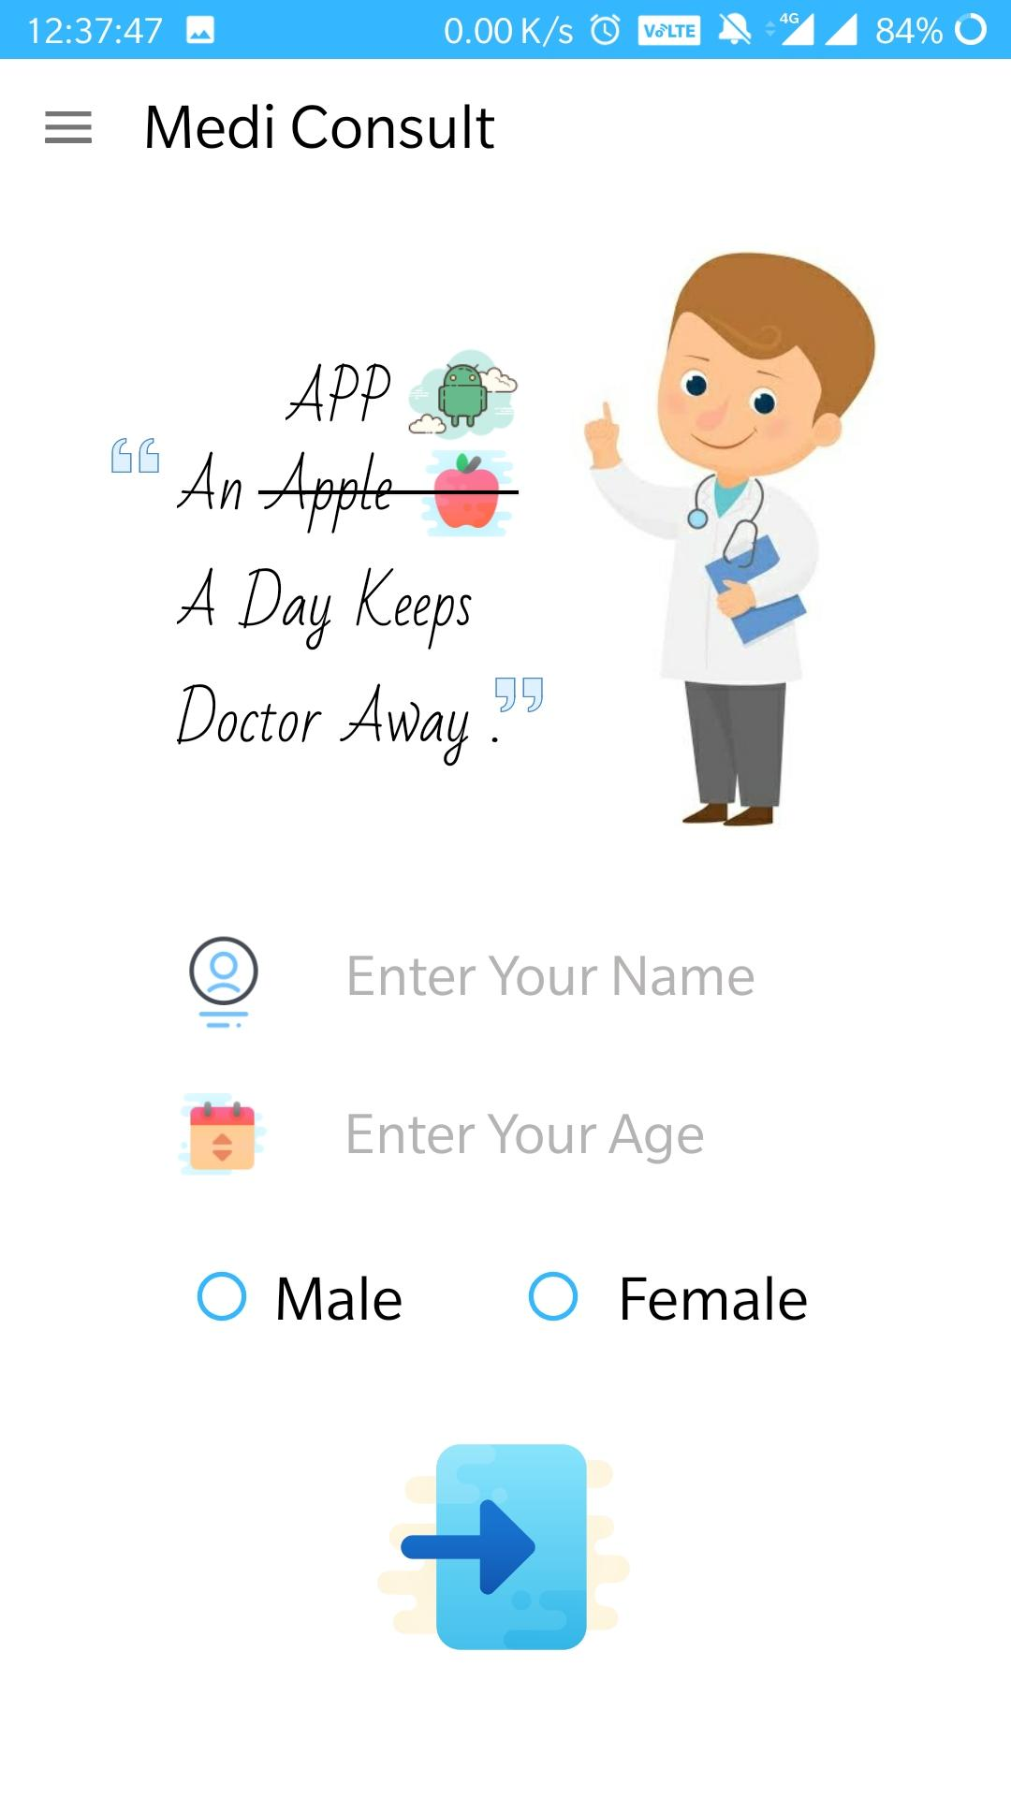
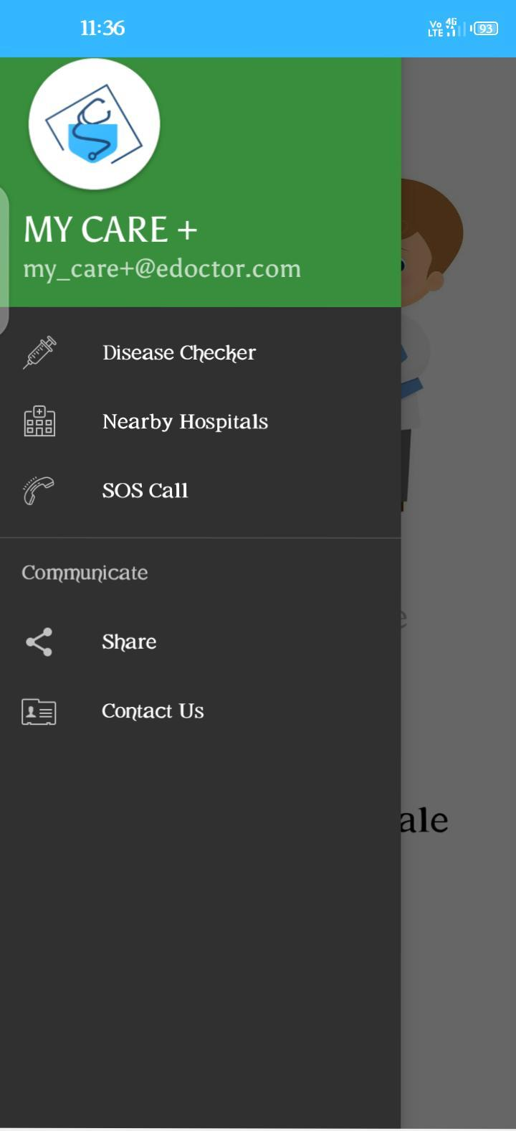
2. HOME PAGE
Name
Age
Gender

Slide 27
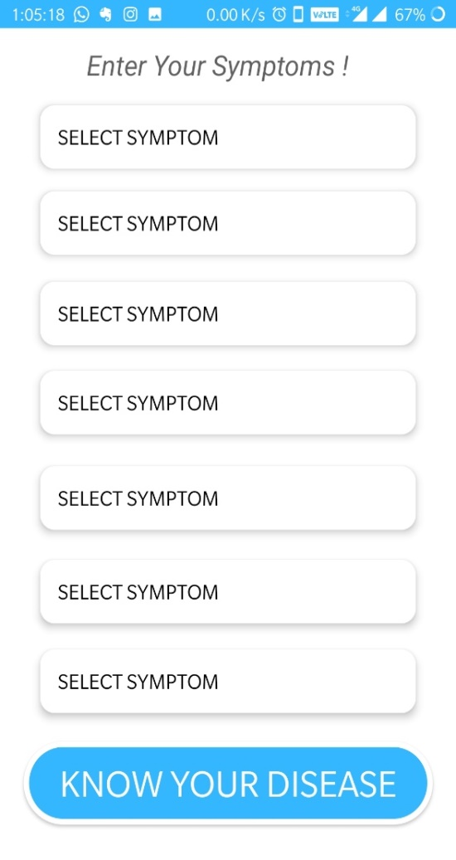
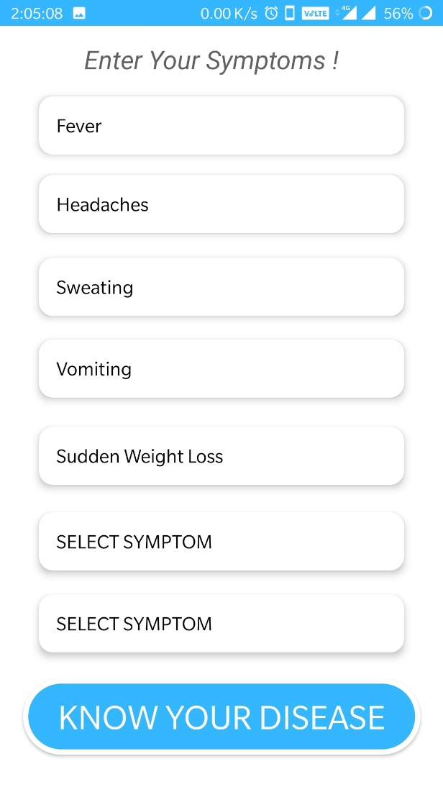
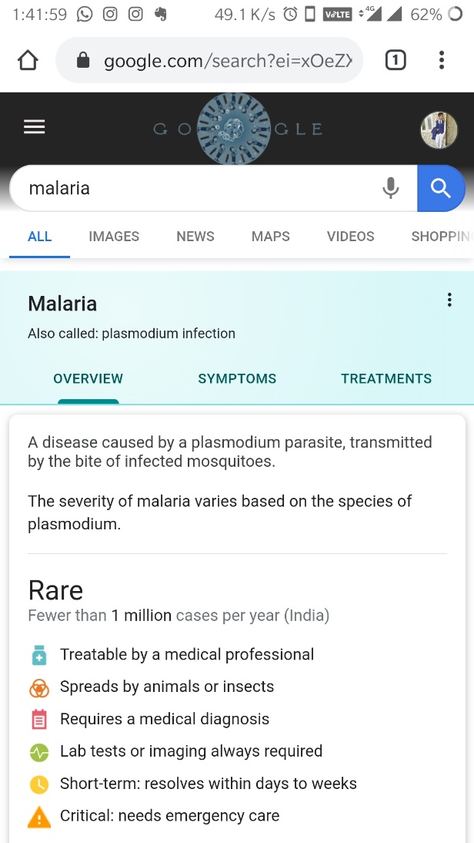
3. DISEASE CHECKER
Entering the Symptoms
Displaying of Diseases
Link for Detailed Information

Slide 28
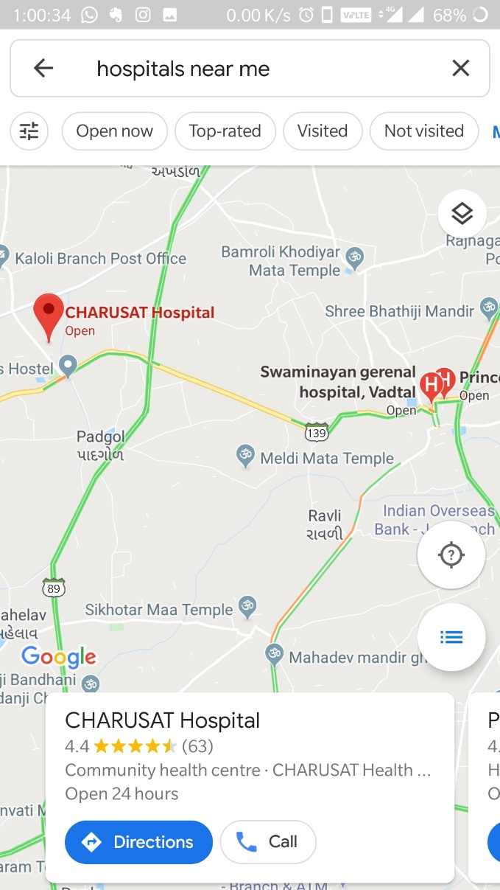
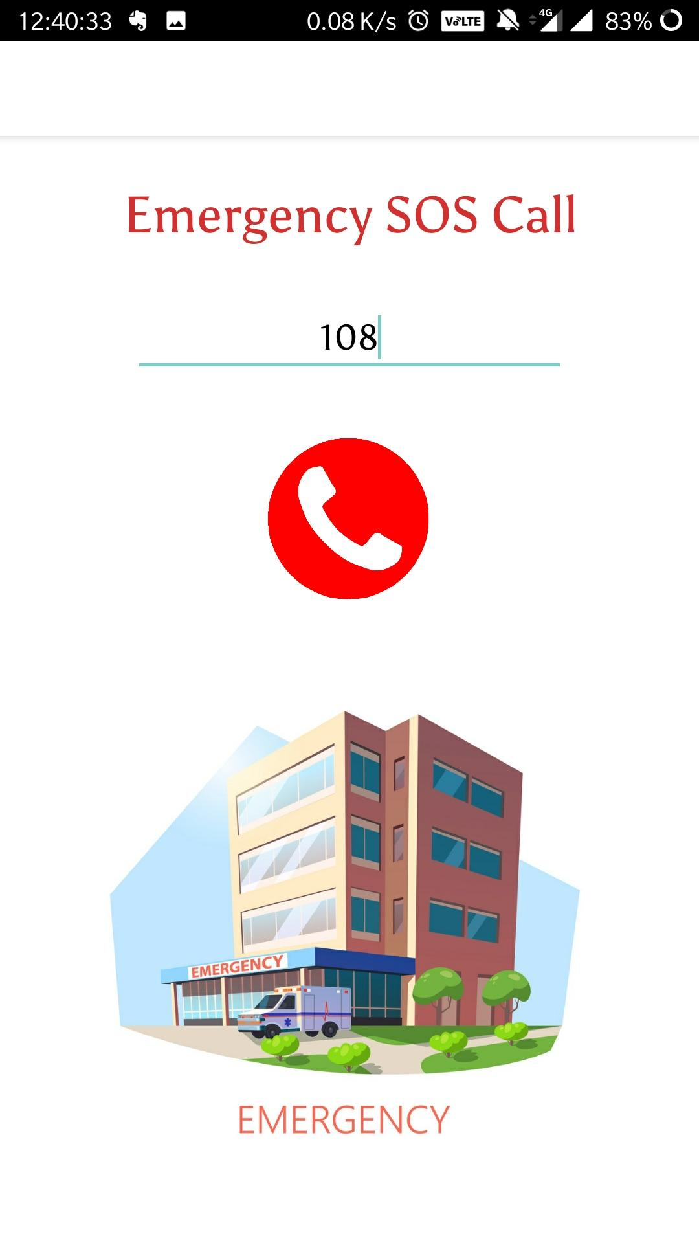
We can Enter any Number
5. SOS Call
4. Nearby Hospitals

Slide 29
Conclusion
With the help of this application one can prevent their Diseases from spreading more. This can save someone’s Life who cannot reach to the Doctor in case of Emergency. They can at least take some action for preventing their Disease. The application is a user friendly and can be run by any person with the help of android phone. The main goal of this application is to help people to cure them and save their Time, Money and Resources, and save their lives as well.

Slide 30
Future work
Limitations:
Following are the currently persisting limitations in the application:
Does not Cover up all the Diseases, as it will need ML as well as large Database.
We have just prepared a Prototype.
Future Enhancements:
Following are some aspirations specifying our future enhancements:
To Obtain Information and contact details of Doctor concerned to your Disease.
To Cover Up All the Diseases.
To Suggest / Advice few basic Medicines for a Disease.

Slide 31
References
https://developer.android.com
https://www.youtube.com/watch?v=UDwj5j4tBYg
https://www.youtube.com/watch?v=fGcMLu1GJEc
https://www.youtube.com/watch?v=nxSdkiFcQxs
https://www.zoftino.com/current-location-and-nearby-places-android-example
https://www.androidtutorialpoint.com/intermediate/google-maps-search-nearby-displaying-nearby-places-using-google-places-api-google-maps-api-v2/
https://ieeexplore.ieee.org/document/8250646
https://ieeexplore.ieee.org/document/7019406/authors
https://ieeexplore.ieee.org/document/7016204/authors#authors.
https://www.studocu.com/in/document/aligarh-muslim-university/computer-and-its-applications/detailed-report-of-app/30565191

Slide 32
Thank You!

