Slide 1
SANITIZER CONTROLLED DOOR
SOCIAL INNOVATION AND PRACTICE
Team No. :- 08
19H51A05N8 – M.MOUNIKA
19H51A05P3 – P.RAVALIKA
19H51A1255 – B.SWARANI
19H51A1258 – D.SRAVYA
20H55A0506 –E.PRIYANKA

Slide 2
ABSTRACT
COVID-19 is a serious pandemic at this moment. The corona virus is spreading quickly and easily between humans. There are ways to curb the spread of this virus and one way is to wash hands using soap for at least 20 seconds. Sometimes, if the person carelessly touches the faucet - which could be contaminated - after washing his/ her hands, he/she has a higher chance of contracting this corona virus disease. If you go out, it is safe to wash your hands before entering your premises. You do not have to touch the door handle because the door lock system is automated. In this project, a person will only be granted access once he/ she wash his/ her hands.
Our project is mainly focused on how to reduce the spreading of virus from one to another by taking some steps even in public places also.

Slide 3
INTRODUCTION
The World Health Organisation (WHO) has declared the corona virus disease 2019 (COVID-19) a pandemic]. A global coordinated effort is needed to stop the further spread of the virus. A pandemic is defined as “occurring over a wide geographic area and affecting an exceptionally high proportion of the population. The last pandemic reported in the world was the H1N1 flu pandemic in 2009.
On 31 December 2019, a cluster of cases of pneumonia of unknown cause, in the city of Wuhan, Hubei province in China, was reported to the World Health Organisation. In January 2020, a previously unknown new virus was identified, subsequently named the 2019 novel corona virus, and samples obtained from cases and analysis of the virus’ genetics indicated that this was the cause of the outbreak. This novel corona virus was named Corona virus Disease 2019 (COVID-19) by WHO in February 2020. The virus is referred to as SARS-CoV-2 and the associated disease is COVID-19.
Due to pandemic situation, the corona virus is spreading quickly and easily between humans. There are ways to curb the spread of this virus and one way is to wash hands using soap for at least 20 seconds. Sometimes, if the person carelessly touches the faucet - which could be contaminated - after washing his/ her hands, he/she has a higher chance of contracting this corona virus disease.

Slide 4

If you go out, it is safe to wash your hands before entering your premises. You do not have to touch the door handle because the door lock system is automated. The person could be wearing face masks when they go to public places but their hands may not be clean. Even if he/ she clean their hands, they could touch the surface which was touched by a virus carrier. The virus carrier's hands would be contaminated. Corona virus could last on a contaminated surface from several hours to days depending on the environmental conditions such as humidity and temperature. By washing your hands before entering the premises, this way of spreading corona virus could be prevented.

Slide 5
PROBLEM STATEMENT
On behalf of community visit, we came to know that the corona virus is spreading quickly and easily between humans. There are ways to curb the spread of this virus and one way is to wash hands using soap for at least 20 seconds. Sometimes, if the person carelessly touches the faucet - which could be contaminated - after washing his/ her hands, he/she has a higher chance of contracting this corona virus disease. To avoid this all problems, we decided to make prototype – “ Sanitizer controlled by Door ” .
The person could be wearing face masks when they go to public places but their hands may not be clean. Even if he/ she clean their hands, they could touch the surface which was touched by a virus carrier. The virus carrier's hands would be contaminated. Corona virus could last on a contaminated surface from several hours to days depending on the environmental conditions such as humidity and temperature. By washing your hands before entering the premises, this way of spreading corona virus could be prevented.

Slide 6
AIM: Touch less Faucet with Door Control System prior to COVID-19
OBJECTIVE:
In this project, we have made a prototype to wash hands safely with automatic door control system. We have made touch less faucet so that do not have to touch the surface of the faucet and it is automatic. The prototype is cheap - only costs around 15K to build - and easy to make. This faucet is automatic and could also prevent wasting water when not in use.
Less cost
To minimize the human effort.
Easy to make
Automatic completely -To develop simple mechanism to perform the operation.
Prevention of wastage of Sanitizer and water

Slide 7
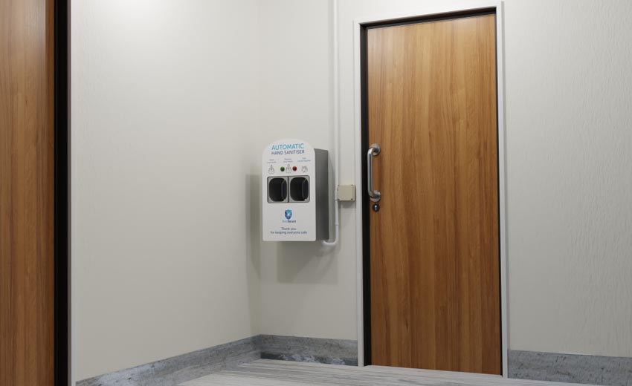
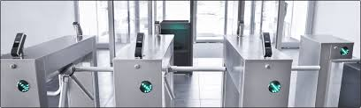
LITERATURE REVIEW
Existing Solutions:-
1. Sanitizer-integrated access control to provide extra care from COVID-19
“It works as a relay device that sits in between the control panel and entry method and only passes on the unlock signal once both hands have been successfully coated with hand sanitizer”. Unlike standard automatic hand sanitizer dispenser, Steri Secure has four spray nozzles, two on top and two at the bottom, which ensure that a user’s hands are fully coated and speeds up the application time allowing up to 30 uses per minute.

Slide 8
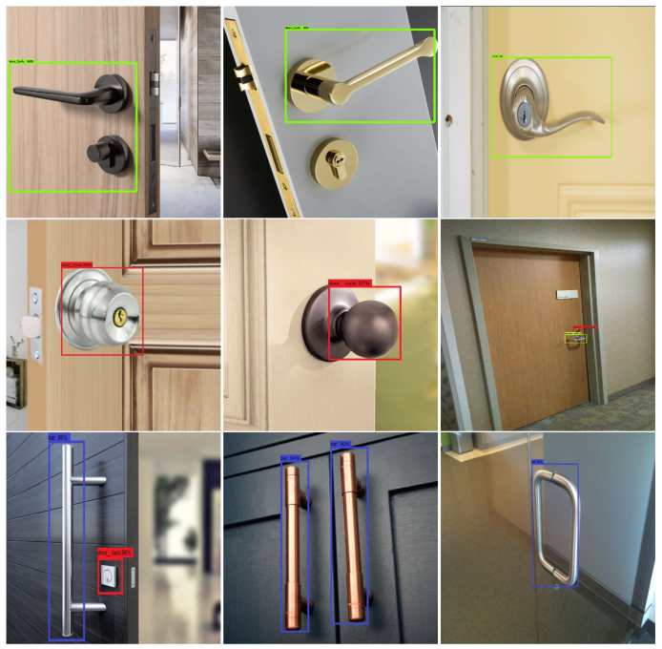
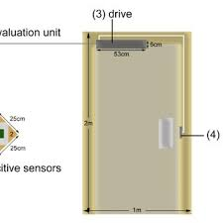
2. Sensor Controlled Sanitizer Door Knob with Scan Technique
In this project a sanitizer is attached to the door handle and releases automatically when the person touches the door handle. But the drawback of this system is tissues get dried up and hence become of no use.

Slide 9
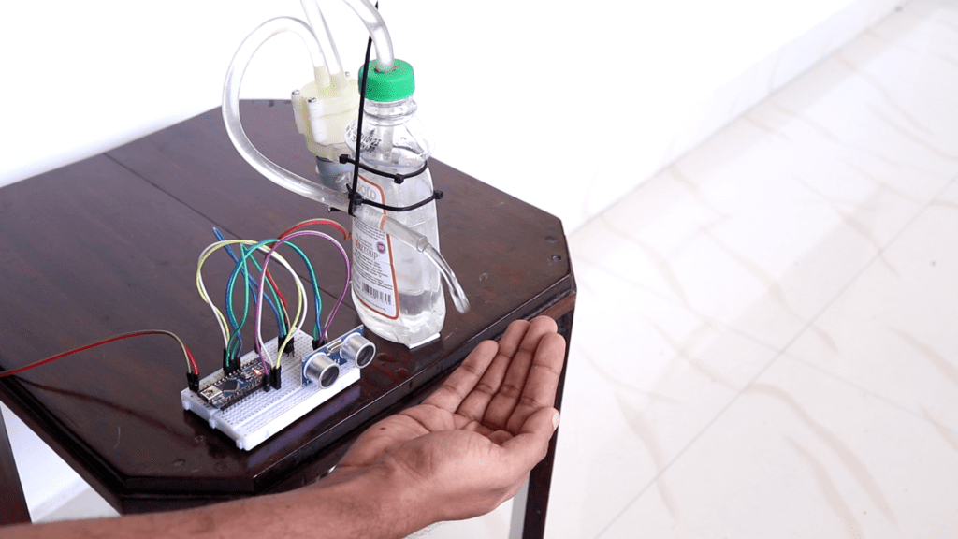
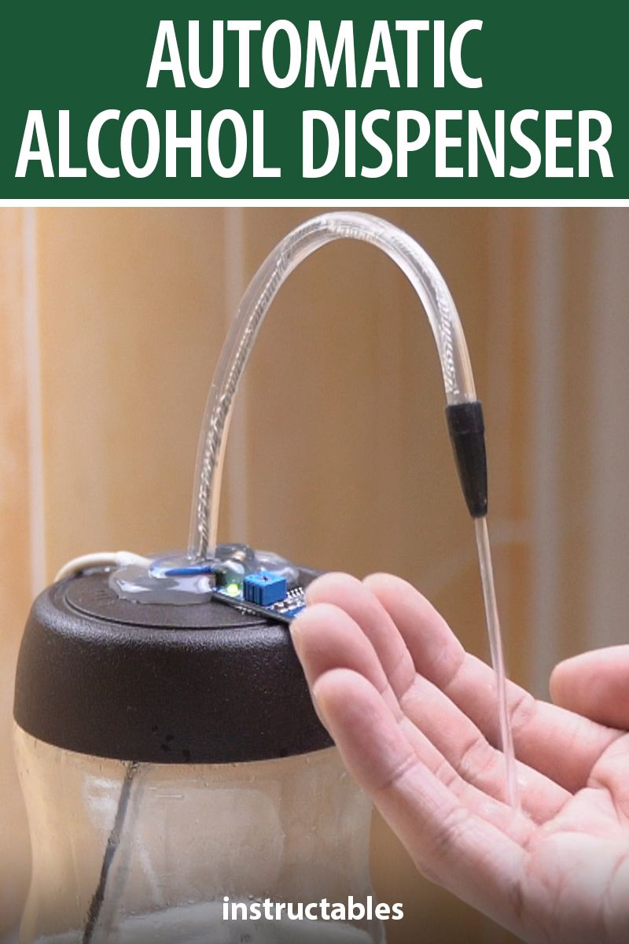
3. Automatic Hand Sanitizer Dispenser
Hand sanitizer is the best way to get rid of all the harmful germs and viruses in our hands. But there is a chance of spreading the virus by pressing the dispenser. To overcome this problem an automatic hand sanitizer dispenser which will help us to dispose of hand sanitizer without contact.

Slide 10
METHODOLOGY
The LCD display shows message, “Sanitize the hands, before entering “. To sanitize the hands, place the hands within 15 cm from the Ultrasonic sensor. According to Arduino program, this will switch on the Relay module. The Submersible water pump is connected to the relay module and an external power supply. The external power supply can be adjusted to provide the appropriate voltage. The water pump is switched on and the water is pumped from the container to your hands through a tube, which is modelled as the faucet in this prototype. The message will show on LCD display, “You are safe, U can enter “.
After washing hands, place hand in front of the IR tracking sensor. The IR sensor sends a LOW signal when an object is detected within 2cm. The LOW signal makes the Servo motor to rotate 90° and open the door (in this model). The door will automatically close after 10 seconds. If you place your hand in front of the IR tracking sensor without washing your hands, the door will not open and the LCD display module will show a message asking you to wash your hands.

Slide 11
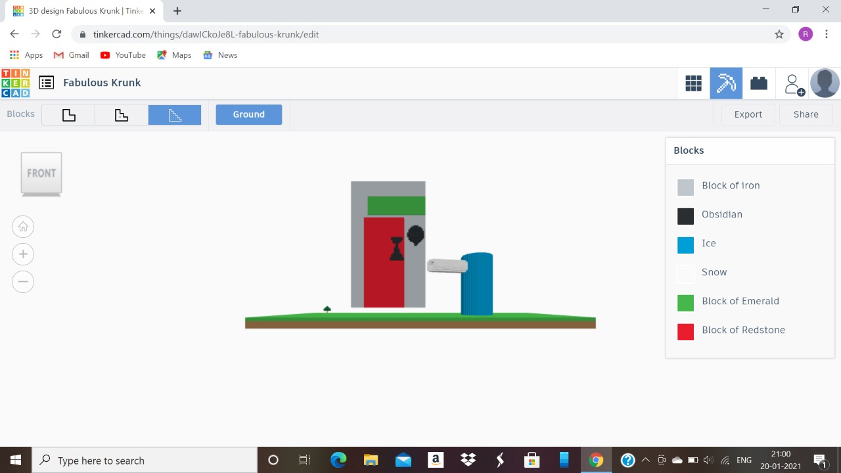
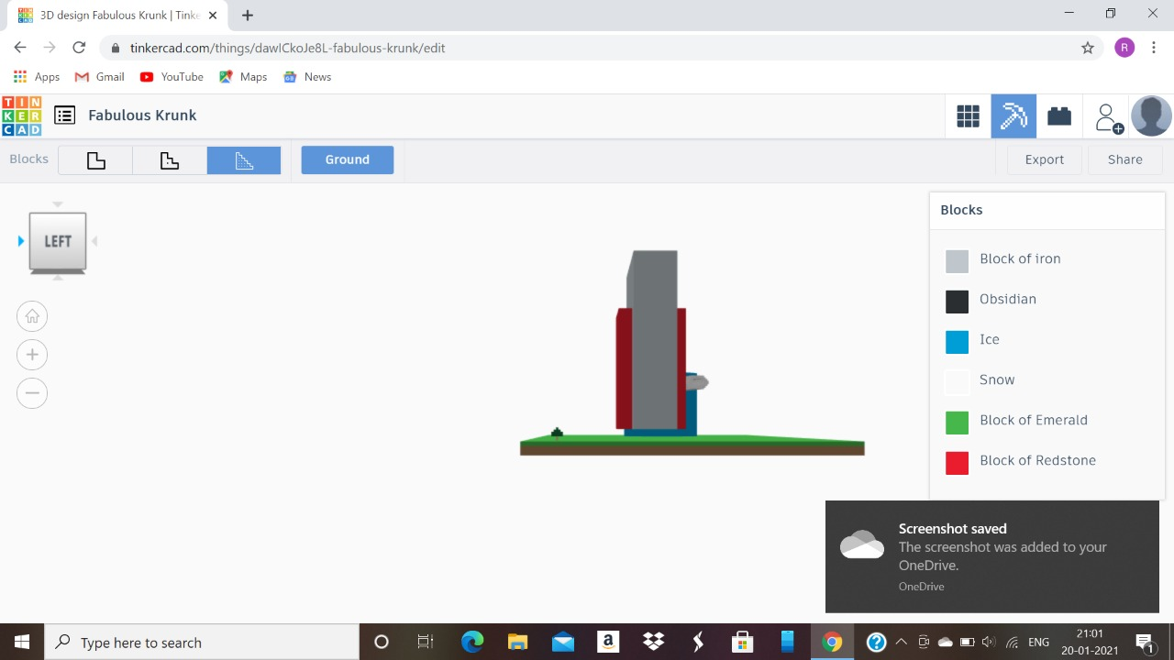
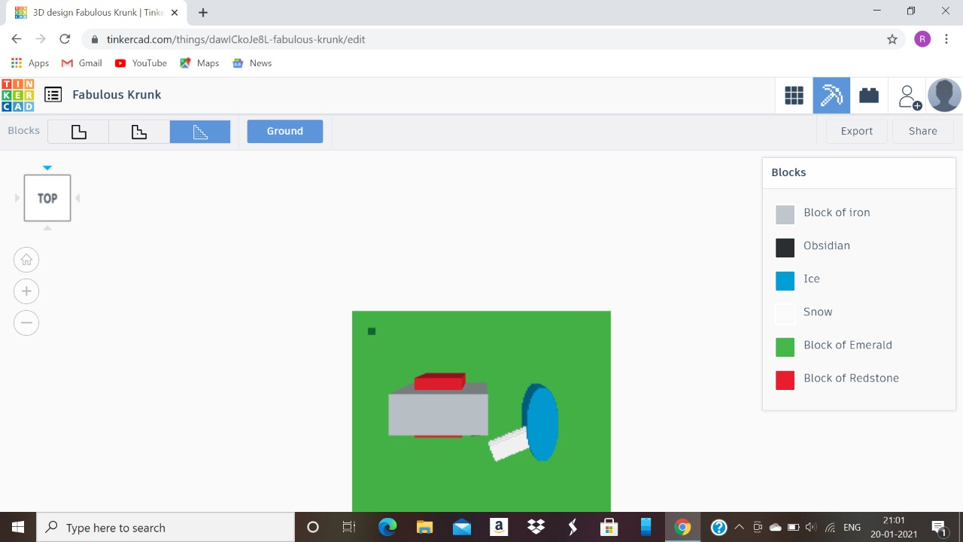
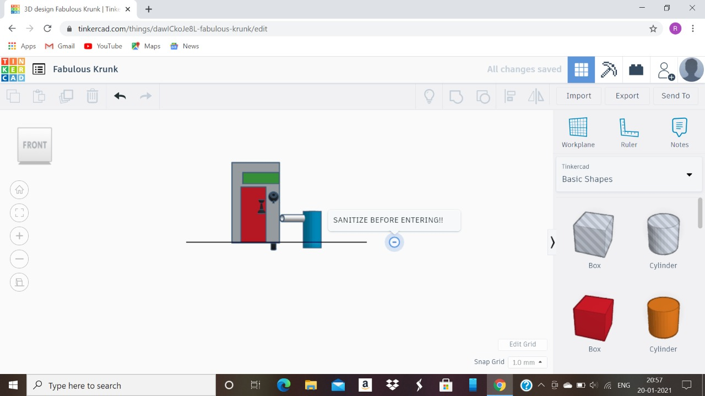
conceptual design
THREE DIMENSIONAL DESIGN
planar view
FRONT VIEW
side view
top view

Slide 12
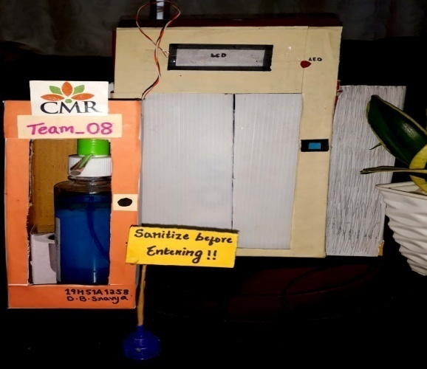
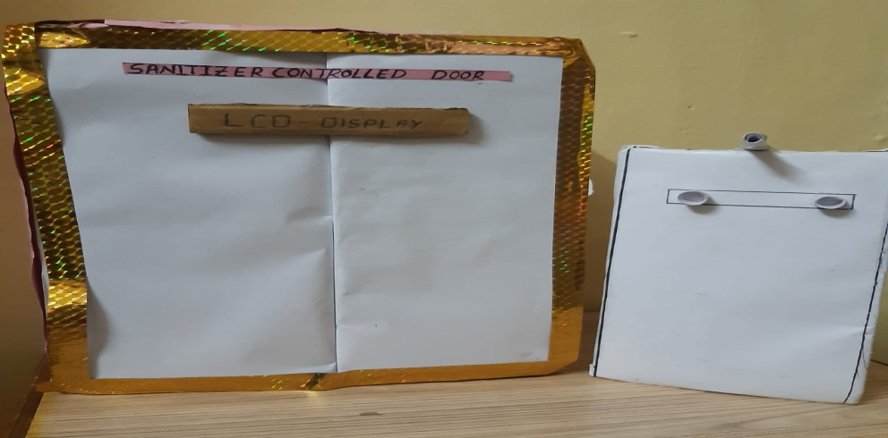
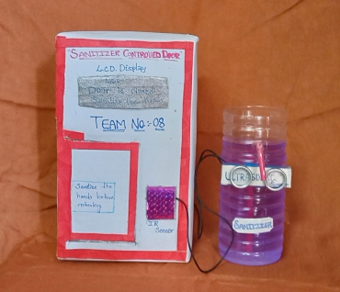
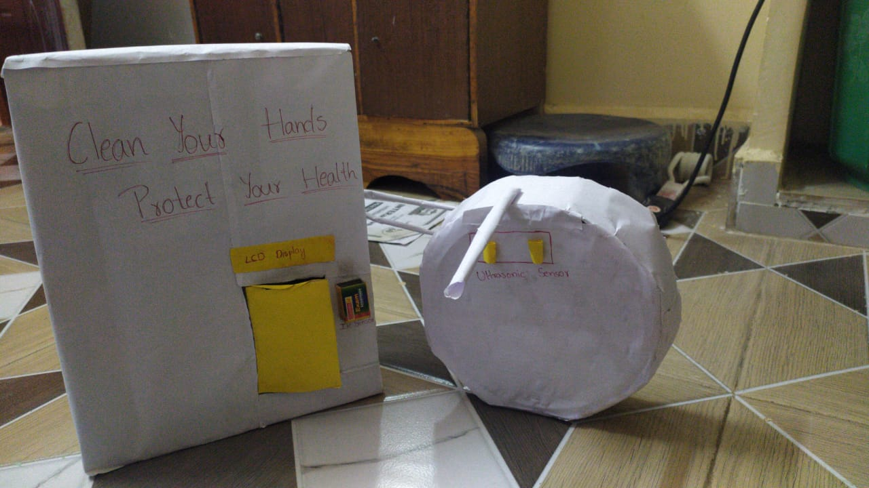
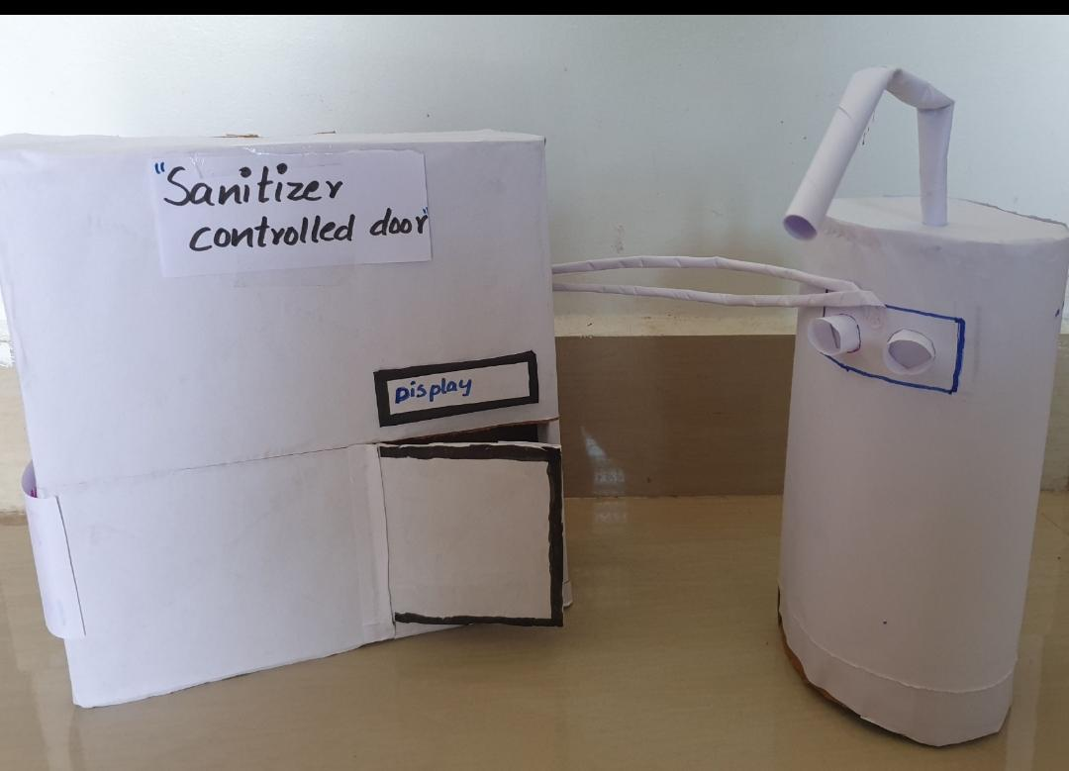
Prototype Paper Models
Finalized paper model

Slide 13
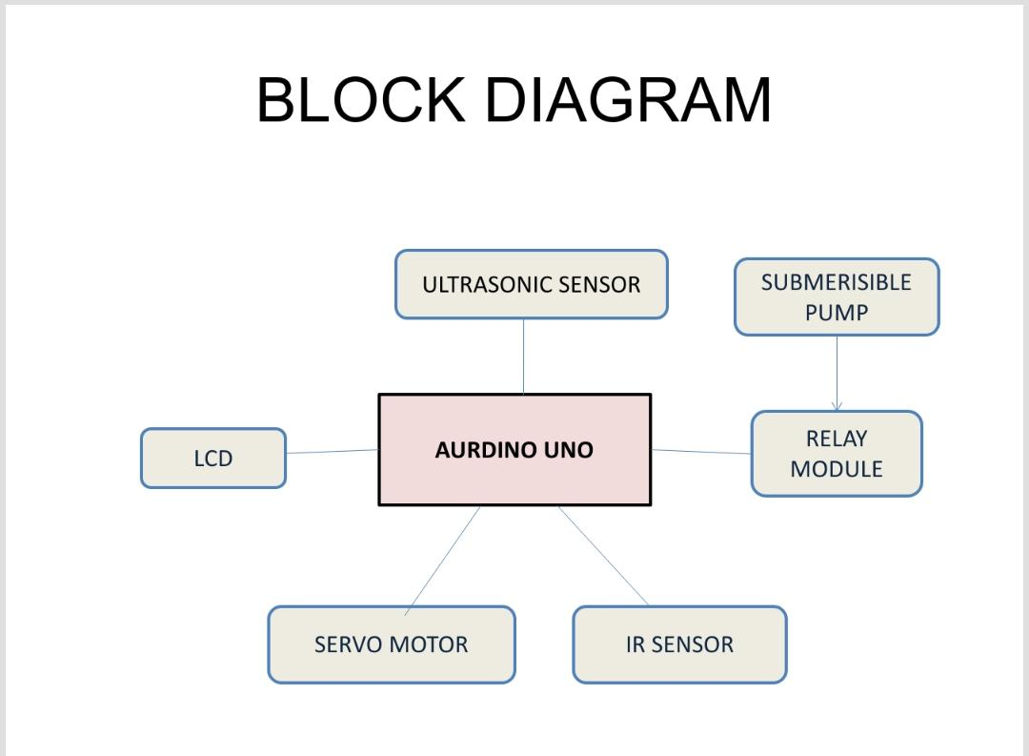
BLOCK DIAGRAM
Relay module connected to Aurdino UNO
Submersible pump connected to relay module
LCD is connected to Aurdino using breadboard
Ultrasonic and IR sensors are connected to Aurdino using breadboard
Servo motor is connected to Aurdino using breadboard

Slide 14
REQUIREMENT ANALYSIS
COMPONENTS:
The major components of Touchless Faucet with Door control system are:-
1. Aurdino Uno R3
2. USB Type A/B cable
3. Solder less Breadboard – Half
4. Ultrasonic sensor module (HC-SR04)
5. IR tracking sensor module
6. Towerpro Micro servo motor - SG90
7. Relay module - 5V single channel relay module
8. LCD display module - 16x2
9. Submersible water pump - 5V or solenoid water valve
10. Male-to-Male Jumper wires
11. Female-to-Male Jumper wires
12. HIW battery

Slide 15
IMPLEMENTATION
In model, consists of two systems - one is automatic door system and other is automatic sanitizer dispenser. Sanitizer dispenser is made up of bottle. Ultrasonic sensor is placed on bottle and connected to submersible pump. This submersible pump is connected to relay module. Pipe is attached to submersible pump is used to pump out. Coming to door, IR sensor and LCD is attached to wall. Servo motor is attached inside and attached to door.
If you want to wash your hands, place your hands within 15 cm from the ultrasonic sensor. According to the Arduino program, this will switch on the relay module. The submersible water pump is connected to the relay module and an external power supply. The external power supply can be adjusted to provide the appropriate voltage. The water pump is switched on and the water is pumped from the container to our hands through a tube, which is modelled as the faucet in this prototype. After washing your hands, place your hand in front of the IR tracking sensor. The IR sensor sends a LOW signal when an object is detected within 2cm. The LOW signal makes the servo motor to rotate 90° and open the door (in this model). The door will automatically close after 10 seconds. If you place your hand in front of the IR tracking sensor without washing your hands, the door will not open and the LCD display module will show a message asking you to wash your hands.

Slide 16
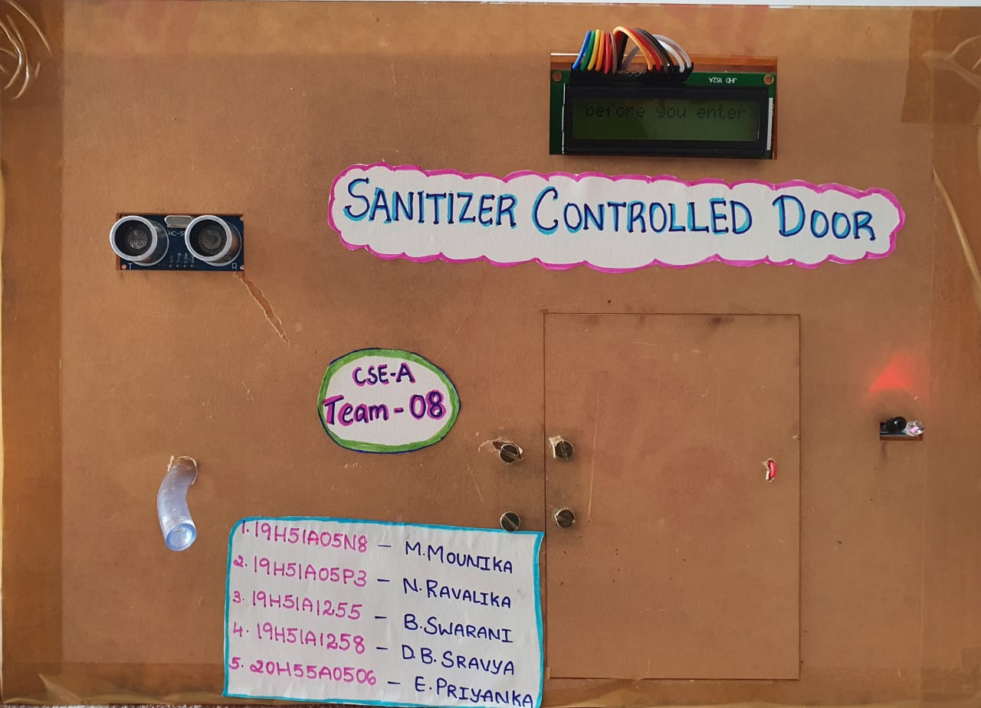
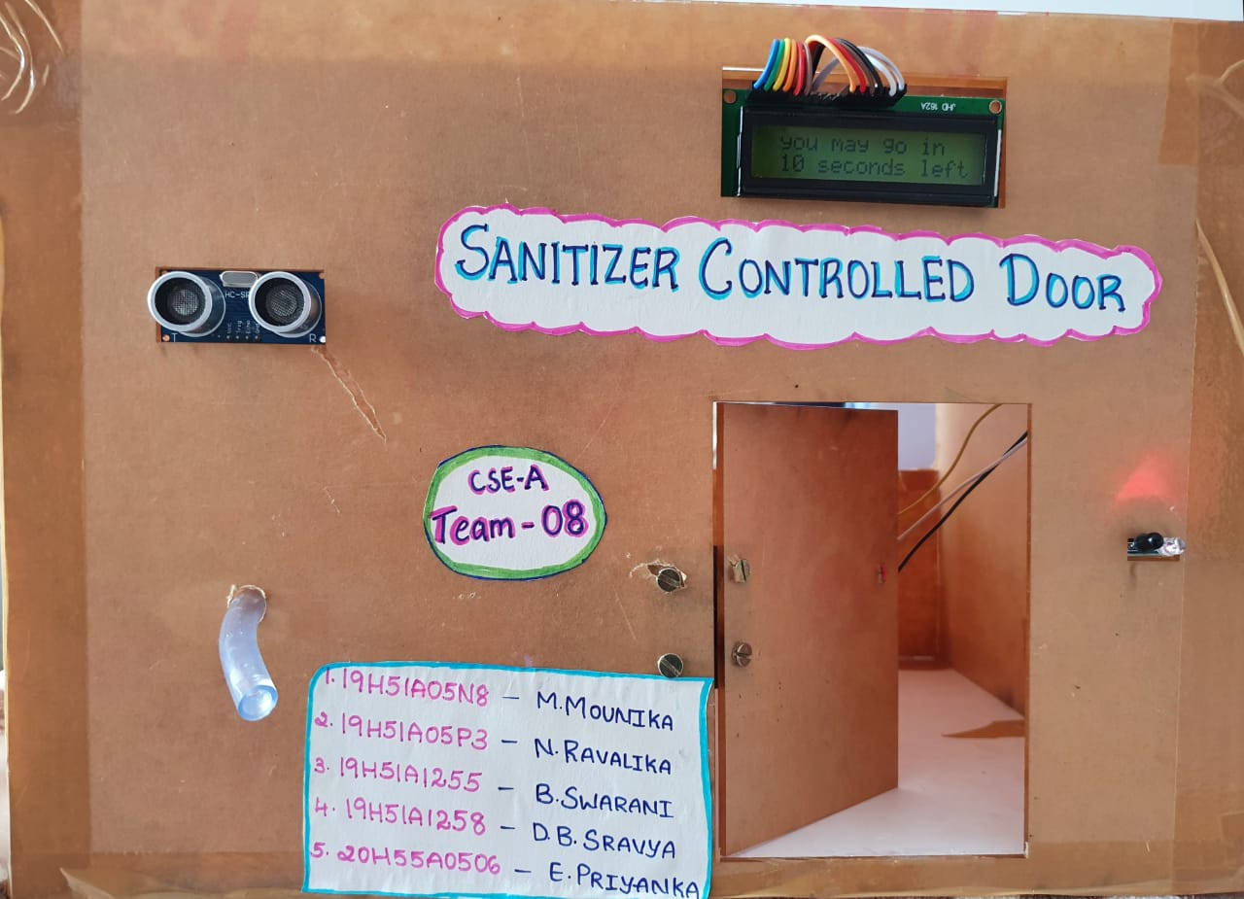
Door is closed.
Sanitize ur hands to enter the premises.
Door is opened after sanitizing the hands.

Slide 17
RESULT AND DISCUSSIONS
In areas such as hospitals or labs, the spread of germs and contagions is a serious health concern. For this reason, many such facilities post visual signs which are intended to remind a person to sanitize their hands before entry or exit, but such signs can be easily ignored, and thus stronger warning systems are required if such spread of disease is to be checked or inhibited, with a view to reducing the spread of germs and contagions, stronger warning means that the visual alerts should be used in certain public facilities to provide these reminders, such as for employees of a restaurant, hospitals, food processing or research facilities.
“The sanitizer controlled door” reminds and forces a person to sanitize or disinfect their hands before permitting an entry or exit, thereby reducing the spread of germs and contagions.”..

Slide 18
CONCLUSION
Our prototype “SANITIZER CONTROLLED DOOR” enables to sanitize the hands automatically before entering the premises. As our prototype is touchless faucet, we need not to touch the surface of the faucet and is automatic. This device is cheap when it is compared to existing models present in market and it is sustainable too.

Slide 19
REFERENCES
https://www.asmag.com/showpost/31495.aspx
https://www.digikey.in/en/maker/blogs/2020/make-an-automatic-hand-sanitizer-dispenser-using-arduino
https://patents.google.com/patent/CA2776280A1/en
https://www.researchgate.net/publication/270339029_Sensor_Controlled_Sanitizer_Door_Knob_with_Scan_Technique
https://hackaday.io/project/171789-automated-door-handle-sanitizer
https://rootsaid.com/automatic-hand-sanitizer-dispenser-using-arduino/
*THE END*

