Slide 1
Project
Text to Speech Conversion

Slide 2
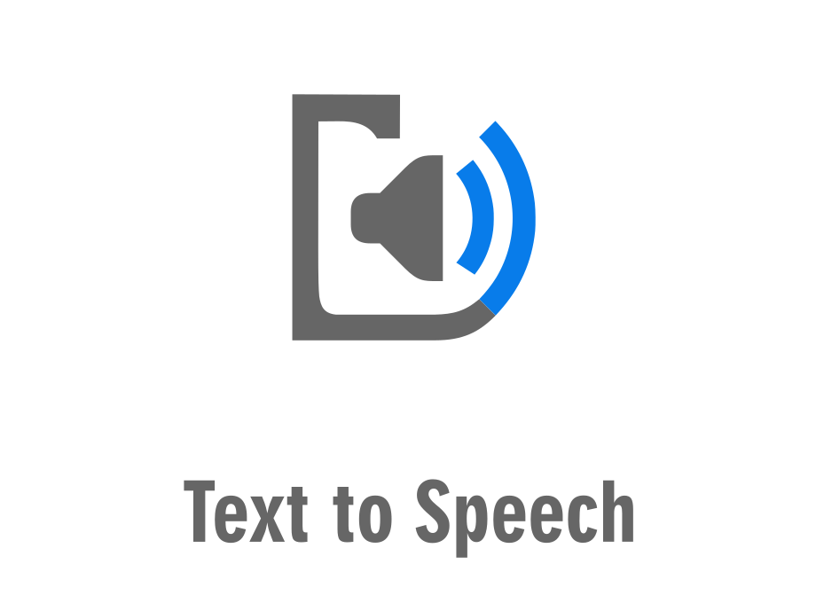
INTRODUCTION
Speech is one of the oldest and most natural means of information exchange between human. Over the years, Many attempts have been made to develop vocally interactive computers in order to achieve voice/speech synthesis. Text-to-Speech Synthesis is a technology that converts written text from a descriptive form to a spoken language that the end user can understand. It is a computer based system that can be able to generate synthesized speech from text and read it aloud. A text-to-speech synthesizer allows people with visual impairments and reading disabilities to listen to written text on a home computer. It is also very helpful for kids and adults who struggle with reading. Great Astro- physician Stephen Hawkins, who was completely paralyzed, gives all his lectures using a TTS system.

Slide 3
Objectives of the Project
The objective of our project is to implement an isolated whole word speech synthesizer that is capable of converting word and responding with speech. It consists of two main phases. The first is text analysis, in which the input text is converted into a phonetic or other linguistic representation, and the second is speech waveform generation, in which the output is generated from this phonetic information.
Text
Phonemes
Speech
Waveform
generation
Speech
Text Analysis

Slide 4
SPEECH SYNTHESIS
Speech synthesis is defined as the automatic creation of speech by 'grapheme to phoneme' translation. A grapheme is the smallest differentiating unit of written language. It has no meaning on its own. Alphabetic letters, numerical digits, punctuation marks, and individual symbols from any of the world's writing systems are all examples of graphemes. A phoneme is defined as "the smallest segmental unit of sound used to create meaningful speech. There are different ways to perform speech synthesis. The choice depends on the task they are used for, but the most widely used method is Concatenative Synthesis, because it generally produces the most natural-sounding synthesized speech. Concatenative synthesis done by concatenating pieces of recorded speech that are stored in a database of computer.

Slide 5
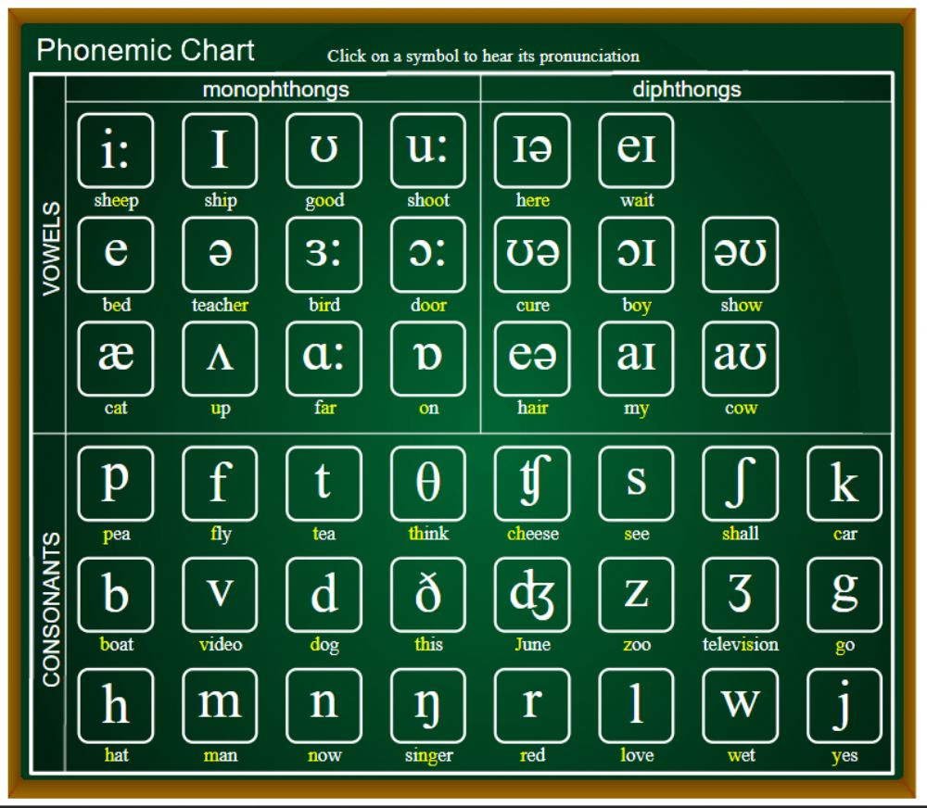
What is Phonemes?
Phase one:
Text to Phoneme
conversion
A set of phonemes is the smallest amount of symbols required to describe every possible word in a language. The written text in most languages does not correspond to the pronunciation. As a result, some type of symbolic presentation is required to represent precise pronunciation. Every language has a unique phonetic alphabet as well as a unique set of phonemes and their combinations. In English there are about 44 phonemes. Out of these 44 phonemes - 22 sounds are of vowels, and 22 are of consonants. We created database for all these pronunciation sounds in form of .wav files. There is .wav files for each phoneme.

Slide 6

Example of some phonemes -
Used In
/f/
/s/
/v/
/z/
Fan
Sip
Van
zip

Slide 7
Concatenation of segments of recorded speech
Phase Two:
Phoneme to Speech
conversion
For this step we use Concatenative synthesis method. We use Matlab software to read the word from input and generate audio signal wave for each phoneme contain in this word. Then we the concatenate each of these audio waves to produce final audio wave of word. Connecting prerecorded natural speech is probably the easiest way to produce intelligible and natural sounding synthetic speech. However, concatenative synthesizers are usually limited to one speaker and one voice and usually require more memory capacity.

Slide 8
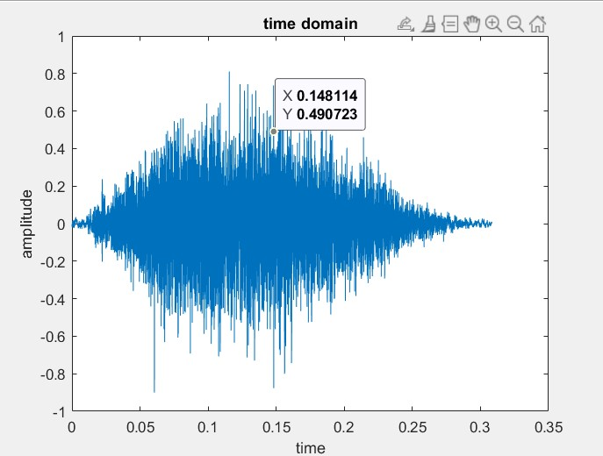
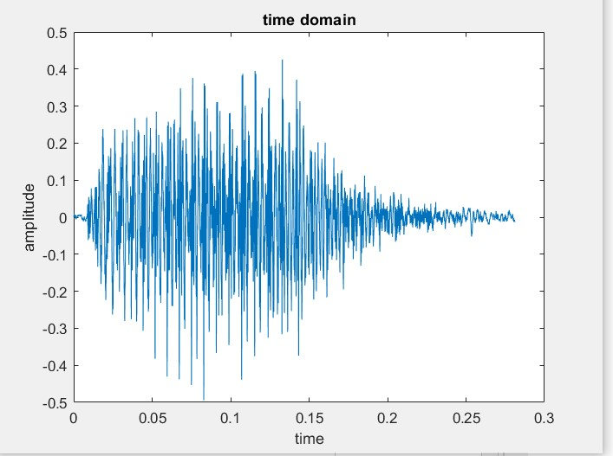
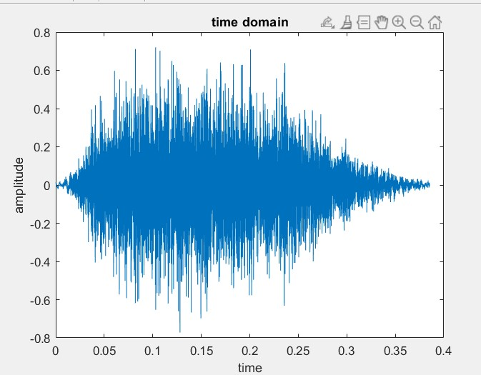
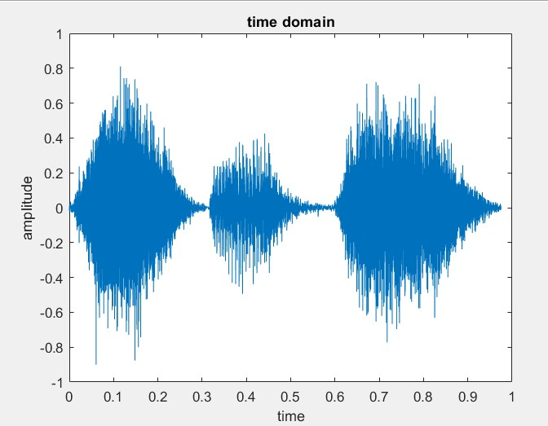
Implementation, Testing and Results
Audio wave of phonemes
Here is a sample of our implementations –
Input – fish
Word ‘fish’ have three phonemes - /f/, /i/, /sh/
Concatenation result -
/f/ /i/ /sh/

Slide 9
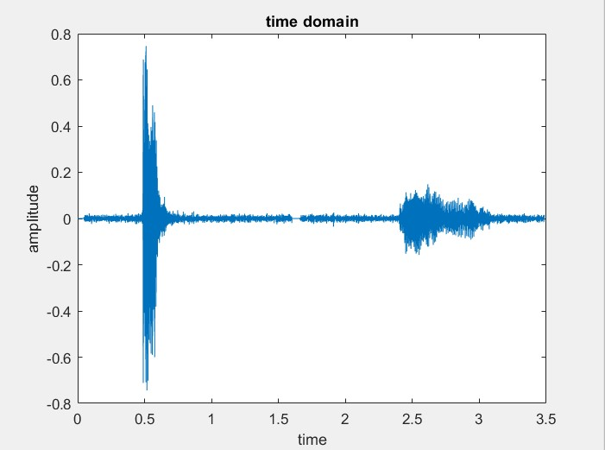
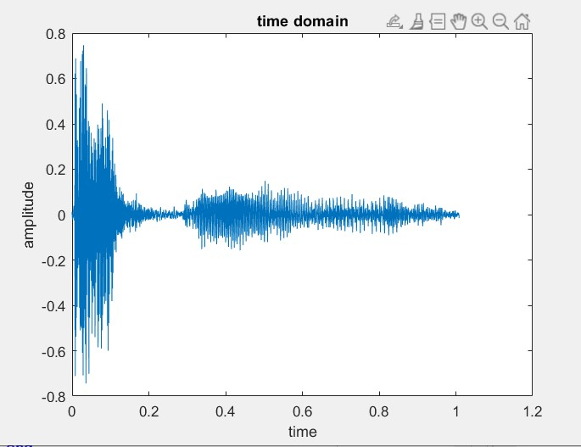
Before Modification
After Modification

Slide 10
ALGORITHM
How to run algorithm
Software and source
Run the main.m file in matlab.
It will ask for user input.
Enter an English letter having words >1.
Press Enter key.
Matlab program will run.
Word what you entered will be played on speaker.
A file named ‘result.wav’ will also be formed.
‘result.wav’ contains recording of the input word.
Software: Matlab is used for signal processing and signal synthesizing purposes.
Algorithm is written in Matlab.
Dataset: .wav files for 44 different phonemes of British English.

Slide 11
Drawbacks and Flaws in our implementation • Sound quality and naturalness is lacking. • Concatenating the sounds depending on the word. • Creating the logic for pronunciation of all the words of a dictionary accurately is difficult. • High accuracy is difficult to achieve.

Slide 12
Thank You

