Slide 1

SARDAR PATEL UNIVERSITY
DEPARTMENT OF STATISTICS
PROJECT TOPIC
"Analysis of Chronic Disease Trends
and
Contributing Factors in India Using NFHS Secondary Data"
PRESENTED BY
Prajapati Monu
  06
Applied Statistics( Sem 4)

Slide 2
Sr . No. | Contents | Page No.
1 | Background
2 | Study Variables information
3 | Objective
4 | Methodology
5 | Descriptive Statistics
 | chi-squared test
6 | Binary Logistic Regression
 | Correspondence Analysis
7 | Conclusion
8 | References
9 | Appendix

Slide 3
Background
Overview of Chronic Diseases in India:
Chronic diseases, including diabetes, hypertension, cardiovascular diseases, and respiratory illnesses, are significant public health issues in India.
These conditions often stem from lifestyle choices, such as poor diet, lack of physical activity, and smoking, resulting in a substantial burden on the healthcare system and overall quality of life.
Importance of NFHS Data:
The National Family Health Survey (NFHS) provides valuable data on health and demographic indicators in India, including information on chronic diseases, risk factors, healthcare access, and socio-economic factors. This survey helps to understand trends in health over time, the effectiveness of health interventions, and provides insights for policymakers and researchers.

Slide 4


Slide 5
Variables and Total Cases in NFHS
NHFS Round | Variables | Cases | Year
NFHS-5 MALE FILE | 862 | 101839 | 2019-2021
NFHS-5 FEMALE FILE | 5972 | 724115 | 2019-2021
NFHS-4 MALE FILE | 746 | 112122 | 2015-2016
NFHS-4 FEMALE FILE | 4796 | 699686 | 2015-2016

Slide 6
STUDY VARIABLES
Sr no | Variable Name | Values | Type
1 | Current Age / Age in 5 Group | 15-19 , 20-24 ………45-49 , 50-54 | Numerical / Categorical
2 | Diabetes | 0=No , 1=Yes , 8=Don’t know | Categorical
3 | Hypertension | 0=No , 1=Yes , 8=Don’t know | Categorical
4 | Kidney disease | 0=No , 1=Yes , 8=Don’t know | Categorical
5 | Heart disease | 0=No , 1=Yes , 8=Don’t know | Categorical
6 | Respitory diseases including Asthma | 0=No , 1=Yes , 8=Don’t know | Categorical
7 | Goitre or any other thyroid disorder | 0=No , 1=Yes , 8=Don’t know | Categorical
8 | Cancer | 0=No , 1=Yes , 8=Don’t know | Categorical
9 | Type of place of residence | 0=Rural , 1= Urban | Categorical
10 | Blood transfusion | 0=No , 1=Yes | Categorical
11 | Smokes Smoking | 0=Not at all , 1=Every Day, 2= Some Day | Categorical
12 | Drink Alcohol | 0=No , 1=Yes | Categorical

Slide 7
Methodology
Descriptive Statistics:
Frequency distributions and histograms to understand the spread of variables such as diabetes, hypertension, etc.
Chi-Square Test:
Test for associations between categorical variables ( prevalence of a specific chronic disease, or rural vs urban populations).
Logistic Regression:
To predict the likelihood of having a chronic disease (e.g., diabetes or hypertension) based on predictor variables (e.g., age, lifestyle factors).
Correspondence Analysis:
Identify long-term patterns and shifts in chronic disease prevalence over time, helping to predict future health trends and policy implications.

Slide 8
Descriptive Statistics
Frequency distribution table:
A frequency distribution table is an arrangement of the values that one or more variables take in a sample.
Each entry in the table contains the frequency or count of the occurrences of values within a particular group or interval, and in this way, the table summarizes the distribution of values in the sample.
Bar graphs
A bar chart or bar graph is a chart with rectangular bars with lengths proportional to the values that they represent.
The bars can be plotted vertically or horizontally. A vertical bar chart is sometimes called a column bar chart.

Slide 9
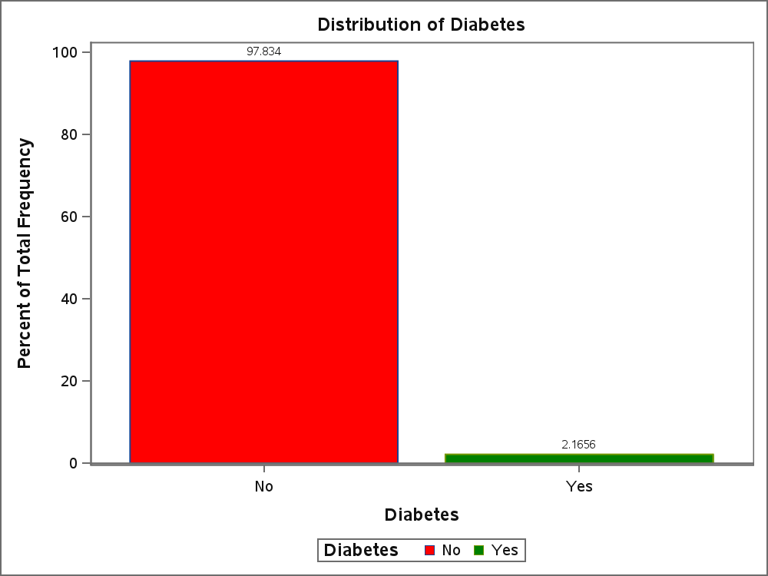
Frequency Table for Diabetes
Diabetes | COUNT | PERCENT
No | 98034 | 97.8344
Yes | 2170 | 2.1656
  2.17% of individuals have diabetes, while 97.83% do not.

Slide 10
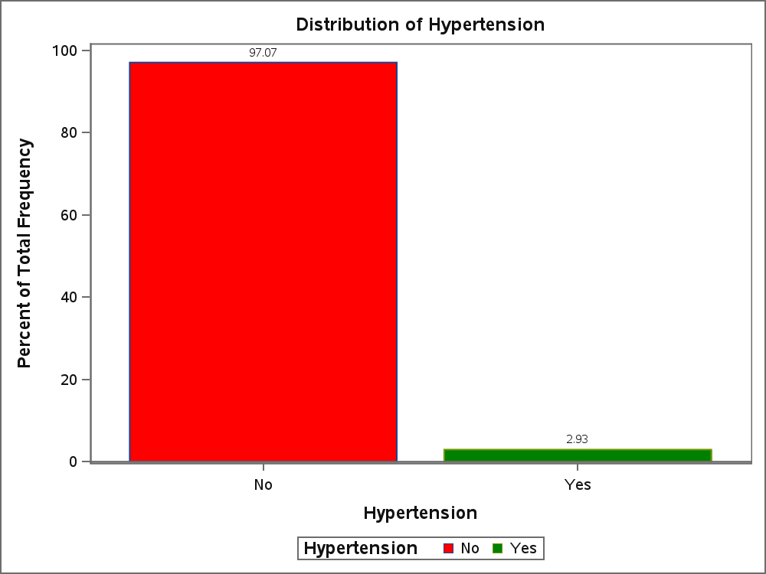
Frequency Table for Hypertension
Hypertension | COUNT | PERCENT
No | 97268 | 97.0700
Yes | 2936 | 2.9300
  2.93% of individuals suffer from hypertension, while 97.07% are unaffected.

Slide 11
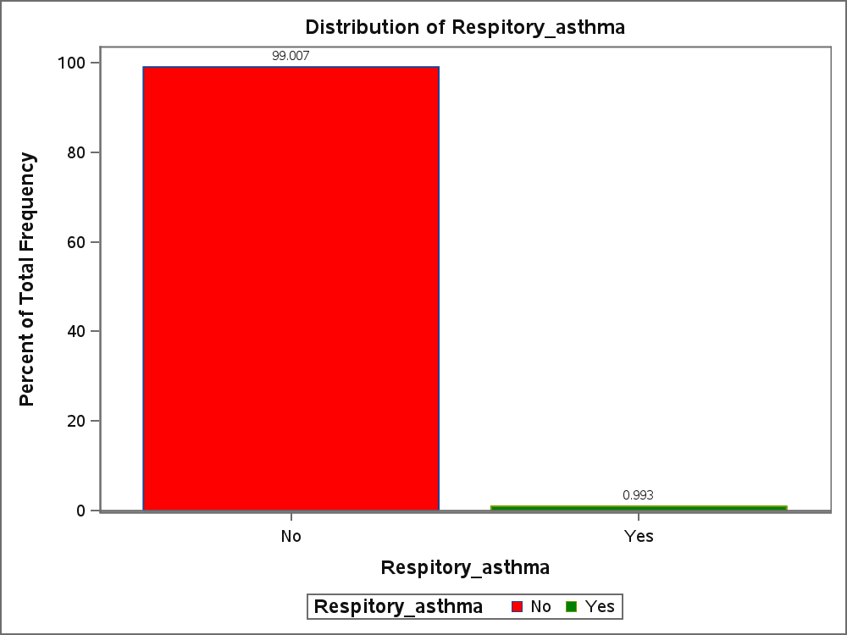
Frequency Table for Respitory_asthma
Respitory_asthma | COUNT | PERCENT
No | 99209 | 99.0070
Yes | 995 | 0.9930
  0.99% of individuals have respiratory asthma, while 99.01% do not.

Slide 12
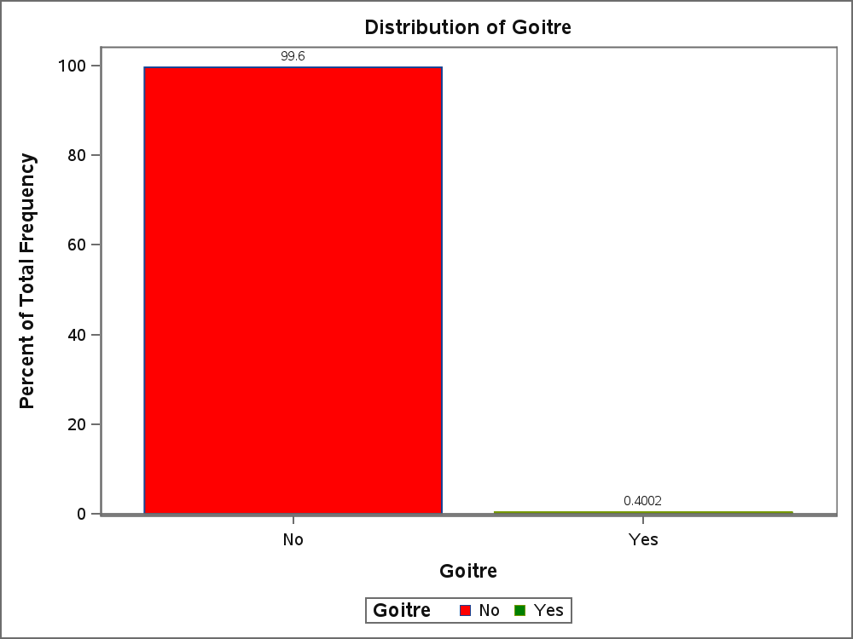
Frequency Table for Goitre
Goitre | COUNT | PERCENT
No | 99803 | 99.5998
Yes | 401 | 0.4002
0.38% of individuals have goitre, while 99.62% do not.

Slide 13

Frequency Table for Heart
Heart | COUNT | PERCENT
No | 99441 | 99.2386
Yes | 763 | 0.7614
  A very small proportion of individuals have heart disease.

Slide 14

Frequency Table for Cancer
Cancer | COUNT | PERCENT
No | 100053 | 99.8493
Yes | 151 | 0.1507
  Cancer cases are rare, with only a small percentage of affected individuals.

Slide 15

Frequency Table for Kidney
Kidney | COUNT | PERCENT
No | 99498 | 99.2954
Yes | 706 | 0.7046
  0.32% of individuals have kidney disease, while 99.68% do not.

Slide 16
Frequency Table for age_5_Years
Age_5_Years | COUNT | PERCENT
15-19 | 16427 | 16.3936
20-24 | 14240 | 14.2110
25-29 | 14165 | 14.1362
30-34 | 13089 | 13.0624
35-39 | 12647 | 12.6213
40-44 | 10646 | 10.6243
45-49 | 10619 | 10.5974
50-54 | 8371 | 8.3540

Slide 17
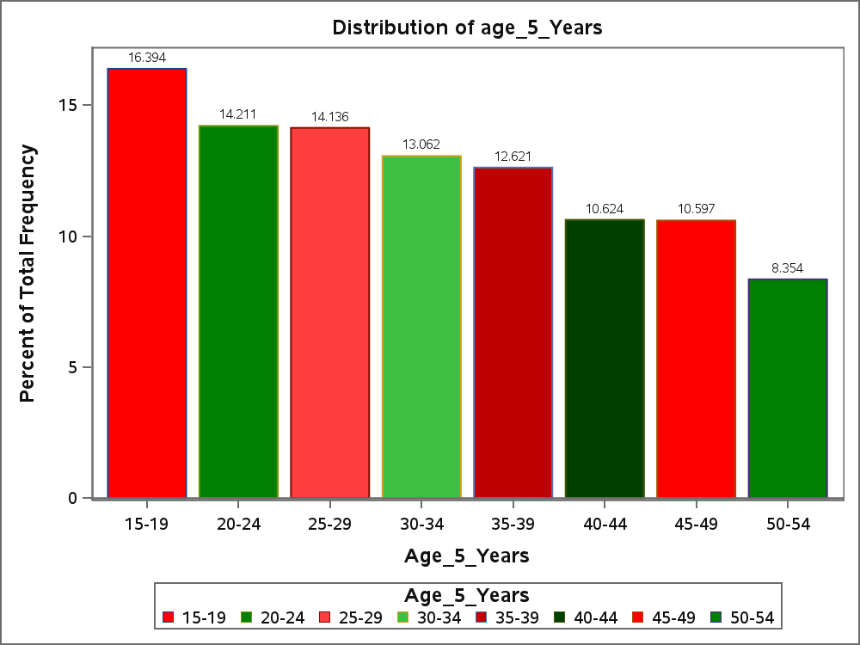
The highest proportion of individuals falls in the 15-19 age group (16.394%), indicating a younger demographic presence.
The proportions gradually decrease with increasing age, suggesting a declining trend in older age groups.

Slide 18
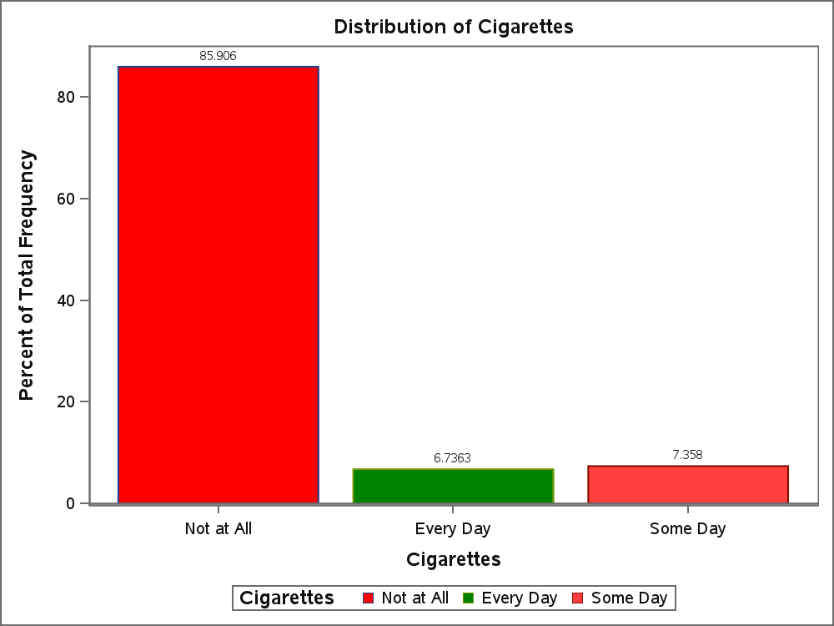
Frequency Table for Smoking
Smoking | COUNT | PERCENT
Not at All | 86081 | 85.9058
Every Day | 6750 | 6.7363
Some Day | 7373 | 7.3580
The majority of individuals (85.91%) do not smoke at all, while a small percentage smoke every day (6.74%) or occasionally (7.36%), indicating low prevalence of regular smoking in the population

Slide 19
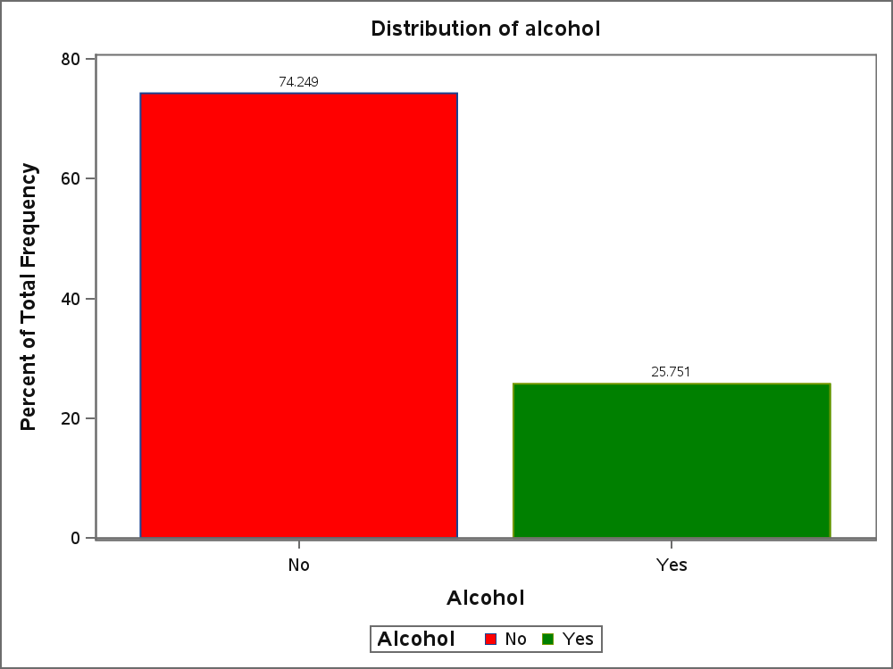
Frequency Table for alcohol
Alcohol | COUNT | PERCENT
No | 74400 | 74.2485
Yes | 25804 | 25.7515
4.87% of individuals consume alcohol, while 95.13% do not.

Slide 20
Final Conclusion :
The dataset shows a low prevalence of chronic diseases, with Diabetes (2.17%), Hypertension (2.93%), and Asthma (0.99%) being the most reported conditions.
Very few cases of Heart Disease, Cancer, and Kidney Disease, suggesting they are rare in this dataset.
Minimal smoking and alcohol consumption (4.87%), meaning lifestyle risk factors are not highly prevalent.
The data shows a higher proportion of younger individuals (15-34 years), with a declining trend in older age groups.

Slide 21
A chi-squared test (also chi-square or χ² test) :
A chi-squared test is a statistical hypothesis test used in the analysis of contingency tables when the sample sizes are large.
In simpler terms, this test is primarily used to examine whether two categorical variables (two dimensions of the contingency table) are independent in influencing the test statistic (values within the table)
Formula:
𝝌𝒄𝟐 =∑ (𝒐𝒊− 𝑬𝒊) / 𝟐 𝑬𝒊
C=degree of freedom , O= observed value , E =expected value
Hypothesis:
H0: There is no association between Two Categorical Variable
H1: There is association between Two Categorical Variable
Cramér’s V
    0 – No Association
    0.10 to 0.30 – Weak Association
    0.30 to 0.50 – Moderate Association
    > 0.50 – Strong Association
    1 – Perfect Association

Slide 22
Hypothesis:
H0: There is no association between Diabetes and Hypertension disease.
H1: There is association between Diabetes and Hypertension disease.
Table of Diabetes by Hypertension
Diabetes(Diabetes) | Hypertension(Hypertension)
Frequency Percent | No | Yes | Total
No | 95671 95.48 | 2363 2.36 | 98034 97.83
Yes | 1597 1.59 | 573 0.57 | 2170 2.17
Total | 97268 97.07 | 2936 2.93 | 100204 100.00
Diabetes and Hypertension :
Chi-square value: 4297.760, p-value: 0.000
Cramér's V: 0.307 (moderate association)
Interpretation: Diabetes and hypertension are moderately associated
Statistic | Value | P-Value
Chi-Square | 4297.7596 | <.0001
Cramer's V | 0.3071 | _

Slide 23
Hypothesis:
H0: There is no association between Alcohol and Diabetes disease.
H1: There is association between Alcohol and Diabetes disease.
Table of Alcohol by Diabetes
Alcohol(Alcohol) | Diabetes(Diabetes)
Frequency Percent | No | Yes | Total
No | 72959 72.81 | 1441 1.44 | 74400 74.25
Yes | 25075 25.02 | 729 0.73 | 25804 25.75
Total | 98034 97.83 | 2170 2.17 | 100204 100.00
Alcohol and Diabetes :
Chi-square value: 71.358, p-value: 0.000
Cramér's V: 0.027 (very weak association)
Interpretation: Alcohol consumption has a very weak association with diabetes.
Statistic | Value | P-Value
Chi-Square | 71.3581 | <.0001
Cramer's V | 0.0267 | _

Slide 24
Hypothesis:
H0: There is no association Smoking between and Diabetes disease.
H1: There is association between Smoking and Diabetes disease.
Table of Smoking by Diabetes
Smoking(Smoking) | Diabetes(Diabetes)
Frequency Percent | No | Yes | Total
Not at All | 84302 84.13 | 1779 1.78 | 86081 85.91
Every Day | 6544 6.53 | 206 0.21 | 6750 6.74
Some Day | 7188 7.17 | 185 0.18 | 7373 7.36
Total | 98034 97.83 | 2170 2.17 | 100204 100.00
Smoking and Diabetes :
Chi-square value: 33.109, p-value: 0.000
Cramér's V: 0.018 (very weak association)
Interpretation: Smoking has a very weak association with diabetes.
Statistic | Value | P-Value
Chi-Square | 33.1086 | <.0001
Cramer's V | 0.0182 | _

Slide 25
Disease Pair | Statistic | Value | P-Value
Table Diabetes * Hypertension | Chi-Square | 4297.7596 | <.0001
Table Diabetes * Hypertension | Cramer's V | 0.3071 | _
Table Diabetes * Respitory_asthma | Chi-Square | 584.5146 | <.0001
Table Diabetes * Respitory_asthma | Cramer's V | 0.0764 | _
Table Diabetes * Goitre | Chi-Square | 652.6729 | <.0001
Table Diabetes * Goitre | Cramer's V | 0.0807 | _
Table Diabetes * Heart | Chi-Square | 747.0873 | <.0001
Table Diabetes * Heart | Cramer's V | 0.0863 | _
Table Diabetes * Cancer | Chi-Square | 654.6565 | <.0001
Table Diabetes * Cancer | Cramer's V | 0.0808 | _
Table Diabetes * Kidney | Chi-Square | 365.8172 | <.0001
Table Diabetes * Kidney | Cramer's V | 0.0604 | _
Table Hypertension * Respitory_asthma | Chi-Square | 1397.0461 | <.0001
Table Hypertension * Respitory_asthma | Cramer's V | 0.1181 | _
Table Hypertension * Goitre | Chi-Square | 782.0049 | <.0001
Table Hypertension * Goitre | Cramer's V | 0.0883 | _
Table Hypertension * Heart | Chi-Square | 1548.9935 | <.0001
Table Hypertension * Heart | Cramer's V | 0.1243 | _
Table Hypertension * Cancer | Chi-Square | 669.3561 | <.0001
Table Hypertension * Cancer | Cramer's V | 0.0817 | _
Table Hypertension * Kidney | Chi-Square | 484.7761 | <.0001
Table Hypertension * Kidney | Cramer's V | 0.0696 | _
Table Respitory_asthma * Goitre | Chi-Square | 2109.8388 | <.0001
Table Respitory_asthma * Goitre | Cramer's V | 0.1451 | _
Table Respitory_asthma * Heart | Chi-Square | 1820.8455 | <.0001
Table Respitory_asthma * Heart | Cramer's V | 0.1348 | _
Table Respitory_asthma * Cancer | Chi-Square | 1720.5496 | <.0001
Table Respitory_asthma * Cancer | Cramer's V | 0.1310 | _
Table Respitory_asthma * Kidney | Chi-Square | 837.8578 | <.0001
Table Respitory_asthma * Kidney | Cramer's V | 0.0914 | _
Table Goitre * Heart | Chi-Square | 1715.1327 | <.0001
Table Goitre * Heart | Cramer's V | 0.1308 | _
Table Goitre * Cancer | Chi-Square | 3897.3921 | <.0001
Table Goitre * Cancer | Cramer's V | 0.3972 | _
Table Goitre * Kidney | Chi-Square | 1383.4887 | <.0001
Table Goitre * Kidney | Cramer's V | 0.1175 | _
Table Heart * Cancer | Chi-Square | 2737.8383 | <.0001
Table Heart * Cancer | Cramer's V | 0.1653 | _
Table Heart * Kidney | Chi-Square | 1449.4195 | <.0001
Table Heart * Kidney | Cramer's V | 0.1203 | _
Table Cancer * Kidney | Chi-Square | 2966.2899 | <.0001
Table Cancer * Kidney | Cramer's V | 0.1721 | _

Slide 26
Table Age_5_Years * Hypertension | Cramer's V | 0.1437 | _
Table Age_5_Years * Respitory_asthma | Chi-Square | 309.7141 | <.0001
Table Age_5_Years * Respitory_asthma | Cramer's V | 0.0556 | _
Table Age_5_Years * Goitre | Chi-Square | 55.8360 | <.0001
Table Age_5_Years * Goitre | Cramer's V | 0.0236 | _
Table Age_5_Years * Heart | Chi-Square | 307.7513 | <.0001
Table Age_5_Years * Heart | Cramer's V | 0.0554 | _
Table Age_5_Years * Cancer | Chi-Square | 26.4169 | 0.0004
Table Age_5_Years * Cancer | Cramer's V | 0.0162 | _
Table Age_5_Years * Kidney | Chi-Square | 93.9211 | <.0001
Table Age_5_Years * Kidney | Cramer's V | 0.0306 | _
Table Urban_Rural * Diabetes | Chi-Square | 82.8043 | <.0001
Table Urban_Rural * Diabetes | Cramer's V | -0.0287 | _
Table Urban_Rural * Hypertension | Chi-Square | 49.7493 | <.0001
Table Urban_Rural * Hypertension | Cramer's V | -0.0223 | _
Table Urban_Rural * Respitory_asthma | Chi-Square | 7.0091 | 0.0081
Table Urban_Rural * Respitory_asthma | Cramer's V | 0.0084 | _
Table Urban_Rural * Goitre | Chi-Square | 0.7455 | 0.3879
Table Urban_Rural * Goitre | Cramer's V | 0.0027 | _
Table Urban_Rural * Heart | Chi-Square | 13.2518 | 0.0003
Table Urban_Rural * Heart | Cramer's V | 0.0115 | _
Table Urban_Rural * Cancer | Chi-Square | 1.4000 | 0.2367
Table Urban_Rural * Cancer | Cramer's V | 0.0037 | _
Table Urban_Rural * Kidney | Chi-Square | 0.3747 | 0.5404
Table Urban_Rural * Kidney | Cramer's V | 0.0019 | _
Table Smoking * Diabetes | Chi-Square | 33.1086 | <.0001
Table Smoking * Diabetes | Cramer's V | 0.0182 | _
Table Smoking * Hypertension | Chi-Square | 187.9833 | <.0001
Table Smoking * Hypertension | Cramer's V | 0.0433 | _
Table Smoking * Respitory_asthma | Chi-Square | 37.1660 | <.0001
Table Smoking * Respitory_asthma | Cramer's V | 0.0193 | _
Table Smoking * Goitre | Chi-Square | 26.0347 | <.0001
Table Smoking * Goitre | Cramer's V | 0.0161 | _
Table Smoking * Heart | Chi-Square | 35.9145 | <.0001
Table Smoking * Heart | Cramer's V | 0.0189 | _
Table Smoking * Cancer | Chi-Square | 6.2649 | 0.0436
Table Smoking * Cancer | Cramer's V | 0.0079 | _
Table Smoking * Kidney | Chi-Square | 61.4703 | <.0001
Table Smoking * Kidney | Cramer's V | 0.0248 | _
Table Alcohol * Diabetes | Chi-Square | 71.3581 | <.0001
Table Alcohol * Diabetes | Cramer's V | 0.0267 | _
Table Alcohol * Hypertension | Chi-Square | 376.4824 | <.0001
Table Alcohol * Hypertension | Cramer's V | 0.0613 | _
Table Alcohol * Respitory_asthma | Chi-Square | 76.1620 | <.0001
Table Alcohol * Respitory_asthma | Cramer's V | 0.0276 | _
Table Alcohol * Goitre | Chi-Square | 11.5795 | 0.0007
Table Alcohol * Goitre | Cramer's V | 0.0107 | _
Table Alcohol * Heart | Chi-Square | 19.0499 | <.0001
Table Alcohol * Heart | Cramer's V | 0.0138 | _
Table Alcohol * Cancer | Chi-Square | 0.2887 | 0.5911
Table Alcohol * Cancer | Cramer's V | -0.0017 | _
Table Alcohol * Kidney | Chi-Square | 46.7916 | <.0001
Table Alcohol * Kidney | Cramer's V | 0.0216 | _

Slide 27
Final Conclusion
Age is weakly associated with most chronic diseases, but diabetes and hypertension show stronger trends with increasing age.
Diabetes and hypertension have a moderate association, meaning people with diabetes are more likely to have hypertension.
Other diseases, including heart disease, cancer, kidney disease, and respiratory asthma, have weak associations with diabetes and hypertension.
Smoking and alcohol consumption show weak associations with chronic diseases, with hypertension being the most
affected condition
Goitre has a moderate association with cancer, suggesting a potential risk link.
This analysis confirms that age, diabetes, and hypertension are key risk factors, while lifestyle habits like smoking and alcohol have weaker effects.

Slide 28
Objective 3:
Examine the relationship between Chronic Diseases and Risk Factors :
Binary Logistic Regression:
Binary Logistic Regression is a statistical method used when the dependent variable is binary, meaning it has two possible outcomes (e.g., yes/no, success/failure, 0/1).
When to use:
When the outcome is categorical with two levels (e.g., presence or absence of a disease).
When you want to estimate the probability of an event occurring based on predictor variables.
SAS Code:
proc logistic data=work.import descending;
model diabetes = current_age Smoking alcohol hypertension kidney cancer heart / link=logit ;
Run;

Slide 29
Output :
The LOGISTIC Procedure
Model Information
Data Set | WORK.IMPORT
Response Variable | diabetes
Number of Response Levels | 2
Model | binary logit
Optimization Technique | Fisher's scoring
Number of Observations Read | 100204
Number of Observations Used | 100204
Response Profile
Ordered Value | diabetes | Total Frequency
1 | 1 | 2170
2 | 0 | 98034

Slide 30
The LOGISTIC Procedure
Analysis of Maximum Likelihood Estimates
Parameter | DF | Estimate | Standard Error | Wald Chi-Square | Pr > ChiSq
Intercept | 1 | -6.6642 | 0.0962 | 4799.1273 | <.0001
current_age | 1 | 0.0698 | 0.00229 | 926.8222 | <.0001
Smoking | 1 | 0.0766 | 0.0386 | 3.9500 | 0.0469
alcohol | 1 | 0.0181 | 0.0498 | 0.1326 | 0.7158
hypertension | 1 | 2.0481 | 0.0571 | 1287.9609 | <.0001
kidney | 1 | 0.8904 | 0.1484 | 35.9735 | <.0001
cancer | 1 | 1.5959 | 0.2364 | 45.5893 | <.0001
heart | 1 | 0.8963 | 0.1250 | 51.4328 | <.0001

Slide 31
Analysis of Maximum Likelihood Estimates
Intercept:
  Estimate: -6.6642
  Standard Error: 0.0962
  Wald Chi-Square: 4799.1273
  p-value: < 0.0001
  Interpretation: The intercept represents the baseline log-odds of having diabetes when all predictors are zero. The negative value suggests a lower baseline probability of diabetes when the predictors are absent, but the intercept should be considered in the context of the predictors.
current_age:
  Estimate: 0.0698
  Standard Error: 0.00229
  Wald Chi-Square: 926.8222
  p-value: < 0.0001
  Interpretation: The positive coefficient indicates that as age increases by 1 year, the log-odds of having diabetes increase by 0.0698. This result is statistically significant, meaning aging increases the likelihood of diabetes.
Smoking:
  Estimate: 0.0766
  Standard Error: 0.0386
  Wald Chi-Square: 3.9500
  p-value: 0.0469
Interpretation: The positive coefficient for Smoking suggests that smoking is associated with an increased likelihood of diabetes. The p-value (0.0469) is below the 0.05 threshold, indicating that the effect is statistically significant

Slide 32
alcohol:
Estimate: 0.0181
Standard Error: 0.0498
Wald Chi-Square: 0.1326
p-value: 0.7158
Interpretation: The coefficient for alcohol is positive, but the p-value (0.7158) is much higher than the typical 0.05 significance level, suggesting that alcohol consumption does not have a statistically significant effect on the likelihood of diabetes in this model.
hypertension:
Estimate: 2.0481
Standard Error: 0.0571
Wald Chi-Square: 1287.9609
p-value: < 0.0001
Interpretation: The positive coefficient for hypertension indicates that individuals with hypertension have significantly higher odds of developing diabetes. This relationship is highly statistically significant.
kidney:
Estimate: 0.8904
Standard Error: 0.1484
Wald Chi-Square: 35.9735
p-value: < 0.0001
Interpretation: The positive coefficient for kidney issues suggests that individuals with kidney disease are more likely to develop diabetes. This result is statistically significant.

Slide 33
cancer:
  Estimate: 1.5959
  Standard Error: 0.2364
  Wald Chi-Square: 45.5893
  p-value: < 0.0001
  Interpretation: The coefficient for cancer is quite high, indicating that individuals with cancer have much higher odds of developing diabetes. This effect is highly statistically significant.
heart:
  Estimate: 0.8963
  Standard Error: 0.1250
  Wald Chi-Square: 51.4328
  p-value: < 0.0001
Interpretation: The positive coefficient for heart disease indicates that individuals with heart disease are significantly more likely to develop diabetes. This result is statistically significant

Slide 34
Conclusion:
Significant Predictors:
  current_age, Smoking, hypertension, kidney, cancer, and heart disease are significantly associated with the likelihood of developing diabetes, as indicated by their very low p-values (< 0.0001).
Non-Significant Predictor:
  alcohol is not statistically significant at the 5% level, meaning that alcohol consumption does not independently affect the likelihood of diabetes in this model.
This analysis suggests that age, smoking, hypertension, kidney disease, cancer, and heart disease are all strongly associated with diabetes risk, while alcohol does not appear to have a significant independent effect.

Slide 35
The LOGISTIC Procedure
Odds Ratio Estimates
Effect | Point Estimate | 95% Wald Confidence Limits
current_age | 1.072 | 1.067 | 1.077
Smoking | 1.080 | 1.001 | 1.164
alcohol | 1.018 | 0.924 | 1.123
hypertension | 7.753 | 6.932 | 8.670
kidney | 2.436 | 1.821 | 3.259
cancer | 4.933 | 3.104 | 7.840
heart | 2.450 | 1.918 | 3.130
current_age (OR = 1.072; CI = 1.067 to 1.077) ((Odds Ratio - 1) * 100).
Interpretation : The odds of diabetes increase by 7.2% with age.
Why significant? CI (1.067–1.077) is entirely above 1, showing the effect is real, not due to chance.
Smoking (OR = 1.080; CI = 1.001 to 1.164)
Interpretation : 8% higher odds of diabetes with smoking.
Why borderline? CI barely above 1 (1.001–1.164). Since 1 is very close, the effect is weak but still technically significant.
alcohol (OR = 1.018; CI = 0.924 to 1.123)
Interpretation : Only a 1.8% increase in odds, very small.
Why NOT significant? CI (0.924–1.123) includes 1, meaning alcohol might have no effect. The result could be due to random chance.

Slide 36
Odds Ratio Estimates
Effect | Point Estimate | 95% Wald Confidence Limits
current_age | 1.072 | 1.067 | 1.077
Smoking | 1.080 | 1.001 | 1.164
alcohol | 1.018 | 0.924 | 1.123
hypertension | 7.753 | 6.932 | 8.670
kidney | 2.436 | 1.821 | 3.259
cancer | 4.933 | 3.104 | 7.840
heart | 2.450 | 1.918 | 3.130
hypertension (OR = 7.753; CI = 6.932 to 8.670)
Interpretation : People with hypertension have 7.75 times higher odds of diabetes.
Why highly significant? CI (6.932–8.670) is way above 1, confirming a strong, real effect.
kidney (OR = 2.436; CI = 1.821 to 3.259)
Interpretation : About 2.4 times higher odds with kidney issues.
Why significant? CI (1.821–3.259) is above 1, confirming significance
cancer (OR = 4.933; CI = 3.104 to 7.840)
Interpretation : Cancer patients have nearly 5 times higher odds of diabetes.
Why significant? CI (3.104–7.840) is well above 1, showing a strong effect.

Slide 37
Odds Ratio Estimates
Effect | Point Estimate | 95% Wald Confidence Limits
current_age | 1.072 | 1.067 | 1.077
Smoking | 1.080 | 1.001 | 1.164
alcohol | 1.018 | 0.924 | 1.123
hypertension | 7.753 | 6.932 | 8.670
kidney | 2.436 | 1.821 | 3.259
cancer | 4.933 | 3.104 | 7.840
heart | 2.450 | 1.918 | 3.130
Conclusion :
Strong Risk Factors: Hypertension, cancer, heart disease, and kidney issues significantly increase diabetes risk.
Moderate Effect: Age and cigarette use show a smaller but significant increase in risk.
Not Significant: Alcohol consumption does not show a significant effect on diabetes risk.

Slide 38
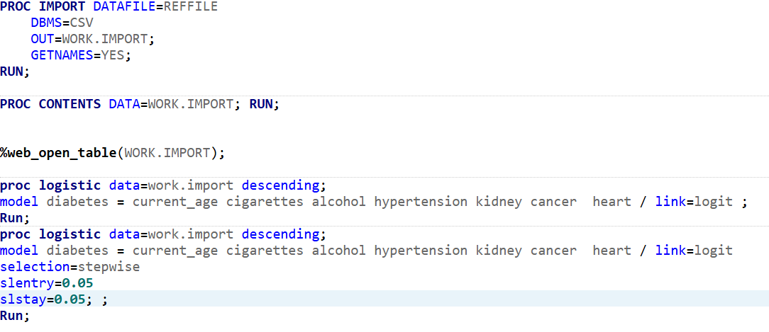

Slide 39
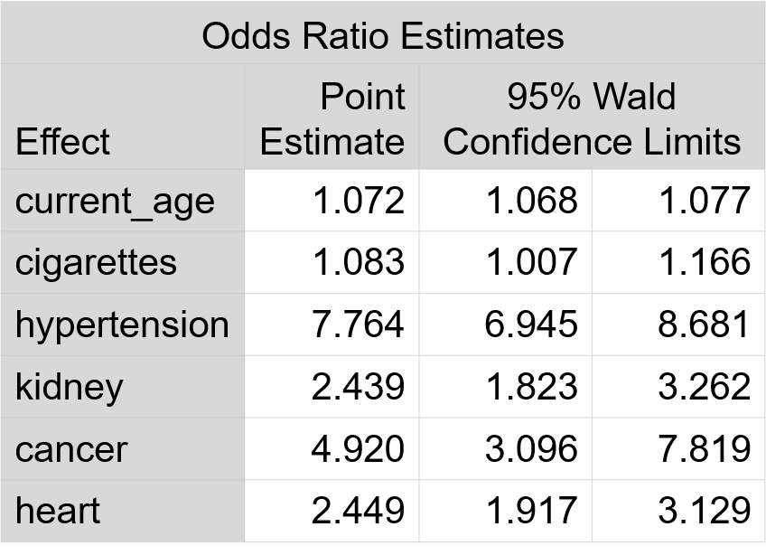
The LOGISTIC Procedure
Analysis of Maximum Likelihood Estimates
Parameter | DF | Estimate | Standard Error | Wald Chi-Square | Pr > ChiSq
Intercept | 1 | -6.6620 | 0.0960 | 4818.2630 | <.0001
current_age | 1 | 0.0698 | 0.00228 | 934.5027 | <.0001
Smoking | 1 | 0.0802 | 0.0373 | 4.6230 | 0.0315
hypertension | 1 | 2.0495 | 0.0569 | 1296.3160 | <.0001
kidney | 1 | 0.8915 | 0.1484 | 36.0776 | <.0001
cancer | 1 | 1.5934 | 0.2363 | 45.4691 | <.0001
heart | 1 | 0.8957 | 0.1250 | 51.3680 | <.0001

Slide 40
Final model Conclusion :
After applying the stepwise selection, the final model identifies current_age, Smoking, hypertension, kidney issues, cancer, and heart disease as significant predictors of diabetes.
Strong Risk Factors:
  Hypertension (OR = 7.76) and cancer (OR = 4.92) greatly increase the risk of diabetes.
  Heart disease (OR = 2.45) and kidney issues (OR = 2.44) also significantly raise the risk.
Moderate Risk Factors:
  Age (OR = 1.072): Each additional year slightly increases diabetes risk by 7.2%.
  Smoking (OR = 1.083): Smoking raises the risk by 8.3%, with a borderline but significant effect.
All predictors are statistically significant (p < 0.05), indicating they meaningfully contribute to diabetes risk. The model is well-optimized with improved fit and reduced complexity compared to the full model.

Slide 41
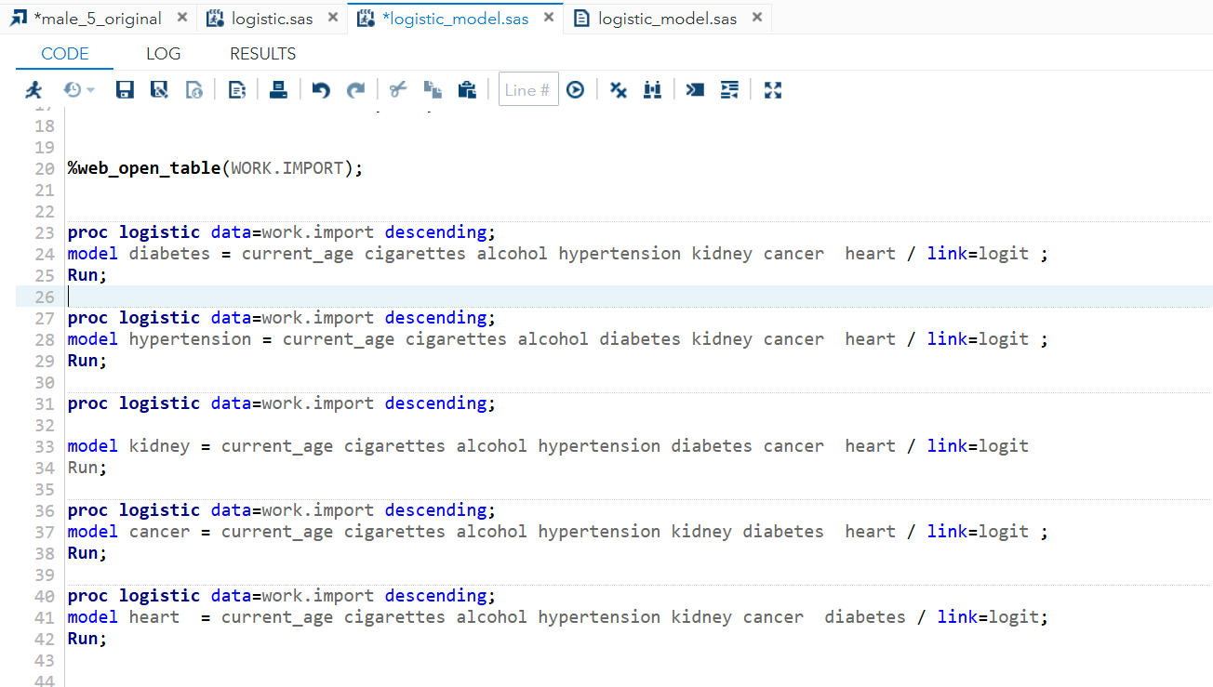

Slide 42
Final Summary of Stepwise Selection Models for Chronic Diseases:
Common Significant Predictors Across Diseases:
Current Age: Increases the risk for all conditions.
Hypertension: A major risk for diabetes, kidney disease, and heart disease.
Diabetes: Strongly increases the risk of hypertension, kidney disease, cancer, and heart disease.
Kidney Disease & Heart Disease: Both highly interconnected with other conditions.
Cancer: Strongly associated with heart disease, kidney disease, and diabetes.
Cigarette Smoking & Alcohol: Moderately increase risk, especially for heart disease, hypertension, and kidney disease.
Strong Risk Factors (High Odds Ratios):
Cancer: Highest risk for kidney disease and heart disease.
Kidney Disease: Strong association with cancer and heart disease.
Heart Disease: Major risk for cancer and diabetes.
Hypertension: Strong risk for diabetes and heart disease.
Diabetes: High odds for hypertension and kidney disease.
Moderate Risk Factors:
Age , Smoking : Moderate increase in risk, particularly for hypertension and kidney disease..

Slide 43
Correspondence Analysis :
Correspondence Analysis (CA) is a multivariate statistical technique used to analyze and visualize relationships between categorical variables in a contingency table.
It is similar to Principal Component Analysis (PCA) but is specifically designed for categorical data.
Objective 4:
To analyze the association between chronic diseases and their response in order to find patterns between disease response.
Multiple Correspondence Analysis (MCA)
MCA is an extension of Correspondence Analysis (CA) used for analyzing relationships among multiple categorical
Variable.
It helps in identifying patterns and associations within a dataset containing more than two categorical variables.
Similar to PCA (Principal Component Analysis) but for categorical data.

Slide 44
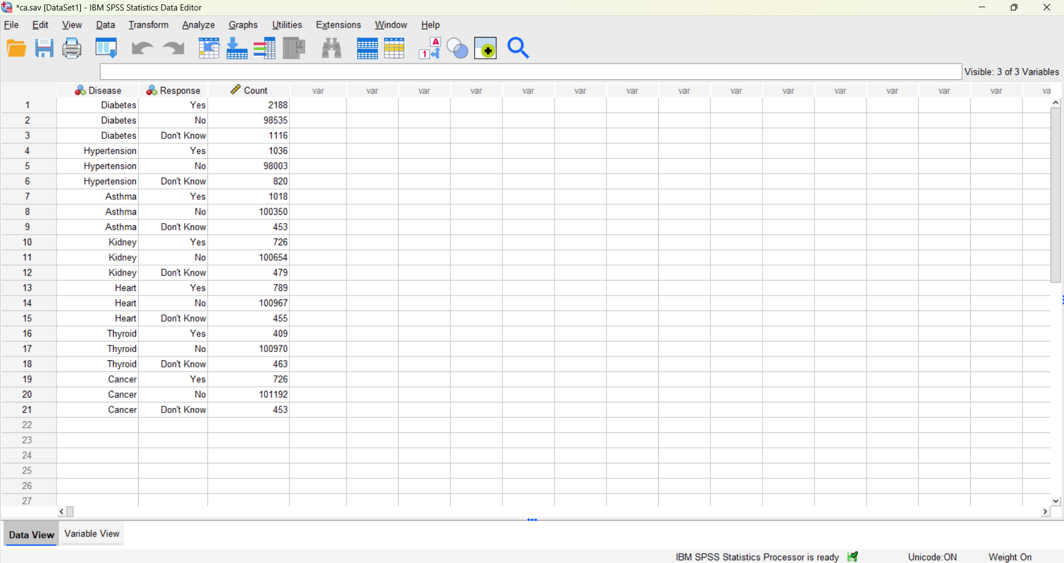
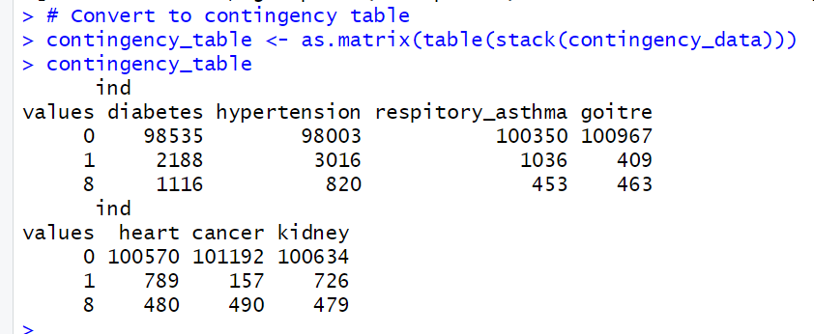

Slide 46
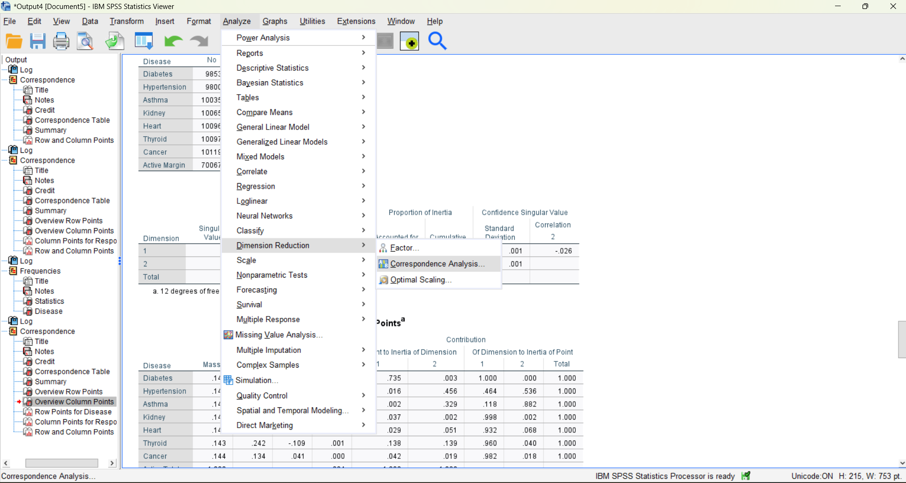

Slide 47
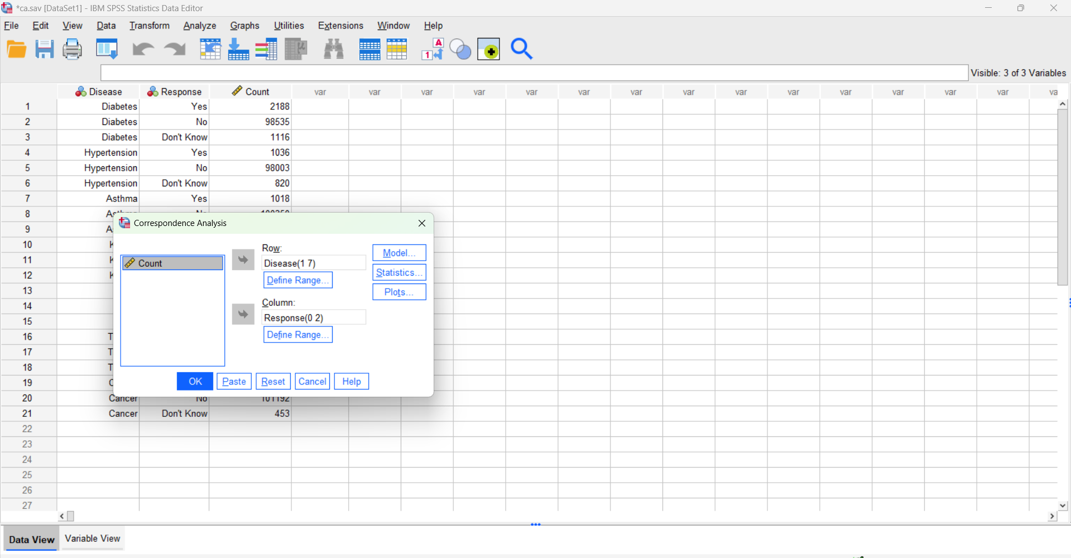

Slide 48
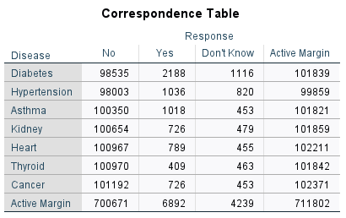
Most responses are "No" – indicating that the majority of respondents do not have these diseases.
"Yes" responses are low – meaning a smaller portion of people reported having these diseases.
"Don't Know" responses– some people are unsure whether they have a disease.
Diabetes has the highest "Yes" responses (2188 cases) compared to other diseases.
Thyroid has the lowest "Yes" responses (409 cases).

Slide 49
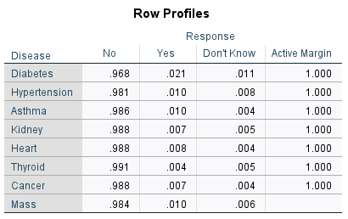

Slide 50
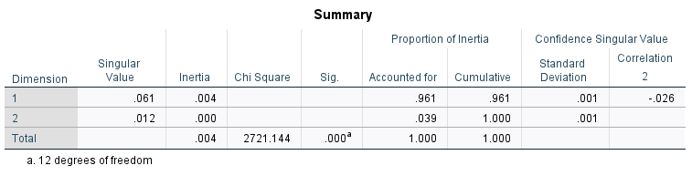
1. Singular Value & Inertia
Singular Values: These indicate how much variance each dimension (axis) explains.
  Dimension 1 (0.061) explains most of the variation.
  Dimension 2 (0.012) explains a much smaller portion.
Inertia: It represents how much information is captured by each dimension.
  Total inertia (0.004) is the sum of all individual inertia values.
2. Chi-Square & Significance (Sig.)
Chi-Square (2721.144): This tests whether there is a significant relationship between the row and column variables in the contingency table.
Significance (p-value = 0.000): Since p-value is very small (< 0.05), we conclude that there is a statistically significant relationship between the categorical variables.

Slide 51
Proportion of Inertia
This tells us how much of the total variation is explained by each dimension.
Dimension 1 (96.1%) explains most of the variation in the data.
Dimension 2 (3.9%) contributes very little.
Cumulative (100%) means both dimensions together explain the total variation.
4. Confidence Measures
Standard Deviation: A measure of uncertainty in the singular values.
Correlation (Dimension 2: -0.026): This is related to the quality of representation but is not a major focus.
Interpretation
Since Dimension 1 captures 96.1% of the variation, the first dimension is the most important for understanding the relationships.
The Chi-square test confirms that the categorical variables are significantly associated.
The second dimension (3.9%) adds minimal extra information and might not be crucial for interpretation.

Slide 52
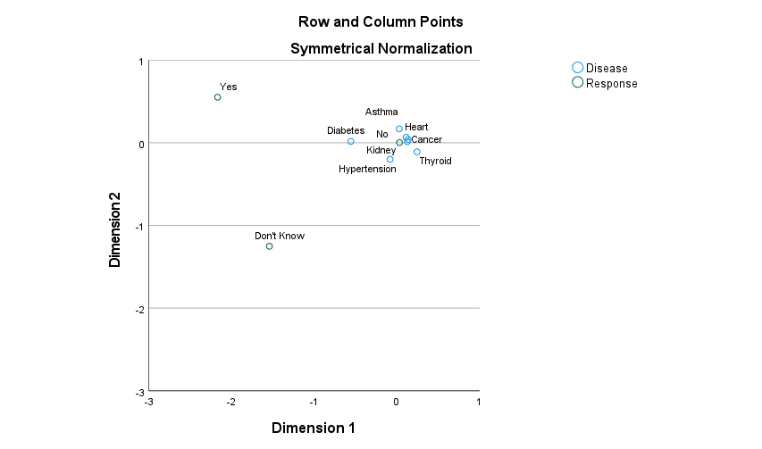

Slide 53
Most diseases (Diabetes, Kidney, Hypertension, Heart, Cancer, Thyroid) are clustered close together near "No."
This suggests that these diseases are more commonly associated with respondents answering "No" rather than "Yes" or "Don't Know."
Asthma is slightly higher on Dim .
This suggests that Asthma is more associated with "Yes" responses than other diseases.
It has a different response pattern compared to conditions like Hypertension or Kidney disease.
Don't Know" is positioned far down on Dimension .
This suggests that "Don't Know" responses are quite different from both "Yes" and "No."
Diseases far from "Don't Know" are more confidently answered with "Yes" or "No."

Slide 54
Interpretation :
Diseases close to "No" (like Kidney, Hypertension, Diabetes, Cancer) → More people responded "No" when asked about these conditions.
Diseases closer to "Yes" (like Asthma) As compared to other .
Diseases far from "Don't Know" → Respondents were more confident in their answers.
This plot helps identify which diseases are more commonly acknowledged ("Yes"), denied ("No"), or uncertain ("Don't Know").

Slide 56
Asthma is positioned higher on Dimension2 , indicating it has a distinct response pattern compared to other diseases.
Diabetes is placed far left on Dimension 2, making it distinct from other diseases. This position implies it contributes differently to the overall variability.
Heart, Cancer, and Kidney diseases cluster together, suggesting similar response patterns.
Hypertension lies in the lower-left quadrant (negative in both dimensions), suggesting its profile is also quite different from other diseases
Thyroid is slightly separated, meaning its response pattern is somewhat different from the clustered diseases.

Slide 57


