Slide 1

SARDAR PATEL UNIVERSITY
DEPARTMENT OF STATISTICS
PROJECT TOPIC
Survival Analysis of Breast Cancer Patients: A Study Using the METABRIC Dataset
PRESENTED BY
Prajapati Monu
06
Applied Statistics( Sem 4)
🎗 Breast Cancer Survival Research 🎗
Notes:
Welcome everyone. My name is Monu Prajapati and this is my MSc Applied Statistics project titled Survival Analysis of Breast Cancer Patients. In this project I have used two well-known statistical techniques — the Kaplan-Meier method and Cox Proportional Hazards regression — to analyze survival data from the METABRIC breast cancer dataset. The METABRIC dataset is one of the most widely used breast cancer datasets in biostatistics, published in Nature in 2012. I will walk you through my objectives, methodology, results, and conclusions in the next 15 slides.

Slide 2
Introduction
Background and Motivation
Why Survival Analysis?
Why Cox Regression?
▸ Breast cancer is the most common cancer in women worldwide
▸ Cox model is the gold standard for survival analysis in medical research
▸ Standard regression cannot handle censored data (patients still alive at study end)
▸ Does not require assuming a specific distribution of survival times (semi-parametric)
▸ Survival analysis specifically models time-to-event data
▸ Estimates Hazard Ratios (HR) for each predictor variable
▸ Allows comparison of survival between patient groups
▸ Can handle multiple predictors simultaneously
▸ Identifies factors that predict how long a patient will survive
▸ Used in virtually all major clinical cancer studies
Notes:
Survival analysis is a branch of statistics that deals with time until an event occurs — in this case, death from breast cancer. Unlike regular regression, survival analysis can handle censored observations: patients who were alive at the end of the study period. We use Kaplan-Meier curves to visualize survival probabilities over time, and Cox regression to quantify which risk factors are statistically associated with survival. The Cox model is preferred because it is semi-parametric — it does not require assumptions about the distribution of survival times. It produces Hazard Ratios that directly tell us how much a variable increases or decreases the risk of death.

Slide 3
Research Objectives
Primary and Secondary Objectives
PRIMARY
Primary Objective
OBJECTIVE
To analyze and describe the overall survival experience of breast cancer patients in the METABRIC cohort using Kaplan–Meier survival estimation, and to estimate median survival time along with 95% confidence intervals.
Secondary Objectives
1
To compare survival across patient subgroups (ER status, PR status, HER2 status, tumor stage, grade, lymph nodes) using Kaplan–Meier curves and log-rank tests.
2
To identify independent prognostic factors for overall survival using Univariable Cox Proportional Hazards regression models — computing Hazard Ratios with 95% CI.
3
To test the Proportional Hazards (PH) assumption using Schoenfeld residuals (cox.zph) and interpret the implications for the final model choice.
Notes:
My project has one primary and three secondary objectives. The primary objective is to describe the overall survival of the METABRIC cohort using Kaplan-Meier analysis. The secondary objectives are: first, to compare survival across subgroups using log-rank tests; second, to identify risk factors using univariable Cox regression and compute Hazard Ratios; and third, to check whether the Proportional Hazards assumption is met using the cox.zph test. I will show you that the PH assumption was violated for several variables, which influenced my analytical decisions.

Slide 4
Dataset Description
1,981
1,144
837
156m
Patients Analysed
Deaths (57.7%)
Censored (42.3%)
Median Survival
About METABRIC : Source [Download_Dataset]
Variables Used in Analysis
▸ Published: Curtis et al., Nature (2012)
Continuous
Age at diagnosis, Tumor size, Lymph nodes (+ve)
▸ Original dataset: 2,509 breast cancer patients
Categorical
ER, PR, HER2 status; Tumor stage; Histologic grade
▸ 34 clinical and genomic variables
▸ Filtered to 1,981 with complete OS data
Treatment
Chemotherapy, Hormone therapy, Radiotherapy
▸ Follow-up: 0 to 355 months (≈ 30 years)
Outcome
Overall survival months + Status (Dead/Alive)
▸ Dataset includes: clinical, treatment, and biomarker variables
Missing
Tumor stage: 515 (26%) missing — key limitation
▸ Reference standard in breast cancer research
Notes:
The METABRIC dataset is one of the most famous breast cancer survival datasets in the world. It was published in Nature in 2012 by Curtis and colleagues. The full dataset contains 2,509 patients but after filtering for complete overall survival data I worked with 1,981 patients. Of these, 1,144 died during follow-up and 837 were censored — meaning they were still alive at the end of the study period. The follow-up period is very long — up to 355 months or about 30 years. One important limitation is that the tumor stage variable had 515 missing values — 26% of the sample — which affected my multivariate analysis.

Slide 5
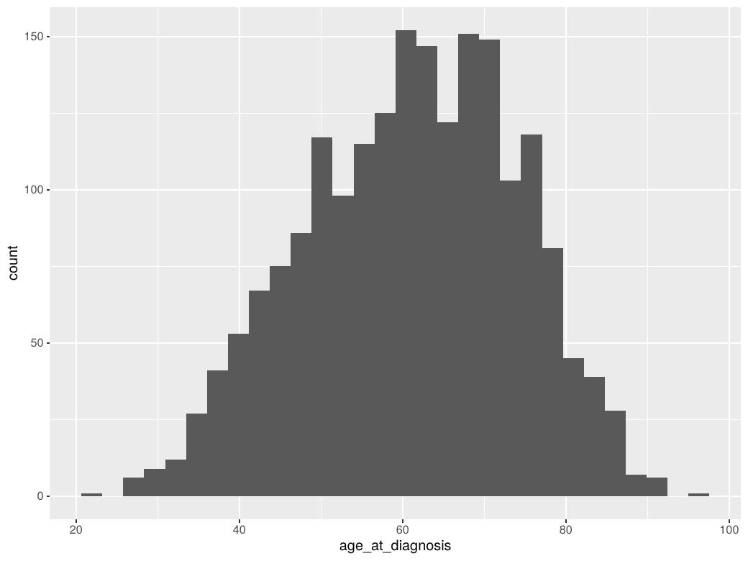
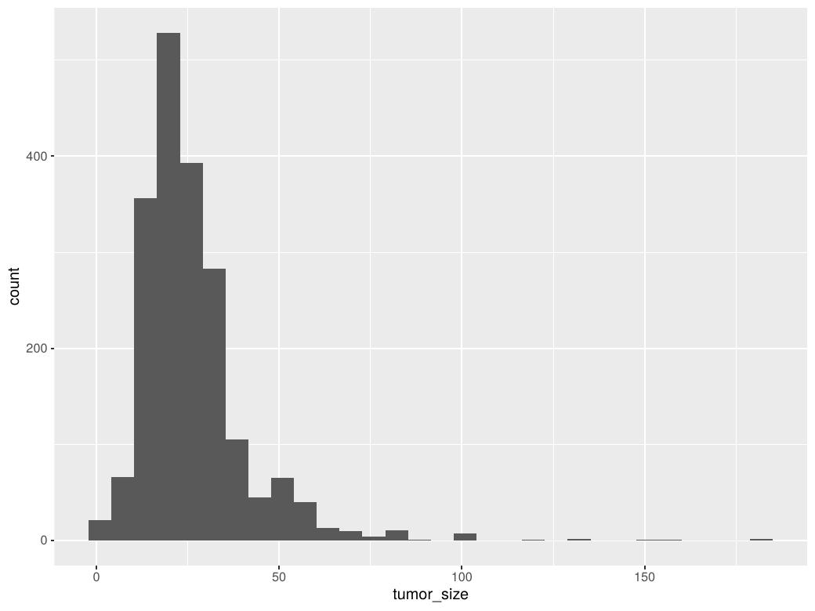
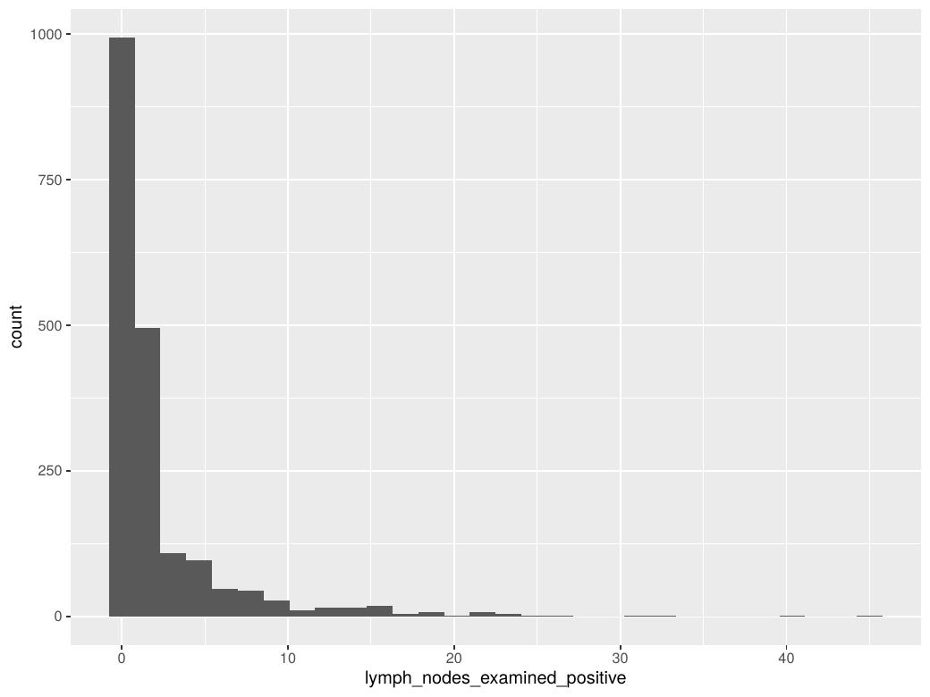
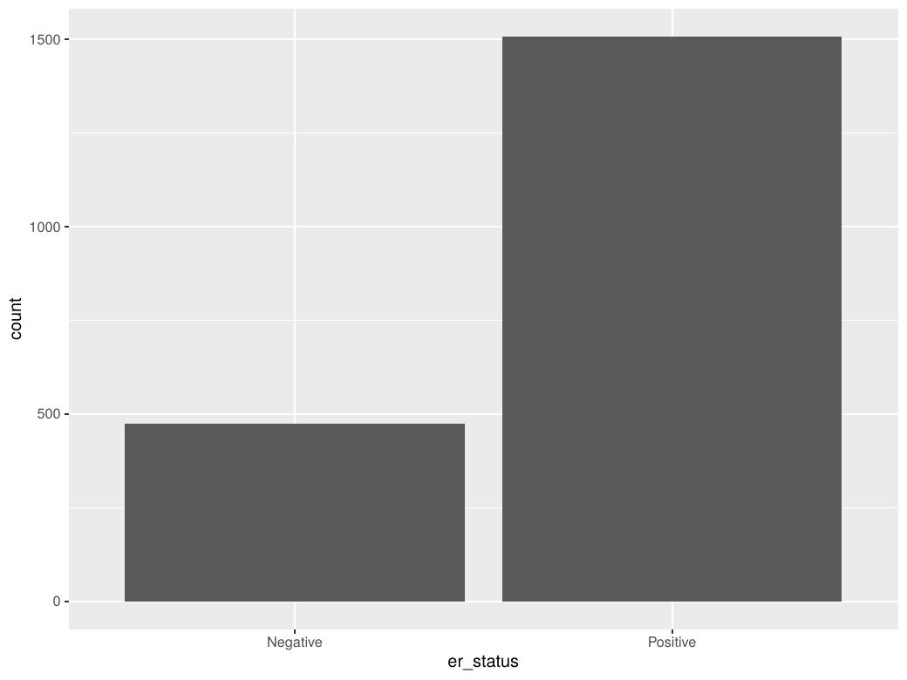
Exploratory Data Analysis
Age Distribution
Tumor Size Distribution
Lymph Nodes Distribution
ER Status (Bar)
Variable
Mean / %
Range / Category
Notes
Age at Diagnosis
61.1 years
21.9 – 96.3
Older patients in majority
Tumor Size
26.3 mm
1 – 182 mm
Right skewed distribution
Lymph Nodes (+ve)
2.0
0 – 45
Most patients: 0 nodes
ER Positive
76.1%
—
Large majority ER+
PR Positive
52.5%
—
About half PR+
HER2 Positive
12.5%
—
Minority HER2+
Tumor Stage II
56.3%
Stage 0–4
Most patients diagnosed at Stage II
Grade 3 (High)
50.3%
Grade 1–3
Half of patients high grade
Notes:
Before any modelling I performed exploratory data analysis. Looking at the distributions: age is roughly normally distributed with a mean of 61 years. Tumor size is right-skewed — most tumors are small but a few are very large. Lymph nodes are heavily right-skewed — the majority of patients had zero positive nodes. For ER status, 76% of patients are ER positive. Most patients were diagnosed at Stage II which is the most common presentation. Importantly, half of all patients had Grade 3 tumors, indicating high-grade cancer in this cohort. The correlation matrix showed that tumor size and lymph nodes have a moderate positive correlation — larger tumors tend to have more lymph node involvement.

Slide 6
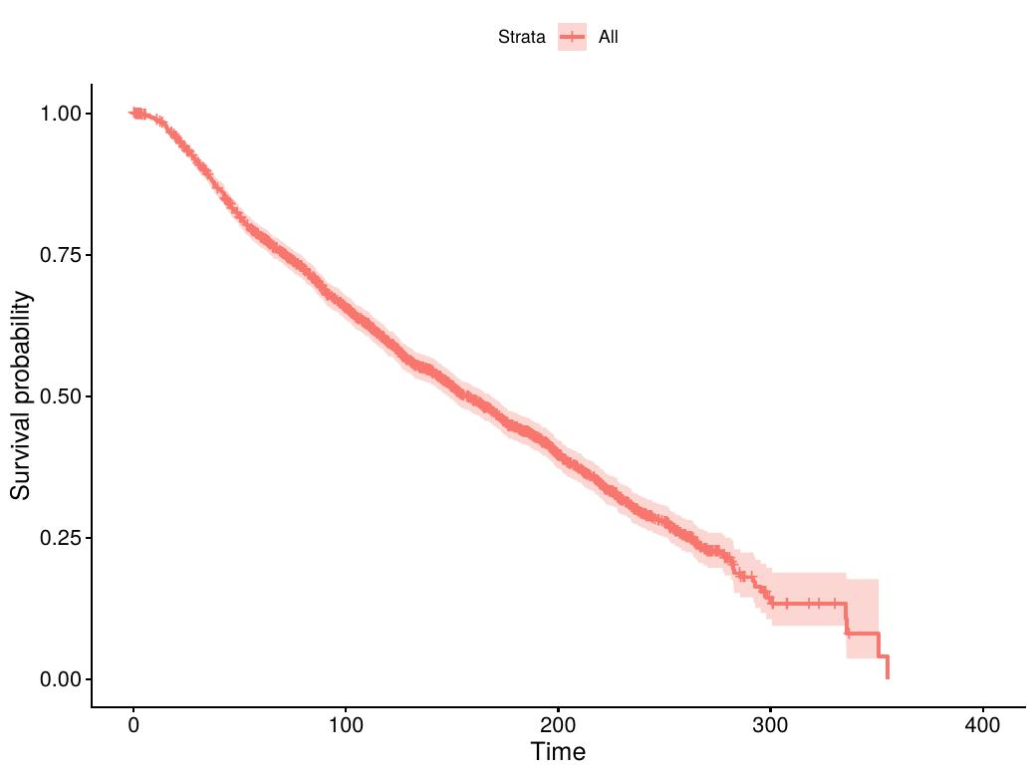
Kaplan–Meier: Overall Survival
All 1,981 METABRIC Patients Combined
Survival Statistics
Median Survival
156 months
95% CI Lower
148 months
95% CI Upper
168 months
Mean Survival
168.8 months
Total Patients
1,981
Deaths
1,144 (57.7%)
Censored
837 (42.3%)
50% of patients survived beyond 156 months — approximately 13 years after diagnosis.
Notes:
This slide shows the overall Kaplan-Meier survival curve for all 1,981 patients combined. The y-axis shows survival probability and the x-axis shows time in months. The curve starts at 1.0 — meaning 100% survival — and declines over time as patients die. The median survival is 156 months, meaning that 50% of patients survived at least 156 months — approximately 13 years. The 95% confidence interval ranges from 148 to 168 months. The small tick marks on the curve are censored observations — patients who were still alive when the study ended. The curve never reaches zero because many patients were still alive at the end of follow-up.

Slide 7
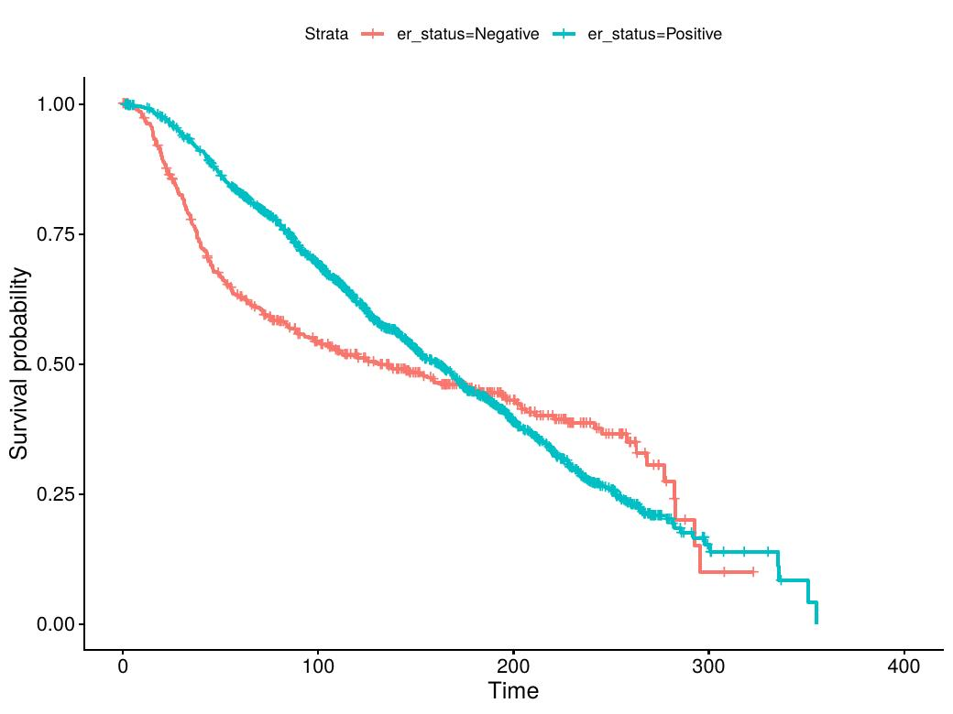
Kaplan–Meier: Survival by ER Status
Log-Rank Test Result
ER Status Results
Group
N
Deaths
ER Negative
474
262 (55%)
ER Positive
1,507
882 (59%)
Log-Rank p = 0.04 ★
HR = 0.862 (95% CI: 0.751–0.990)
Interpretation
▸ ER+ patients have 14% lower hazard (risk) of death than ER− patients
▸ The difference in survival curves is statistically significant (p=0.04)
▸ ER+ tumors respond to hormone therapy, explaining better survival
▸ Effect is relatively modest — curves are close together
Notes:
This slide compares survival between ER negative and ER positive patients. Estrogen Receptor positive patients — shown in blue — have slightly better survival than ER negative patients shown in red. The log-rank test p-value is 0.04 which is statistically significant at the 5% level. The Hazard Ratio from the univariable Cox model is 0.862, meaning ER positive patients have 14% lower risk of death compared to ER negative patients. This makes biological sense — ER positive tumors can be treated with hormone therapy such as tamoxifen, which helps control disease progression. However, the effect is modest and the survival curves are relatively close together.

Slide 8
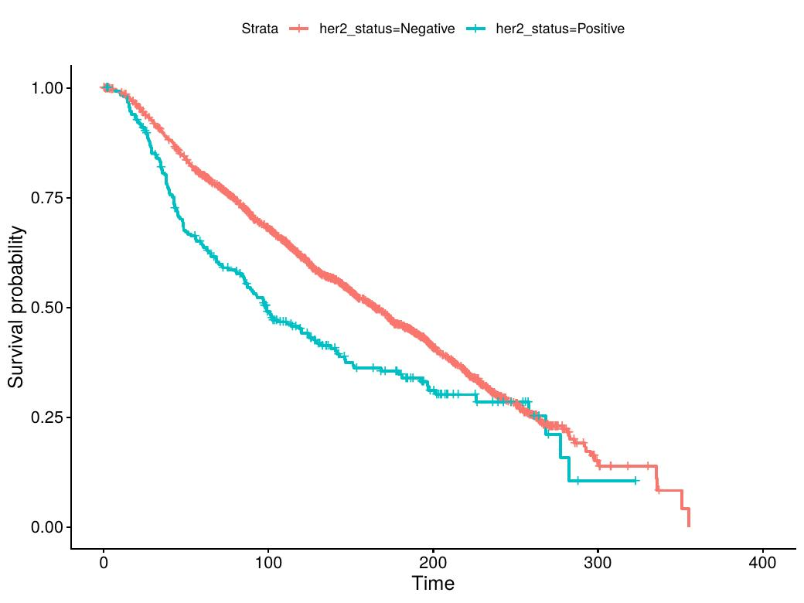
Kaplan–Meier: Survival by HER2 Status
Log-Rank Test Result
HER2 Status Results
Group
N
Deaths
HER2 Negative
1,733
988 (57%)
HER2 Positive
247
155 (63%)
Log-Rank p = 9×10⁻⁶ ★★★
HR = 1.467 (95% CI: 1.238–1.738)
Interpretation
▸ HER2+ patients have 47% higher hazard of death
▸ Highly significant: p < 0.0001
▸ HER2+ tumors are biologically more aggressive
▸ Separation of curves is visible from early follow-up
▸ Remained significant in multivariate model (HR=1.46)
Notes:
This is one of the most striking results in my analysis. HER2 positive patients — shown in red — have substantially worse survival compared to HER2 negative patients. The log-rank p-value is extremely small at 9 times 10 to the power of minus 6, which is highly statistically significant. The Hazard Ratio is 1.467, meaning HER2 positive patients have 47% higher risk of death compared to HER2 negative patients. HER2 positive tumors are known to be biologically aggressive — they grow faster and spread more readily. This result is consistent with the published literature. Importantly, HER2 remained statistically significant in my multivariate model as well, confirming it as an independent risk factor.

Slide 9
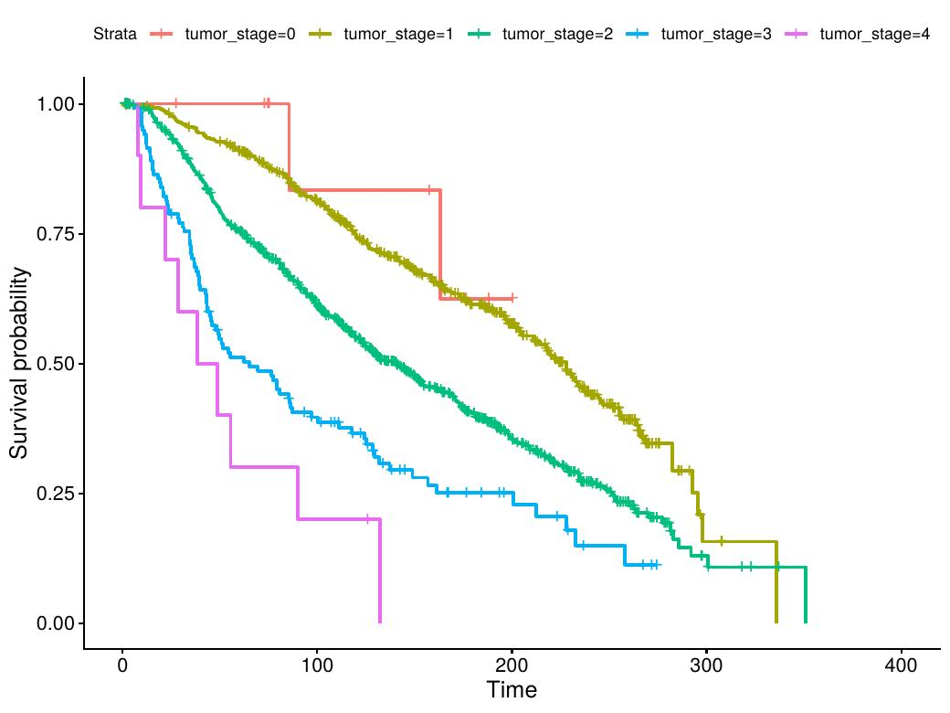
Kaplan–Meier: Survival by Tumor Stage
Log-Rank Test | χ² = 128 | p < 2×10⁻¹⁶
Stage-Wise Results
Stage
N
HR (vs Stage 0)
p
0 (Ref)
12
1.000
—
1
501
1.624
0.495
2
825
2.919
0.131
3
118
5.294
0.020 ★
4
10
10.710
0.002 ★★
χ² = 128 p < 2×10⁻¹⁶ ★★★
Key Finding
▸ Stage IV patients have 10.7× higher risk than Stage 0
▸ Tumor stage is the STRONGEST univariate predictor
Notes:
Tumor stage is the strongest predictor of survival in my analysis. The Kaplan-Meier curves separate dramatically with higher stages showing much worse survival. The log-rank chi-square statistic is 128 with 4 degrees of freedom, giving a p-value below 2 times 10 to the power of minus 16 — essentially zero. Looking at the Hazard Ratios from the Cox model: Stage 3 patients have 5.3 times the risk of death compared to Stage 0, and Stage 4 patients have 10.7 times the risk. This is a massive effect. However, I need to note an important limitation — tumor stage has 515 missing values, which is 26% of the dataset. In the multivariate model, tumor stage lost statistical significance, largely due to this missing data problem and its correlation with other stage-related variables.

Slide 10
Univariable Cox Regression — Risk Factors
Variables Associated with Increased Mortality Risk (HR > 1)
These factors INCREASE the risk of death (Hazard Ratio > 1.0):
Variable
HR
95% CI Lower
95% CI Upper
p-value
Concordance
Interpretation
Age at Diagnosis (per year)
1.036
1.031
1.041
<2×10⁻¹⁶ ★★★
0.588
Each additional year raises risk by 3.6%
Tumor Size (per mm)
1.015
1.012
1.018
<2×10⁻¹⁶ ★★★
0.614
Each mm increase raises risk by 1.5%
Lymph Nodes +ve (per node)
1.067
1.057
1.077
<2×10⁻¹⁶ ★★★
0.606
Each additional node raises risk by 6.7%
HER2 Positive (vs Neg)
1.467
1.238
1.738
9.7×10⁻⁶ ★★★
0.529
HER2+ patients have 47% higher risk
Tumor Stage 4 (vs 0)
10.710
2.313
49.60
0.002 ★★
0.612
Stage IV = over 10× the risk of Stage 0
Histologic Grade 3 (vs 1)
1.644
1.294
2.089
<0.0001 ★★★
0.566
Grade 3 tumors: 64% higher risk vs Grade 1
Chemotherapy Yes (vs No)
1.263
1.090
1.462
0.002 ★★
0.539
Higher risk — but selection bias applies
Hormone Therapy Yes (vs No)
1.266
1.121
1.430
0.0001 ★★★
0.506
Higher risk — selection bias applies
Notes:
This slide presents the univariable Cox regression results for variables that increase mortality risk — that is, with Hazard Ratio greater than 1. A Hazard Ratio means: for every unit increase in the predictor, this is the multiplicative change in the instantaneous risk of death. Age, tumor size, and lymph nodes are all continuous variables, so their HR is per unit. For example, age HR is 1.036, meaning each additional year of age increases the risk of death by 3.6%. Tumor stage is the strongest effect — Stage 4 patients have over 10 times the risk of Stage 0 patients. An important caveat: chemotherapy and hormone therapy both show HR greater than 1, suggesting they are associated with worse survival. But this is a selection bias effect — doctors give these treatments to sicker patients in the first place, so the worse outcome reflects patient severity, not treatment harm.

Slide 11
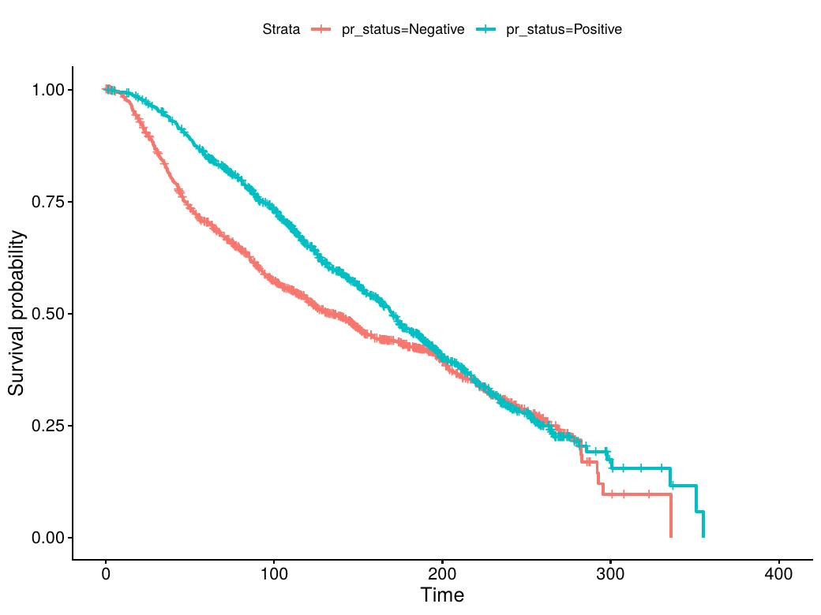
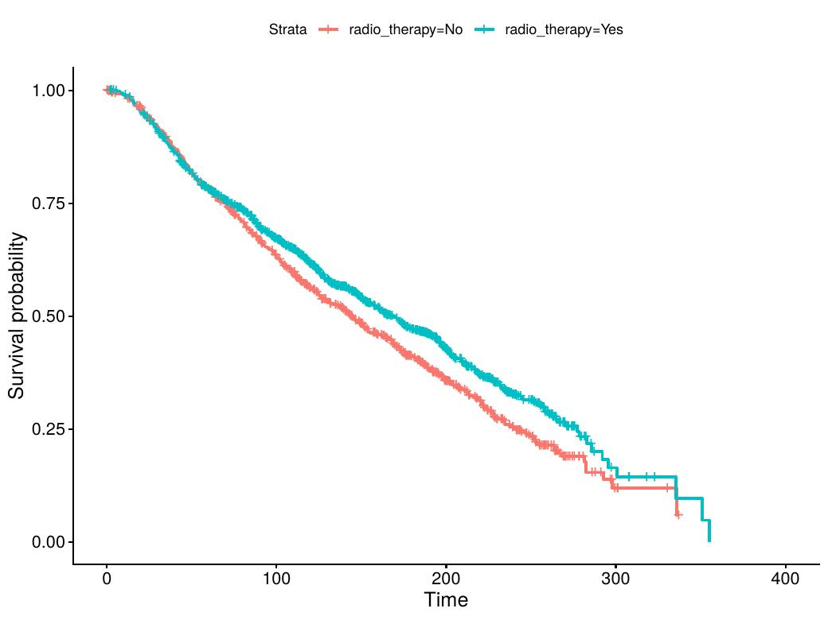
Univariable Cox Regression — Protective Factors
Variables Associated with Reduced Mortality Risk (HR < 1)
These factors DECREASE the risk of death (Hazard Ratio < 1.0):
Variable
HR
95% CI
p-value
Concordance
Clinical Interpretation
ER Positive (vs Negative)
0.862
0.751–0.990
0.035 ★
0.540
ER+ patients have 14% lower risk — respond to hormone therapy
PR Positive (vs Negative)
0.792
0.705–0.890
8.6×10⁻⁵ ★★★
0.554
PR+ patients have 21% lower risk — strongly protective
Radiotherapy Yes (vs No)
0.851
0.757–0.956
0.007 ★★
0.515
Radiotherapy associated with 15% lower mortality risk
PR Status KM Curve (p=8×10⁻⁵)
Radiotherapy KM Curve (p=0.007)
Notes:
Three variables were associated with reduced mortality risk in the univariable Cox models — meaning they are protective factors. First, ER positive status has HR of 0.862 — a 14% reduction in risk. Second, PR positive status has HR of 0.792 — a 21% reduction in risk and is highly significant with p less than 0.0001. Third, radiotherapy is associated with 15% lower mortality risk with HR of 0.851. Looking at the Kaplan-Meier curves on this slide: for PR status you can see the PR positive curve is clearly above the PR negative curve, and for radiotherapy the curves separate from early follow-up. Radiotherapy is the only treatment variable that remained statistically significant in the multivariate model after controlling for all other variables.

Slide 12
Proportional Hazards Assumption Test
Schoenfeld Residuals — cox.zph() in R
What is the PH Assumption? The Cox model assumes that the Hazard Ratio for each variable stays CONSTANT over time — the relative risk between groups does not change as time progresses.
cox.zph() Test Results — Schoenfeld Residuals:
Why Does This Matter?
Variable
χ²
df
p-value
PH Assumption
▸ Most variables violate the PH assumption
Age at Diagnosis
59.50
1
1.2×10⁻¹⁴ ★★★
VIOLATED ✗
Tumor Size
0.272
1
0.602 ✓
Met ✓
▸ This means HR changes over time
Lymph Nodes
3.718
1
0.054
Borderline
▸ Full multivariate model results are unreliable for these variables
Histologic Grade
34.16
2
3.8×10⁻⁸ ★★★
VIOLATED ✗
Tumor Stage
18.17
4
0.001 ★★★
VIOLATED ✗
▸ Therefore I interpret univariable Cox results individually
ER Status
57.08
1
4.2×10⁻¹⁴ ★★★
VIOLATED ✗
▸ In univariable analysis, hormone therapy appears associated with higher mortality, likely due to selection bias. However, in multivariable analysis, hormone therapy shows a protective effect, suggesting confounding in univariable results.
PR Status
28.29
1
1.0×10⁻⁷ ★★★
VIOLATED ✗
HER2 Status
9.070
1
0.003 ★★
VIOLATED ✗
Radiotherapy
1.199
1
0.274 ✓
Met ✓
GLOBAL TEST
133.77
15
< 2×10⁻¹⁶ ★★★
OVERALL VIOLATED
Notes:
This is an important methodological slide. After fitting the multivariate Cox model, I checked the Proportional Hazards assumption using the cox.zph function in R, which is based on Schoenfeld residuals. If the p-value from this test is significant, it means the Hazard Ratio for that variable is not constant over time — the assumption is violated. As you can see from the table, most variables including age, ER status, PR status, HER2 status, grade, and stage all violate the PH assumption. The global test is also highly significant. Only tumor size and radiotherapy satisfy the assumption. This is an important limitation of my analysis. Because of these violations, I focus on interpreting univariable Cox models individually rather than relying entirely on the multivariate model results.

Slide 13
Key Findings & Conclusions
⚠ HER2+ Increases Mortality Risk
📊 Tumor Stage — Strongest Predictor
🔗 Lymph Nodes — Strong Continuous Predictor
HR = 1.47 — HER2 positive patients have 47% higher risk of death. HER2 is an independent prognostic factor.
Stage 4 HR = 10.7 (univariable). Log-rank χ²=128, p<2×10⁻¹⁶. However, 26% missing data limited multivariate interpretation. Strongest categorical signal in the data.
HR = 1.067 per node. Log-rank χ²=205, p<2×10⁻¹⁶. >10 positive nodes associated with dramatically worse survival. Remained significant in multivariate (HR=1.064).
📏 Tumor Size Increases Risk
🛡 ER & PR Positive are Protective
💊 Radiotherapy — Independent Protective Effect
HR = 1.015 per mm (univariable), HR = 1.008 (multivariate). Concordance=0.614. PH assumption was met for tumor size. Larger tumors mean significantly worse prognosis.
ER+ HR=0.862 (p=0.035). PR+ HR=0.792 (p=8.6×10⁻⁵). Both lost significance in multivariate due to mutual confounding. Individually, both are significant protective factors.
HR=0.851 (univariable), adiotherapy was significantly associated with reduced mortality.
Notes:
To summarise my key findings: First, HER2 positivity is the most consistently significant biomarker risk factor — it was significant in both univariable and multivariate Cox models. Second, tumor stage is the strongest individual predictor, with Stage 4 having over 10 times the risk of Stage 0, though missing data is a limitation. Third, lymph nodes are a very strong predictor — more positive nodes mean worse survival. Fourth, tumor size is a significant and reliable predictor — it was the only continuous variable with the PH assumption met. Fifth, ER and PR positive status are protective individually but confound each other in the multivariate model. Sixth, radiotherapy is the only treatment that shows genuine independent protective effect after controlling for all other variables.

Slide 14
Clinical Importance & Practical Implications
How Survival Analysis Helps in Clinical Practice
How This Helps Doctors
Risk Prediction & Research Value
▸ Survival curves help doctors give patients realistic prognosis estimates — e.g., 50% of patients with your profile survived beyond 13 years
▸ Multivariable models can be used to build prognostic scores — ranking patients by predicted risk
▸ Hazard Ratios tell clinicians which factors matter most for prognosis — HER2, tumor size, and lymph nodes are actionable
▸ Concordance of 0.681 in the full model means good discrimination between high and low risk patients
▸ Comparing groups (ER+/ER−) guides treatment selection — ER+ patients are good candidates for hormone therapy
▸ Missing data in tumor stage (26%) highlights need for complete data collection in clinical registries
▸ Radiotherapy's independent survival benefit supports its use in treatment planning
▸ PH assumption violations suggest some risk factors have time-varying effects — motivating extended Cox or stratified models
▸ Stage and grade at diagnosis give immediate prognostic information at point of care
▸ METABRIC results are validated across multiple countries and institutions — findings are generalisable
Notes:
The practical implications of survival analysis extend beyond academic research. In clinical practice, survival curves and hazard ratios help oncologists communicate prognosis to patients, choose between treatment options, and identify which patients need the most aggressive intervention. The hazard ratios I have computed — for example, HER2 positive patients having 47% higher risk — provide clinicians with quantitative risk estimates. The concordance of 0.681 in the multivariate model is a respectable level of predictive accuracy for clinical data. One limitation of this study is the missing data in tumor stage, which reduced the effective sample size in the multivariate analysis and inflated standard errors. Future work could use multiple imputation to address this. Another direction is stratified Cox models or time-varying coefficient models to properly handle the PH assumption violations I identified.

Slide 15
Thank You
Monu Prajapati | MSc Applied Statistics
Survival Analysis of Breast Cancer | METABRIC Dataset
Quick Reference for Examiners
▸ Hazard Ratio (HR): Ratio of the instantaneous rate of death in one group vs another. HR>1 = higher risk; HR<1 = protective
▸ Kaplan–Meier: Non-parametric method to estimate survival probability at each time point, accounting for censored observations
▸ Log-Rank Test: Non-parametric test comparing survival curves between groups. P<0.05 = significant difference
▸ Concordance (C-statistic): Proportion of patient pairs correctly ranked by predicted risk. 0.5=random; 1.0=perfect
Notes:
Thank you for your attention. I am happy to take any questions. For the benefit of examiners, here is a quick glossary of the key statistical terms used in my presentation. A Hazard Ratio greater than 1 means the variable increases the risk of death — for example, HER2 positive patients had HR of 1.467, meaning 47% higher risk. A Hazard Ratio less than 1 means protective — for example, PR positive patients had HR of 0.792, meaning 21% lower risk. Kaplan-Meier curves show survival probability over time accounting for censored observations. The log-rank test compares survival curves between groups. The concordance statistic measures how well the model discriminates between high and low risk patients — my multivariate model achieved 0.681 which is a reasonable level for clinical data. I am ready for questions.

