Slide 1

SOTA OG – Deep Learning Time Series Modelling Results - Technical
Monu Singh

Slide 2

Univariate Time Series Modelling

Slide 3
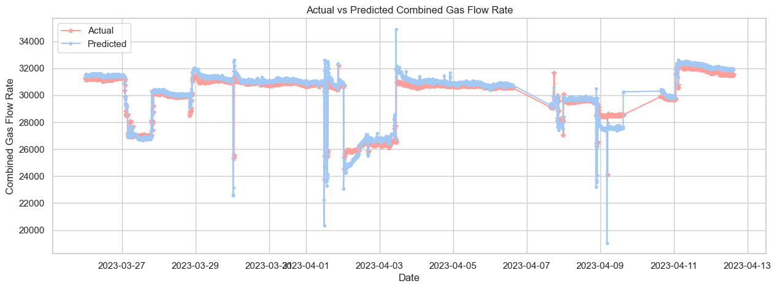
Univariate (Gas Flow Rate) Long Short-Term Memory RNN
Long Short-Term Memory (LSTM) networks are a type of recurrent neural network capable of learning order dependence in sequence prediction problems.
Model is AR(7) i.e. previous 7 time steps take to predict the next steps in rolling window for each of gas flow rate for well-X and well-Y
Model-Gas-Well-X | Metric Type | Metric Score
GRU | R2 Score | 96.09
GRU | RMSE | 182.533
Model-Gas-Well-Y | Metric Type | Metric Score
GRU | R2 Score | 77.81
GRU | RMSE | 742.054

Slide 4
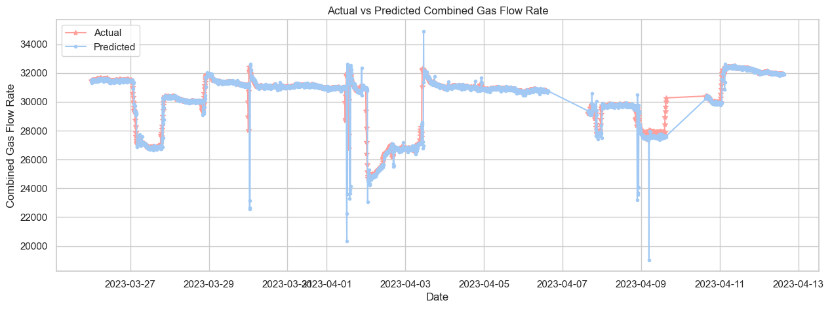
Univariate (Gas Flow Rate) Bidirectional LSTM RNN
A Bidirectional LSTM, or BiLSTM, is a sequence processing model that consists of two LSTMs: one taking the input in a forward direction, and the other in a backwards direction. BiLSTMs effectively increase the amount of information available to the network, improving the context available to the algorithm
Model-Gas-Well-X | Metric Type | Metric Score
GRU | R2 Score | 93.11
GRU | RMSE | 242.51
Model-Gas-Well-Y | Metric Type | Metric Score
GRU | R2 Score | 80.25
GRU | RMSE | 699.97

Slide 5
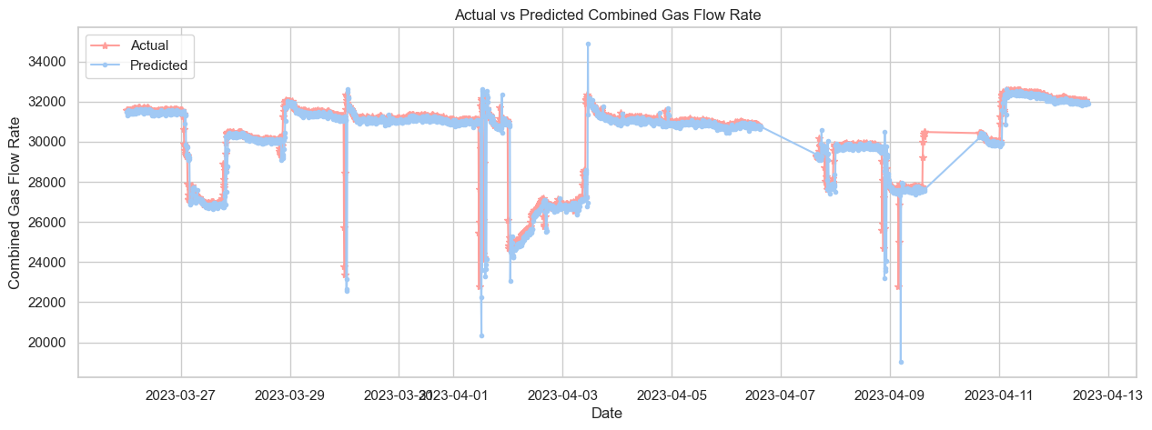
Univariate (Gas Flow Rate) Gated Recurrent Unit Forecasting
GRUs are very similar to Long Short Term Memory(LSTM). GRU uses gates to control the flow of information.
Model is AR(7) i.e. previous 7 time steps take to predict the next steps in rolling window for each of gas flow rate for well-X and well-Y
Model-Gas-Well-X | Metric Type | Metric Score
GRU | R2 Score | 96.69
GRU | RMSE | 168.059
Model-Gas-Well-Y | Metric Type | Metric Score
GRU | R2 Score | 78.36
GRU | RMSE | 732.758

Slide 6
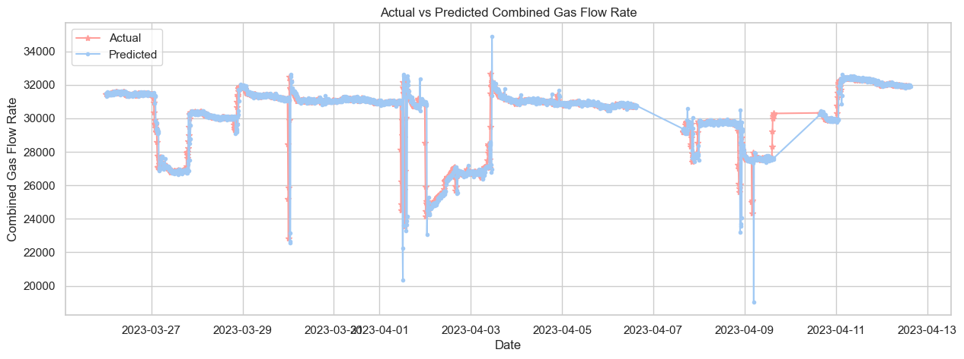
Univariate (Gas Flow Rate) 1D Conv Neural Network
1D Convolutional Neural Networks are similar to well known and more established 2D Convolutional Neural Networks.
The approach of using a 1 x 3 convolution filter is equivalent to training several local auto-regressive models of order three. These local models generate features over short-term subsets of the input time series.
Model-Gas-Well-X | Metric Type | Metric Score
GRU | R2 Score | 95.93
GRU | RMSE | 186.364
Model-Gas-Well-Y | Metric Type | Metric Score
GRU | R2 Score | 81.17
GRU | RMSE | 683.580

Slide 7
Multivariate Time Series Modelling

Slide 8
Multivariate (Gas Flow Rate) LSTM RNN
Long Short-Term Memory (LSTM) networks are a type of recurrent neural network capable of learning order dependence in sequence prediction problems.
All the 7 input features for each gas well are used in this modelling with timestep of 1, i.e. one previous timestep for each sample
Model-Gas-Well-X | Metric Type | Metric Score
GRU | R2 Score | 81.81
GRU | RMSE | 392.582
Model-Gas-Well-Y | Metric Type | Metric Score
GRU | R2 Score | 74.32
GRU | RMSE | 797.07

Slide 9
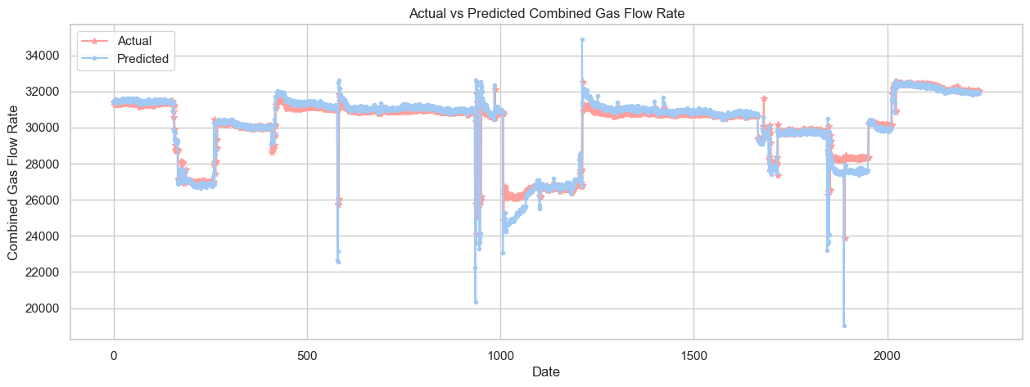
Multivariate (Gas Flow Rate) Bidirectional LSTM RNN
A Bidirectional LSTM, or BiLSTM, is a sequence processing model that consists of two LSTMs: one taking the input in a forward direction, and the other in a backwards direction.
All the 7 input features for each gas well are used in this modelling with timestep of 1, i.e. one previous timestep for each sample
Model-Gas-Well-X | Metric Type | Metric Score
GRU | R2 Score | 89.47
GRU | RMSE | 298.632
Model-Gas-Well-Y | Metric Type | Metric Score
GRU | R2 Score | 78.18
GRU | RMSE | 734.75

Slide 10
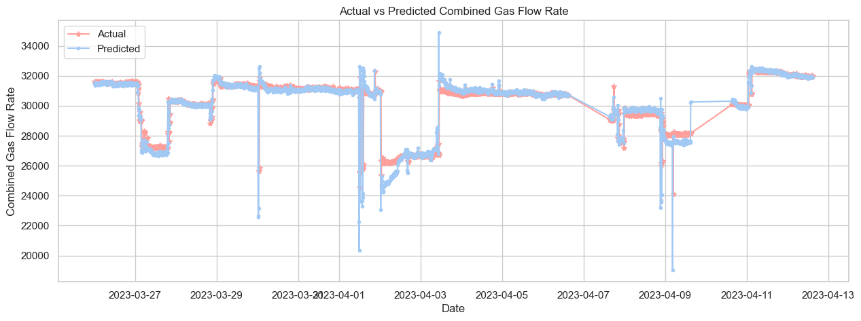
Multivariate (Gas Flow Rate) Gated Recurrent Unit RNN
GRUs are very similar to Long Short Term Memory(LSTM). GRU uses gates to control the flow of information.
All the 7 input features for each gas well are used in this modelling with timestep of 1, i.e. one previous timestep for each sample
Model-Gas-Well-X | Metric Type | Metric Score
GRU | R2 Score | 86.66
GRU | RMSE | 336.265
Model-Gas-Well-Y | Metric Type | Metric Score
GRU | R2 Score | 79.11
GRU | RMSE | 718.901

Slide 11
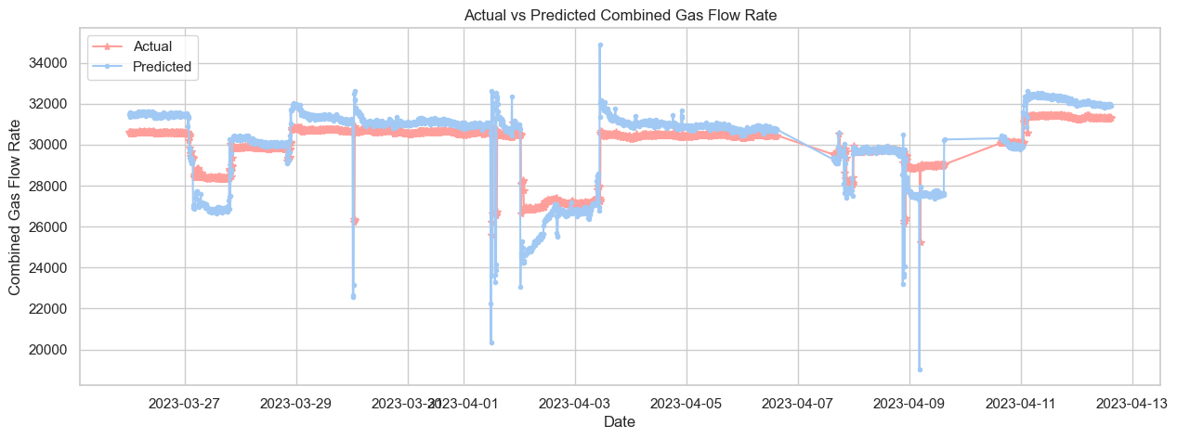
Multivariate (Gas Flow Rate) 1D Conv Neural Network
1D Convolutional Neural Networks are similar to well known and more established 2D Convolutional Neural Networks.
The approach of using a 1 x 3 convolution filter is equivalent to training several local auto-regressive models of order three. These local models generate features over short-term subsets of the input time series.
Model-Gas-Well-X | Metric Type | Metric Score
GRU | R2 Score | 64.14
GRU | RMSE | 551.306
Model-Gas-Well-Y | Metric Type | Metric Score
GRU | R2 Score | 65.12
GRU | RMSE | 928.971

Slide 12

THANK YOU

