Slide 1

2024
User Logs report
2024/06/04

Slide 2
01
Data Description
Time Interval
2023/04/01 – 2023/06/30
Sample
181,978
Rows (3153 sample no timestamp & Function record)
Customer
237
People
Residence
4
Places
User Type
3
Kinds
Function
33
Functions

Slide 3
01
Data Description – missing sample eliminate
Time Interval
2023/04/01 – 2023/06/30
Sample
178,825
Rows
Customer
222
People
Residence
4
Places
User Type
3
Kinds
Function
33
Functions

Slide 4

01
EDA range description
Residence
Function1
Function Name
Usage Date
Function2
User Type
Function3
Users
...
System
The EDA contains two dimension, User & System
Then we can use the main 4 attribute to explore

Slide 5
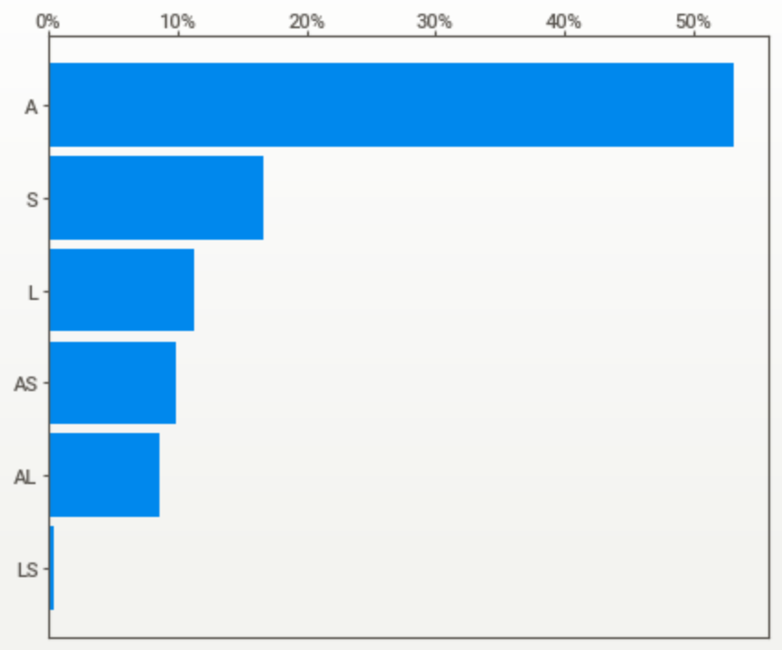
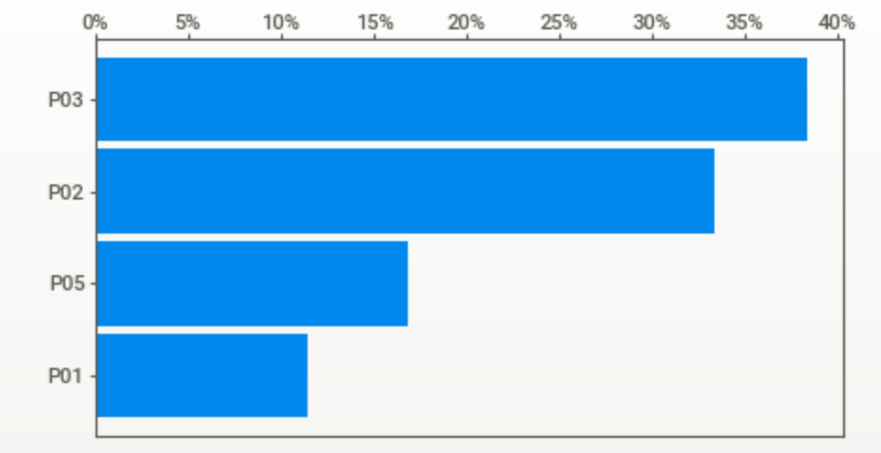
01
Basic EDA with Users - 222 people
0
10%
20%
30%
40%
50%
A
S
“A” Type dominates with 50%
20% People with two type in (AS, AL, LS)
User Type
L
AS
AL
LS
0
10%
20%
30%
40%
P03
P03 Residence dominates
Residence
P02
P01
P05

Slide 6
01
Basic EDA with Users - 222 people
Usage Date
With different topic to show the usage habit

Slide 7
01
Basic EDA with System

Slide 8
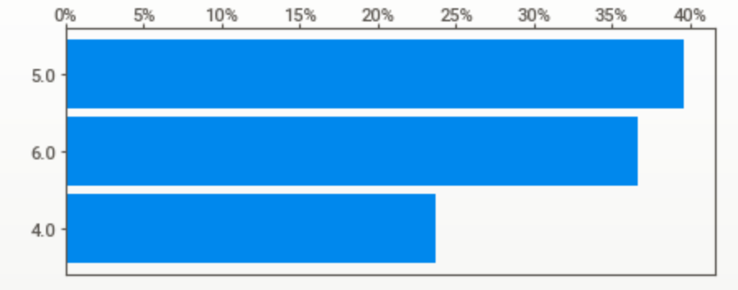
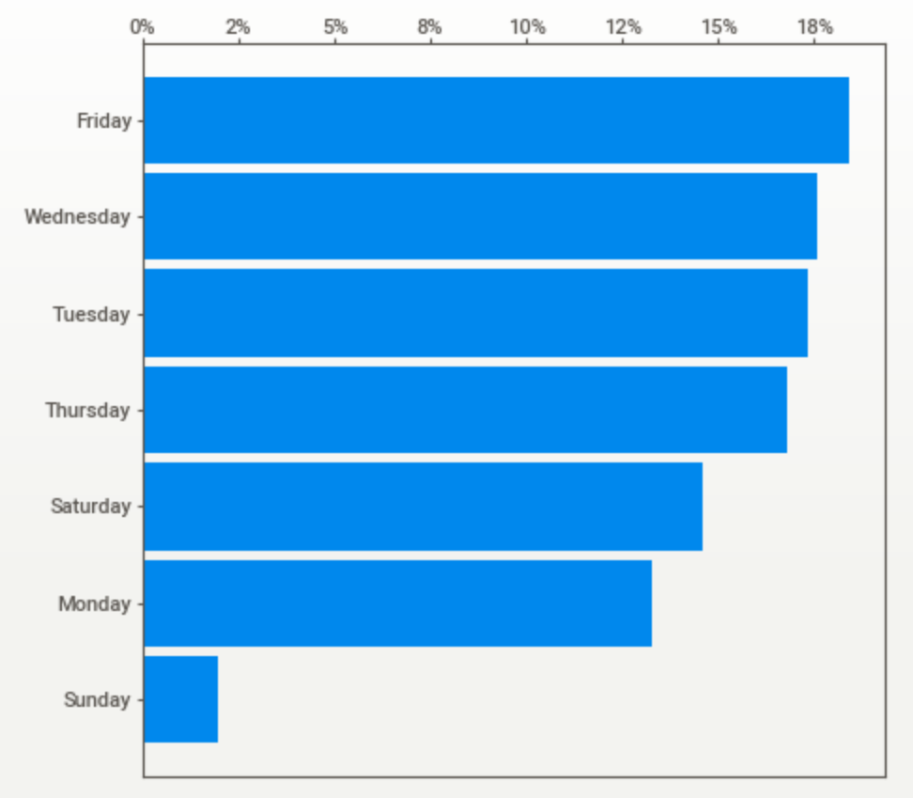
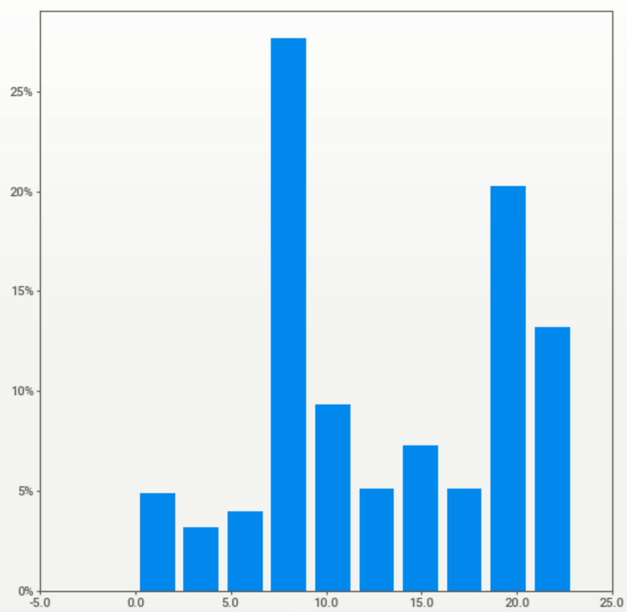
01
Basic EDA
Usage Period
Month
Weekday
Hour

Slide 9
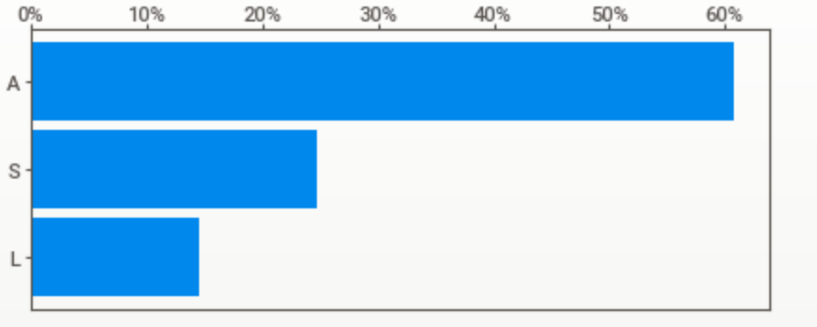
01
Basic EDA
Function Usage

Slide 10



01
Education
Master's degree
National Chengchi University
Department of Management Information Systems
Bachelor's degree
National Central University
Department of Management Information Systems
Count on the education of Department of Management Information Systems
Help me touch the different aspect in Data Science.

Slide 11

02
Experience
Data Scientist
2017/10 – 2020/05
Machine Learning
Automated valuation model
Underwriting robot
Personal risk assessment model
Request form classification
Analytics reports
External customer data (Appier) import and EDA for marketing list
Other reports assigned by manager
Notes:
Graduated from school, I have got a job in CathayLife to be a Data Scientist,
In the first 3 years, I have experience different kind of mission such as analytics, model training and lead a small team.
Make a lot of analyze report to find the insight in the company, and build several AI models for company process automation that improve efficiency and cutdown on labor needs.
In the recent 3 years, when I’ ve make reports, built more and more model, helped members resolve issues in projects , I found something weird that everyone work by themselves, and don’t have a robust process to record information or restructured the programming codes. That means everyone repeating the same tasks, even though cannot understand the code they have written.
So based on the training in the school, My team researched the robust way, management method to avoid those problems.
Since then I dedicated to import the process of MLOps to the machine learning teams. My team analyze the whole process that Data scientists went through, and find the new tool or build our own tool to solve the problem in these processes.
Management tools
Mediawiki
GitLab
Data Team Workbench
Mlops tools
Feature Library (Feature codebase)
Xspace (Features table)
Sqltoflowchart (Data lineage for SAS)
Mlflow (Model Registery)
Jupyter Template (Model Evaluation Template)
Machine Learning Testing Flow (CI/CD)
Great Expectaion (Monitoring)

Slide 12
02
Experience
At the same time, as a team lead with 2 to 3 People
Data Scientist
Advanced Data Scientist
2017/10 – 2020/05
2020/05 – 2021/12
Machine Learning
Automated valuation model
Underwriting robot
Personal risk assessment model
Request form classification
Analytics reports
External customer data (Appier) import and EDA for marketing list
Other reports assigned by manager
Machine Learning (Lead)
Automated property valuation-v2
Loan default model
Call reason prediction model
Underwriting case level model
Analytics reports
Data import across subsidiaries for improve model efficiency
Other reports assigned by manager
Notes:
Graduated from school, I have got a job in CathayLife to be a Data Scientist,
In the first 3 years, I have experience different kind of mission such as analytics, model training and lead a small team.
Make a lot of analyze report to find the insight in the company, and build several AI models for company process automation that improve efficiency and cutdown on labor needs.
In the recent 3 years, when I’ ve make reports, built more and more model, helped members resolve issues in projects , I found something weird that everyone work by themselves, and don’t have a robust process to record information or restructured the programming codes. That means everyone repeating the same tasks, even though cannot understand the code they have written.
So based on the training in the school, My team researched the robust way, management method to avoid those problems.
Since then I dedicated to import the process of MLOps to the machine learning teams. My team analyze the whole process that Data scientists went through, and find the new tool or build our own tool to solve the problem in these processes.
Management tools
Mediawiki
GitLab
Data Team Workbench
Mlops tools
Feature Library (Feature codebase)
Xspace (Features table)
Sqltoflowchart (Data lineage for SAS)
Mlflow (Model Registery)
Jupyter Template (Model Evaluation Template)
Machine Learning Testing Flow (CI/CD)
Great Expectaion (Monitoring)

Slide 13
02
Experience
At the same time, as a team lead with 2 to 3 People
Data Scientist
Advanced Data Scientist
MLOps Engineer
2017/10 – 2020/05
2020/05 – 2021/12
2022/01 – 2024/05
Machine Learning
Automated valuation model
Underwriting robot
Personal risk assessment model
Request form classification
Analytics reports
External customer data (Appier) import and EDA for marketing list
Other reports assigned by manager
Machine Learning (Lead)
Automated property valuation-v2
Loan default model
Call reason prediction model
Underwriting case level model
Analytics reports
Data import across subsidiaries for improve model efficiency
Other reports assigned by manager
Managements Systems (Engineer&Lead)
MediaWiki Build & Teach (Open source)
GitLab Build & Teach (Open source)
Data Team Workbench Build & Teach (Self-built)
MLOps builds (Engineer & Lead)
Feature : Data Linage, Code base, Data Table build
Model : File management, Model Review build
Deploy : Code Reivew, CI/CD process build
Monitor : Data monitor tools Research
Notes:
Graduated from school, I have got a job in CathayLife to be a Data Scientist,
In the first 3 years, I have experience different kind of mission such as analytics, model training and lead a small team.
Make a lot of analyze report to find the insight in the company, and build several AI models for company process automation that improve efficiency and cutdown on labor needs.
In the recent 3 years, when I’ ve make reports, built more and more model, helped members resolve issues in projects , I found something weird that everyone work by themselves, and don’t have a robust process to record information or restructured the programming codes. That means everyone repeating the same tasks, even though cannot understand the code they have written.
So based on the training in the school, My team researched the robust way, management method to avoid those problems.
Since then I dedicated to import the process of MLOps to the machine learning teams. My team analyze the whole process that Data scientists went through, and find the new tool or build our own tool to solve the problem in these processes.
Management tools
Mediawiki
GitLab
Data Team Workbench
Mlops tools
Feature Library (Feature codebase)
Xspace (Features table)
Sqltoflowchart (Data lineage for SAS)
Mlflow (Model Registery)
Jupyter Template (Model Evaluation Template)
Machine Learning Testing Flow (CI/CD)
Great Expectaion (Monitoring)

Slide 14
02
Experience - Skills
At the same time, as a Team Lead with 2 to 3 People
Data Scientist
Advanced Data Scientist
MLOps Engineer
2017/10 – 2020/05
2020/05 – 2021/12
2022/01 – 2024/05
Lightgbm
Xgboost
Shap
Plotly
Word2Vec
Keras,
CNN
Python Programming,
SAS Programming,
Pyspark
Team management,
Project planning
Requirements analysis
Across subsidiaries communication
MLOps
Mlflow
Docker
Linux
Flask API
GitLabRunner
Airflow
LDAP connect
Django
Vuejs
Notes:
Graduated from school, I have got a job in CathayLife to be a Data Scientist,
In the first 3 years, I have experience different kind of mission such as analytics, model training and lead a small team.
Make a lot of analyze report to find the insight in the company, and build several AI models for company process automation that improve efficiency and cutdown on labor needs.
In the recent 3 years, when I’ ve make reports, built more and more model, helped members resolve issues in projects , I found something weird that everyone work by themselves, and don’t have a robust process to record information or restructured the programming codes. That means everyone repeating the same tasks, even though cannot understand the code they have written.
So based on the training in the school, My team researched the robust way, management method to avoid those problems.
Since then I dedicated to import the process of MLOps to the machine learning teams. My team analyze the whole process that Data scientists went through, and find the new tool or build our own tool to solve the problem in these processes.
Management tools
Mediawiki
GitLab
Data Team Workbench
Mlops tools
Feature Library (Feature codebase)
Xspace (Features table)
Sqltoflowchart (Data lineage for SAS)
Mlflow (Model Registery)
Jupyter Template (Model Evaluation Template)
Machine Learning Testing Flow (CI/CD)
Great Expectaion (Monitoring)

Slide 15



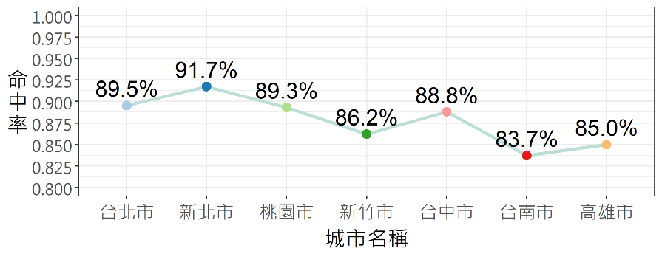



03
Projects – ML : Automated property valuation model
Property Info
GIS POI
Average with 85% hit rate (+-10%)
Feature engineering
AVM
Similiarity house
True Price Model
Model Method
Train Sample(5 Fold Valid)
Segment
XGBoost
2017-2020/10
Municipality + Hsinchu
Test Sample
2020/11 – 2020/12
1. Sample : The Consumer Banking Propery price evaluated by real people：27,398
2. Property type Limited：Apartment、Apartment complex with elevator

Slide 16










03
Projects – ML : Personal risk assessment model
High
Customer Info
R
I
S
K
V
A
L
U
E
Product record
Average * 254%
Risk Model with Bank Info
Deposit Info
Average * 23 %
Credict Card Info
Model Method
Validation Sample
Segment
Low
(ex: male in age 35-39)
XGBoost+ensemble
2018y sample / 5-fold
Gender
Using bank and transaction data, an algorithm predicts customers' personal risk rankings.
Customers of the same gender and age are split into different groups.
In marketing , focusing on the low risk group is the most important target.

Slide 17







03
Projects – MLops Engineer
All serving by docker container
Mediawiki & GitLab is opensource
Workbench is self-built system with Django and Vuejs
Mediawiki
GitLab
Data team Workbench
Property for project
Domain Knowledge
Code documents
Project documents
Feature Engineering
Model
Training
Model
Evaluation
Model
Deployment
Monitoring
Data lineage (for SAS code)
Model Registry
CI/CD Process
Data quality
monitoring
All Tool was built as a container service for data scientist using
Teach all data scientist and implement them in existing process
Feature Codebase
Evaluation Template
Features table
Self-built Tool (Python, Django, mermaid)
Runner with
Flask deployment
Pyspark in Hadoop
Mlflow built by docker
Notes:
So based on the training in the school, My team researched the robust way, management method to avoid those problems.
Since then I dedicated to import the process of MLOps to the machine learning teams. My team analyze the whole process that Data scientists went through, and find the new tool or build our own tool to solve the problem in these processes.
Management tools
Mediawiki
GitLab
Data Team Workbench
Mlops tools
Feature Library (Feature codebase)
Xspace (Features table)
Sqltoflowchart (Data lineage for SAS)
Mlflow (Model Registery)
Jupyter Template (Model Evaluation Template)
Machine Learning Testing Flow (CI/CD)
Great Expectaion (Monitoring)

Slide 18
Thanks for your listening

Slide 19
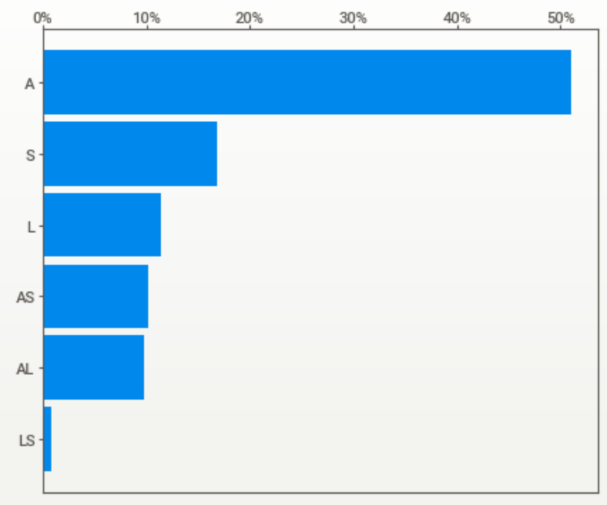
01
Basic EDA with Users - 237 people
A
S
“A” Type dominates with 50%
20% People with two type in (AS, AL, LS)
User Type
L
AS
AL
LS
P03
P03 Residence dominates
Residence
P02
P01
P05

