Slide 1
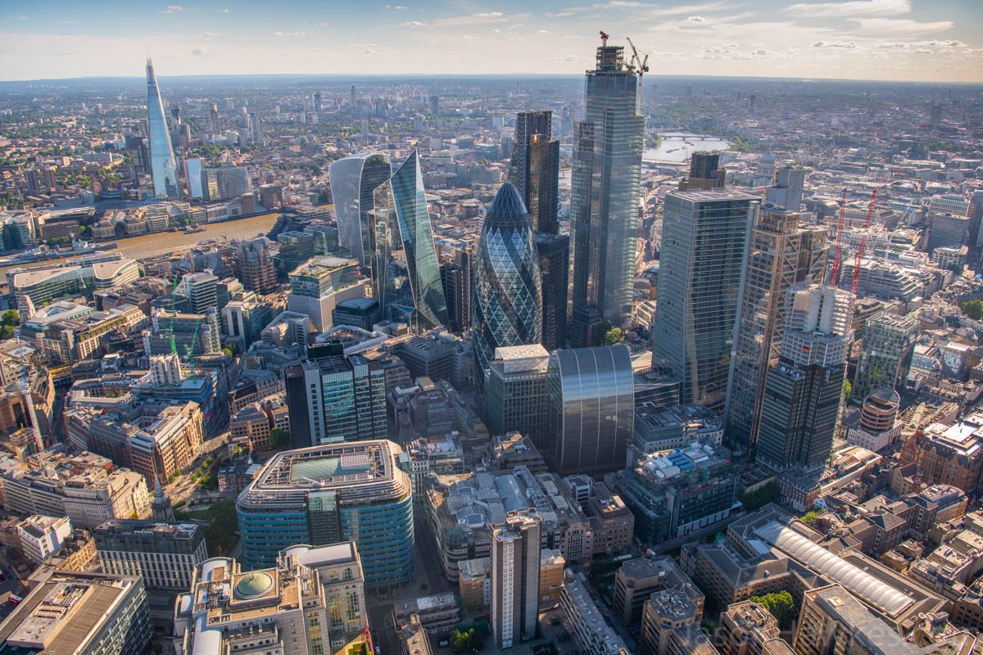
2024
User Logs report
2024/06/04

Slide 2

01
Description & Basic EDA
AGENDA
02
Customer Segment
03
Function Usage

Slide 3
PART
Description & Basic EDA
01

Slide 4
01
Data Description
Time Interval
2023/04/01 – 2023/06/30
Sample
181,978
Rows (3153 sample no timestamp & Function record)
Customer
237
People
Residence
4
Places
User Type
3
Kinds
Function
33
Functions

Slide 5
01
Data Description – missing sample eliminate
Time Interval
2023/04/01 – 2023/06/30
Sample
178,825
Rows
Customer
222
People
Residence
4
Places
User Type
3
Kinds
Function
33
Functions

Slide 6

01
EDA range description
Residence
Function1
Function Name
Usage Date
Function2
User Type
Function3
Users
...
System
The EDA contains two dimension, User & System
Then we can use the main 4 attribute to explore

Slide 7
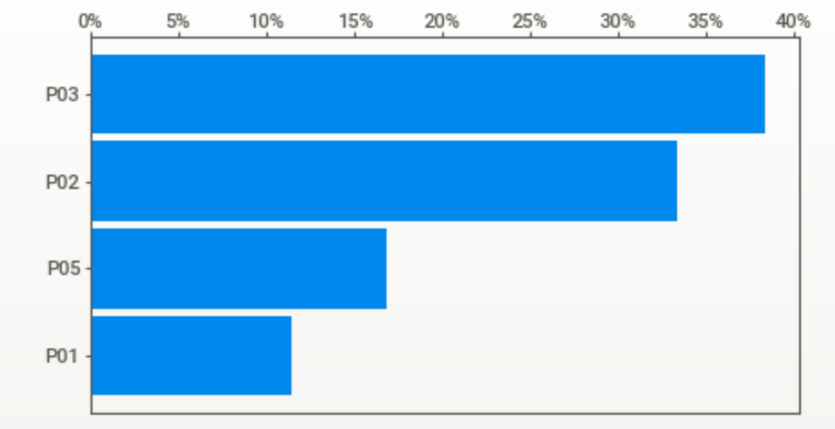
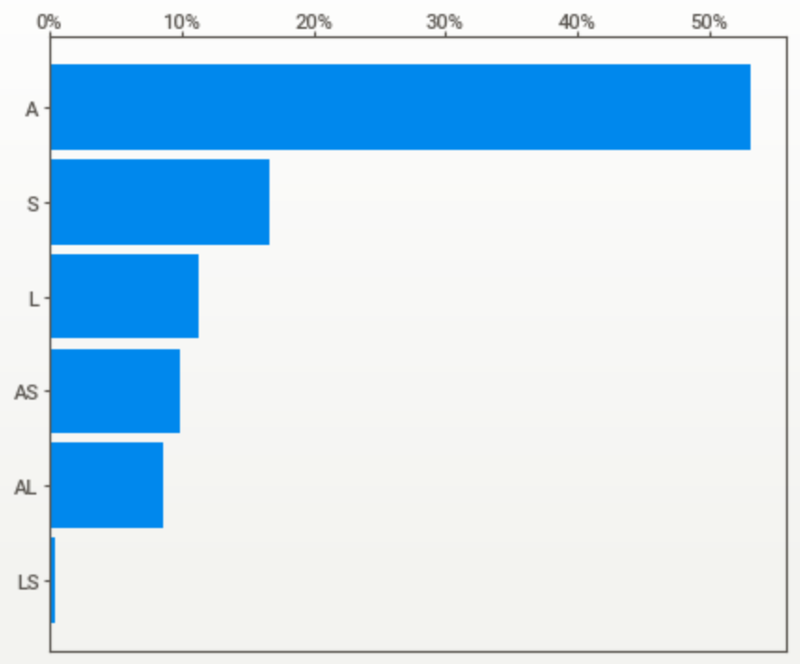
02
Basic EDA with Users - 222 customer
Ratio
0
10%
20%
30%
40%
P03
P03 Residence dominates
Residence
P02
P01
P05
Ratio
0
10%
20%
30%
40%
50%
A
S
“A” Type dominates with 50%
20% People with two type in (AS, AL, LS)
User Type
L
AS
AL
LS

Slide 8
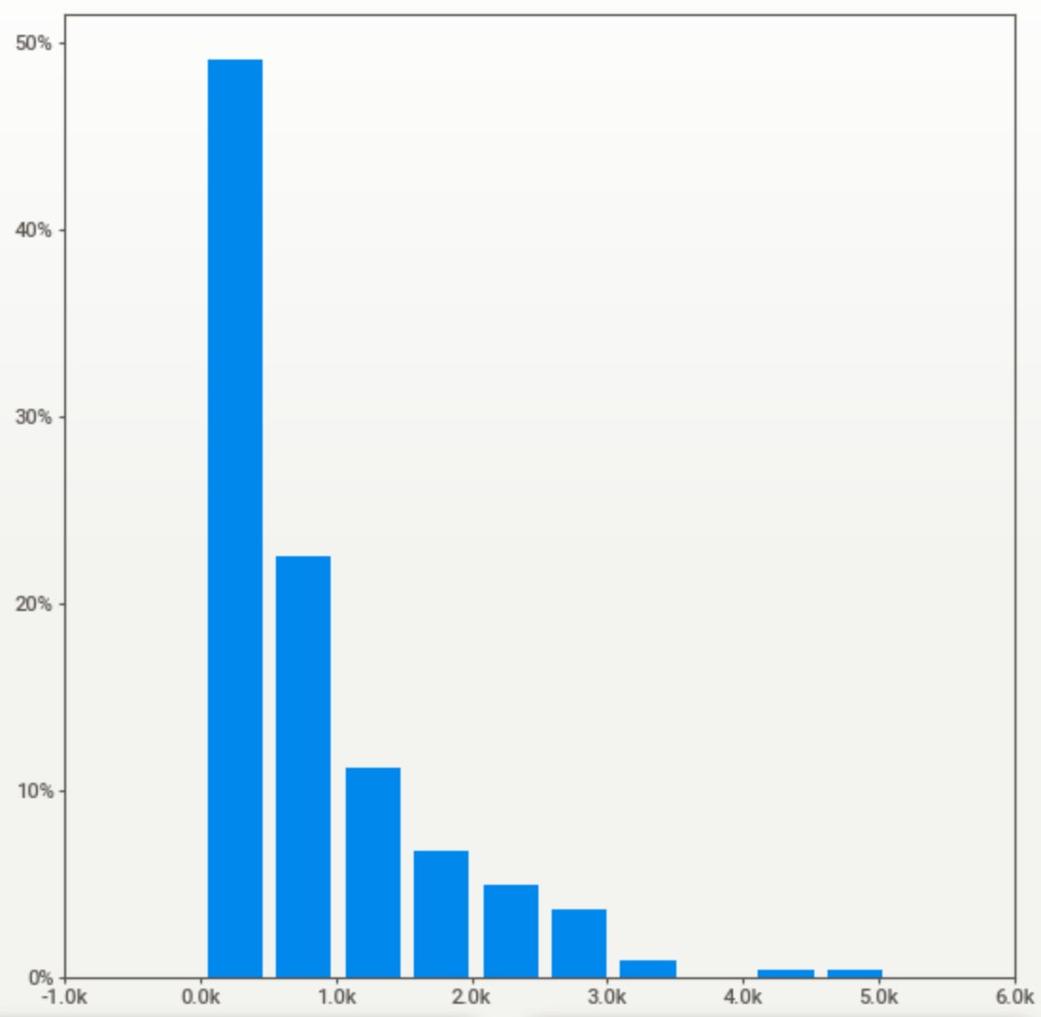
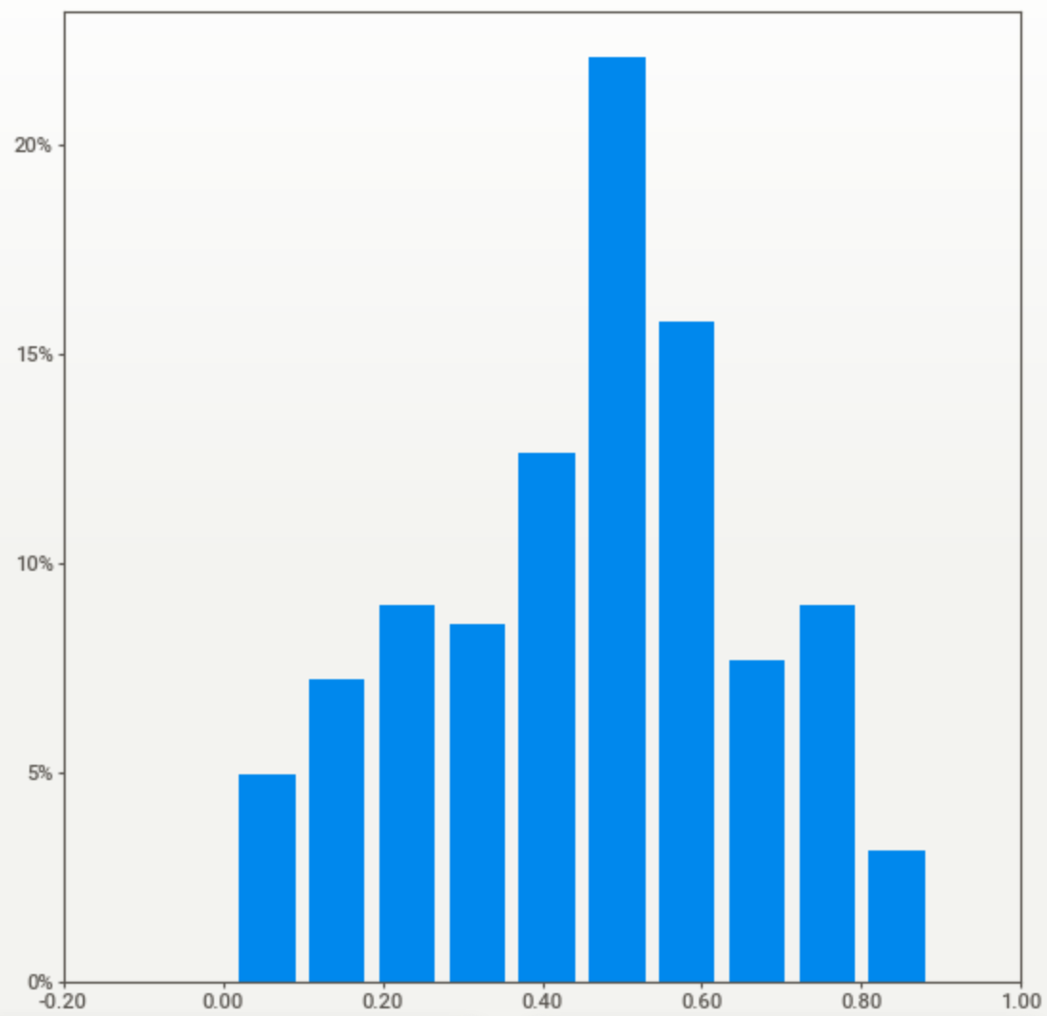
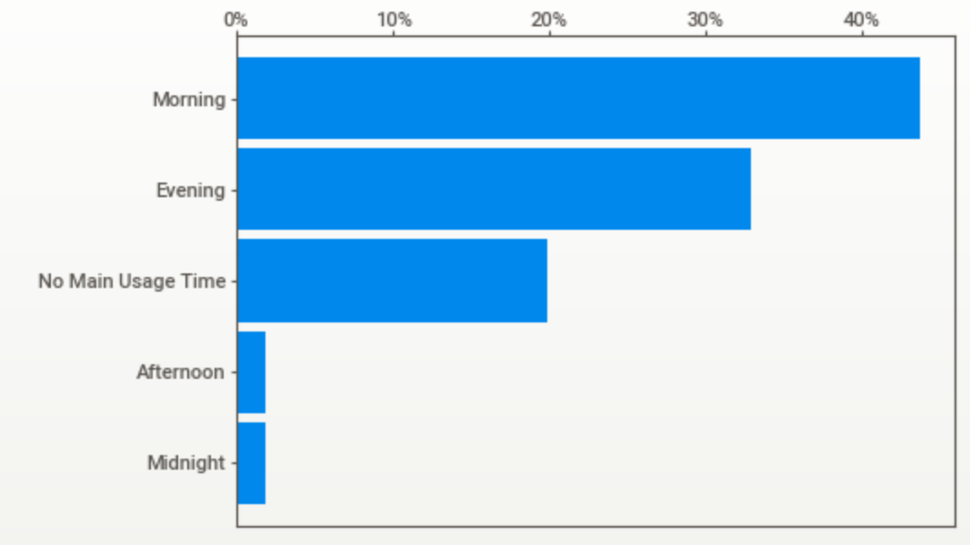
02
Basic EDA with Users - 222 Customer
Usage Date
With different topic to show the usage habit
Function
Total Usage Number
System Using Proportion
(Calculated by how many day use system)
Main usage Time (Over 50%)
Ratio
Ratio
Ratio
50%
20%
40%
Morning 6-12
Afternoon 12-18
Evening 18-24
Midnight 0-6
40%
30%
15%
30%
20%
10%
20%
10%
5%
10%
0k
1k
2k
3k
4k
5k
Use times
Using propotion
Morning
Evening
Afternoon
Time Slot
0
0.2
0.4
0.6
0.8
No main usage
Midnight
In 2023/04/01 – 2023/06/30
About 80% user is using under 1k times
Some special user use over 4k times
On this system.
In 2023/04/01 – 2023/06/30
Most of people have been use this system over half of the days.
Most user use this system in the morning,
followed by the evening.

Slide 9
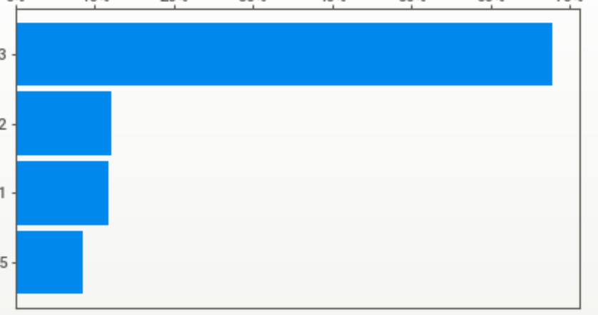
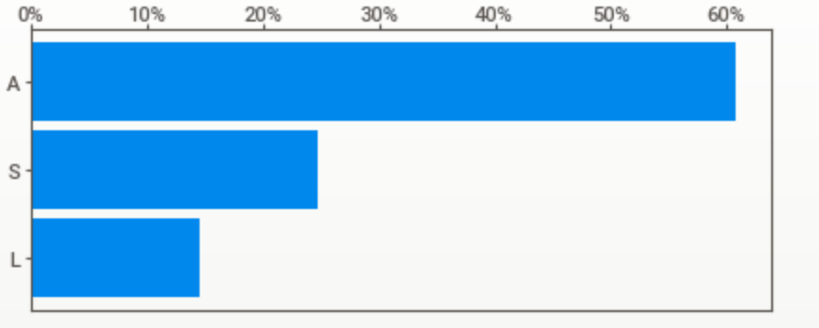
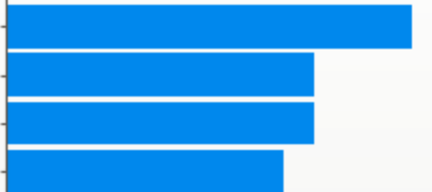
03
Basic EDA with System - 178,825 function calling
Ratio
0%
10%
20%
30%
40%
50%
60%
70%
P03
P03 Residence dominates and the proportion is larger than customer distribution.
Residence
P02
P01
P05
Ratio
0%
10%
20%
30%
40%
50%
60%
“A” Type dominates over 60%
User Type
A
S
L
0
2%
5%
8%
10%
“F13” function was called mostly, followed by “F14” function
F13
Function Call
F14
F02
F07

Slide 10
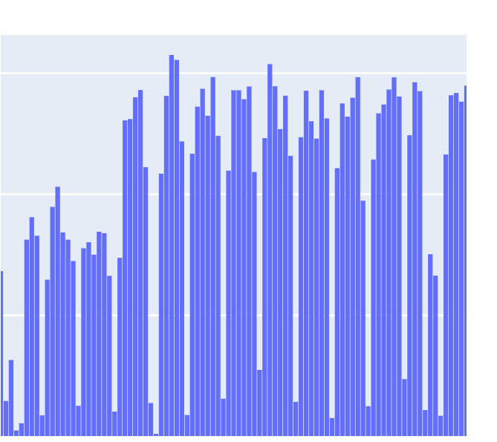
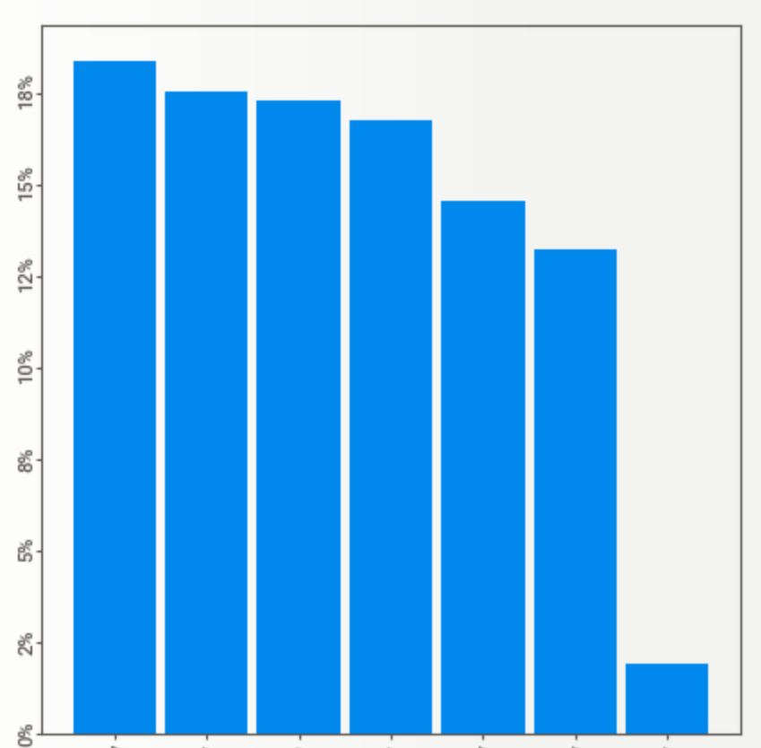
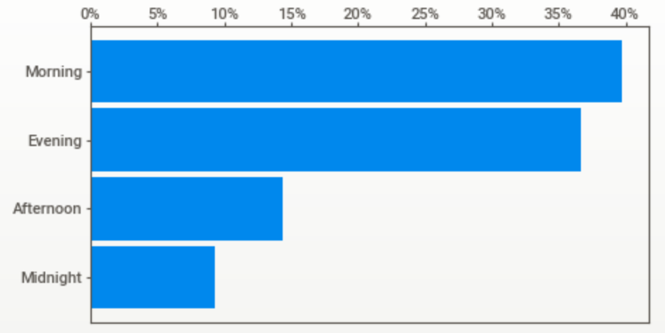
03
Basic EDA with System - 178,825 function calling
Usage Date
With different topic to show the usage habit, in system dimension.
Usage date distribution
Main usage weekday
Main usage Time (Over 50%)
Calling count
Ratio
Ratio
40%
3K
Morning 6-12
Afternoon 12-18
Evening 18-24
Midnight 0-6
15%
30%
2K
10%
20%
1K
5%
10%
Apr
May
Jun
Month
0%
Weekday
0%
Time Slot
Thursday
Monday
Sunday
Morning
Evening
Afternoon
Midnight
Wednesday
Saturday
Friday
Tuesday
From the April to June, the number of
function calling is raising.
From Monday to Saturday, the usage
is nearly the same, but it is significantly
lower on Sunday.
System most be called in the morning,
followed by the evening.

Slide 11






03
Briefly conclusion
Users
Functions
P03
P03 x 2
P03 is greater than others
Morning
Using Half of the days
P03 majority
F13
Rest day
Most people is mainly using the system in the morning
In the logs, Most people is mainly using the system for half of the days.
The majority of usage comes from the P03 area.
F13 is the most frequently used feature.
The usage on Sunday is only 1/10th compared to other days
Users in the P03 area use the system 2 times more than users in other areas.

Slide 12
PART
Customer Segment
02

Slide 13


01
Customer segment attribute
Customer stickiness
Function usage number
Investigate the day that the customer use in the time interval 2023/04/01 – 2023/06/30.
Using the proportion as an indicator.
Investigate the functions that the customer use in the time interval 2023/04/01 – 2023/06/30.
Using the function usage number as an indicator .

Slide 14
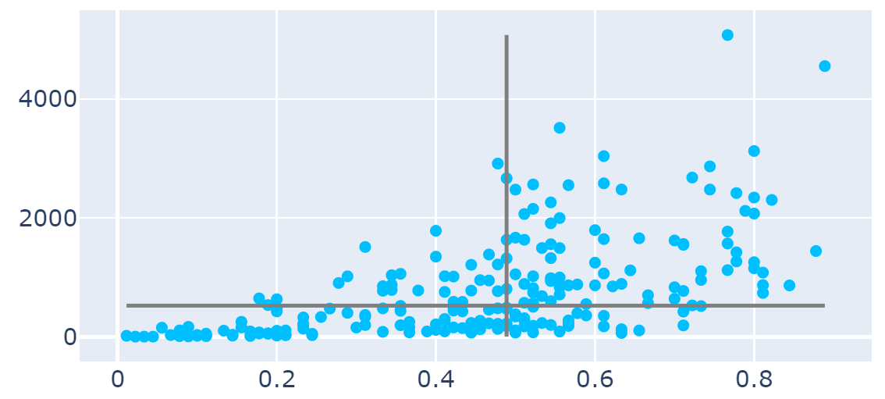
01
Customer segment attribute
Function usage
number
526
0.5
Customer stickiness
Segmenting customers based on the median of “Customer stickiness” (0.5 usage proportion)& median of “Function usage breadth” (20 function usage)

Slide 15
02
Customer segment Group
Occasional user (32)
Heavy User (79)
Function usage
number
526
Normal User (85)
Casual User(26)
0.5
Customer stickiness
Segment the users to 4 Groups , and we can observe that the normal user and heavy user make up the majority.

Slide 16
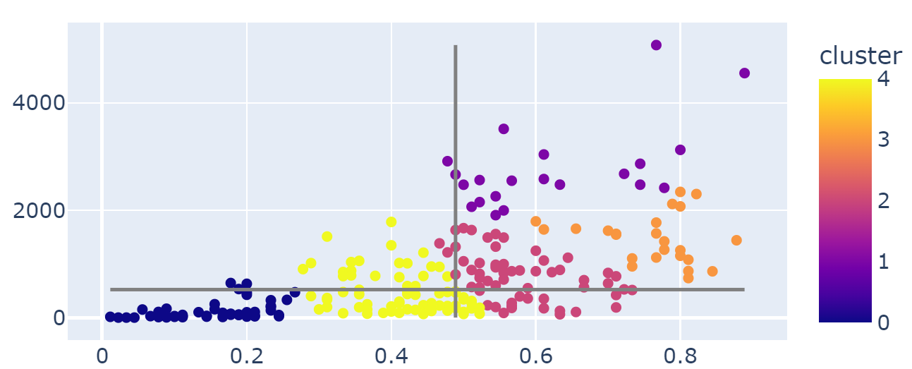
02
Customer segment Group – K means cluster
Function usage
number
526
0.5
Customer stickiness
To fit the 4 dimension segment that have built before.
Try different group number, and finally determine the 5 group cluster.

Slide 17
02
Customer segment Group – K means Adjusted
Heavy User (21)
Function usage
number
Today we’ll focus on this group.
Normal user (72)
Sticky User(24)
Infrequent user(47)
526
Casual User(26)
0.5
Customer stickiness
The new grouped we can segment to 5 groups. And based on high customer stickiness, segment the users to 3 different group.
In low customer stickiness, segment the users to 2 group and mark new group “Infrequent User” .

Slide 18
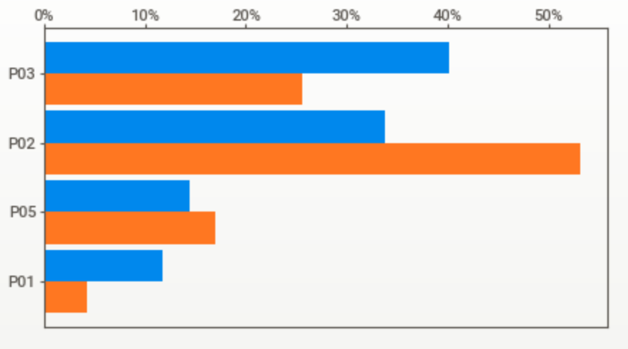
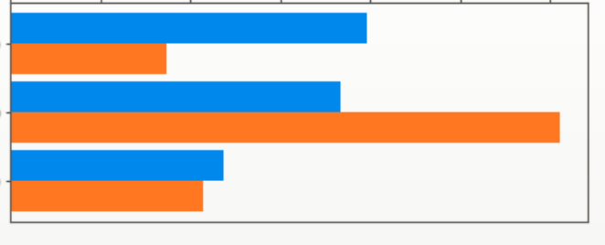
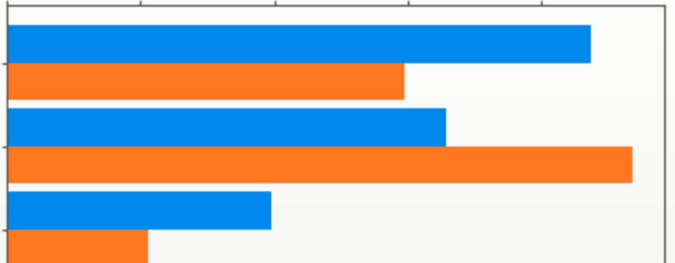
03
Infrequent user
All user
Infrequent user
Ratio
0
10%
20%
30%
40%
50%
P02 Residence dominates About 50% infrequent user live in P02.
P03
Residence
P02
P05
P01
Ratio
0
10%
20%
30%
40%
50%
60%
The functions is about 60% be called at June.
With this sign, maybe contains some new customers.
Function Calling at month
May
Jun
APR
0%
10%
20%
30%
40%
Compared to all users, low-frequency users are more likely to use the system in the evening.
Usage Time slot
Morning
Evening
No main
15

Slide 19

03
Infrequent user – Marketing Strategy
Location
Time
Target
+
+
P02
Evening
New Customer
Strategy 1 :
Host some limited-time evening events in P02, offering rewards to attract customer usage.
Host New customer events, help them rapidly transfer
to Normal user.
Strategy 2 :

Slide 20
PART
Function
Usage
03

Slide 21
Strategy1
01
Function usage - Strategy
F13 function enhancing and redirecting
Could make some program focus on how to make this function stable for using.
Try to redirect customer to other new function or low call frequency function such as F33
Functions
Strategy2
Maintenance days and major update days
P03 x 2
Maintenance can set on the Sunday to avoid impact too many people.
P03 is greater than others
F13
Rest day
Strategy3
F13 is the most frequently used feature.
The usage on Sunday is only 1/10th compared to other days
Users in the P03 area use the system 2 times more than users in other areas.
Network traffic expansion in the P03 area
Most of request come from P03, for the stability and user experience, expanding the network traffic is important.

Slide 22
Thanks for your listening

Slide 23
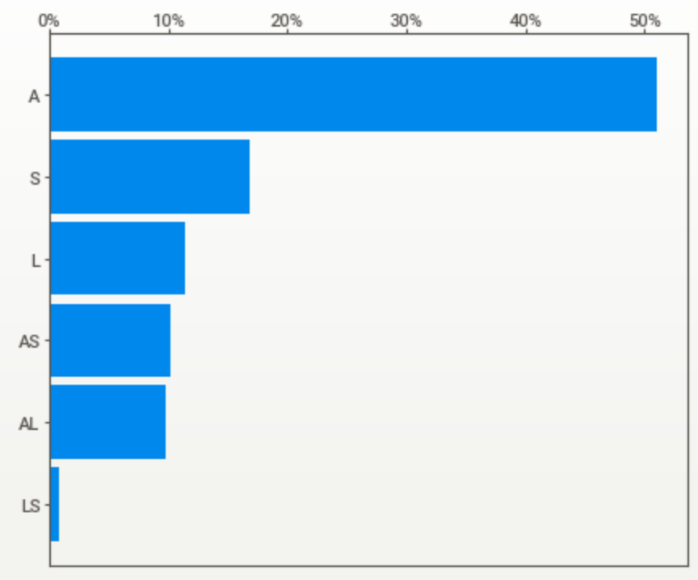
01
Basic EDA with Users - 237 people
A
S
“A” Type dominates with 50%
20% People with two type in (AS, AL, LS)
User Type
L
AS
AL
LS
P03
P03 Residence dominates
Residence
P02
P01
P05

