Slide 1
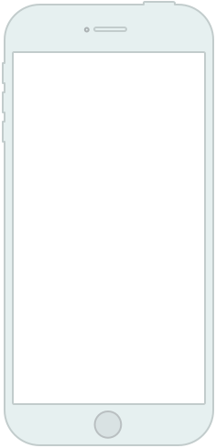
Welcome to
Moodle
iOS Wireframes
Login
Moodle-Name
logo
username
••••••••
?

Slide 2
Title of Page
Changes per page
Login
Moodle-Name
Name of Product
This will change to whatever we name it
Logo
Similar to Blackboard®, we are creating our own logo
logo
Username
Provided from schools to student
username
Username
Provided from schools to student
••••••••
Login
Upon success, change screen to Dashboard
?
Help
Loads an offline help menu, which contains a variety of topics about both the system and the app.

Slide 3

Title of Page
Changes per page
Help
logo
Back Button
Takes you to the previous page
Contact Us
Opens a new email to the support email address,
Or, in-app support via database
Welcome
Welcome to our Moodle App! We are very proud to offer a clean, intuitive experience for you to view your course content, grades and connect with your instructors and peers.
For popular help topics, please select an item below. If you do not see an item listed, please search or forum or Contact Us for further help.
How To
How to use Help menu
List of Topics
List of top 8 topics viewed
Topic 1
Topic 2
Topic 3
Topic 4
Topic 5
Topic 6
Animation Notes:
The top navigation bar will animate to a smaller height
The back button and contact button will “roll” or slide in from the sides
The logo icon moves up with the navigation bar
Everything below the logo will animate up from the bottom
Topic 7
Topic 8

