Slide 1
Moodle Grading App
Senior Project: Final Presentation
Developers: Emily Costa & Michael Sisko
Advisor: Victor Norman

Slide 2
Project Overview
Problem:
Moodle’s grading interface is inefficient
Grading is time consuming and redundant
Graders must edit in Moodle or download CSV file
Solution:
Custom feedback
Globally reflected changes
Display grade statistics
Notes:
Grading is already a time consuming and redundant task, and Moodle’s user interface doesn’t aid in making the grading process more efficient.
When you grade on Moodle you can either enter the feedback directly into Moodle’s web page or download a CSV file, edit/enter the feedback into the csv file, and then reupload it
One issue with both of these methods is that the feedback has to be manually entered each time, and the same feedback is often repeated on numerous student submissions.
Another issue, when entering feedback into the CSV file, is that you have to fit all the feedback into one line in a single cell. And, if a grader decides to change the number of points taken off for a specific mistake, they have to manually go back and change all of the scores for that specific mistake

Slide 3
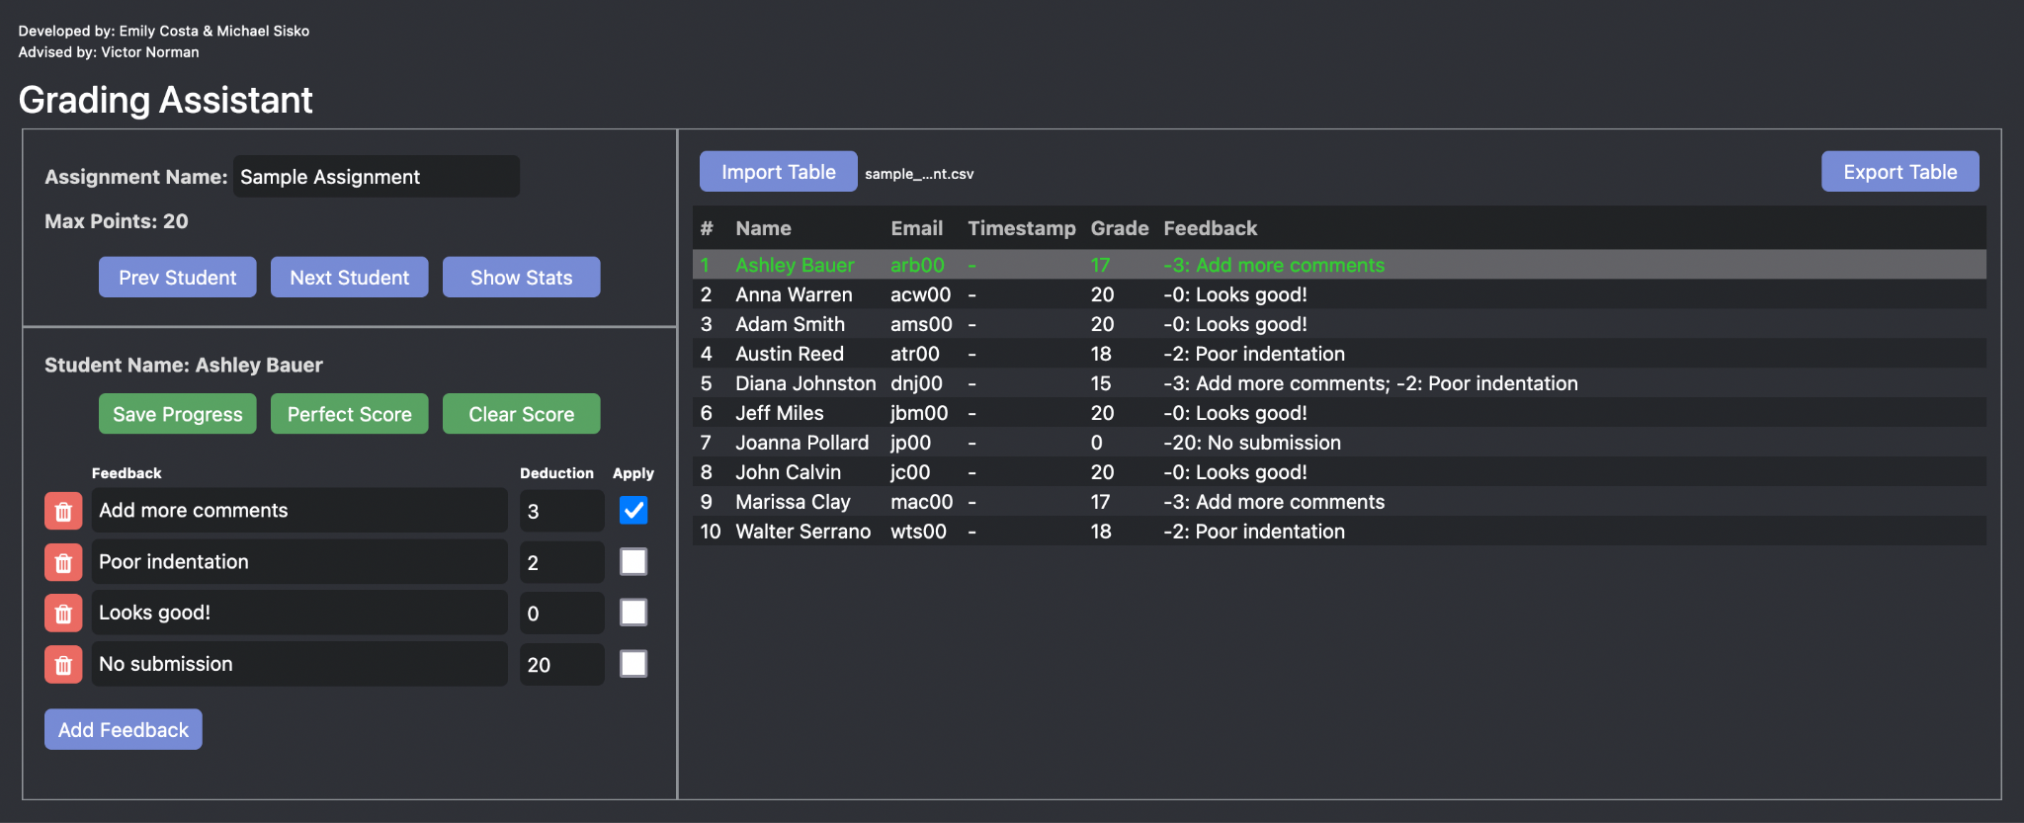
What we accomplished...
*** The names on this list are not real students.
Notes:
Make a web app where a student grader or professor would download an assignment’s CSV file from Moodle, upload it, and then our app will parse through the file to nicely display the CSV file
The application will display a full chart of the students’ full name, their Calvin email, their grade for the assignment, and the feedback
All of the feedback strings and their point values will be stored into a saved list
Using this list, a grader can then just check off the feedback that applies to each student’s submission
Our application will also keep track of the feedback given to each student, so if the grader modifies the custom feedback or the deduction value, if saved, the change will be reflected globally.
Finally, the application will also display assignment statistics: the frequency of each feedback, the average score, standard deviation, median, and mode

Slide 4
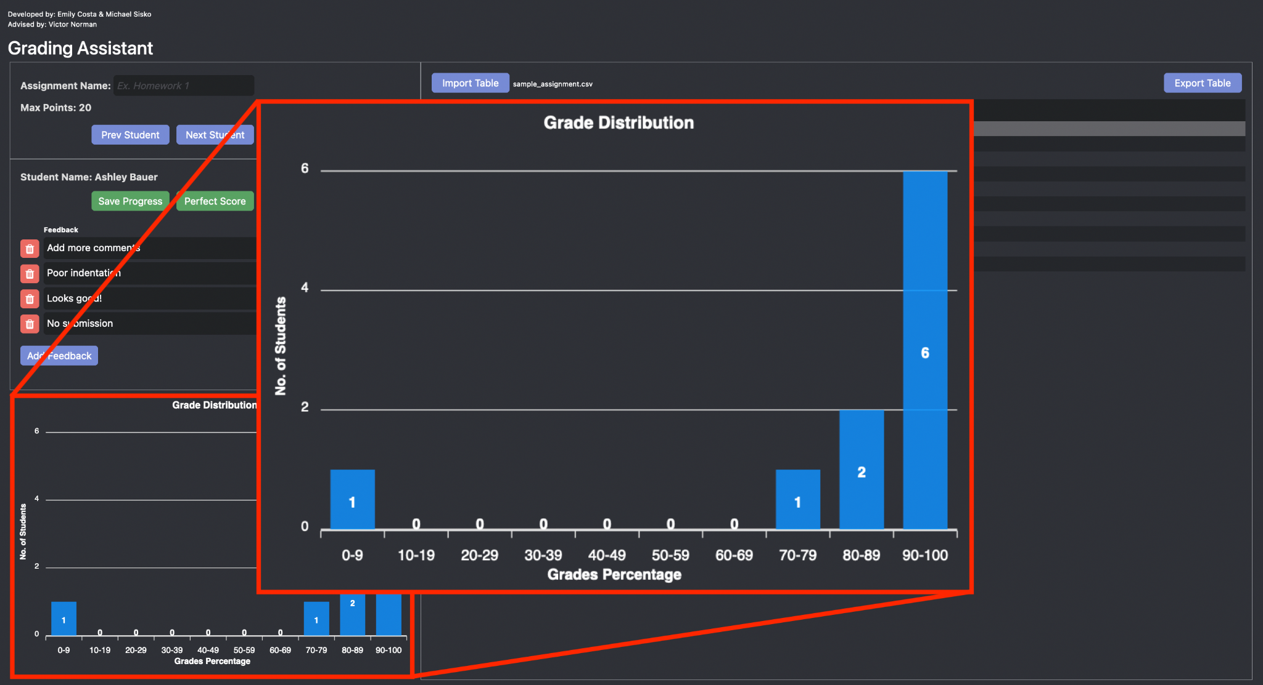
What we accomplished...
Notes:
Make a web app where a student grader or professor would download an assignment’s CSV file from Moodle, upload it, and then our app will parse through the file to nicely display the CSV file
The application will display a full chart of the students’ full name, their Calvin email, their grade for the assignment, and the feedback
All of the feedback strings and their point values will be stored into a saved list
Using this list, a grader can then just check off the feedback that applies to each student’s submission
Our application will also keep track of the feedback given to each student, so if the grader modifies the custom feedback or the deduction value, if saved, the change will be reflected globally.
Finally, the application will also display assignment statistics: the frequency of each feedback, the average score, standard deviation, median, and mode

Slide 5
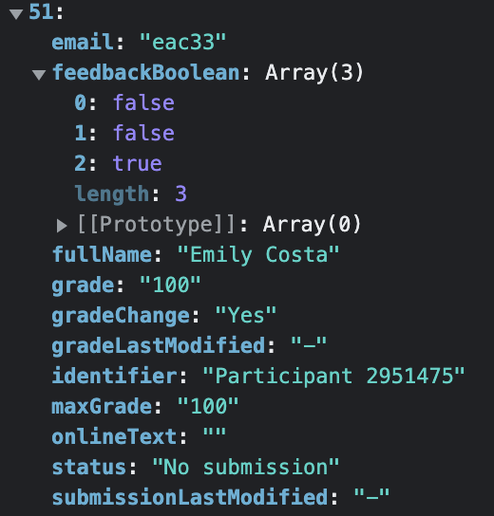
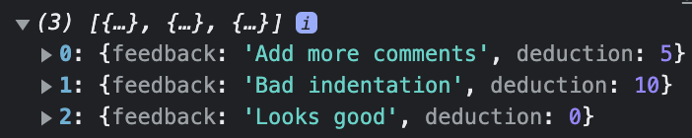
Problems encountered...
How to parse and store CSV file
Per student feedback management
Notes:
Angular as our web app framework
Bootstrap for our UI library
Apex Charts for creating graphs of the homework stats
we are practicing end-to-end testing using Cypress refers to a software testing method that involves testing an application's workflow from beginning to end
This method basically aims to replicate real user scenarios so that the system can be validated for integration and data integrity

Slide 6
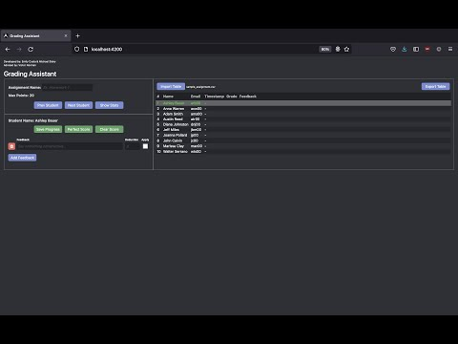
Demo
Notes:
Make a web app where a student grader or professor would download an assignment’s CSV file from Moodle, upload it, and then our app will parse through the file to nicely display the CSV file
The application will display a full chart of the students’ full name, their Calvin email, their grade for the assignment, and the feedback
All of the feedback strings and their point values will be stored into a saved list
Using this list, a grader can then just check off the feedback that applies to each student’s submission
Our application will also keep track of the feedback given to each student, so if the grader modifies the custom feedback or the deduction value, if saved, the change will be reflected globally.
Finally, the application will also display assignment statistics: the frequency of each feedback, the average score, standard deviation, median, and mode

Slide 7
Design Norms
Cultural Appropriateness
Promotes efficiency, and protects the privacy of students
Transparency
Simple design, moderately intuitive, and ample documentation
Trust
Reliable, end-to-end tested, and consistent results

Slide 8
Future Work
Persistent storage
Table sorting
Settings page
Notes:
Angular as our web app framework
Bootstrap for our UI library
Apex Charts for creating graphs of the homework stats
we are practicing end-to-end testing using Cypress refers to a software testing method that involves testing an application's workflow from beginning to end
This method basically aims to replicate real user scenarios so that the system can be validated for integration and data integrity

Slide 9
Questions?

