Slide 1
Senior Project: Status Report
Moodle Grading App
Developers: Emily Costa & Michael Sisko
Advisor: Victor Norman

Slide 2
Background & Problem
Moodle’s UI is not efficient
Grading is time consuming and redundant
Two options: edit in web browser or download CSV file
Notes:
Grading is already a time consuming and redundant task, and Moodle’s user interface doesn’t aid in making the grading process more efficient.
When you grade on Moodle you can either enter the feedback directly into Moodle’s web page or download a CSV file, edit/enter the feedback into the csv file, and then reupload it
One issue with both of these methods is that the feedback has to be manually entered each time, and the same feedback is often repeated on numerous student submissions.
Another issue, when entering feedback into the CSV file, is that you have to fit all the feedback into one line in a single cell. And, if a grader decides to change the number of points taken off for a specific mistake, they have to manually go back and change all of the scores for that specific mistake

Slide 3
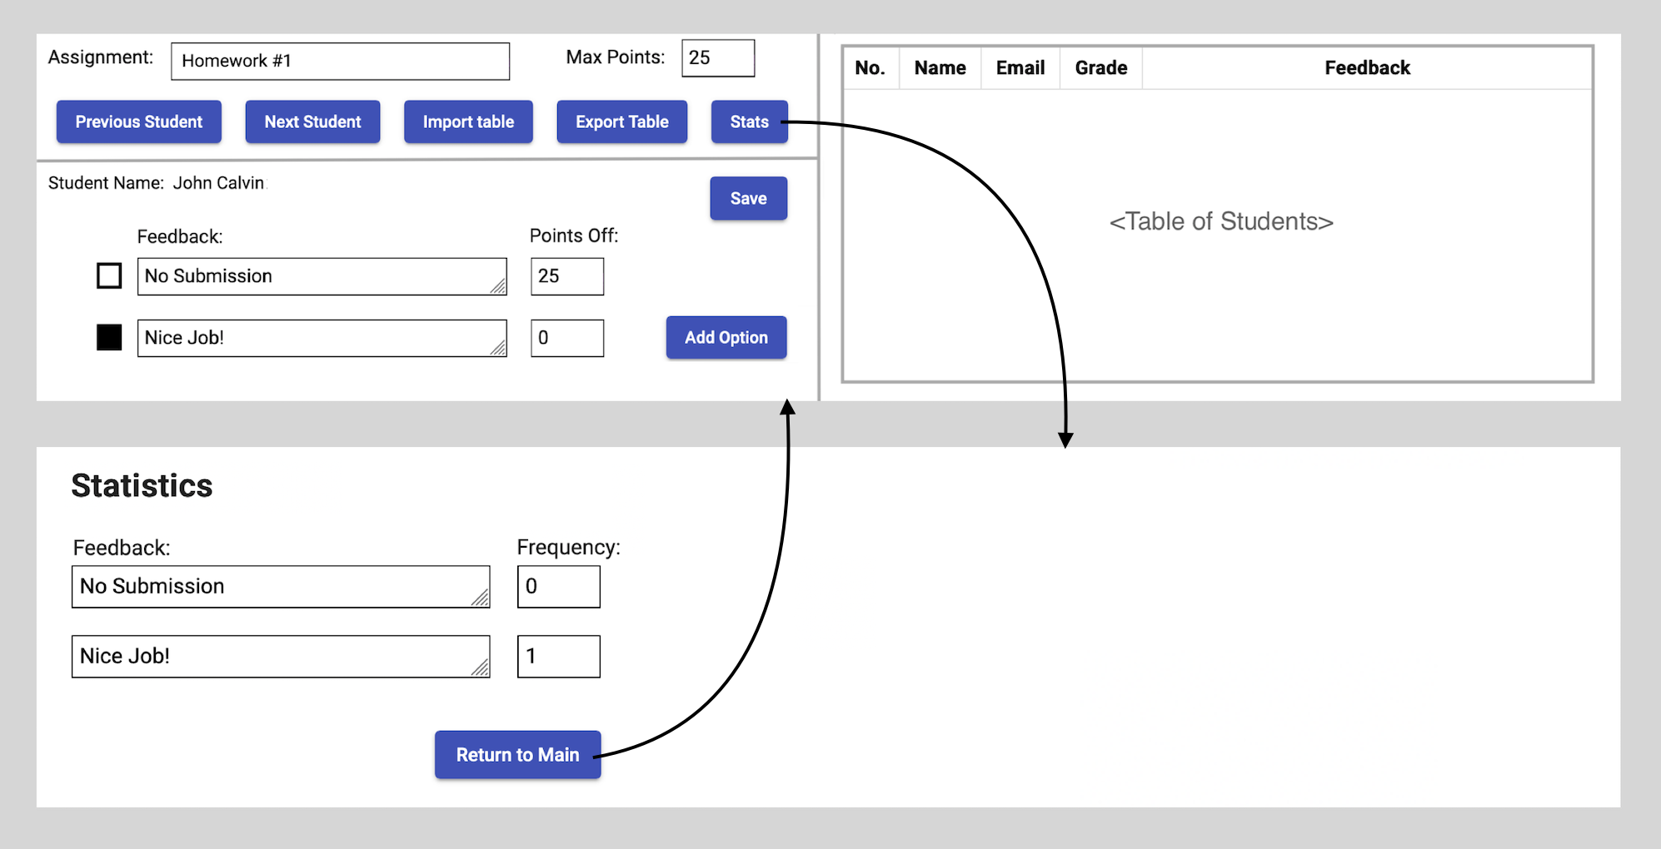
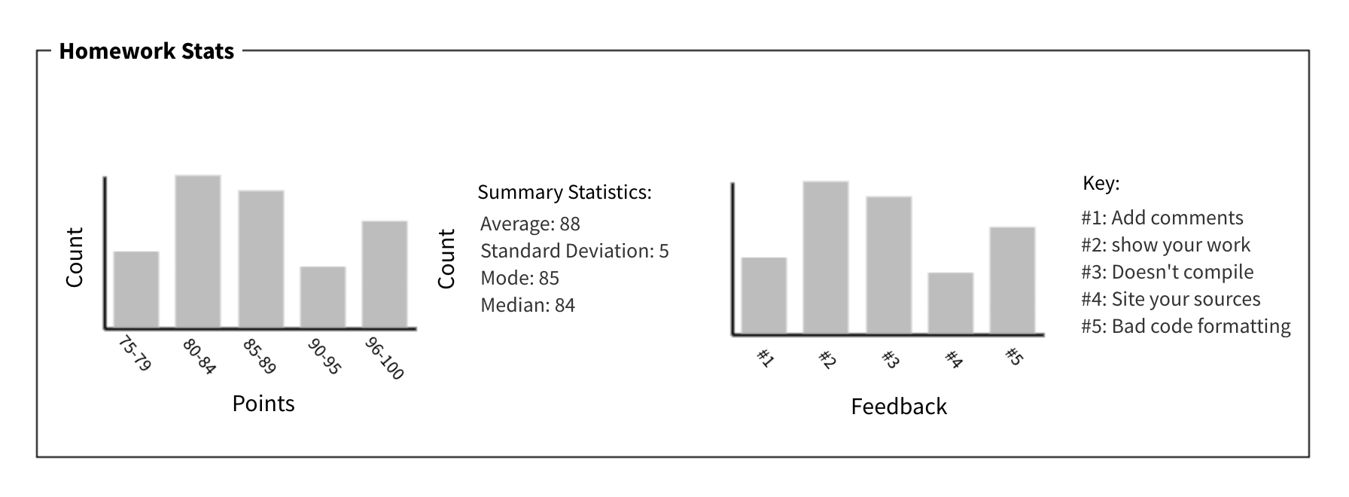
Our Solution
Angular web application
Custom feedback
Globally reflected changes
Display grade statistics
Notes:
Make a web app where a student grader or professor would download an assignment’s CSV file from Moodle, upload it, and then our app will parse through the file to nicely display the CSV file
The application will display a full chart of the students’ full name, their Calvin email, their grade for the assignment, and the feedback
All of the feedback strings and their point values will be stored into a saved list
Using this list, a grader can then just check off the feedback that applies to each student’s submission
Our application will also keep track of the feedback given to each student, so if the grader modifies the custom feedback or the deduction value, if saved, the change will be reflected globally.
Finally, the application will also display assignment statistics: the frequency of each feedback, the average score, standard deviation, median, and mode

Slide 4
Live Demo...
Notes:
This is a pre-recorded screen capture of our project being served locally on my device
Put our csv parser into a service, whenever a file is selected it will update the service

Slide 5
Developing Tools
Angular
Bootstrap
Apex Charts
Cypress
Notes:
Angular as our web app framework
Bootstrap for our UI library
Apex Charts for creating graphs of the homework stats
we are practicing end-to-end testing using Cypress refers to a software testing method that involves testing an application's workflow from beginning to end
This method basically aims to replicate real user scenarios so that the system can be validated for integration and data integrity

Slide 6
Left to do...
Adding/changing the scores and feedback
Exporting the service into a CSV file
Homework statistics and charts
Notes:
Adding the functionality to the ‘apple feedback’ button
Exporting service into a CSV file to be re-uploaded into moodle
Calculating the homework stats and then representing the data into nicely formatted charts

Slide 7
Questions?

