Slide 1
Databases Project – Spring 2018
Team No: 7
Da Rocha Rodrigues David Joaquim,
Torres Da Cunha Pedro Filipe ,
Justinas Sukaitis
:

Slide 2
Table of Content
ER-model
Cleaning
  General
  Creating Ids
3rd part Query results
Interface
  Tools
  Demo

Slide 3
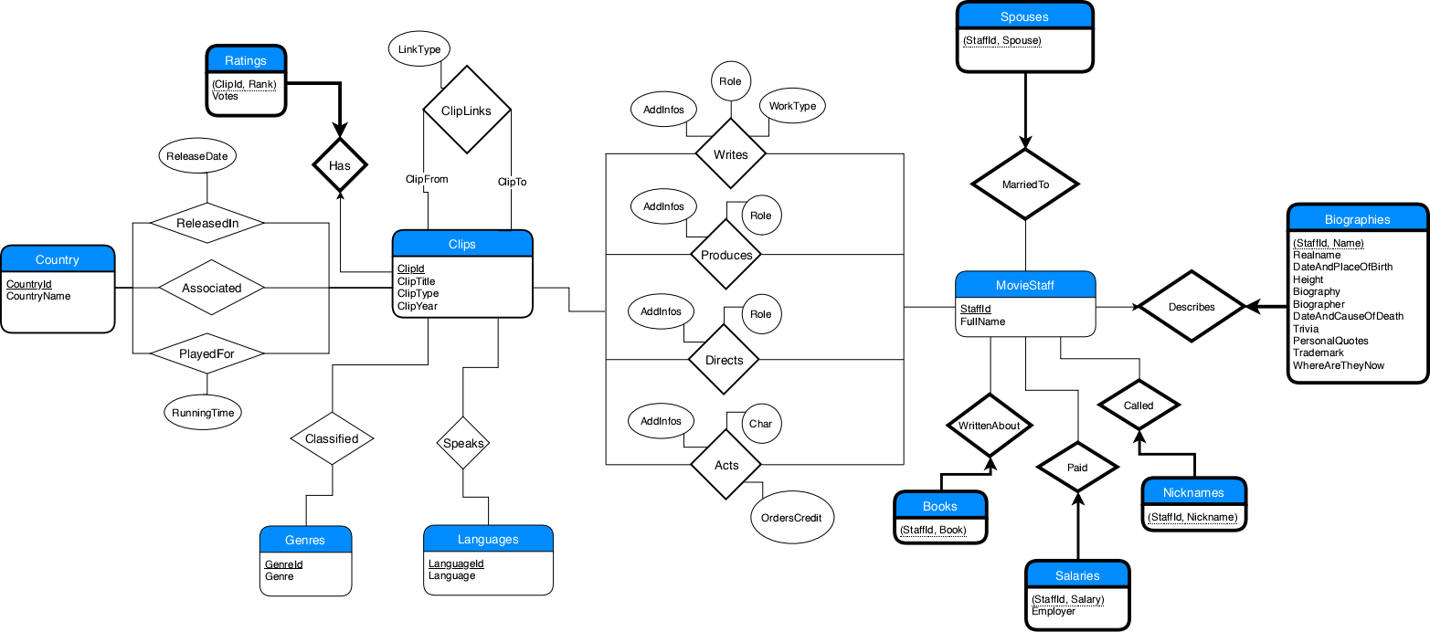
ER-Model

Slide 4
Cleaning
Tools:
  Python, Regex
Pipeline:
  Create new csv, and set object “added”
  For each row
    Check if key already added before
    Flatten and filter values
    Add cleaned row in csv and key in added

Slide 5
Cleaning Cont.
Creating Keys for staff
  Create map (Name→StaffId) and set of names
  Run through all csv tables for Staff
  If Name not in set, add (Name→Incr. Value) to map
Renders adding foreign keys trivial
No duplicate keys
Do the same for Languages, Countries and Genres

Slide 6
Query Results
3.a <> lines in <> ms
3.b <> lines in <> ms
3.c <> lines in <> ms
3.d <> lines in <> ms
3.e <> lines in <> ms
3.f <> lines in <> ms
3.g <> lines in <> ms
3.h <> lines in <> ms
3.i <> lines in <> ms
3.j <> lines in <> ms
3.k <> lines in <> ms
3.l <> lines in <> ms

Slide 7
Interface

Slide 8
Demo

