Slide 1
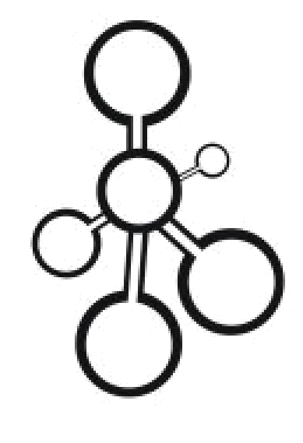
Data Structures
UML

Slide 2

Classes (1)
Classes and structures are represented as boxes.
The box consists of three compartments.
The first compartment is the name of the class.
The second compartment is the data fields of the class
The third compartment is the functions of the class.
Primitive data types (e.g. integers) or simple classes (e.g. strings) are generally not represented as boxes. Instead, they are represented as data fields.
Only show the significant data fields and functions (no need to show getters and setters)
Line
total_items: int
speed_rate: int
+ push(num_items: int): void
+pop(): void
Notes:
Please give examples on that

Slide 3
Classes (2)
For classes that aren’t your contribution, just show the class name.
For generic classes, you need to show the type of data it deals with (e.g. a queue of integers, a vector of items)
Queue<int>
Vector<Line>
Notes:
Please give examples on that

Slide 4

Access Modifiers
Modifier | Applicability | Accessibility | UML presentation
Private | Data field, function | Accessible to the class only | -
Protected | Data field, function | Accessible to the subclasses | #
Public | Data field, function | Accessible to all classes | +
Line
total_items: int
speed_rate: int
+ push(num_items: int): void
+pop(): void
Notes:
Please give examples on that

Slide 5
Class Relationships (1)
Relationships between classes are represented using lines.
Only permanent relationships are represented as lines (e.g. a class keeps track of another class)
To describe the nature of the relationship, we need multiplicities (cardinalities).
There are different kinds:
A
1
*
B
A
*
*
B
A
5
*
B
* | Zero or many
0..*
1..* | One or many
1 | One
0..1 | Zero or One
A
*
0..1
B
Notes:
Explain types of multiplicity

Slide 6
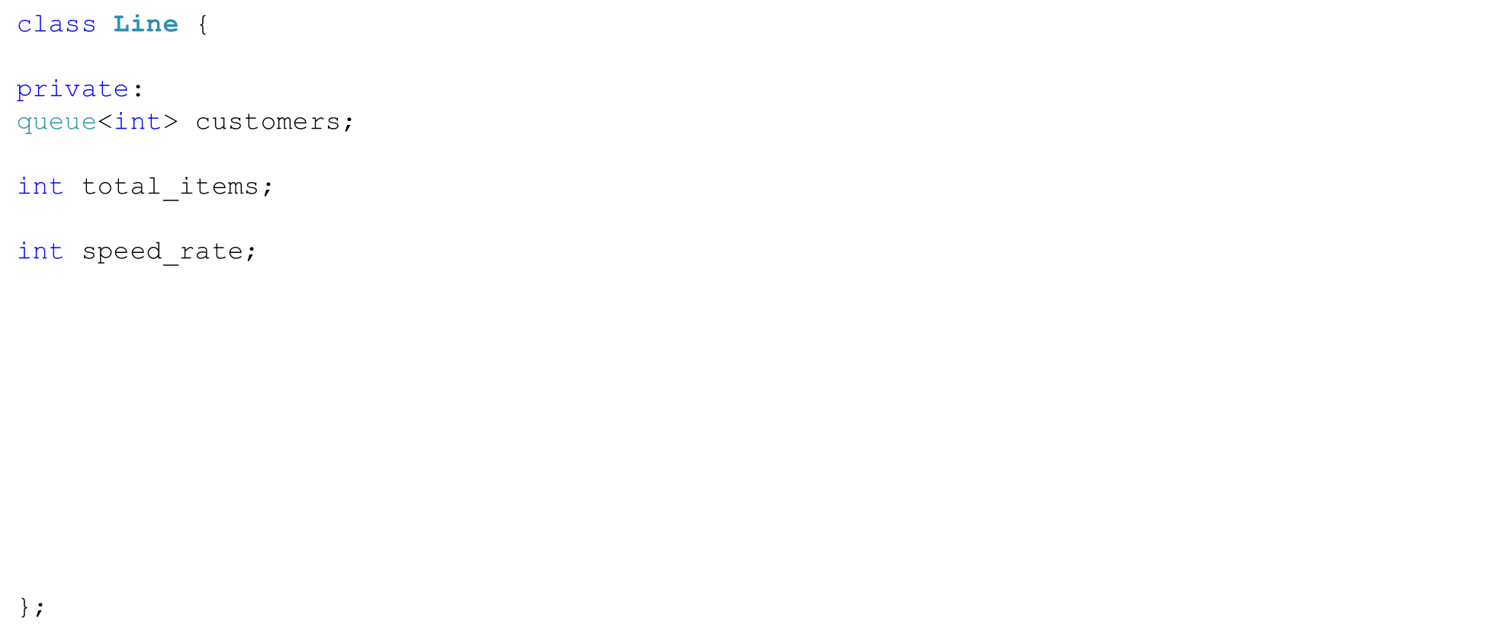
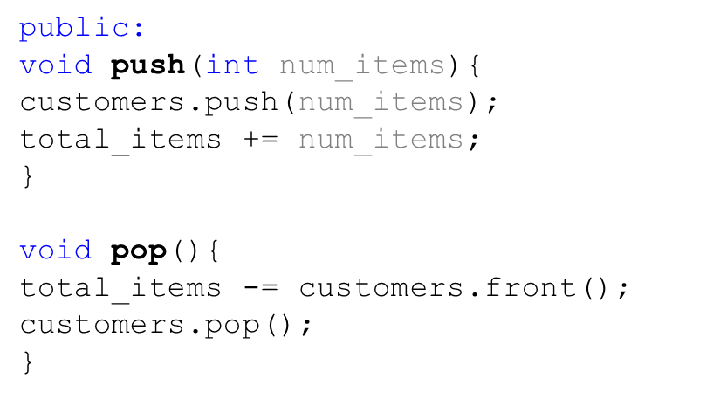
Class Relationships (2)
Line
total_items: int
speed_rate: int
+ push(num_items: int): void
+pop(): void
1
Queue<int>
customers
Notes:
Explain types of multiplicity

Slide 7
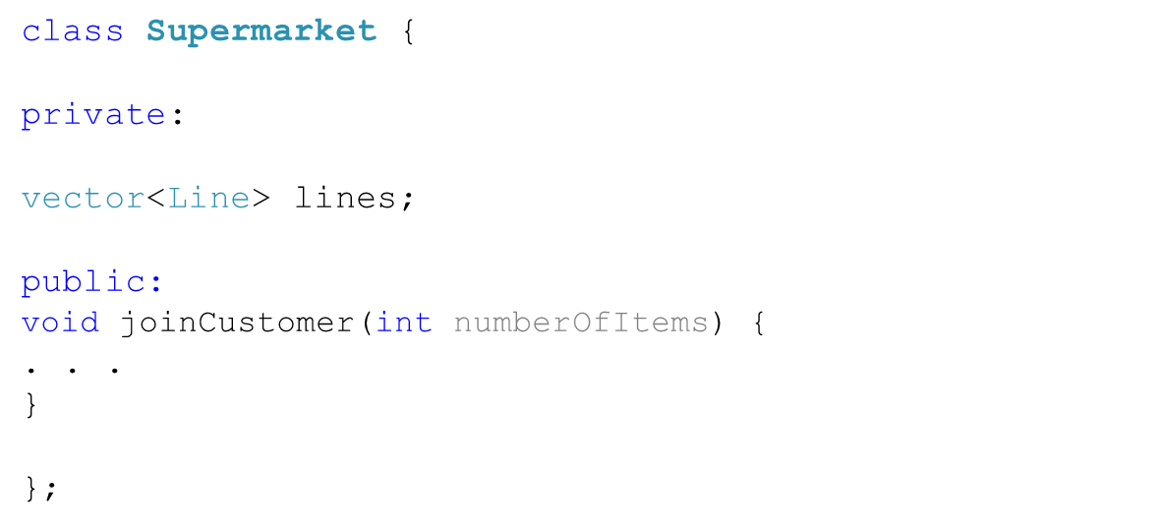
Class Relationships (3)
Line
total_items: int
speed_rate: int
+ push(num_items: int): void
+pop(): void
1
Queue<int>
customers
*
SuperMarket
+ joinCustomer(int)
1
Vector<Line>
lines
Notes:
Explain types of multiplicity

Slide 8
Aggregation, Composition
Company
Car
wheels
4
theDepartment
Wheel
1..*
Department
Aggregation
When the car is dissolved,
the wheels are not necessarily dissolved.
Composition
When the company is dissolved,
the department is dissolved as well.
Reference: http://www.ibm.com/developerworks/rational/library/content/RationalEdge/sep04/bell/
Notes:
Also, explain that any number can be placed on the connection (4 for instance), explain the arrow as well.
Explain labels on relationships.

Slide 9
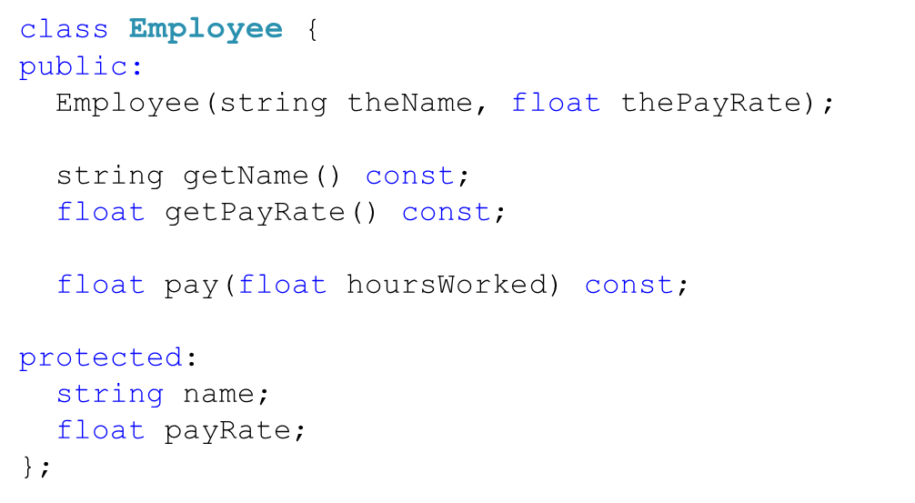
Inheritance (1)
The ability of one class (subclass) to inherit the data and functionality of another class (super class or base class), and then add new functionality of its own
Employee
# name:String
# payRate:float
+ pay(houseWorked:float):float

Slide 10
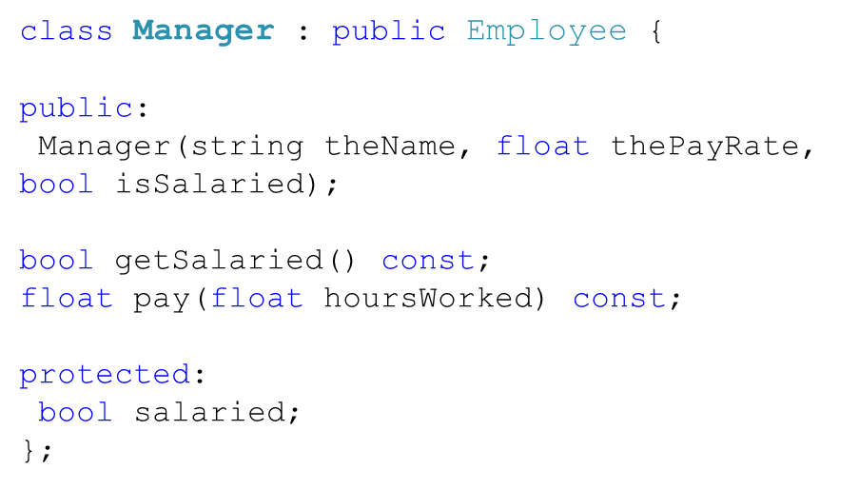
Inheritance (2)
The ability of one class (subclass) to inherit the data and functionality of another class (super class or base class), and then add new functionality of its own
Employee
# name:String
# payRate:float
+ pay(houseWorked:float):float
Manager
# salaried:bool
+ pay(houseWorked:float):float

Slide 11
_{Books}
_{- total_items: int} _{- speed_rate: int}
_{+ push(num_items: int): void} _{+ pop(): void}
_{Date}
_{- total_items: int} _{- speed_rate: int}
_{+ push(num_items: int): void} _{+ pop(): void}
_{Employee}
_{- total_items: int} _{- speed_rate: int}
_{+ push(num_items: int): void} _{+ pop(): void}
_{Library}
_{- total_items: int} _{- speed_rate: int}
_{+ push(num_items: int): void} _{+ pop(): void}

