Slide 1
Smart Healthcare Companion & Medication Safety Care Agent
Agentic AI Hackathon
Team： Sage Serpent

Slide 2



Medical Staff are overloaded in Taiwan
The pressure on Taiwan's healthcare system is evident in the ratio of healthcare providers to patients.
In the United States, this ratio is 1:4 on average, while in Taiwan, it reaches 1:8.6.
United States Taiwan
Healthcare workers

Slide 3
Challenges/Hopes of each Persons
Persona A
Patients (especially elderly) –
Persona B
Healthcare Providers (Doctors & Pharmacists) –
1. Long and inefficient waiting times during hospital visits
2. Risk of medication conflicts when seeing multiple specialists in different outpatient department in hospital
3. Difficulty understanding and remembering complex medication instructions
4. Lack of continuous and united healthcare support system
1. Limited consultation time to fully understand patient conditions
2. Difficulty tracking cross-departmental prescriptions
3. Time-consuming repetitive medication instructions
4. Need for better patient care quality management tools

Slide 4
Business value statement
Persona A
Patients (especially elderly) –
Persona B
Healthcare Providers (Doctors & Pharmacists) –
Enhanced hospital visit experience with efficient waiting time
Improved consultation efficiency and quality
Reduced medication risks and improved medication safety
Better understanding and adherence to medication instructions
Continuous healthcare support
Reduced risk of medication conflicts and interactions
Enhanced medication safety management
Reduced repetitive workload
Increased healthcare service satisfaction
Lower risk of medical disputes

Slide 5
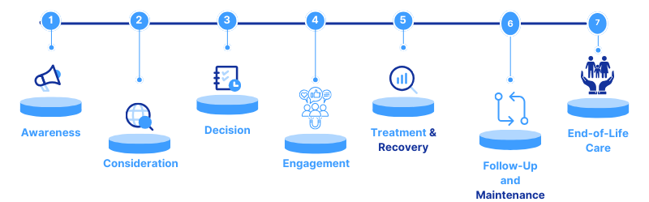
Patient Journey for Colorectal Cancer/Polyp Removal
Initial Symptoms and Seeking Medical Attention
Clinic Consultation and Examination
Colonoscopy
Polyp Removal
Pathology Report and Follow-up Treatment
Home Care
Regular Follow-up
Most important: Patient Education ; Psychological Support and Family involvement
Notes:
大腸癌/大腸息肉切除病患就醫旅程 (Patient Journey for Colorectal Cancer/Polyp Removal)
1. 初始症狀和尋求醫療協助 (Initial Symptoms and Seeking Medical Attention)
中文： 病患可能出現腹痛、排便習慣改變、血便、體重減輕等症狀，因此前往消化內科門診就醫。
英文： Patients may experience symptoms such as abdominal pain, changes in bowel habits, blood in stool, weight loss, etc., and seek medical attention at a gastroenterology clinic.
2. 門診諮詢和檢查 (Clinic Consultation and Examination)
中文： 醫師會詢問病患的病史、家族史和生活習慣，並進行身體檢查，例如腹部觸診。 醫師可能會安排糞便潛血檢查或血液檢查。
英文： The doctor will inquire about the patient's medical history, family history, and lifestyle habits, and conduct a physical examination, such as abdominal palpation. The doctor may order a fecal occult blood test or blood tests.
3. 大腸鏡檢查 (Colonoscopy)
中文： 醫師會安排大腸鏡檢查，以直接觀察大腸內部，並進行診斷。 檢查前，病患需要遵循特定的飲食和清腸準備。
英文： The doctor will schedule a colonoscopy to directly visualize the inside of the colon and make a diagnosis. The patient needs to follow specific dietary and bowel preparation instructions before the examination.
4. 息肉切除 (Polyp Removal)
中文： 如果在大腸鏡檢查中發現息肉，醫師通常會直接切除，並送病理化驗。
英文： If polyps are found during the colonoscopy, the doctor will usually remove them directly and send them for pathological examination.
5. 病理報告和後續治療 (Pathology Report and Follow-up Treatment)
中文： 根據病理報告結果，醫師會決定後續的治療方案，例如定期追蹤、手術切除或其他治療。
英文： Based on the pathology report, the doctor will determine the follow-up treatment plan, such as regular follow-up, surgical resection, or other treatments.
6. 家庭護理 (Home Care)
中文： 醫師會提供居家照護指示，例如飲食建議、傷口護理、藥物使用、活動限制和後續追蹤等。
英文： The doctor will provide home care instructions, such as dietary recommendations, wound care, medication use, activity restrictions, and follow-up appointments.
7. 定期追蹤 (Regular Follow-up)
中文： 病患需要定期回診追蹤，以監測病情和預防復發。
英文： The patient needs to schedule regular follow-up appointments to monitor their condition and prevent recurrence.
8. 長期健康管理 (Long-term Health Management)
中文： 醫師會指導病患進行長期健康管理，例如維持健康的飲食和生活習慣、定期篩檢等，以降低大腸癌復發的風險。
英文： The doctor will guide the patient in long-term health management, such as maintaining healthy dietary and lifestyle habits and undergoing regular screening, to reduce the risk of colorectal cancer recurrence.
治療成功的重要事項 (more important )
病患教育 (Patient education): 醫師應向病患詳細解釋病情、治療方案和預後，並解答病患的疑問。
心理支持 (Psychological support): 提供病患心理支持，協助他們應對疾病带来的壓力和焦慮。
家庭參與 (Family involvement): 鼓勵家屬參與病患的照護，提供支持和協助。
在healthcare人力缺乏下，我們希望可以用AI agent chatbot 來幫助醫師提供病患一個品質好的patient journal

Slide 6
As-is process (without Agentic AI)
Patients passively wait for consultations, wasting valuable time
Doctors must manually collect patient history in limited consultation time
Cross-departmental and systems medication checks rely on manual processes
One-time medication instructions often forgotten or misunderstood
Lack of automated patient care tracking mechanisms

Slide 7
end-to-end Agentic AI solution
The Smart Healthcare Companion & Medication Safety System is an end-to-end Agentic AI solution that integrates IBM Watsonx technology with hospital disease education information to deliver intelligent healthcare companionship, cross-departmental medication safety management, and personalized medication guidance then support the patient care.
The system accesses multiple medical knowledge base documents, connects to enterprise-level medical systems and databases, and can answer medical inquiries, provide medication recommendation education, and execute related tasks feed back from patient to existing hospital systems.

Slide 8
Solution Section To-be process (with Agentic AI)
1. Smart Pre-consultation Assistant
Collects patient symptoms and medical history through natural conversation
Utilizes RAG technology for response accuracy
Automatically structures data for doctor reference
Makes waiting time more valuable
2. Cross-departmental Medication Safety Guardian
Real-time connection to hospital databases for medication checks
Automatic alerts for duplicate medications and drug interactions
AI-powered medication risk assessment
Special focus on patients seeing multiple specialists

Slide 9
Solution Section To-be process (with Agentic AI)
3. Intelligent Medication Guidance Assistant
Interactive medication instructions and health education
Personalized medication and care reminders
Dietary restriction advice
Real-time medication query response
4. Technical Implementation Highlights
IBM watsonx.ai for natural language processing
Watsonx.data for medical data processing
Watsonx.governance for AI compliance
HL7 FHIR standard integration
HIPAA privacy protection compliance

Slide 10

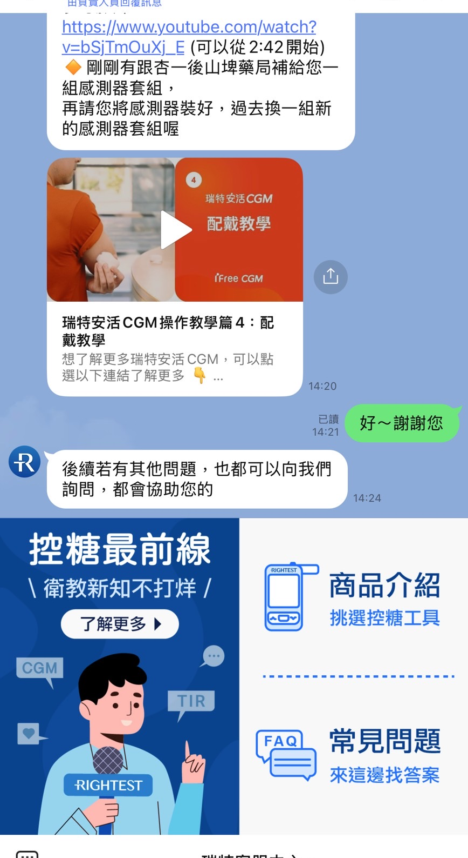
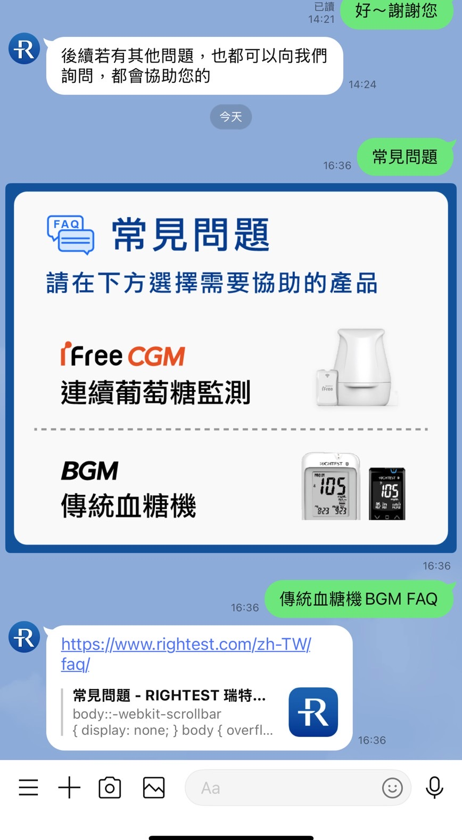
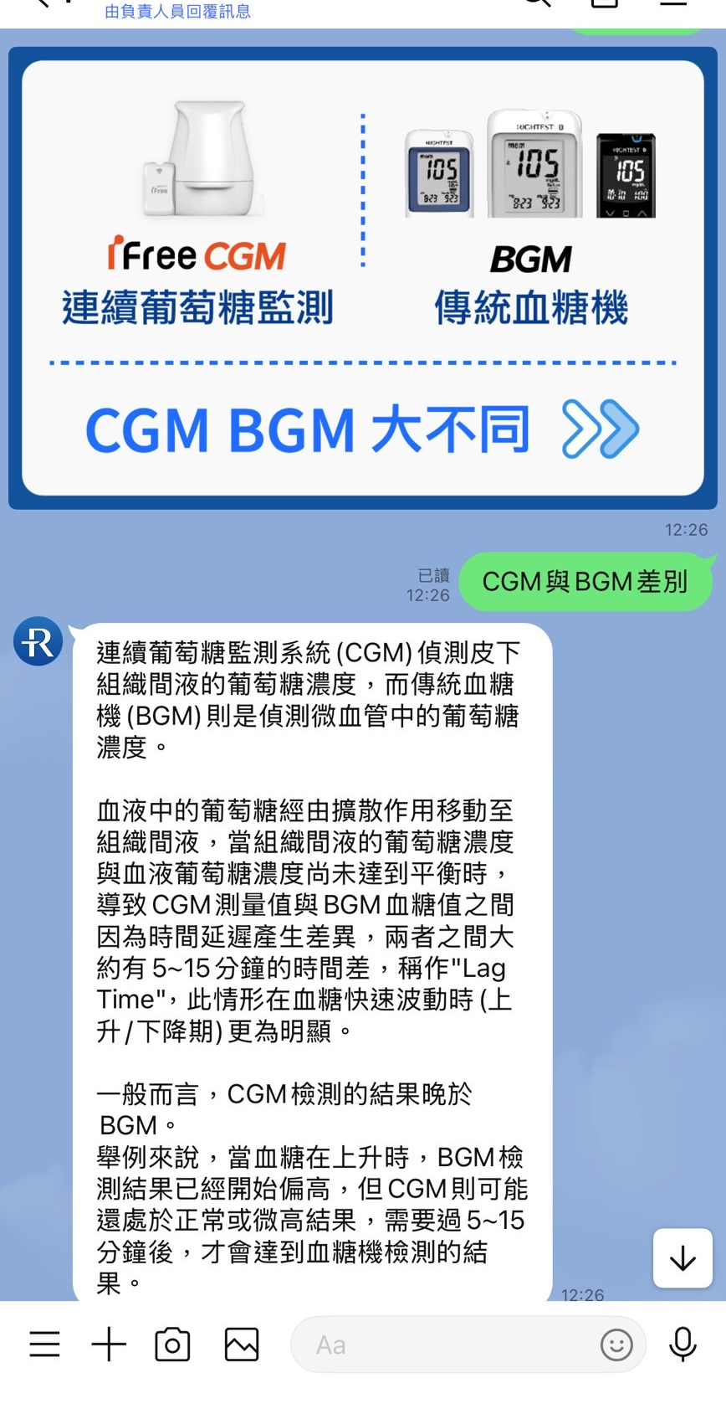
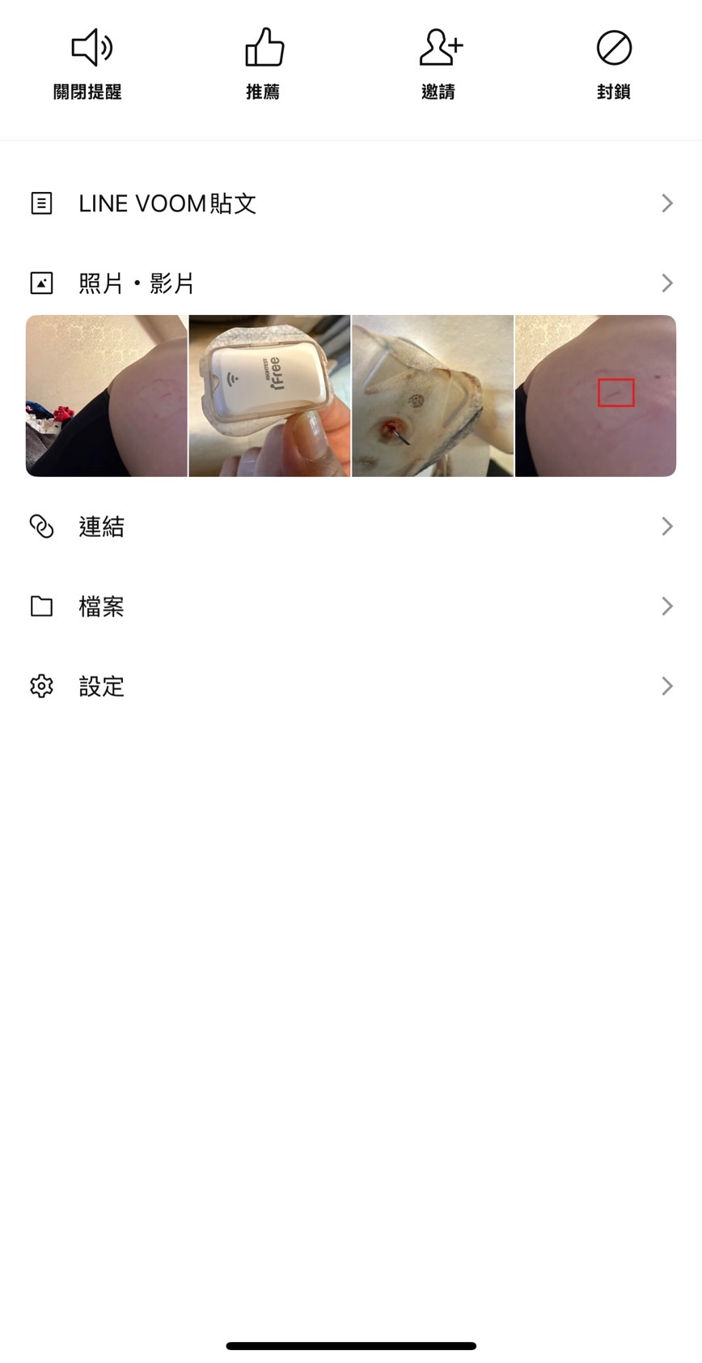
Personalized reminders and feedback
24/7 support
Disease Knowledge Search
Health Education
The patient needs to follow specific dietary and bowel preparation instructions before the examination.
The doctor will provide home care instructions, such as dietary recommendations, wound care, medication use, activity restrictions, and follow-up appointments.
data collection gathers information on the patient's medical history, family history, and lifestyle habits.
Share with clinicians to gain a clearer understanding of the patient's condition.
Sent back information from cell phone to hospital HIS system.
The system then checks if the patient has been prescribed the same medication by different departments to prevent the risk of medication overdose.
Home Care Fellow up

Slide 11
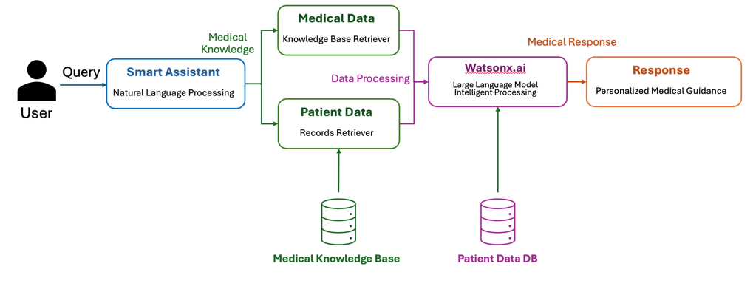
Demo skip hospital HIS medical data

Slide 12




Fellowship of the Ring
​
Laetitia Wei
Moofon Li​
Jessie Lan
ChuChun Kang

Slide 13


