Slide 1
KO vs NG
The Ultimate Debate

Slide 2
Agenda
Tech Talks……………………. (10 min)
KO vs NG: Overview…….. (15 min)
KO vs NG: Components.. (20 min)
KO vs NG: Conclusion…… (5 min)
Q & A…………………………… (5 min)

Slide 3
Tech Talks: Why?
Tech Talk 2011 (Mama said Knock Me Out)
-> Lead to KO in WSB v7.
Increase the value of our company
Get to know GoDaddy Developers
Discover new technologies
-> Lets do these more often

Slide 4
Tech Talk: How to Set One Up
Pick a Topic
Schedule with Kim Gartner/Ansley Waggoner
Create a confluence page
Send invite
Set Up Lync Meeting
Have trial runs

Slide 5
KO vs NG: Purpose
Experience two-way data-binding with Audience!
<div data-bind=‘share: presenter’></div>
<share ng-value=‘presenter’></share>
Not “Evangelizing” one over the other

Slide 6
KO vs NG: What? Why?
Knockout (KO)
Angular (NG)
A compact MVVM module, that keeps the various parts of a web page in synch with a data model.
Built inside of Microsoft
A complete javascript framework that greatly simplifies the creation of a single page web application.
Built inside of Google
90s: Static Web Sites (html)
00s: Dynamic Web Sites (ajax/jquery)
10s: Web Applications (spa)
Want to learn more about the various frameworks:
http://todomvc.com/

Slide 7
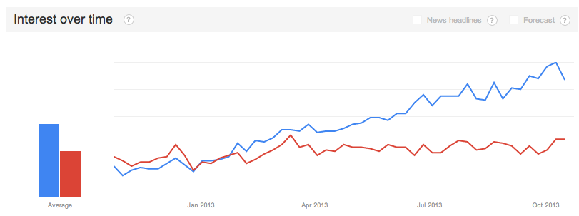
KO vs NG: Interest
Knockout
Angular
38 Contributors
1 commit since the 15th
436 Contributors
9 commits since the 15th
Angular JS
Knockout JS
Google Trends

Slide 8
KO vs NG: Learning
Knockout
Angular
Easier to learn since there is less functionality
Knockoutjs.com is great for the beginners
Knockmeout.net is great for the advanced users
Open Source: GitHub/Knockout
GoDaddy Yammer
Angularjs.org is great for beginners
Has own YouTube channel
Both Manning and O’Reilly has books available
Open Source: GitHub/Angular
GoDaddy Yammer

Slide 9
KO vs NG: File Sizes
Knockout
Angular
ko_v2.3_min.js: 43Kb
ko + jQuery + require.js + $.address = 43 + 84 + 15 + 10 = 152kb
ng_v1.0.8_min.js: 81kb

Slide 10
KO vs NG: Performance
Test: Loading 2000 contacts onto a page:
KO: http://localhost:3001/koperf.html
JSPerf test:
http://jsperf.com/angularjs-vs-knockoutjs/18

Slide 11
KO vs NG: Components
Knockout
Angular
Module
Module
3rd Party Plugins
Config
Model
Routes
View Model
ko
View
Controller
View
$scope
Extenders
Directive
Factory/Service/Provider/Value
Custom Bindings

Slide 12
KO vs NG: Dependency Injection
Knockout (w/ Require)
Angular
Add Require to head tag:
<script data-main=”/scripts/main" src=”/lib/require_v2.1.8.js"></script>
In ‘main.js’ inject dependencies:
require([‘ko_v2.3.0.js’, ‘jquery’, …], function(ko, $,… ) {…}
Use a 3rd party library:
Durandal.js
Create Module
var myModule= angular.module(‘myModule’, [array of dependencies]);
Add Module to ng-app attribute
<html ng-app=‘myModule’>…
Add any 3rd party libraries:
<script></script>…

Slide 13
KO vs NG: Routing/History
Knockout
Angular: $routeProvider
Need to integrate with another library
Knockback.js
Backbone.js
$.address
Bind the route to a knockout observable to load a templated view
module.config(function($routeProvider) {
$routeProvider
.when(‘/’, {
controller: ‘c1’,
templateUrl: ‘v1.html’
})
…
.otherwise({
redirectTo: ‘/’
})
});

Slide 14
KO vs NG: Two Way Binding
Knockout: M-V-VM
Angular: M-V-C $Scope
Model:
{Id: ID, Name: NAME, Dept: DEPT}
View:
<input data-bind=“value:name”/>
<div data-bind=“text:name”></div>
<button data-bind=“click: edit”></button>
View Model:
var ViewModel = {
id: m.Id,
name: ko.observable(m.Name),
dept: ko.observable(m.Dept),
edit: function() {…},
save: function() {…}
}
Binding:
ko.applyBindings(viewModel, view)
Model:
{Id: ID, Name: NAME, Dept: DEPT}
View:
<html ng-app>
…
<input ng-model=“name”/>
<div ng-model=“name”>{{name}}</div>
<button ng-click=“edit”>Edit</button>
…
Controller:
function($scope, factory) {
$scope.customer = factory.getCustomer();
$scope.edit = function() {…}
}
Binding: $scope
Notes:
ng-app, ng-model.. are directives
$Scope == ViewModel and is the glue between the controller and view

Slide 15
KO vs NG: Server Communication
Knockout Mapping Plugin
Angular Factories/Services
Loading a Contact:
$.get(“/api/contact/1”,
function(model) {
viewModel = ko.mapping.fromJS(model);
});
Saving a contact:
$.post(“/api/contact”, ko.mapping.toJS(viewModel)
);
app.factory(‘ContactFactory, [‘$http’, function($http) {
return {
load: function() {
return $http.get(“/api/contact/1”);
};
save: function(contact) {
return $post(“/api/contact”, contact);
};
}
}]);
app.controller(‘ContactController’, [‘$scope’, ‘ContactFactory’, function($scope, ContactFactory) {
…}]);

Slide 16
KO vs NG: DOM Widgets
Knockout (Binding Handlers)
Angular (Directives)
<div data-bind=“smartImage: URL”></div>
ko.bindingHandlers
.smartImage = {
init: function(…) {…},
update: function(…) {…}
}
<ng-SmartImage></ng-SmartImage>
app.directive(‘ngSmartImage, function() {
return {
restrict: ‘E’,
require: ‘^ngModel’,
scope: { ngModel:’=‘},
template: templateUrl
}
}

Slide 17
KO vs NG: Validation
Knockout: Extenders
Angular: Filters
View:
<input data-bind=“value: name”/>
ViewModel:
ko.extenders.maxLength = function(target, max) {
read: target,
write: function(newValue) {
if (newValue.length > max) target(newValue.substring(0, max);
}
}
ViewModel.name =
ko.observable(m.Name)
.extend({ maxLength: 64});
<input ng-model=“name | limitTo:max”/>

Slide 18
KO vs NG: Templating
Knockout
Angular
<script id=“contactTemplate” type=“type/html”>
<div data-bind=“text:name”></div>
<div data-bind=“text:dept”></div>
<button data-bind=“value: id, click: edit”></button>
</script>
<div data-bind=“template: {name: ‘contactTemplate’, data: contact}”></div>
Static Html File:
<div ng-model=‘name’>{{ name }}></div>
Reference file:
Routes,
Directives,
etc

Slide 19
KO vs NG: Conclusion
When to Use KO
When to use NG:
Need a easy to learn MVVM component to your application
When your application is already using a module you don’t want to or can’t replace.
Need a javascript framework that does it all

Slide 20
Resources

