Slide 1
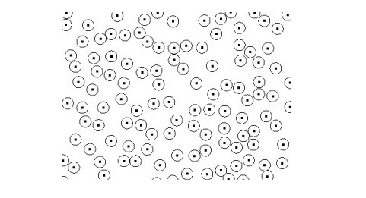
Cumulus Layer sampled with poisson

